Slide 1
Priyum Koonjul
Fisheries over view

Slide 2
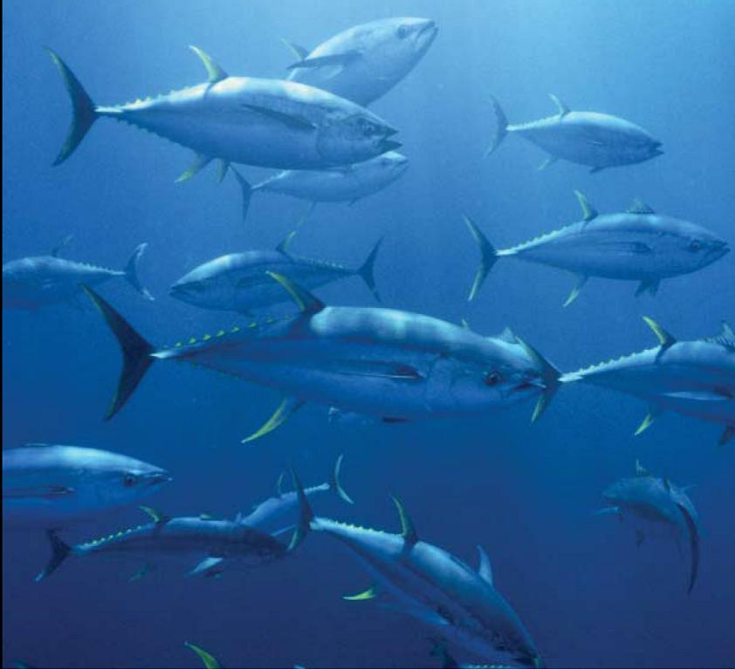
Fisheries and the World around Us
What is a Fishery?
Why are Fisheries important?
What are the different kinds of Fisheries in Hawaii and around the world?
How is fishing changing the ocean?
How do we study these changes in the ocean?

Slide 3

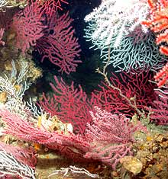
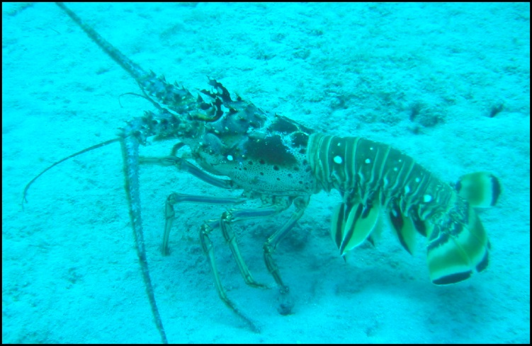

What is a Fishery?
An organized effort by humans to catch
fish or other aquatic species
A fishery is just like a large predator in the foodweb. Often there will be fisheries for several different animals at different levels in the foodweb
Examples include:
Lobster fishery Hawaii, Coral fishery, Tuna fishery E. Pacific
Notes:
Fisheries don’t have to be for fish. Notice lobster and coral, even algae!

Slide 4
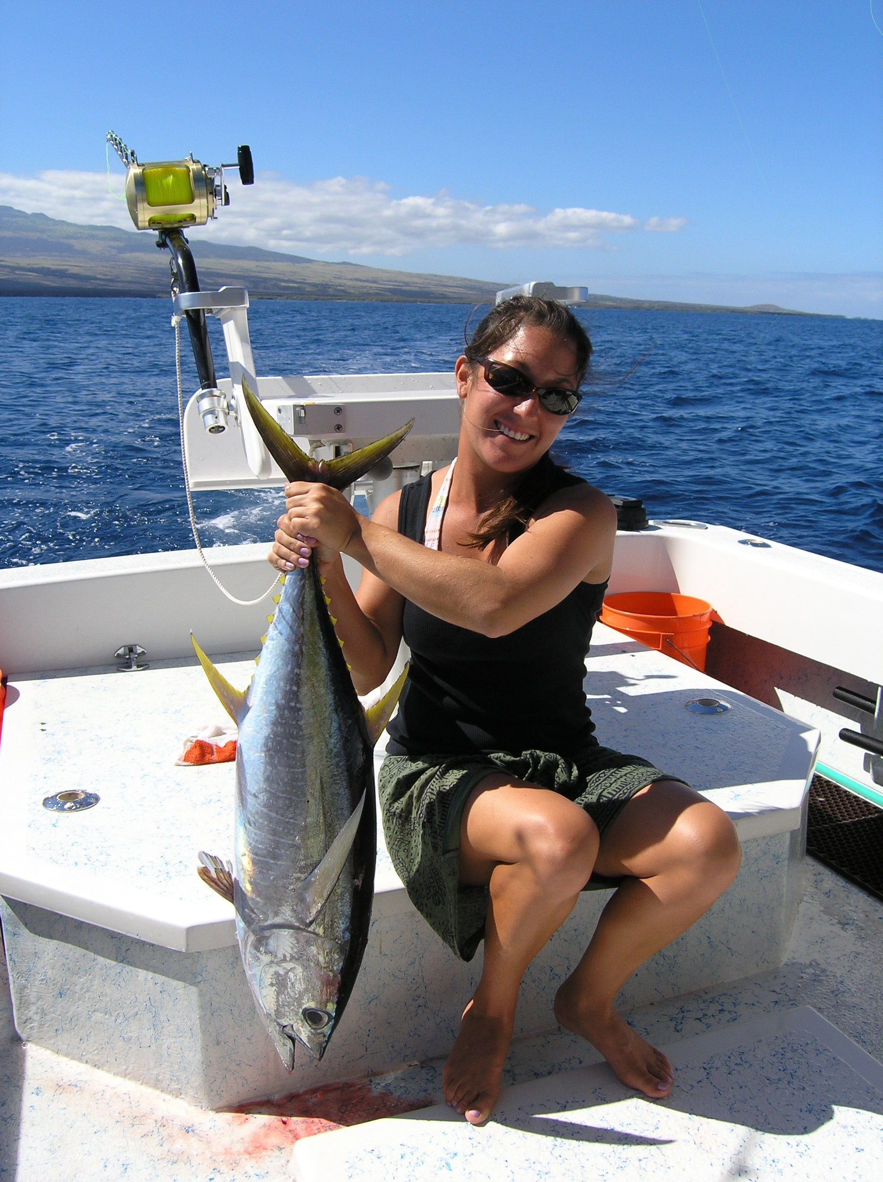
Why are fisheries important?
I like to eat fish!

Slide 5
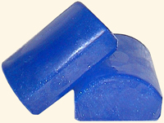
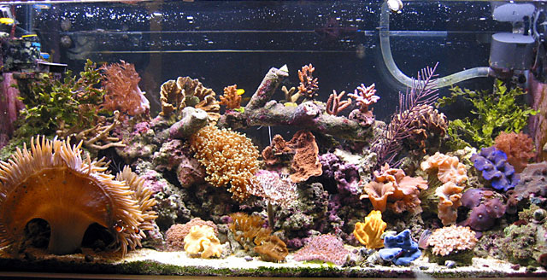
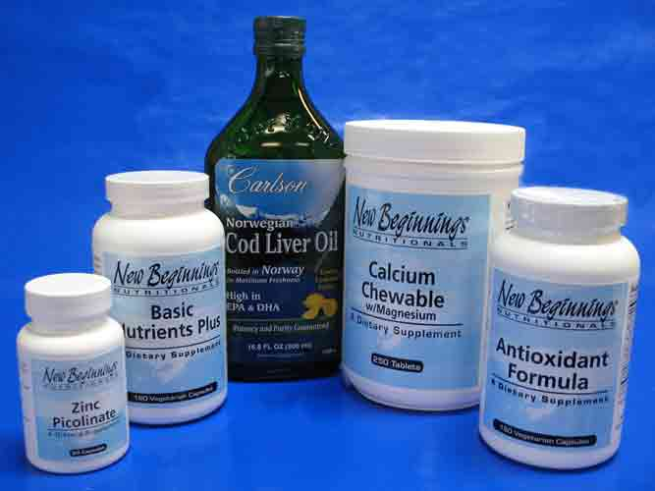
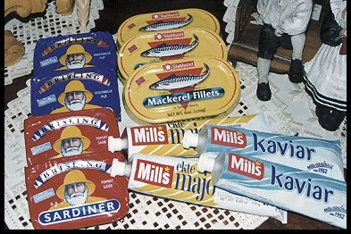
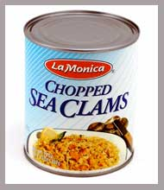
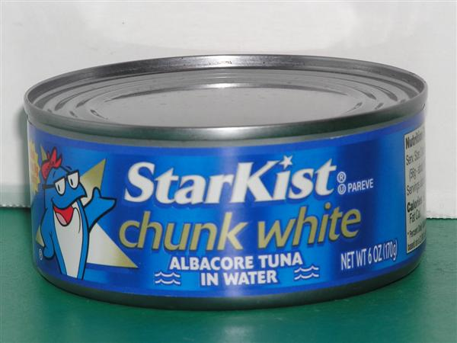
Food
Money
Fun
Culture
Tourism
Medicine
Minerals
Fuel
Fertilizer
Food for pets or farms
Beauty products

Slide 6
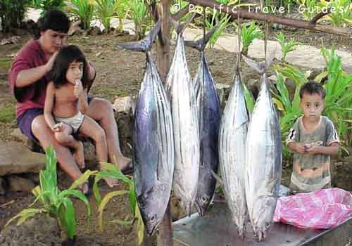
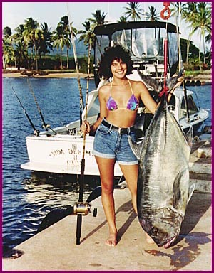
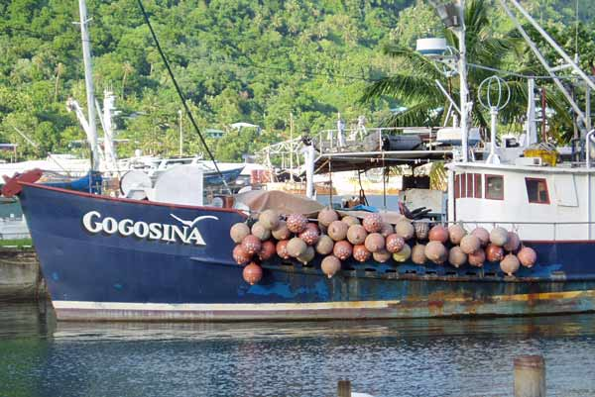
3 types of fisheries
1. Subsistence
→ to survive
2. Recreational
→ for fun and food
3. Commercial
→ For money
Notes:
Commercial fisheries are often the largest fisheries and the ones that have the most impact.

Slide 7
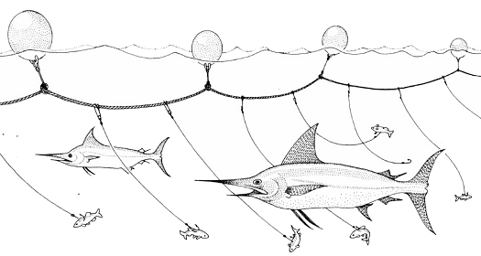
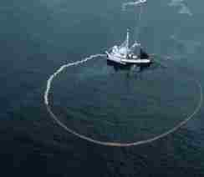
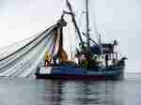
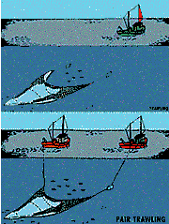
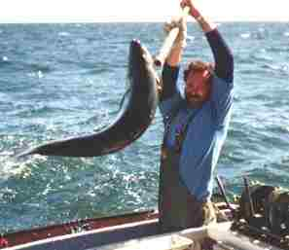
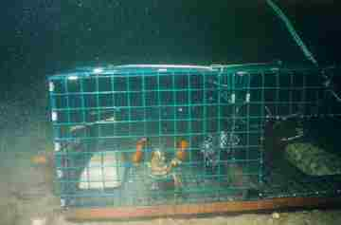
Types of Commercial Fishing
Longline
Seining
Trawling
Handline
Trapping
Notes:
In Hawaii the major fisheries are longline and handline

Slide 8
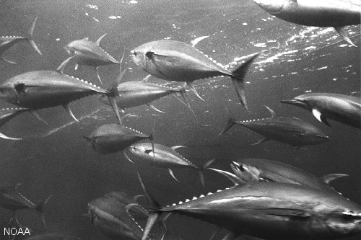

Major Fisheries in Hawaii
Tuna- 28 million pounds
Swordfish- 5 million pounds
Bottomfish- 600,000 pounds
Coral- unknown
Akule/Opelu- 1 million pounds
Reeffish- 289,000 pounds
Aquarium Fish- 312,000 pounds
Notes:
Tuna fishery worth 40 million dollars, Swordfish worth 20 million

Slide 9
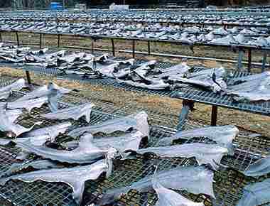
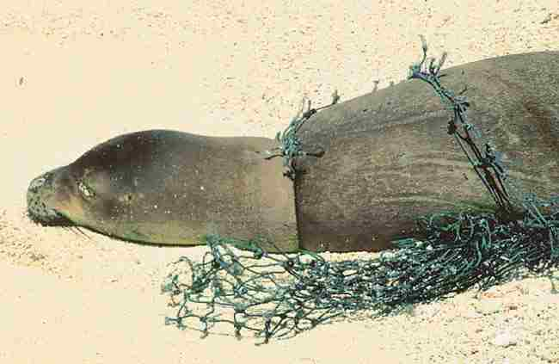
What happens when we fish the wrong way?
Overfishing
Bycatch/Waste
Habitat Destruction
Size of Fish
Marine Debris
Notes:
We are focused on the negative impacts. This doesn’t mean that fishing cannot be done sustainably.

Slide 10
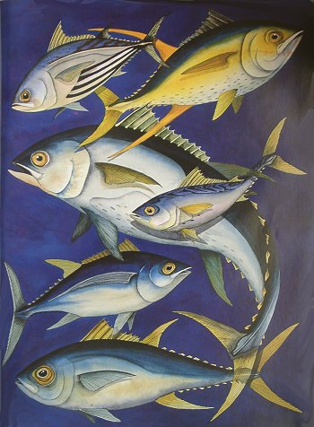
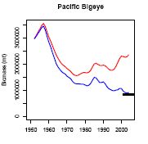
Overfishing
A reduction in the number of fish over time
The biomass of the NWHI is 3.6x that of the Main Hawaiian Islands
Impact of commercial fishing on Pacific Bigeye biomass: 1960-2000: Notice the severe downward trend.

Slide 11
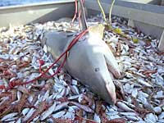
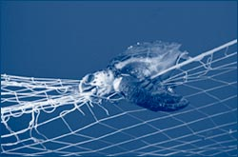
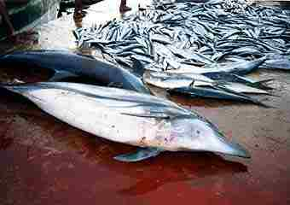
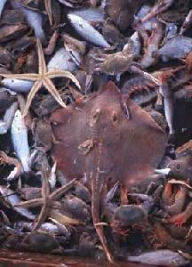
Bycatch/Waste
The total worldwide catch of all fishery species is about 93 million tons. Approximately one-third of that catch is wasted—thrown back into the sea dead or dying. That's around 30 million tons—as heavy as 525 average-sized cruise ships! These unwanted marine organisms are called bycatch, or incidental take.
Common Types of Bycatch
Dolphins (see picture)
Seabirds
Whales
Sharks
Turtles
Rays
Young fish

Slide 12
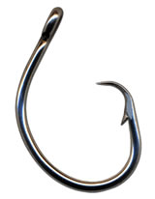
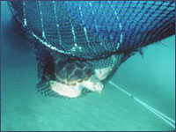
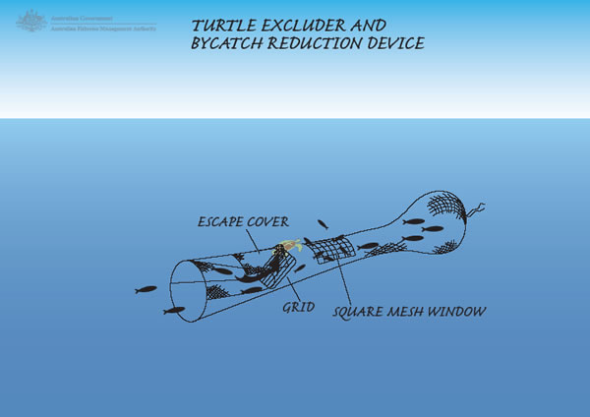
Some Solutions to Bycatch
Turtle Excluders
      Allow turtles to escape nets
Circle Hooks
      Keep some species from biting
Large Mesh sizes
      Let some smaller fish escape net

Slide 13
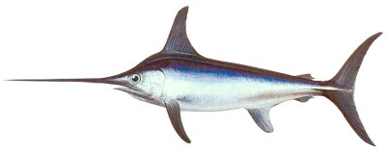
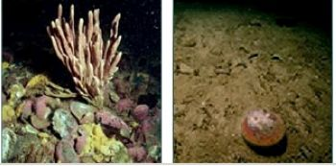
Habitat Destruction
(1) Directly removing animals
(2) Digging up the bottom from dragging fishing gear or using dynamite to blow up reef
(3) Introducing habitat – buoys or fish aggregating devices and Marine Debris
http://www.youtube.com/watch?v=ti5H9zR1-no
Notes:
Regeneration times vary by habitat type and method of disturbance (e.g. gear type)

Slide 14
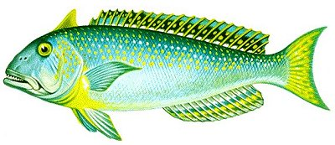
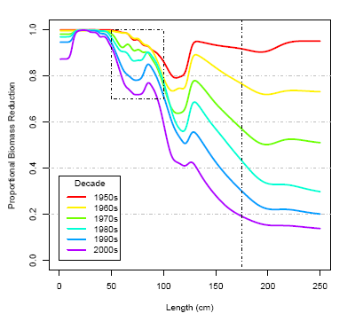
Impact on Fish Size
YOU SURE LOOK
SMALL!
A significant change in average fish size per catch
Overtime
Fish get smaller and may therefore have less babies. Does this help???
Notes:
We may be fishing out the genes for large fish

Slide 15
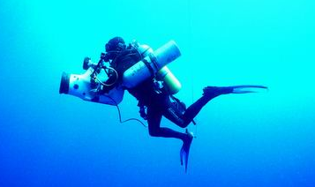
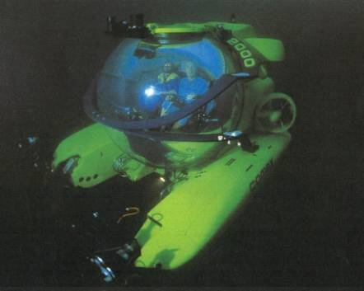
How do we study fisheries and fish?
Count the amount of organisms caught
      This info usually comes from the fishermen and may be unreliable
Directly observe animals
      This may be difficult or very expensive
Tag Fish
      This is becoming a well used method as the technology gets better
Use Sonar
      Sonar may be used to map or count fish underwater
Notes:
How many fish are there, where are they going, how many are being caught, how many die from natural causes, how fast do they reproduce

Slide 16
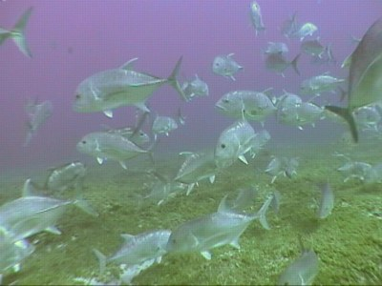
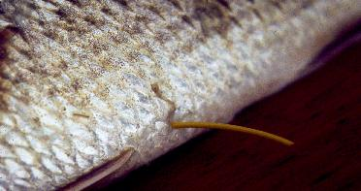
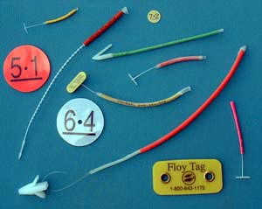
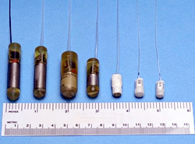
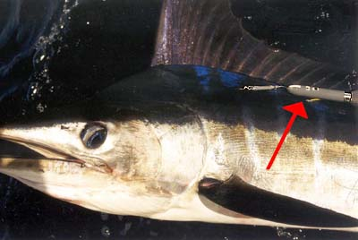
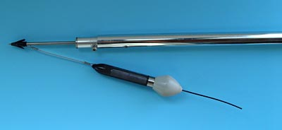
Tags may be used to track the movements of the fish as well as measure their depth, temp, speed, etc.
There are many kinds of tags (conventional, radio, sonic, popup, sattelite).
Notes:
Needs pic of ulua in NWHI.

Slide 17
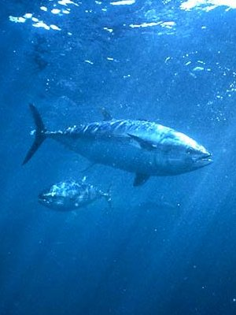
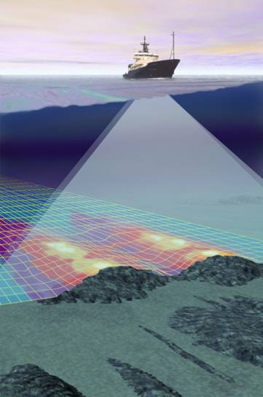
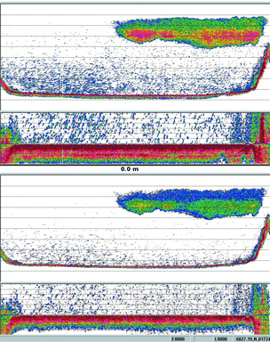
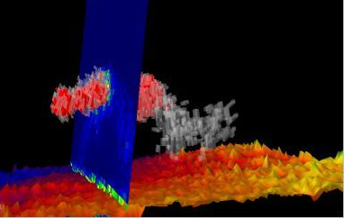
Measuring a sound signal that is transmitted, bounces off a target, and received is called sonar. Fishermen use sonar to find fish. Marine scientists use sonar to count fish and determine their size.

Slide 18
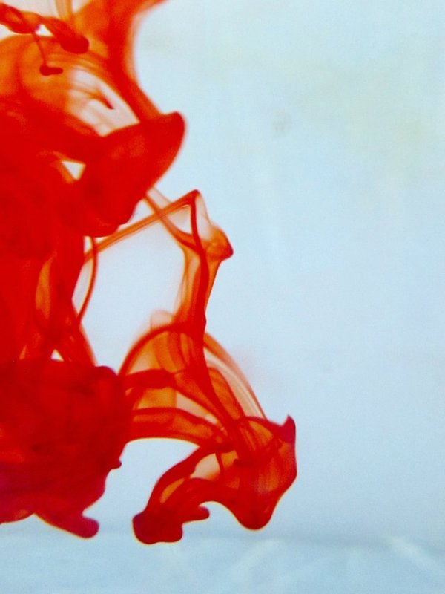
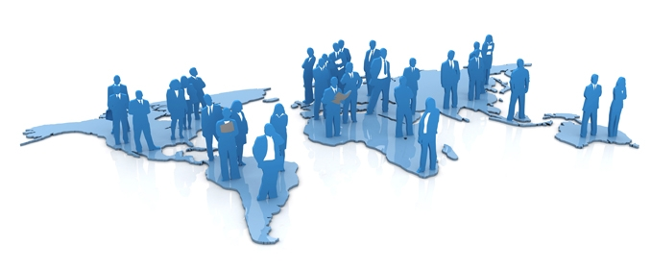
OMICS Group Open Access Membership
OMICS International Membership enables academic and research institutions, funders and corporations to actively encourage open access in scholarly communication and the dissemination of research published by their authors.
For more details and benefits, click on the link below:
http://omicsonline.org/membership.php

