Slide 1
OMICS Group
OMICS Group International through its Open Access Initiative is committed to make genuine and reliable contributions to the scientific community. OMICS Group hosts over 400 leading-edge peer reviewed Open Access Journals and organizes over 300 International Conferences annually all over the world. OMICS Publishing Group journals have over 3 million readers and the fame and success of the same can be attributed to the strong editorial board which contains over 30000 eminent personalities that ensure a rapid, quality and quick review process. OMICS Group signed an agreement with more than 1000 International Societies to make healthcare information Open Access.
Contact us at: contact.omics@omicsonline.org

Slide 2
OMICS Journals are welcoming Submissions
OMICS Group welcomes submissions that are original and technically so as to serve both the developing world and developed countries in the best possible way.
OMICS Journals are poised in excellence by publishing high quality research. OMICS Group follows an Editorial Manager® System peer review process and boasts of a strong and active editorial board.
Editors and reviewers are experts in their field and provide anonymous, unbiased and detailed reviews of all submissions.
The journal gives the options of multiple language translations for all the articles and all archived articles are available in HTML, XML, PDF and audio formats. Also, all the published articles are archived in repositories and indexing services like DOAJ, CAS, Google Scholar, Scientific Commons, Index Copernicus, EBSCO, HINARI and GALE.
For more details please visit our website: http://omicsgroup.org/journals/pigmentary-disorders-open-access.php

Slide 3
Prof. Torello Lotti, MD, MD(Hon)
President World Health Academy Foundation Zurich (CH)
Professor & Chair of Dermatology
University of Rome " G.Marconi"
Rome , Italy
E-mail: professor@torellolotti.it
Tel: +393286214588

Slide 4
Dr. Alessandro Pizzoccaro President GUNA International Italy

Slide 5
BASES AND PRINCIPLES OF
LOW DOSE MEDICINE AND P.N.E.I.
FOUNDATIONS OF
LOW DOSE PHARMACOLOGY

Slide 6
The questions of this lecture:
Can LOW DOSE hormones and cytokines be effective on biological systems under minimal pharmacological effective dose?
Is the PHYSIOLOGICAL CONCENTRATION of messenger molecules a low dose?
How LOW must a low dose hormone or cytokine be to be effective and safe?
Does a low dose’s “INTELLIGENCE” exist?
Dipartimento Scientifico Guna S.p.a.

Slide 7
Low Dose Medicine:
…a dynamic new concept
Low Dose Medicine (LDM) is an innovative therapeutic system based on the possibility to therapeutically use mainly LOW DOSE of biological substances that naturally lead the Physiology of the human body.
© Dipartimento Scientifico Guna S.p.a.

Slide 8
LOW DOSE MEDICINE
The science of Low Dose Medicine integrates state of the art scientific advances in:
Psycho-Neuro-Endocrine-Immunology (PNEI)
Molecular Biology
Quantum Physics
P.N.E.I.
Molecular Biology
Quantum Physics
© Dipartimento Scientifico Guna S.p.a.

Slide 9
Low Dose Medicine
Low Dose Medicine codifies the vision of the organism as a P.N.E.I. (psycho-neuro-endocrine-immune) NETWORK regulated by mechanisms of…
FINE CONTROL (through LOW DOSE of messenger molecules acting on membrane receptors’ up-regulation)
© Dipartimento Scientifico Guna S.p.a.

Slide 10
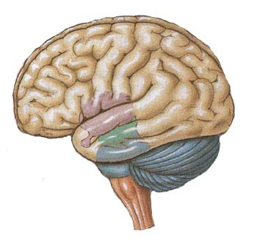
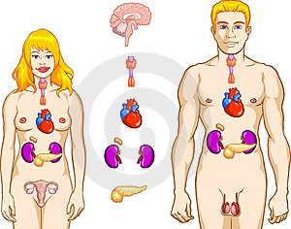
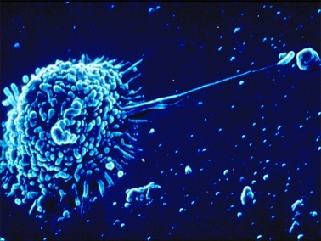
Homeostatic control systems
P
N
E
I
CENTRAL NERVOUS SYSTEM
&
NEUROVEGETATIVE SYSTEMS
ENDOCRINE SYSTEM
IMMUNE SYSTEM
Ader, R., Psychoneuroimmunology, IV edition, vol. 1 e 2, Academic Press, Amsterdam 2007.
It is the classical text on the matter, pubblished for the first time in 1981.
© Dipartimento Scientifico Guna S.p.a.

Slide 11
DISEASE
P
N
E
I
T°
pH
O2
Glycemia
HOMEOSTASIS
DISEASE
© Dipartimento Scientifico Guna S.p.a.

Slide 12
Homeostatic control systems
P
N
E
I
CENTRAL NERVOUS SYSTEM
&
NEUROVEGETATIVE SYSTEMS
ENDOCRINE SYSTEM
IMMUNE SYSTEM
Ader, R., Psychoneuroimmunology, IV edition, vol. 1 e 2, Academic Press, Amsterdam 2007.
It is the classical text on the matter, pubblished for the first time in 1981.
© Dipartimento Scientifico Guna S.p.a.

Slide 13
P.N.E.I.
A global vision of the human body
Even if localized in a specific organ or tissue, diseases are expression of the unbalance of the whole P.N.E.I. axis.
Dipartimento Scientifico Guna S.p.a.

Slide 14
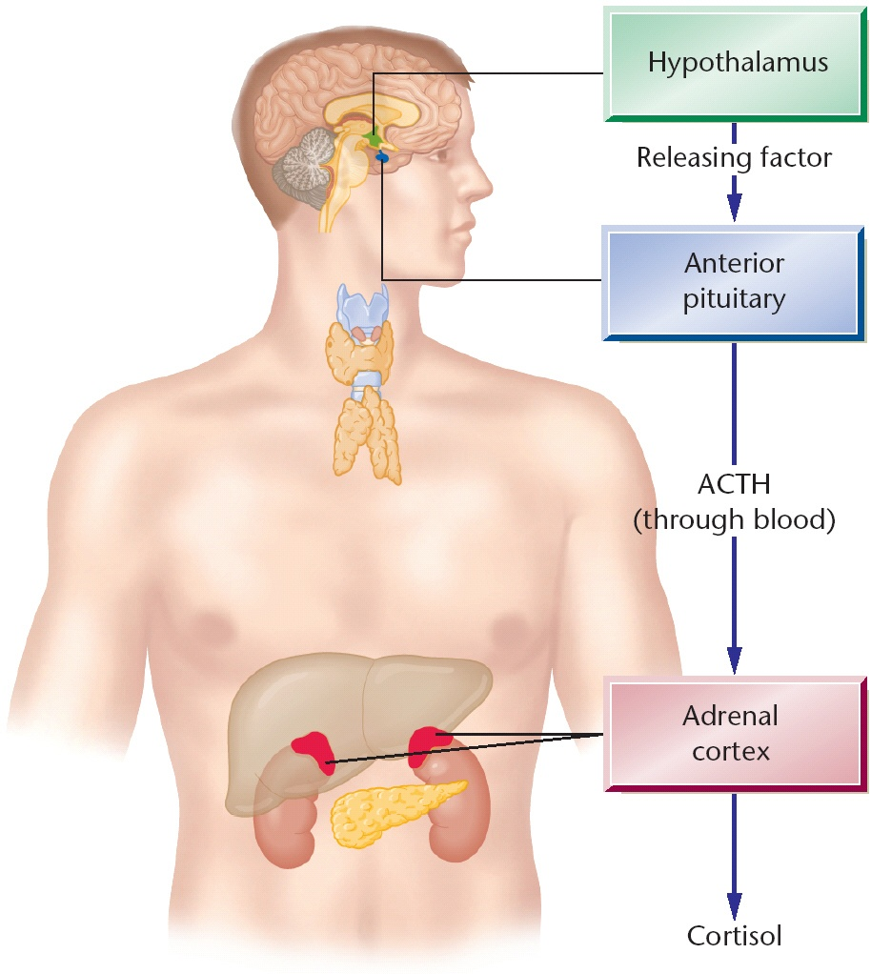
HPA AXIS
Da: PsicoNeuroEndocrinoImmunologia. Francesco Bottaccioli – RED Edizioni

Slide 15
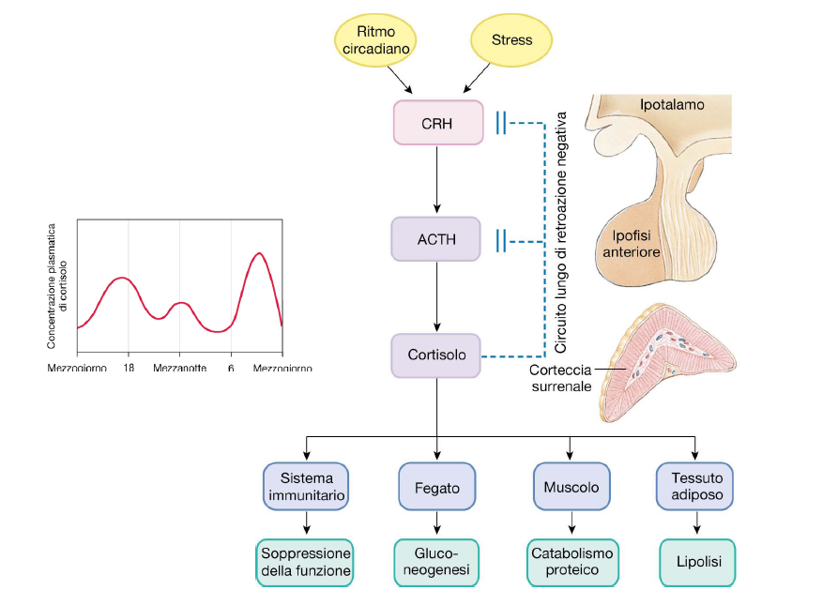

Slide 16
STRESS AXIS
Ts
Tc
CD8⁺
Not correct stimulation of
Reduction in
IFN-γ
Th2
CORTISOL
DOWN-REGULATION Th1
Th1

Slide 17
Relationship between hormones and cytokines
+
stimulate
Th₁
FEMALE SEXUAL HORMONES
-
inhibit
Th₂
__________________
+
inhibit
Th₁
CORTISOL
-
stimulate
Th₂
© Dipartimento Scientifico Guna S.p.a.

Slide 18
Relationship between hormones and cytokines
MELATONIN
+
Th₁
up-regulates
Miller SC, Pandi-Perumal SR, Esquifino AI, Cardinali DP, Maestroni GJ. The role of melatonin in immuno-enhancement: potential application in cancer. Int J Exp Pathol. 2006 Apr;87(2):81-7.
© Dipartimento Scientifico Guna S.p.a.

Slide 19
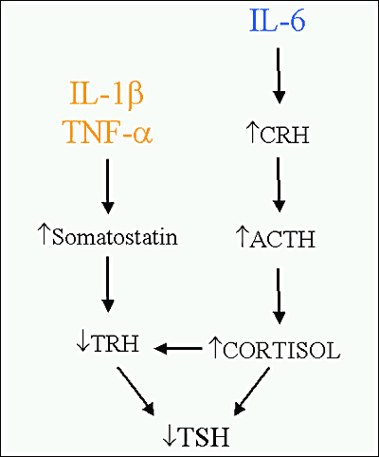
Relationship between cytokines and hormones
© Dipartimento Scientifico Guna S.p.a.

Slide 20
Relationship between cytokines and hormones
IL-2
IL-4
-
DOWN-REGULATE
NOR-ADRENALINE
© Dipartimento Scientifico Guna S.p.a.

Slide 21
P.N.E.I. NETWORK AND MESSENGER MOLECULES
PSYCHE
P
NEUROPEPTIDES
N
HORMONES
HORMONES
E
I
INTERLEUKINS
SOMA
PSYCHE
I
E
N
P
© Dipartimento Scientifico Guna S.p.a.

Slide 22
Messenger Molecules
The Foundation for PRM
COMMUNICATING MOLECULES are messengers, the words used by the 3 homeostatic control systems to speak each other …and to understand each other.
© Dipartimento Scientifico Guna S.p.a.

Slide 23
P.N.E.I. NETWORK AND MESSENGER MOLECULES
DISEASES CAN BE CONSIDERED AS EXPRESSIONS, CONSEQUENCES OF CHANGED CONCENTRATION OF MESSENGER MOLECULES, DUE TO UP- OR DOWN-REGULATION OF THE P.N.E.I. AXIS CELLS
Dipartimento Scientifico Guna S.p.a.

Slide 24
DISEASE
HYPER-CONCENTRATION
10⁻⁶
HEALTH
picogramms/milliliter
nanogramms/milliliter
PHYSIOLOGICAL CONCENTRATION
10⁻¹⁵
HYPO-CONCENTRATION
DISEASE
C O P E Cytokines & Cells Online Pathfinder Encyclopedia Version 26.7 (Spring 2011 Edition)
Dipartimento Scientifico Guna S.p.a.

Slide 25
DEFINITIONS
g (gram)= 1
10 ⁻¹ = 0.1
10 ⁻² = 0.01
mg (milligram)= 10 ⁻³ = 0.001
μg (microgram)= 10 ⁻⁶ = 0.000001
ng (nanogram)= 10 ⁻⁹ = 0.000000001
pcg (picogram)= 10 ⁻¹² = 0.000000000001
fg (fentogram)= 10 ⁻¹⁵ = 0.000000000000001
© Dipartimento Scientifico Guna S.p.a.

Slide 26
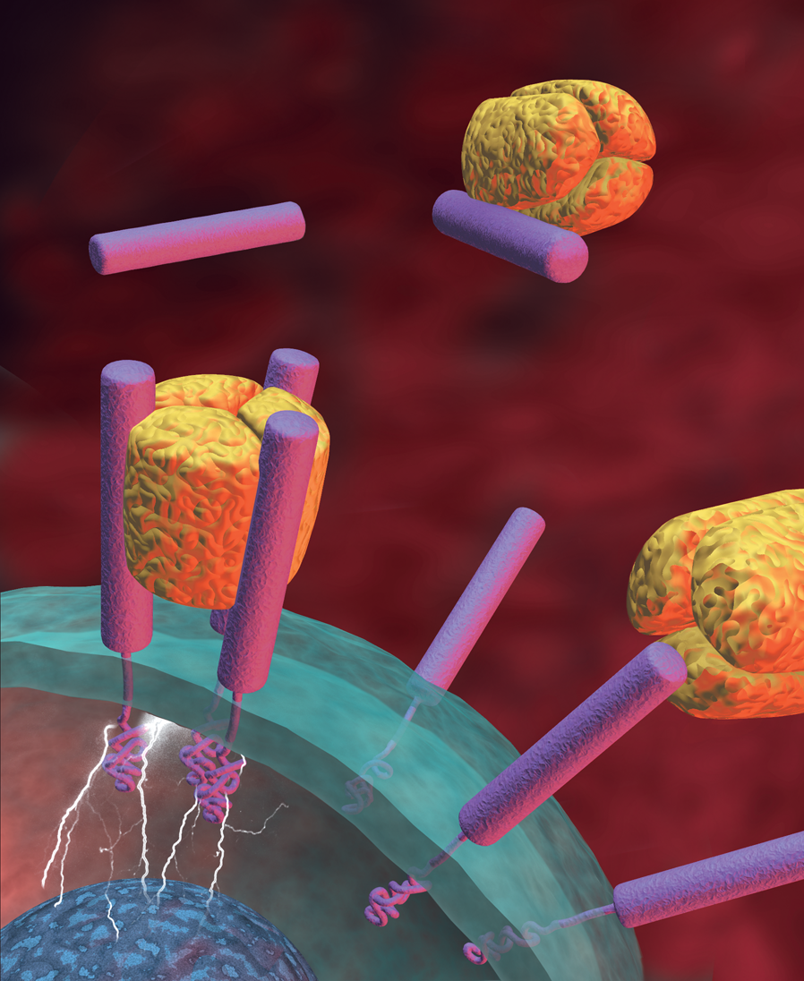
TRANS-MEMBRANE RECEPTORS Up- and Down-Regulation
TNF
Soluble TNF receptor
Cell-surface receptor
Cell activation
Notes:
Importance of targeting TNF
In RA, levels of TNF become elevated in the synovium and at the pannus-cartilage joint, overwhelming the soluble TNF receptors that normally regulate proinflammatory activity. TNF molecules are thus able to bind to receptors on the surface of synovial cells, triggering multiple destructive events.¹ For example, the binding of TNF to neutrophils, fibroblasts, and chondrocytes stimulates the release of tissue-degrading enzymes such as collagenase and matrix metalloproteinases. TNF also induces expression of adhesion molecules, thereby promoting the migration of T cells to the synovium.²
In addition, TNF has been shown to induce the production of other proinflammatory cytokines, including IL-1, IL-6, and IL-8.^{2,3} Therefore, targeting TNF may inhibit the destructive effects of both TNF and these other cytokines.^{3,4}
References: 1. Moreland LW, Inhibitors of tumor necrosis factor: New treatment options for rheumatoid arthritis. Cleve Clin J Med 66:367-374, 1999. 2. Moreland LW, Inhibitors of tumor necrosis factor for rheumatoid arthritis. J Rheumatol 26(Suppl 57):7-15, 1999. 3. Choy EHS, Panayi GS, Cytokine pathways and joint inflammation in rheumatoid arthritis. N Engl J Med 344:907-916, 2001. 4. Feldmann M, Brennan FM, Maini RN, Rheumatoid arthritis. Cell 85:307-310, 1996.

Slide 27
The membrane receptor plays a KEY role.
The quantity of “ligand” (hormone, cytokine or neurotransmitor) and the receptor’s ability to bind these molecules (including the ligand’s affinity to the receptor) are both critical to the process of communication.
ONLY physiologic concentrations are able to activate or reactivate the membrane receptors and consequently, stimulate the physiologic function of a target cell.
UP- AND DOWN-REGULATION
Dipartimento Scientifico Guna S.p.a.

Slide 28
UP AND DOWN REGULATION
The affinity of a receptor for the specific cytokine or the specific hormone is very high.
The dissociation constant (K_{D}) is about 10⁻⁹-10 ⁻¹²
Mire-Sluis A. R, Thorpe R. (editors). Cytokines. Academic Press, London, San Diego, 1998.
Dipartimento Scientifico Guna S.p.a.

Slide 29
Messenger Molecules
Quality and Quantity
Not only the right MESSAGE but also the right “VOLUME”.
Dipartimento Scientifico Guna S.p.a.

Slide 30
PROBLEM
By a pharmacological point of view, in which concentration to use messenger molecules?
Dipartimento Scientifico Guna S.p.a.

Slide 31
EFFECTS OF DIFFERENT DOSES OF CYTOKINES
TM
TOXIC CONCENTRATION
mg/ml
TOXIC EFFECT
10⁻³
PHARMACOLOGICAL EFFECTS
PHARMACOLOGICAL CONCENTRATION
mcg-ng/ml
SIDE EFFECTS
10⁻⁶
MINIMAL EFFECTIVE PHARMACOLOGICAL DOSE
WITH DYNAMIZATION: PHYSIOLOGICAL EFFECTS
WITHOUT DYNAMIZATION: NO BIOLOGICAL EFFECTS
PHYSIOLOGICAL CONCENTRATION
ng-pcg-fg/ml
10⁻¹⁵
MINIMAL EFFECTIVE PHYSIOLOGICAL DOSE
Dipartimento Scientifico Guna S.p.a.

Slide 32
Effects of different doses of IL-1-β on isolated human fibroblasts
Dipartimento Scientifico Guna S.p.a.
32
Notes:
32

Slide 33
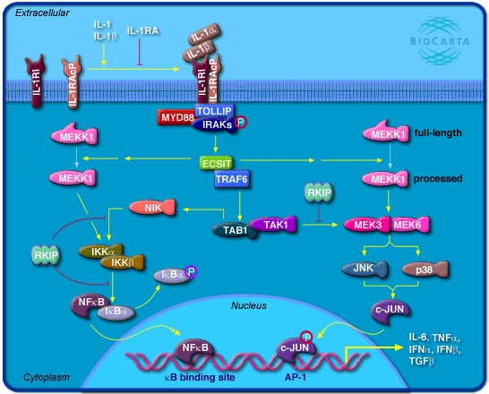

Slide 34
Expression of NFKb on isolated fibroblasts
nfkb
lps a c d b
lps a c d b
1h
18h
Legend
lps=control
A=placebo (water and alcohol)
B=pharmacological concentration
C=4CH diluted and dynamized
D=4CH only diluted but not dynamized
Dipartimento Scientifico Guna S.p.a.

Slide 35
S.K.A
It is a smart DRUG DELIVERY SYSTEM able to make effective molecular conecentration below the minimal effective dose.
Dipartimento Scientifico Guna S.p.a.

Slide 36
RELEASE ACTIVITY: capability of basic substance to release in the water milieu its pharmacological activity.
Bulletin of Experimental Biology and Medicine, Vol. 154, No. 1, November, 2012
© Dipartimento Scientifico Guna S.p.a.

Slide 37
^{COHERENCE EFFECTS IN WATER}
Ordinary water
O
O
With SKA they onset the
di Frölich phenomenon:
all the water dipoles
become in series instead
of cahotic, that brings to
the reduction of dielectric
Constant, taht is a easier
electromagnetical
Transmission.
H
H
O
H
H
H
H
O
O
H
H
104.5°
H
H
O
O
H
H
H
H
O
O
O
H
H
H
H
H
H
Biological water
© Dipartimento Scientifico Guna S.p.a.

Slide 38
How to use LOW DOSE CYTOKINES
Same or Opposing Cytokine

Slide 39
IF DISEASES ARE EXPRESSIONS, CONSEQUENCES OF CHANGED CONCENTRATION OF MESSENGER MOLECULES…
PROBLEM
Is it possible to modulate the action of interleukines and hormones?
Dipartimento Scientifico Guna S.p.a.

Slide 40
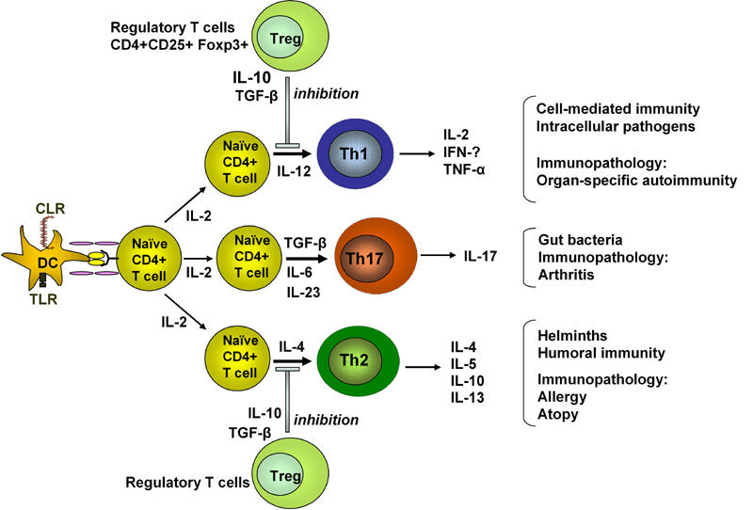
Antigen presentation to naïve T cells results in the development of Th1, Th2 or Th17 cells depending on the cytokine milieu.
From: The Review of Diabetic Studies (2006) 3:72-75

Slide 41
THE CONCEPT OF BALANCE – RECIPROCITY of TH CELLS
Th0
IL-12 UP-REGULATES
IL-4 UP-REGULATES
Th1
Th2
Inflammatory diseases
Allergy
IL-12, INF-γ
IL-4
IL-4 DOWN-REGULATES
INF-γ DOWN-REGULATES
Th subsets cross-regulate expansion and functions each other.
Cooke , A. Th17 in Inflammatory Conditions. 2006, Rev Diabetic Stud 3: 72-7
- Bettelli E. et al. Th17: the third member of the effector T cell trilogy. Current Opinion in Immunology 2007, 19: 652-657
Dipartimento Scientifico Guna S.p.a.

Slide 42
The central role of Th17 and IL-23 and IL-17 in autoimmune diseases
Th0
+++ IL6 ++IL-21 ++IL-23
- - - IL4
Th1
Th3
Th2
Th17
IL1, INF-γ, IL2, TNF-α, IL6, IL8, IL12
IL 10, TGF-β
IL4, IL5, IL6, IL9, IL10, IL13,
IL 17
Autoimmunity Trigger
AUTOIMMUNE PATOLOGIES
In autoimmune pathologies it is generally possible to detect low levels of INF-γ e IL-4 ; since these interleukines don’t stimulate the Th₀ to differentiate into Th₁ or Th₂, it enables IL-6 to stimulate Th17 to produce IL-17, the real trigger interleukine in autoimmune diseases.
According with PRM it’s important to use antagonistic cytokines; therefore, to slow down IL-6 it is important to use IL-4 4CH.
From: The Review of Diabetic Studies (2006) 3:72-75
Dipartimento Scientifico Guna S.p.a.

Slide 43
Clinic use of low dose cytokines
THE IMMUNE SYSTEM
Th1
Th2
© Dipartimento Scientifico Guna S.p.a.
43
Notes:
43

Slide 44
Th-1/Th-2 BALANCE
Th1 UP-REGULATION
Th-2
Th2 UP-REGULATION
Th1
Th17
Th2
RHEUMATOID
ARTHITIS
ALLERGY
Th2
TReg
Th1
Th2 DOWN-REGULATION
Th1 DOWN-REGULATION
© Dipartimento Scientifico Guna S.p.a.
44
Notes:
44

Slide 45
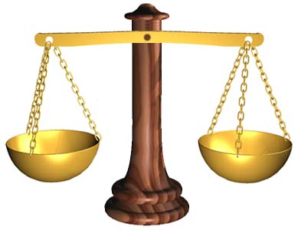
The concept of BALANCE and the use of cytokines and hormones
Antagonistic cytokines or hormones are utilized in order to brake a biological effect.
©Dipartimento Scientifico Guna S.p.a.

Slide 46
IF INFLAMMATION IS EXPRESSION, CONSEQUENCES OF CHANGED CONCENTRATION OF MESSENGER MOLECULES…
PROBLEM
Is it possible to correct the excess or the deficiency of cytokines, hormones, neuropeptides in INFLAMMATION?
© Dipartimento Scientifico Guna S.p.a.

Slide 47
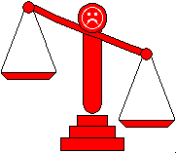
…in INFLAMMATION
Th1
Th17
Th2
TReg
IL-1
TNF-α
IL-6
IL-8
© Dipartimento Scientifico Guna S.p.a.

Slide 48
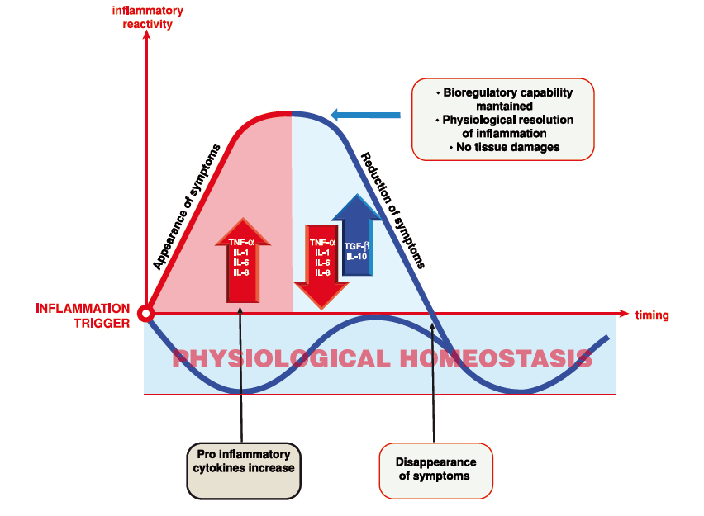
CHRONOBIOLOGY of inflammation
Physiological trend
72-96 hours
© Dipartimento Scientifico Guna S.p.a.

Slide 49
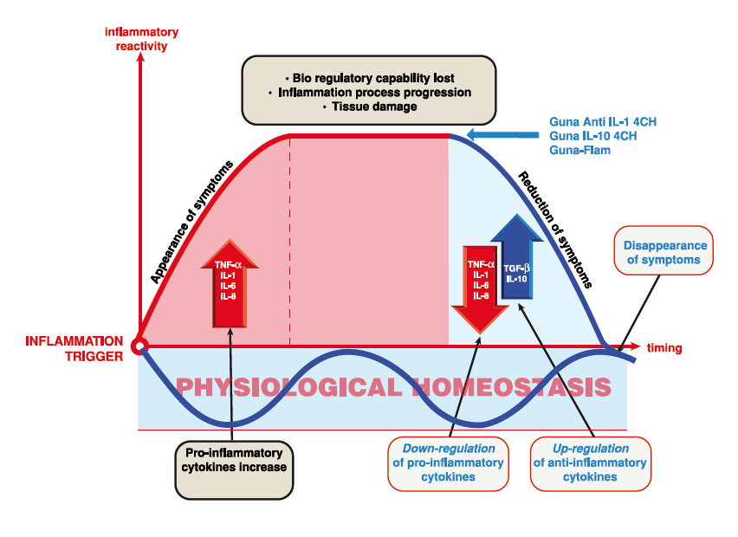
CHRONOBIOLOGY of inflammation
Pathological trend
PERSISTENCE
© Dipartimento Scientifico Guna S.p.a.

Slide 50
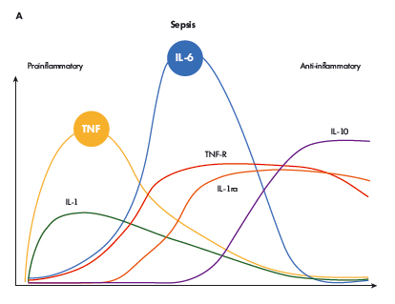
CHRONOBIOLOGY OF MOST IMPORTANT CYTOKINES INVOLVED IN INFLAMMATION IN PRESENCE OF ACUTE INFLAMMATION
Petersen AM¹, Pedersen BK. The anti-Inflammatory effect of exercise. J Appl Physiol (1985). 2005 Apr;98(4):1154-62.

Slide 51
…in acute INFLAMMATION
Th1
Th17
Th2
TReg
IL-1
TNF-α
IL-6
IL-8
© Dipartimento Scientifico Guna S.p.a.

Slide 52
INTERLEUKINE-1 (α; ß)
Interleukin 1 (IL-1) cytokine secreted by macrophages, monocytes, dendritic cells, fibroblasts and endothelial cells.
IL-1 SUPPORTS INFLAMMATORY PROCESSES
© Dipartimento Scientifico Guna S.p.a.

Slide 53
IL-1 (α; ß) ACTION MECHANISM
IL-1 (α; ß) activates:
cyclooxygenase type 2 (COX₂)
prostaglandin E2 (PGE₂)
prostaglandin D2 (PGD₂)
nitric oxide (NO)
© Dipartimento Scientifico Guna S.p.a.

Slide 54
CONVENTIONAL DRUGS TO STOP INTERLEUKINE-1 EFFECTS
NSAIDs
CORTISON
ASA
-
-
-
COX₂
PGE₂
NO
© Dipartimento Scientifico Guna S.p.a.

Slide 55
Low dose SKA-actived Antibody Anti Interleukins -1 (α and β) in Inflammation
Guna-Flam and/or Anti IL-1
IL-1
BLOCK
-
-
-
Anti Interleukins-1 (α; ß) act as NSAIDs, cortisone and, in part, as salicylates , without the negative side effects caused by these allopathic medicines.
COX₂
PGE₂
NO
© Dipartimento Scientifico Guna S.p.a.

Slide 56
Guna Anti IL-1
(Anti IL-1 α and Anti IL-1 β)
Main Indications:
Acute inflammatory diseases
Fever
Pain syndromes
Osteoarthritis
...
© Dipartimento Scientifico Guna S.p.a.

Slide 57
…in low grade chronic INFLAMMATION
Th1
Th17
Th2
TReg
IL-1
TNF-α
IL-6
IL-8
© Dipartimento Scientifico Guna S.p.a.

Slide 58
CHRONOBIOLOGY OF MOST IMPORTANT CYTOKINES INVOLVED IN INFLAMMATION IN PRESENCE OF ACUTE INFLAMMATION
Petersen AM¹, Pedersen BK. The anti-Inflammatory effect of exercise. J Appl Physiol (1985). 2005 Apr;98(4):1154-62.

Slide 59
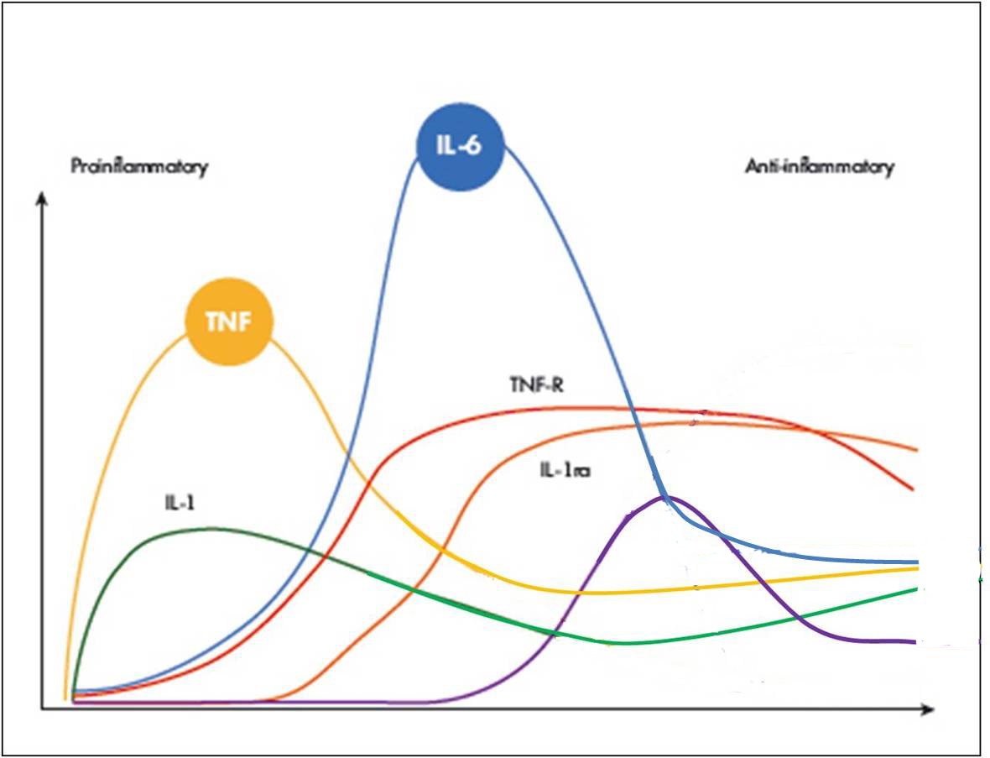
CHRONOBIOLOGY OF MOST IMPORTANT CYTOKINES INVOLVED IN INFLAMMATION IN PRESENCE OF LOW GRADE CHRONIC INFLAMMATION
IL-10
Petersen AM¹, Pedersen BK. The anti-Inflammatory effect of exercise. J Appl Physiol (1985). 2005 Apr;98(4):1154-62
Modificata a fini didattici (vedi freccia).

Slide 60
Inflammation Trial
The big accused:
IL-1
TNF-α
IL-6
© Dipartimento Scientifico Guna S.p.a.

Slide 61
The concept of BALANCE and the use of the cytokines.
In PHYSIOLOGICAL REGULATING MEDICINE (PRM) antagonistic (opposing) cytokines or hormones are utilized in order to brake a biological effect.
© Dipartimento Scientifico Guna S.p.a.

Slide 62
RECOVERING THE BALANCE IN INFLAMMATION
Inflammation
Cytokines
ANTI-Inflammation
Cytokines
IL-1
TNF-α
IL-6
IL-8
Anti-IL-1
IL-10
IL-4
TGF-β
62
© Dipartimento Scientifico Guna S.p.a.
Notes:
62

Slide 63
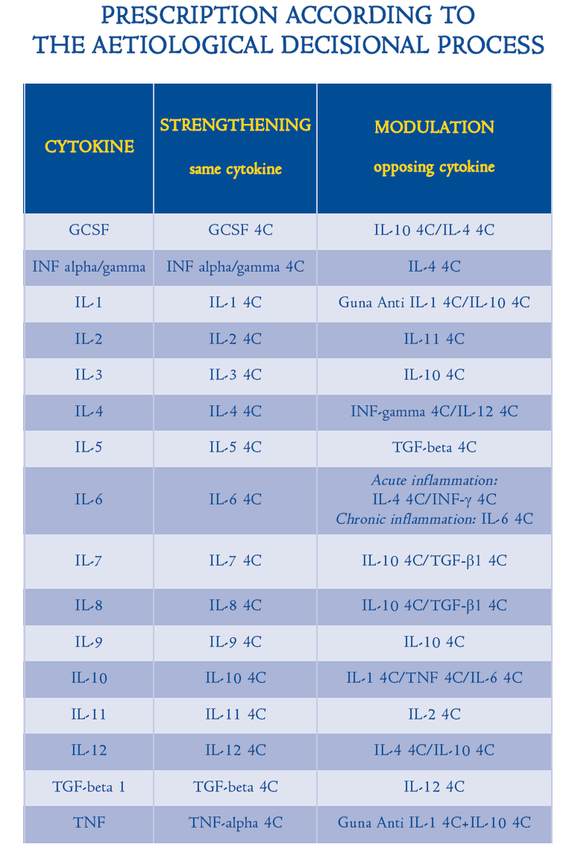
IL-10 4CH
© Dipartimento Scientifico Guna S.p.a.

Slide 64
THERAPEUTIC APPROACH WITH
LOW DOSE S.K.A. ANTIBODY ANTI IL-1, IL-10, IL-4 & TGF-β
IN INFLAMMATIONS IN GENERAL AND IN MUSCLE-SKELETAL PAIN MANAGEMENT
Anti IL-1 4CH  Decrease of acute inflammation.
IL-10 4CH  Decrease of chronic inflammation.
IL-4 4CH  Control of autoimmune diseases trigger.
TGF-β 4CH  Resolution phase and restitutio ad integrum.
© Dipartimento Scientifico Guna S.p.a.

Slide 65
In Crohn’s disease
Th1
Th17
Th2
TReg
TNF-α
IFN-γ
IL-17
IL-12
IL-8
Dipartimento Scientifico Guna S.p.a.

Slide 66
RECOVERING THE BALANCE IN CROHN’S DISEASE
Inflammation
Cytokines
ANTI-Inflammation
Cytokines
TNF-α
IFN-γ
IL-17
IL-12
IL-8
Anti-IL-1
IL-10
(IL-4)
66
Dipartimento Scientifico Guna S.p.a.
Notes:
66

Slide 67
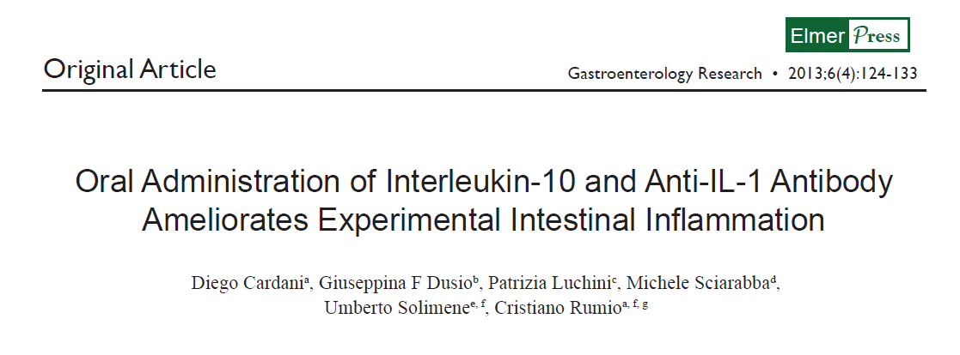
Dipartimento Scientifico Guna S.p.a.
67
Notes:
67

Slide 68
Cytokines levels
IL-12*
IFN-γ
1
2
3
4
5
1
2
3
4
5
TNF-α*
IL-8
© Dipartimento Scientifico Guna S.p.a.
1
2
3
4
5
1
2
3
4
5

Slide 69
Cytokines levels
IL-17
Legenda:
1: values in healthy mouse
2: values in mouse with Crohn’s
3: values in the mouse with Crohn’s after 7 days tretment with Anti IL-1+IL-10 at phamacological dosages
4: : values in the mouse with Crohn’s after 7 days tretment with Anti IL-1+IL-10 at 4CH concentration SKA
5: values in the mouse with Crohn’s after 7 days tretment with Anti IL-1+IL-10 at 4CH concentration not-SKA
1
2
3
4
5
IL-10
1
2
3
4
5
© Dipartimento Scientifico Guna S.p.a.

Slide 70
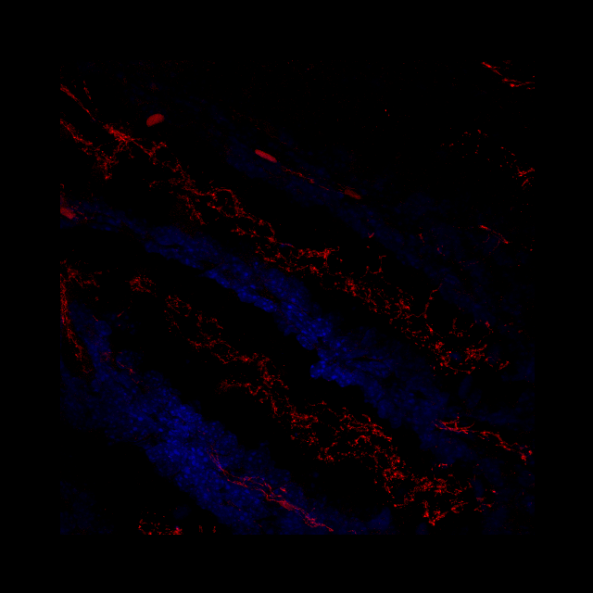
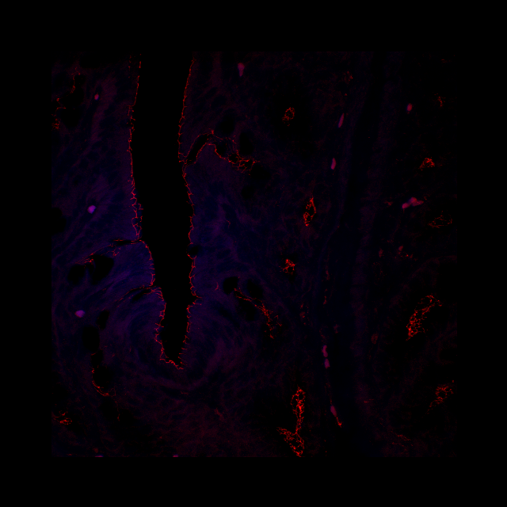
DSS (Dextran Sodium Sulphate)
Anti Il-1 4CH + IL-10 4CH
BEFORE TREATMENT
AFTER TREATMENT
60 x
© Dipartimento Scientifico Guna S.p.a.

Slide 71
We can say that
are a modern, effective,
no side effects Anti TNF-α
Guna Anti IL-1 4CH
+
Guna IL-10 4CH
© Dipartimento Scientifico Guna S.p.a.

Slide 72
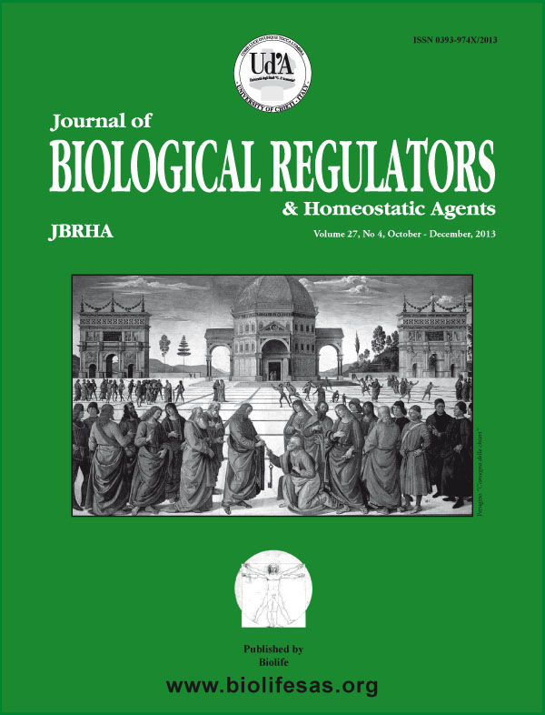
IMMUNOMODULATING TREATMENT WITH LOW DOSE INTERLEUKIN-4, INTERLEUKIN-10 AND INTERLEUKIN-11 IN PSORIASIS VULGARIS
Journal Of Biological Regulators & Homeostatic Agents 2014 Jan-Mar;28(1):133-9.
© Dipartimento Scientifico Guna S.p.a.

Slide 73
RESULTS ANALYSIS
Amielaration of 3.7 PASI* points in avaerage, that is 55,2% better than the T0 (primary outcome: + 25%)
*Psoriasis Area Severity Index
© Dipartimento Scientifico Guna S.p.a.

Slide 74
RESULTS ANALYSIS
Amielaration of 4.3 DLQI* points in avaerage, that is 56,5% better than the T0 (secondary outcome: + 20%)
*Dermatology Life Quality Index
© Dipartimento Scientifico Guna S.p.a.

Slide 75
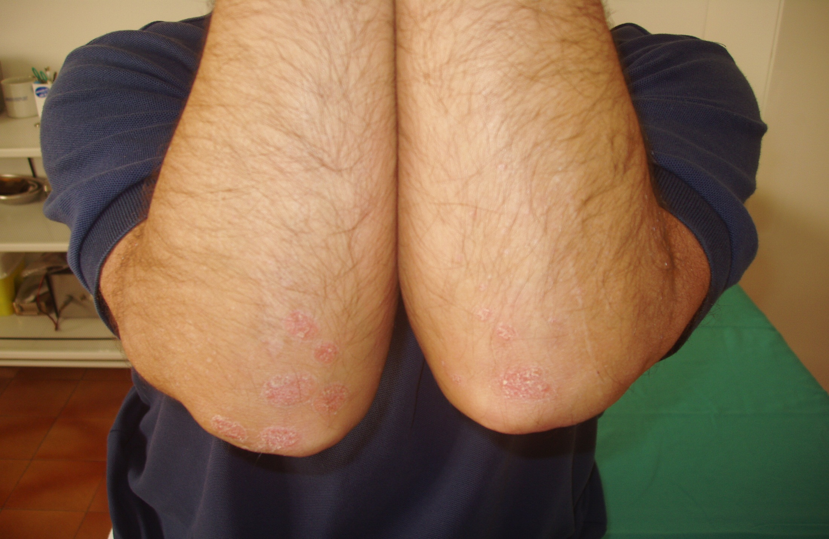

Slide 77
IN ALLERGY
Th2
IL-4
IL-5
IL-13
Th1
Dipartimento Scientifico Guna S.p.a.

Slide 78
RECOVERING THE BALANCE IN ALLERGY
ANTI-Allergic
Cytokines
Allergic
Cytokines
IL-12
IFN-γ
IL-4
IL-5
IL-13
78
Dipartimento Scientifico Guna S.p.a.
Notes:
78

Slide 79
Effects of low dose cytokines in treatment of inflammatory pathologies: use in an animal model of allergic asthma
Dipartimento Scientifico Guna S.p.a.
Silvia Gariboldi et al. Low dose oral administration of cytokines for treatment of allergic asthma. Pulmonary Pharmacology and Therapeutics - Volume 22, Number 6, pp 497-510, December 2009
79
Notes:
79

Slide 80
EXPERIMENTAL PROTOCOL
DAY 1
DAY 7
DAY 13
LUCKY MOUSE
Injection of 1 mg of egg-albumin + 5 mg Al(OH)₃ in PBS (IP)
Injection of 1 mg of egg-albumin + 5 mg Al(OH)₃ in PBS (IP)
Aerosol of 1 mg of egg-albumin + 5 mg Al(OH)₃ in PBS
TREATMENT WITH IL-12+IFN-γ
from DAY 18 until DAY 38
Blood drawing
ALLERGIC MOUSE
DAY 38
Bronchoalveolar lavage fluid
DAY 30
5% egg-albumin in PBS 0,5. (Aerosol)
DAY 27
Injection of 1 mg of egg-albumin + 5 mg Al(OH)₃ in PBS (IP)
Dipartimento Scientifico Guna S.p.a.

Slide 81
Asthma
©Dipartimento Scientifico Guna S.p.a.
BALF – after treatment with egg albumin and Al (OH)₃
Legend
1-Untr=healthy mouse
2-OVA=allergic mouse
180
60
160
140
50
120
40
100
[IL-5] (pcg/ml)
[IL-4] (pcg/ml)
30
80
60
20
40
10
20
0
0
UNTR
OVA
UNTR
OVA

Slide 82
Level of IL-4 and IL-5 in mice sera
on day 7th of treatment
Treatment plan of allergic mouse with the 2 anti-allergic interleukines in association
(IL-12+IFN-γ)
Legenda
1-Untr=healthy mouse
2-OVA=allergic mouse
3-OVA+ALLO=IL-12+IFN-γ in pharmacological concentration
4-OVA+4CH=IL-12+IFN-γ in physiological concentration (4CH) diluted and dynamized
5-OVA+4CHn=IL-12+IFN-γ in physiological concentration (4CH) only diluted but not dynamized
Levels of IL-4
Levels of IL-5
1
2
3
4
5
1
2
3
4
5
Dipartimento Scientifico Guna S.p.a.

Slide 83
Treatment plan of allergic mouse with the 2 anti-allergic interleukines in association
(IL-12+IFN-γ)
Legenda
1-Untr=healthy mouse
2-OVA=allergic mouse
3-OVA+ALLO=IL-12+IFN-γ in pharmacological concentration
4-OVA+4CH=IL-12+IFN-γ in physiological concentration (4CH) diluted and dynamized
5-OVA+4CHn=IL-12+IFN-γ in physiological concentration (4CH) only diluted but not dynamized
Level of IL-12 and INF-γ in mice sera
on day 7th of treatment
Levels of IL-12
Level of IFN-γ
1
2
3
4
5
1
2
3
4
5
Dipartimento Scientifico Guna S.p.a.

Slide 84
Unit of measurement…
…the mystery… that is not a mystery
we give…
…we detect in the blood
fg
pg
4CH
1 fg/mouse
Dipartimento Scientifico Guna S.p.a.

Slide 85
Eosinophil numbers in mouse BALF (bronchoalveolar lavage fluid)
on day 20 of treatment
UNTREATED | 0
OVA=CONTROL (ALLERGIC MOUSE) | 20,188±0,613
OVA+ALLO (PHARMACOLOGICAL TREATMENT) | 0
OVA+4 CH (4 CH SKA-ACTIVITED TREATMENT) | 0
OVA+4 CH n (4 CH not-SKA-ACTIVITED TREATMENT) | 19,567±0,685
OVA+30 CH (30 CH SKA-ACTIVITED TREATMENT) | 20,788±0,416
Number of cells expressed in cells/BALF (x10⁴)
Dipartimento Scientifico Guna S.p.a.

Slide 86
Dipartimento Scientifico Guna S.p.a.
One cell one target or a multitargeted approach?
IL-12 versus association of IL-12+IFN-γ
Blood levels of IL-12 and IFN-γ
association
Only IL-12
Association IL-12 + IFN-γ

Slide 87
Dipartimento Scientifico Guna S.p.a.
Safety of clinical use of SKA treated low doses of interleukines

Slide 88
Focus on:
Relationship among Th1-Th2-Th3
© Dipartimento Scientifico Guna S.p.a.

Slide 89
Plasticity and Rigidity of Immune System
Relationship among Th1-Th2-Th3
Th₀
Th₁
Th₂
DOWN-REGULATES
TGF-β
DOWN-REGULATES
Th₃
© Dipartimento Scientifico Guna S.p.a.

Slide 90
Low Dose of IL-12 stimulates T Cell response in cultures of PBMCs derived from Non Small Cell Lung Cancer Patients.
Dipartimento Scientifico Guna S.p.a.
Osp. Le Molinette
Torino
in cooperation with:
D’Amico L, Ruffini E, Ferraccini R, Roato I. Journal of Cancer Therapy. 2012; 3: 337-342.
90
Notes:
90

Slide 91
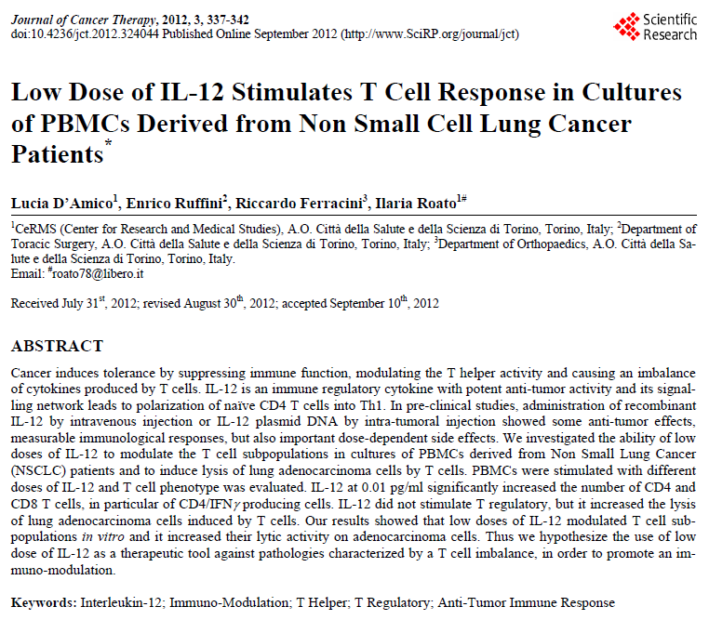

Slide 92
-
Th₃
Th1
I Th1 non sintetizzano la giusta quantità di IFN-gamma
I Th3 down-regolano i TH1
IFN-gamma
L’IFN-gamma in difetto non riesce ad espletare correttamente la sua funzione di attivazione dei CD8+
+
I CD8+, non stimolati a sufficienza, non si differenziano in T suppressor nella giusta quantità
CD8⁺
+
+
T citotoxic Lymphocites
T suppressors
Lymphocites

Slide 93
Th3
Responsable of immundeficiency during cancer
Th1
+
-
IL-12 4C
IFN-gamma
+
CD8⁺
+
+
T citotoxic Lymphocites
T suppressors
Lymphocites

Slide 97
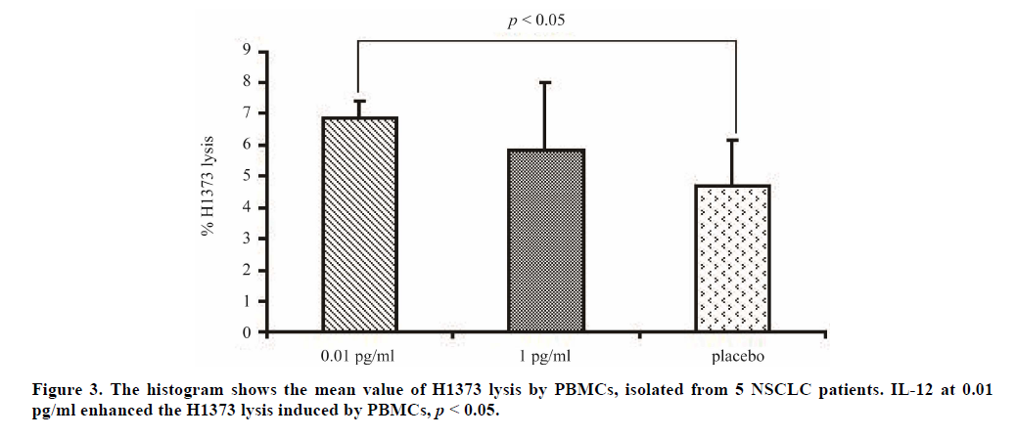
Mean value of H1373 lysis by PBMC.

Slide 98
This is the BIOLOGICAL INTELLIGENCE of low doses!
©Dipartimento Scientifico Guna S.p.a.

Slide 99
Biological Intelligence of
Low Doses
Conclusions:
Physiological low-dose cytokines are able to recover the physiological function and the BIOLOGICAL PLASTICITY of the PNEI axis acting on bio-regulation mechanisms, whereas conventional pharmacological high doses induce the RIGIDITY of the Systems and their inhability to recover the balance (what clinically we call side effects).
Dipartimento Scientifico Guna S.p.a.

Slide 100
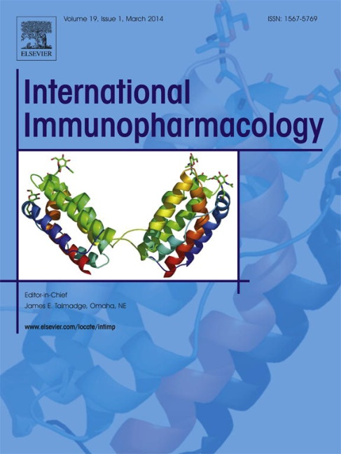
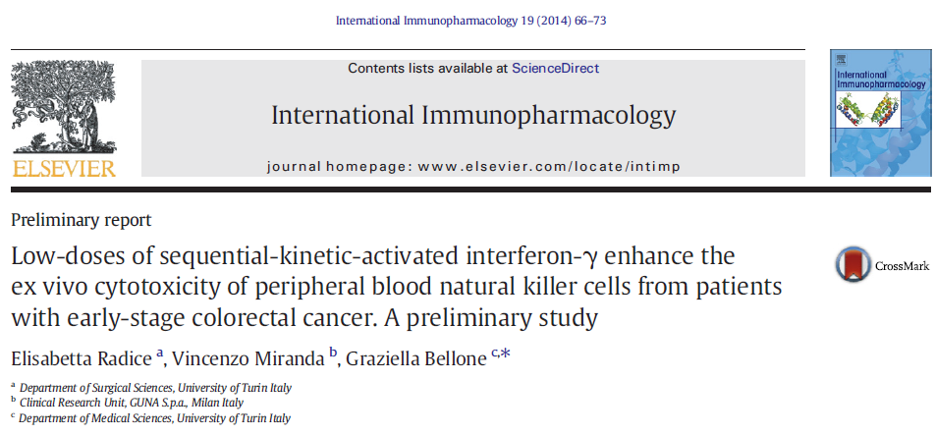
© Dipartimento Scientifico Guna S.p.a.

Slide 101
ACTIVATION OF NK-cells IN CANCER PATIENTS
Th1
IFN-gamma
IFN-gamma 4C
+
+
NK-cells
+
Anti cancer activity

Slide 102
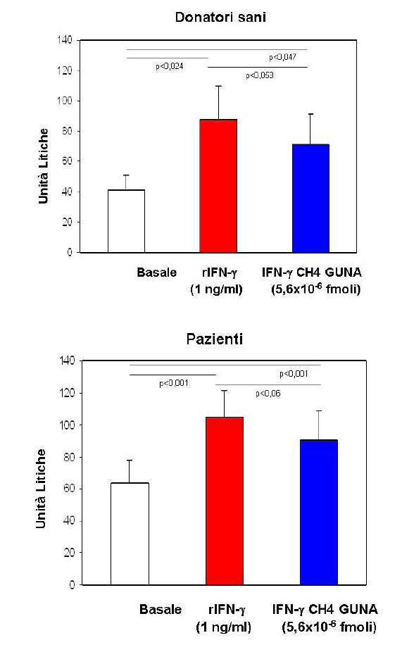

Slide 103
How to use LOW DOSE HORMONES
Positive and Negative Feedback

Slide 104
NOT A HORMONAL REPLACEMENT THERAPY BUT A HORMONAL PHYSIOLOGICAL (REGULATIVE) THERAPY AIMED TO RECOVER THE ENDOCRINE HOMEOSTASIS.
Hormonal Therapy sec. P.R.M.
Dipartimento Scientifico Guna S.p.a.

Slide 105
Hormones of PRM
Hypothalamus
Somatostatine
Beta-Endorphin
Hypophysis
FSH
LH
ACTH
Prolactin
TSH
Pineal Gland
Melatonin
Thyroid
TSH
Triiodohyronine (T3)
Thyroxine (T4)
Calcitonin
Parathyroids
Parathormone (PTH)
Ovary
Beta-Estradiol
Progesterone
© Dipartimento Scientifico Guna S.p.a.

Slide 106
Clinic use of low dose hormones
Clinic use of homeopatic Hormones
HYPERESTROGENISM
PROGESTERONE D6
Sensitization of the hypophyseal receptors for progesterone
(-)
Negative feedback
-
HYPOPHYSIS
Decreased hypophyiseal gonadotropins synthesis
(-)
OVARY
Decreased estrogen synthesis
© Dipartimento Scientifico Guna S.p.a.

Slide 107
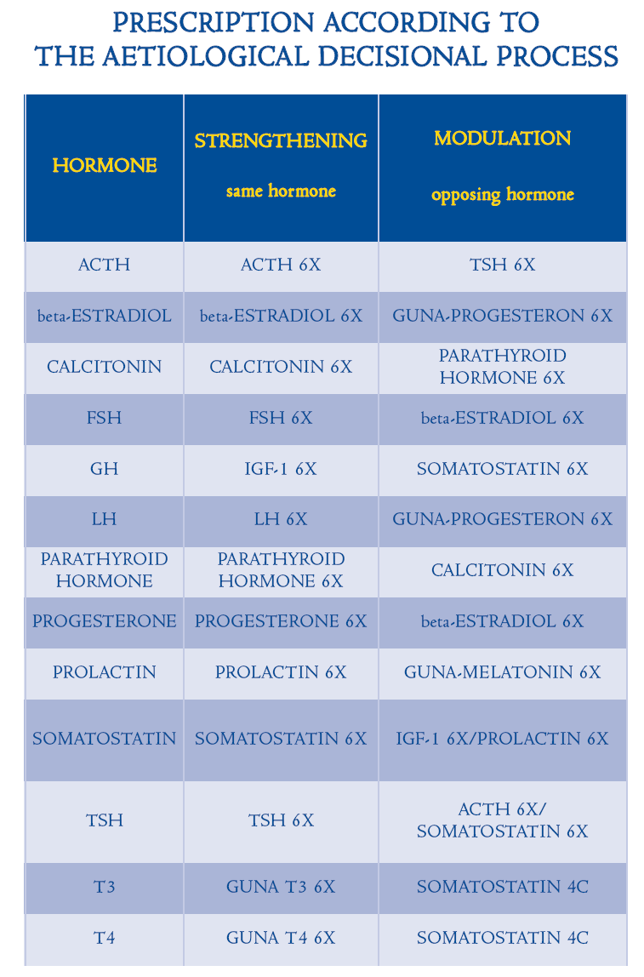

Slide 108
Preliminary data

Slide 110
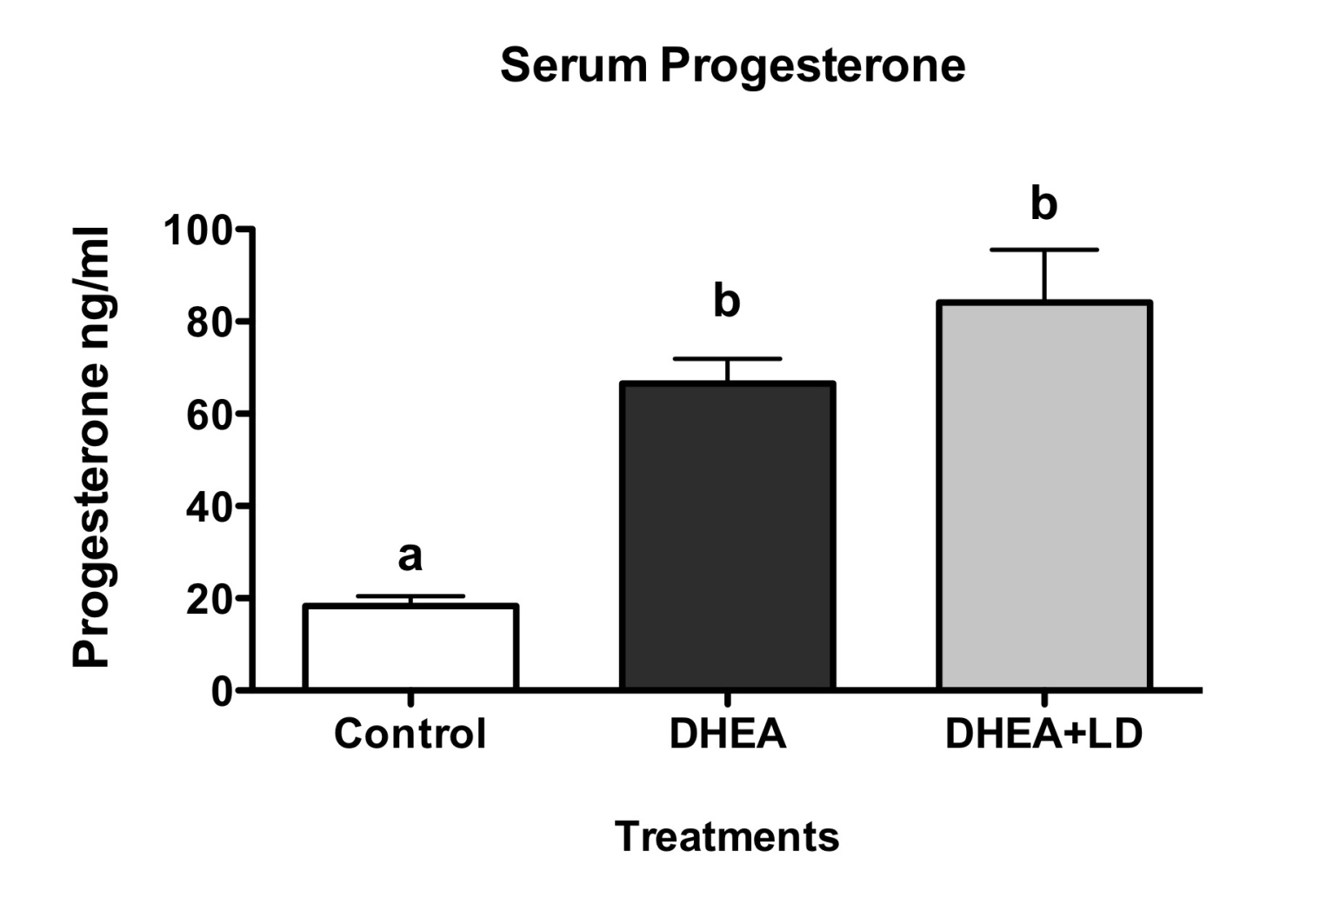
Serum Progesterone
(a, b: p< 0.001)

Slide 111
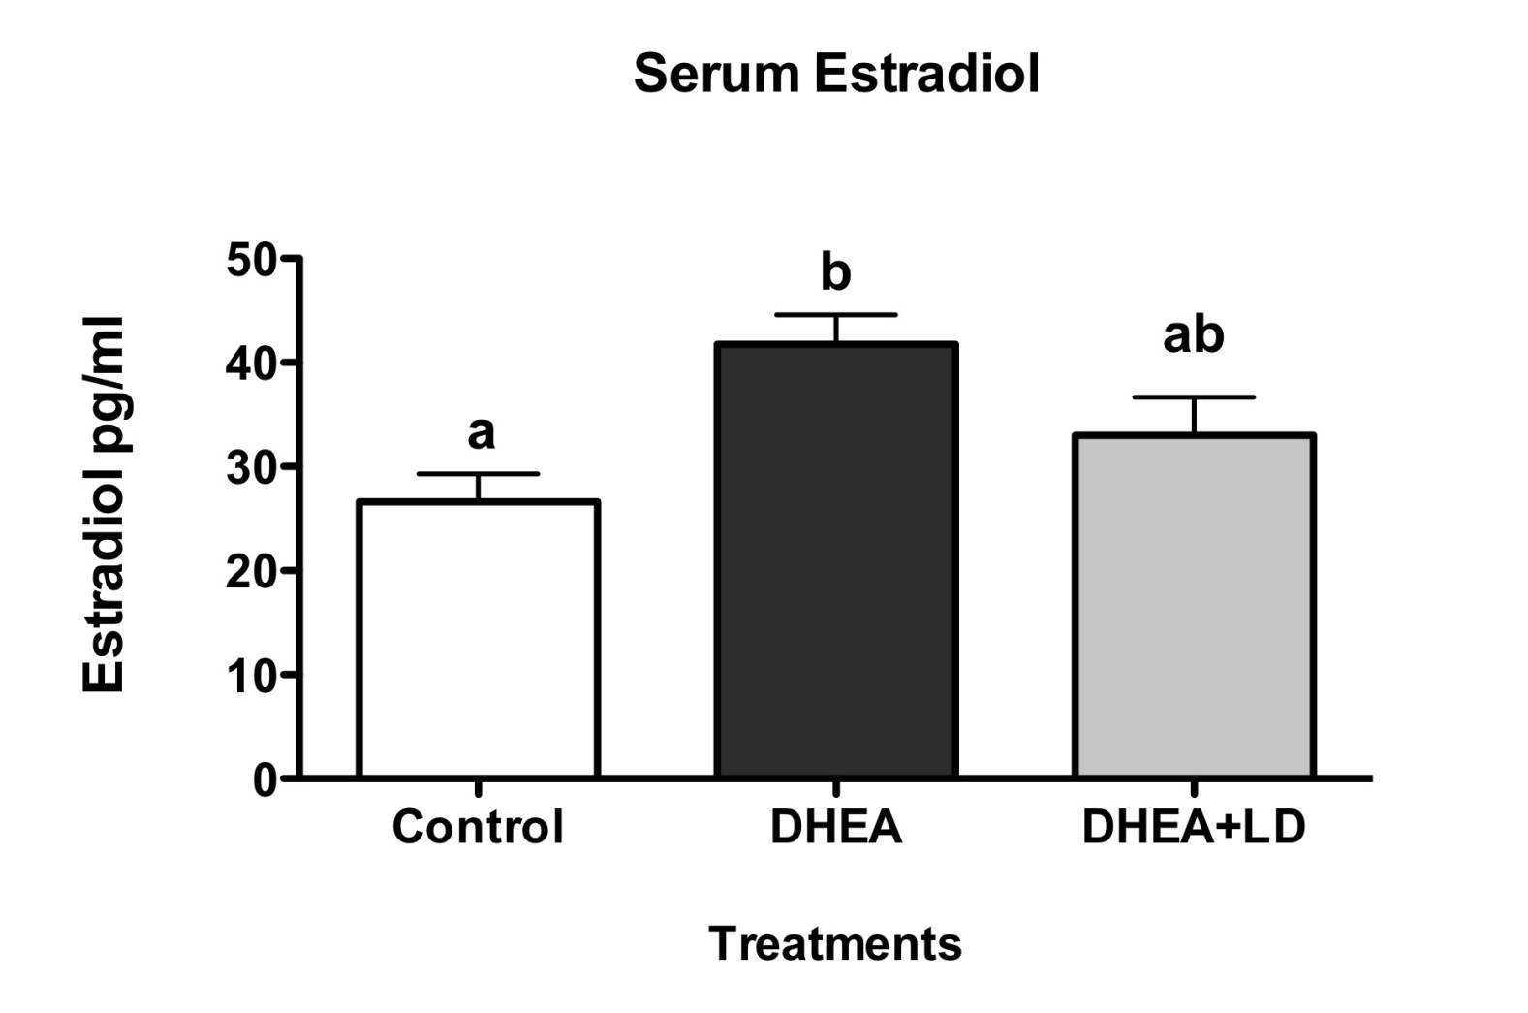
Serum Estradiol
(a, b: p< 0.05)

Slide 112
Clinic use of low dose neuropeptides
They use the physiological low dose of a NEUROPEPTIDE to strenght the biological action of that neuropeptide through the UP-REGULATION of its trans-membrane receptors of the target cells.
Th2
© Dipartimento Scientifico Guna S.p.a.

Slide 113
Neuropeptides of PRM
HyIpothalamus e Hypophysis
Beta-Endorfin
Nucleus of rafe of Bulbo, of Bridge and of Mesencefalo. Stomach and bowel
Serotonin
Pineal Gland
Melatonin
© Dipartimento Scientifico Guna S.p.a.

Slide 114
Clinic use of GROWTH FACTORS
They use the physiological low dose of a GROWTH FACTOR to strenght the biological action of that growth factor through the UP-REGULATION of its trans-membrane receptors of the target cells.
Th2
© Dipartimento Scientifico Guna S.p.a.

Slide 115
GROWTH FACTORS
Some of the most interesting Growth Factors in Neurodegenerative diseases and Anti Aging Therapy:
NT3 4CH
NT4 4CH
BDNF 4CH
CNTF 4CH
Some of the most interesting Growth Factors Aesthetic Medicine:
PDGF 4CH
FGF 4CH
IGF-1 4CH
TGF-beta 4CH
© Dipartimento Scientifico Guna S.p.a.

Slide 116
Journal of Pigmentary Disorders Related Journals
Journal of Clinical & Experimental Dermatology Research
Interdisciplinary Journal of Microinflammation

Slide 117
Primary Health Care: Open Access Related Conferences
5th International Conference on Clinical & Experimental Dermatology
5th International Conference on Clinical & Experimental Ophthalmology

Slide 118
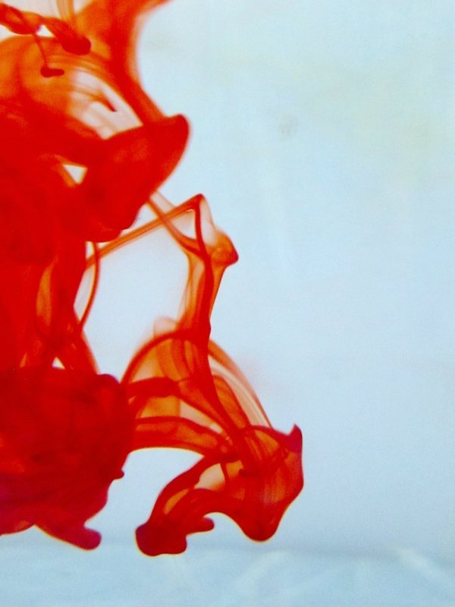
OMICS Group Open Access Membership
OMICS publishing Group Open Access Membership enables academic and research institutions, funders and corporations to actively encourage open access in scholarly communication and the dissemination of research published by their authors.
For more details and benefits, click on the link below:
http://omicsonline.org/membership.php

