Slide 1
OMICS Journals are welcoming Submissions
OMICS International welcomes submissions that are original and technically so as to serve both the developing world and developed countries in the best possible way.
OMICS Journals are poised in excellence by publishing high quality research. OMICS International follows an Editorial Manager® System peer review process and boasts of a strong and active editorial board.
Editors and reviewers are experts in their field and provide anonymous, unbiased and detailed reviews of all submissions.
The journal gives the options of multiple language translations for all the articles and all archived articles are available in HTML, XML, PDF and audio formats. Also, all the published articles are archived in repositories and indexing services like DOAJ, CAS, Google Scholar, Scientific Commons, Index Copernicus, EBSCO, HINARI and GALE.
For more details please visit our website: http://omicsonline.org/Submitmanuscript.php

Slide 2
Punit Kaur, Ph.D.
Assistant Professor
Department of Microbiology, Biochemistry & Immunology
Department of Pathology and Anatomy

Slide 3
Dr Punit Kaur Biography
Dr Kaur obtained a Bachelor of Science (B.Sc.) in 1999 from Government College for Girls, Chandigarh, India majoring Chemistry, Zoology and Botany. Dr Kaur was awarded a M.Sc. degree in Microbiology in 2001 from Guru Nanak Dev University majoring Microbiology, Genetics and Biochemistry. Dr Kaur’s studies demonstrated that the soil samples from various sites in Amritsar, India showed the presence of actinomyctes. Dr Kaur was awarded a Ph.D. degree from Post Graduate Institute of Medical Education and Research (PGIMER), the largest institute for patient care and medical research in Chandigarh, India. During this time, Dr Kaur identified and characterized acid-shock induced outer membrane proteins (ASP) in Enteroaggregative Escherichia coli (EAEC), and elucidated the mechanisms by which these bacteria adapt and grow in the acid shock environment of stomach. Dr Kaur demonstrated for the first time the stress proteome in EAEC and found that these acid-shock proteins show cross reactivity with Heat Shock Proteins (HSP). The putative ASP with cell surface associated with an acid-tolerant phenotype provides new information regarding EAEC pathogenesis in humans.Dr Kaur has published 25 scientific articles, book chapters and reviews. Dr Kaur’s studies have been selected for poster presentations at 30 national and international conferences. More recently, Dr Kaur has been selected as an invited speaker to 6 international and national conferences. Dr Kaur has played major role in the advisory responsibilities in undergraduate (15), international undergraduate (53), graduate (2) postdoctoral (3) and medical residents (1) training, and in teaching at Texas A&M Health Science Center College of Medicine, Scott and White Hospital and Clinic, Temple College, Temple, TX and Morehouse School of Medicine, Atlanta, GA.

Slide 4
Dr Punit Kaur Research Interest
Cancer Research
Hyperthermia
Nanotechnology
Neuroscience
Infectious Diseases
Medicinal Plants
Proteomics

Slide 5
Recent Publications Authored by Dr Punit Kaur
Asea A, Kaur P, Panossian A, Wikman G. Evaluation of molecular chaperones Hsp72 and neuropeptide Y as characteristic markers of adaptogenic activity of plant extracts. Phytomedicine 2013; 3: S0944-7113(13)00245-6. PMID: 23920279.
Kaur P, Nagaraja GM, Zheng H, Gizachew D, Galukande M, Krishnan S, Asea A. A mouse model for triple-negative breast cancer tumor-initiating cells (TNBC-TICs) exhibits similar aggressive phenotype to the human disease. BMC Cancer 2012; 12:120-128. PMID: 22452810.
Panossian A, Wikman G, Kaur P, Asea A. Adaptogens stimulate neuropeptide Y and Hsp72 expression and release in neuroglia cells. Front Neurosci 2012; 6: 1-12. PMID: 22347152.
Nagaraja GM, Kaur P, Neumann W, Asea EE, Bausero MA, Multhoff G, Asea A. Silencing Hsp25/Hsp27 gene expression augments proteasome activity and increases CD8+ T cell-mediated tumor killing and memory responses. Cancer Prev Res (Phila) 2012; 5 (1):122-137 (Figure featured on journal cover). PMID: 22185976.
Kaur P, Hurwitz MD, Krishnan S, Asea A. Combined hyperthermia and radiotherapy for the eradication of cancer. Cancers 2011; 3: 3799-3823. PMID: 24213112.
Kaur P, Asea A. Quantitation methods for heat shock proteins in clinical samples using mass spectrometry. Methods Mol Biol 2011; 787:165-188. PMID: 21898236.
Kaur P, Nagaraja GM, Asea A. Combined lentiviral and RNAi technologies for the delivery and permanent silencing of the hsp25 gene. Methods Mol Biol 2011; 787:121-136. PMID: 21898232.

Slide 6
A Mouse Model for Triple-Negative Breast Cancer Stem Cells (TNBC-CSC) Exhibits an Aggressive Phenotype
Editorial Board Member Journal of Proteomics and Bioinformatics
Punit Kaur, Ph.D.
Assistant Professor
Department of Microbiology, Biochemistry & Immunology
Department of Pathology and Anatomy

Slide 7
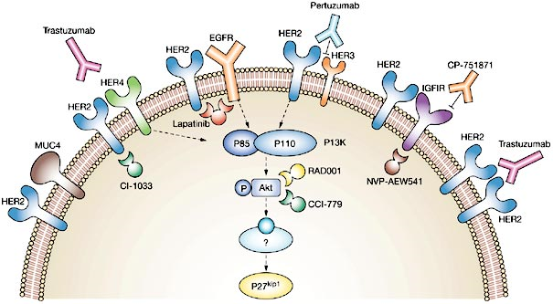
Triple-Negative Breast Cancer (TNBC)
Recent studies on surface receptors and gene expression of breast tumors have come up with a term triple-negative breast cancer (TNBC).
The disease gets its name because of testing negative for:
Estrogen Receptor (ER)
Progesterone Receptor (PgR)
Human Epidermal Growth Factor Receptor 2 (HER2) gene

Slide 8
Triple-Negative Breast Cancer (TNBC)
Despite lower incidence and the steady improvement in screening, African-American and Hispanic women are more likely to die of triple-negative breast cancer than Caucasian women.

Slide 9
Triple-Negative Breast Cancer (TNBC)
TN-BC (HER2⁻/ER⁻/PgR⁻) - Creates a disease quite distinct from that seen in Caucasian women (HER2⁺/ER⁺/PgR⁺), and is a much more aggressive disease without tumor-specific treatment options and accounts for 15% of all types of breast cancer with higher percentages in premenopausal African American and Hispanic women.
Although slightly responsive to chemotherapy, TNBC is more difficult to treat and generally insensitive to most available hormonal or targeted therapeutic agents.
Depending on its stage of diagnosis, TNBC can be extremely aggressive - recurring and metastasizing more often than other subtypes of breast cancer.

Slide 10
Research Plan
Elevated heat shock protein (HSP) levels have been found in various tumors including breast, prostate, pancreatic, gastric, uterine, ovarian, head and neck cancer and also cancers arising from the nervous system and urinary system.
High expression of Hsp27 and Hsp72 is one of the reasons for TNBC aggressiveness.
This area of research has direct implications for clinical and patient care because understanding fundamental mechanisms by which combined HT and RT induces the killing of TNBC can be directly implemented for the treatment of patients with TNBC.
My goal is to understand the molecular mechanisms by which combined hyperthermia (HT) and radiotherapy (RT) induces the killing of TNBC cells.

Slide 11
In vivo TNBC Tumor Model
Murine breast carcinoma 4T1 cells are a 6-thioguanine-resistant cell line selected from 410.4 tumor without mutagen treatment. When injected into the abdominal breast gland of female BALB/c mice (8–12 weeks old), 4T1 spontaneously produce highly metastatic tumors that can metastasize to the lung, liver, lymph nodes and brain while the primary tumor is growing in situ. The primary tumor does not have to be removed to induce metastatic growth. The tumor growth and metastatic spread of 4T1 cells in BALB/c mice very closely mimic human Stage IV breast cancer.
Notes:
11

Slide 12
Transfection of Rat HER2, ER and PgR Genes to Produce TNBC Population
Kaur et al., BMC Cancer, 2012

Slide 13
Selection of TNBC-Tumor Initiating Cells (TNBC-TICs)
Kaur et al., BMC Cancer, 2012

Slide 14
Higher Tumor Growth Potential in TNBC-TICs
Kaur et al., BMC Cancer, 2012

Slide 15
Confidence Interval (95%) for Re-populating Mammary Cell Frequency
Kaur et al., BMC Cancer, 2012

Slide 16
Fast Cell Proliferation in TNBC-TICs
Kaur et al., BMC Cancer, 2012

Slide 17
Larger Tumor Growth in TNBC-TICs
Kaur et al., BMC Cancer, 2012

Slide 18
Production of More Metastatic Foci in TNBC-TICs
Kaur et al., BMC Cancer, 2012

Slide 19
Higher Expression of Hsp25 and Hsp72/HspA1A in TNBC-TICs
Kaur et al., BMC Cancer, 2012

Slide 20
Summary
We have produced a TNBC model that can be used to study why human TNBC is so aggressive and will help in design of new targets to treat TNBC.
TNBC-TICs have:
CD24⁺/ALDH1⁺/CD44^{high}
High proliferation rate
High tumor growth rate
High metastatic potential
Higher expression of Hsp25
Higher expression of Hsp72
Kaur et al., BMC Cancer, 2012

Slide 21
Proteomics in Biomarker Discovery
Proteome is a complete complement of proteins that make up a cell or tissue:
Study of protein expression, regulation, modification and function in living systems for understanding how living systems use proteins
Using a variety of techniques, proteomics can be used to study how proteins interact within a system or how proteins change due to applied stresses
Proteomics requires the use of advanced measurement techniques with an emphasis on separations and mass spectrometry
Mass spectrometry measures the mass of molecules by determining the mass to charge ratios (m/z)

Slide 22
Obesity and Diabetes
Obesity is a complex disease and is a known risk factor for a variety of chronic diseases including:
Hypertension
Coronary Heart Disease
Type 2 Diabetes
Over the past decade obesity has become a major public health problem in most industrialized nations and the costs associated with the management of obesity and obesity-related diseases account for about 5% of total healthcare expenditures in most industrialized nations.
Body mass index (BMI) has been demonstrated to correlate well with fat mass, morbidity and mortality, and effects obesity-related disease risk.
Obese individuals have a greater than 10-fold increased risk of developing type 2 diabetes as compared to normal weight individuals.

Slide 23
Removal of High Abundant Proteins from Blood
9.91%
1%
Concentration range of proteins: 1 to 10¹²
Notes:
23

Slide 24
Depletion of High Abundant Proteins
M
Crude
Eluted
Flow through
Immunodepletion of plasma sample with affinity binding to column
Kaur et al., J Prot Bioinform, 2010

Slide 25
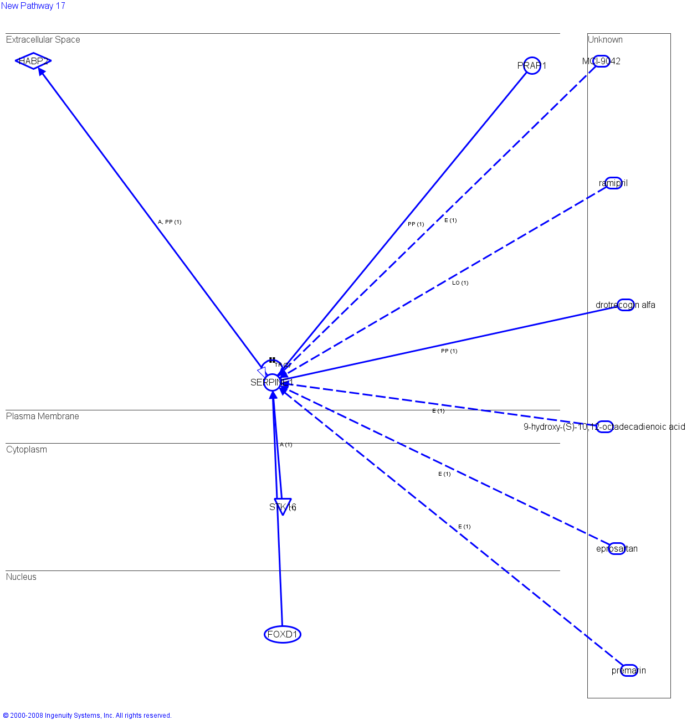
Canonical Pathways for Obesity
FOXD1, a transcription regulator, found in the cell nucleus directly acts on SERPINE1, which then activates the peptidase HABP2 and translocate to the kinase STK16.
Drugs used for obesity including drotrecogin alfa was shown to directly bind to SERPINE1, whereas 9-hydroxy-(S)-10, 12-octadecadiencic acid indirectly acts on SERPINE1. Eprosartan drug used in both obesity and hypertension, were shown to indirectly act on SERPINE1.
PRPA1, a protein known to play an important role in cancer was also shown to directly act on SERPINE1.
Kaur et al., J Prot Bioinform, 2010

Slide 26
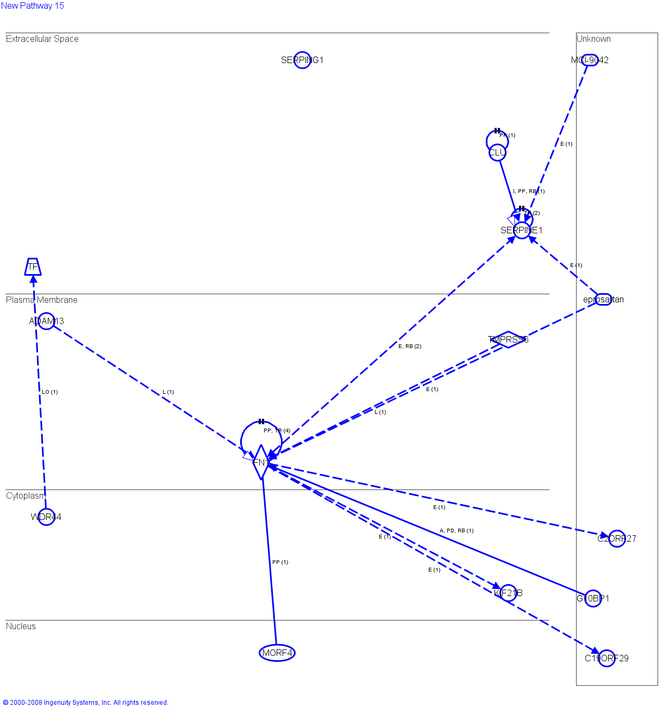
Canonical Pathways for Diabetes
Protein CLL found in the extracellular space directly acts on SERPINE1.
SERPINE1 in turn indirectly acts on the enzyme FN1, found in the plasma membrane, which is binds to the transcription regulators MORF4.
The diabetic drugs MCL-9042 and eprostartan indirectly act on SERPINE1.
Kaur et al., J Prot Bioinform, 2010

Slide 27
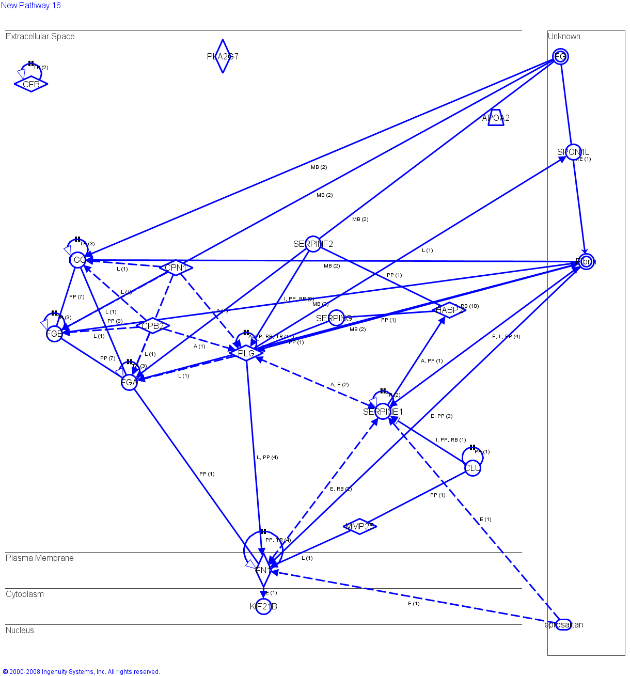
Canonical Pathways for Cardiovascular Diseases
The enzyme, FN1, and the peptidase, PLG, both known to play an important role in cardiovascular disease indirectly act on SERPINE1.
Fibrin was found to directly act on SERPINE1.
Epipsartan, was also shown to indirectly act on SERPINE1 in the cardiovascular disease pathway.
CLL inhibits and acts on SERPINE1.
Peptidases CPB2 and CPN1 were shown to indirectly act on SERPINE1 through PLG.
Kaur et al., J Prot Bioinform, 2010

Slide 28
Venn Diagram for Protein Expression in Obesity and Diabetics
Kaur et al., J Prot Bioinform, 2010
Kaur et al., J Prot Bioinform, 2010

Slide 29
Summary
Our data demonstrates a first step in understanding a link between diabetes and obesity.
Our ultimate goal of using mass spectrometry was to perform rapid screening of a large number of clinical samples, to identify the proteins that change in their relative abundance due to a particular disease for early detection.
This study is a proof-of-concept of protein profiling to investigate the usefulness of the immunodepletion approach for the clinical proteomics.
This study with small sample set is not statistically significant it is a step ahead to explore the some candidate protein profiles associated with significant changes in blood plasma proteins of obese and diabetic patients.

Slide 30
Acknowledgements
Kaur Lab
Princess Bempong
John Mark Carruth
Ian Collier
Shahrum Lillard
Michael McNamara
Viraj Mehta
Lei Shi
Scott & White Hospital

Slide 31
Journal of Proteomics & Bioinformatics Related Journals
Transcriptomics: Open Access
Journal of Pharmacogenomics & Pharmacoproteomics
Journal of Data Mining in Genomics & Proteomics

Slide 32
For more details on Conferences Related
Journal of Proteomics & Bioinformatics please visit:
http://www.conferenceseries.com/biochemistry-meetings

Slide 33
Open Access Membership with OMICS International enables academicians, research institutions, funders and corporations to actively encourage open access in scholarly communication and the dissemination of research published by their authors.
For more details and benefits, click on the link below:
http://omicsonline.org/membership.php

