Slide 3
BROADLY REACTIVE PAN-VIRAL PCR OF CEREBROSPINAL FLUID IN CANINE MENINGOENCEPHALITIS OF UNKNOWN ETIOLOGY

Slide 4
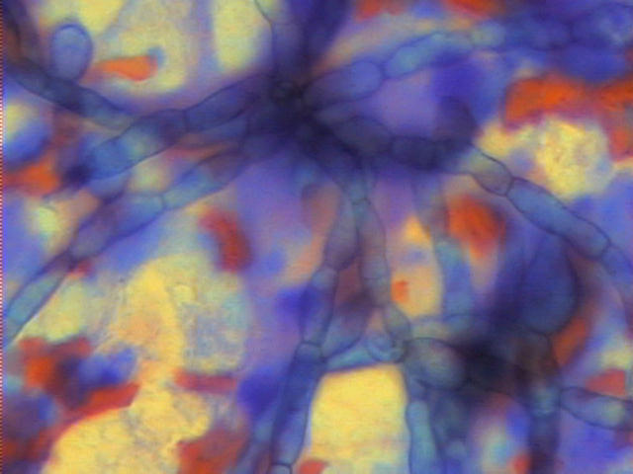
The canine meningoencephalitides of unknown etiology (MUE)
GME,NME,NLE
Histopathologic lesions are similar to those present in human viral meningoencephalitis
PCR method has demonstrated that 50-70% of human meningoencephalitides are caused by CNS viral infections.

Slide 5
We hypothesize that a subset of canine MUE results from aberrant immune responses following infection of the CNS. Objective :
Objective : To determine whether or not nucleic acids from infectious agents can be identified in cerebrospinal fluid (CSF) by applying degenerate viral PCR to 146 CSF samples, collected pre- and/or postmortem from dogs with MUE and control dog.

Slide 6
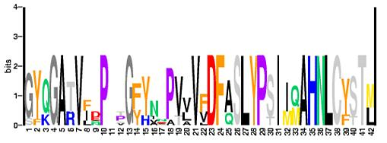
Consensus Degenerate Primers (CODEHOP)
Motif:
S I I Q A H N L C
A
C
C
C
C
CODEHOP:
5’TCC ATC ATC CAG GCC
CA
AA
T
TG
T
T
T
G
T
5’ Consensus Clamp
3’ Degenerate Core
Rose et al., 1998, Nucl Acids Res 26:1628

Slide 7
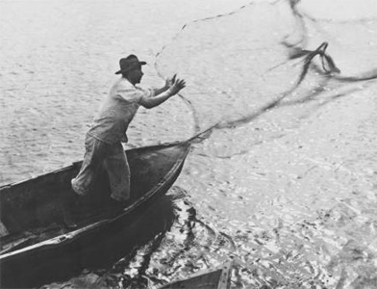
Viral Families: Herpesviridae,
Adenoviridae, Alphaviridae, Picornaviridae, Paramyxoviridae, Polyomaviridae, Flaviviridae, Bunyaviridae, Bornaviridae, Rhabdoviridae, Coronaviridae

Slide 8
Pan-Viral PCR Positive Controls

Slide 9
Methods
DNA and RNA extracted from 146 CSF samples and non-neurological controls by standard methods (Qiagen and Invitrogen)
Housekeeping PCR and RT PCR for GAPDH (DNA) and beta-actin to confirm DNA and RNA integrity
PCR and RT PCR on ~ 5 µl of each sample in 20 various CODEHOP reactions

Slide 10
Broadly reactive pan-viral PCR on MUE CSF (146 cases)
Coronavirus
Bornavirus
Rhabdovirus
Alphavirus
Herpesvirus
Flavivirus

Slide 11
Pan-bunyavirus PCR – LaCrosse virus
Breed | Sex | Color | Weight | CSF | MRI | Diagnosis
Shih Tzu | M/N | Wh/Tan | 7.4kg | RBC=1963 WBC=12 TP=23.8 Mixed pleocytosis | normal brain | MUE (brain)
Boxer | M | Fawn | 37kg | RBC=87 WBC=9 TP=17.0 Macro56%,Neut18%, Lymph16%, Eos10% | T2W hyperintensity cingulate gyrus | brain tumor +/-meningitis
Pug | F/S | Black | 8.25kg | RBC=0 WBC=3 TP=38.7 | T2W IM hyperintensity thoracic cord | MUE (T/L)
Weimaraner | F/S | Gray | 25.8kg | RBC=38 WBC=26 TP=96.1 Lymph85%, Macro13%, neut2% | N/D | MUE (brain)
Boston Terrier | M | Blk/Wh | 9.3kg | RBC 69 WBC 20 TP 16.5; 2%% nondeg neut 19% lg mono 79% sm lymphs | normal brain | MUE (brain)
Chihuahua | F/S | Wh | 3.8kg | WBC 1 TP 19.5 ;1% nondeg neut 26% lg mono 73% sm lymphs | T2W multifocal hyperintense lesions throughout brain | MUE (brain)
CSF from 6/60 (10%) MUE cases positive on pan-bunyavirus PCR
Sequences analysis disclosed 99% homology to LAC
Black et al. J Vet Diagn Invest. 1994 Apr;6(2):250-4.
Specific LAC PCR underway
Developing an Ab to LaCrosse to perform serology on CSF and serum in dog
Bunyavirus

Slide 12
Pan-polyomavirus PCR – Merkel Cell Polyomavirus
CSF from 3/60 (5%) MUE cases positive on pan-polyomavirus PCR
Sequencing (320 bp) shows 98% homology to Merkel Cell Polyomavirus (MCV)
Feng et al. Science. 2008 Feb 22;319(5866): 1096-100.
IHC on one case negative with human MCV Ab
Specific MCV PCR underway
CSF antigen testing
Labrador Retriever | F/I | Chocolate | 26 kg | RBC=1263 WBC=11 TP=19 16% Lymphs 10%Monos 73%Neuts 1%Eos | Normal cervical spine. | MUE (cervical)
Border Collie | M/N | Blk/Wht | 18.2 kg | RBC = 30, WBC = 139 TP 28 mixed pleocytosis | Hydrocephalus and syringohydromyelia | MUE
Great Dane | M/N |  |  | RBC 4 WBC 53 TP 56 17% monos 52% eos 31% lymphs | Syringohydromyelia | MUE

