Slide 1
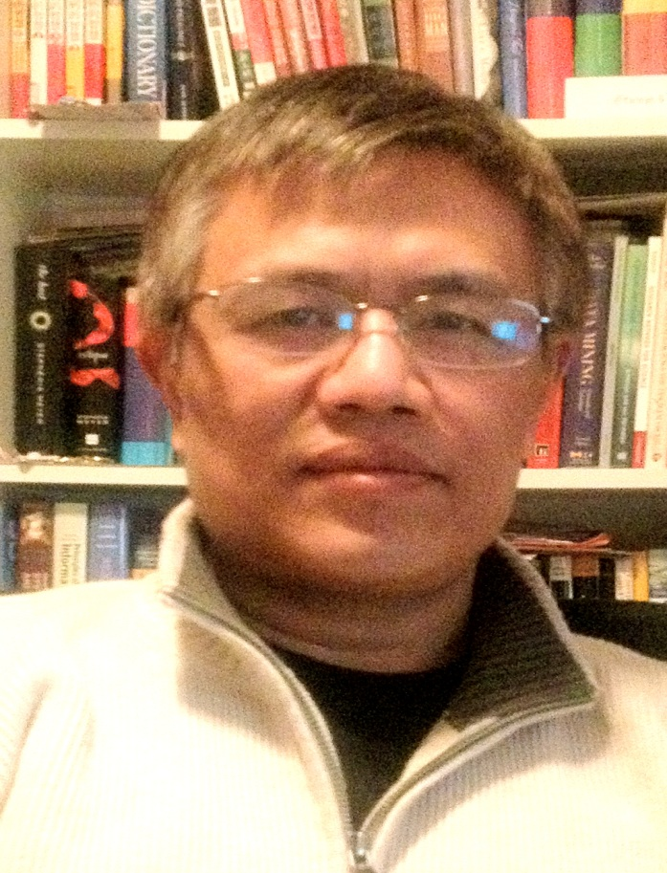
International Journal of Sensor Networks and Data Communications
Dr. Qing Tan
Associate professor
Athabasca University
Canada

Slide 2
International Journal of Sensor Networks and Data Communications
Brief biography:
Dr. Qing Tan is an associate professor in School of Computing and Information Systems at Athabasca University.
He earned his PhD in Cybernetics Engineering for Robotics from the Norwegian Institute of Technology in 1993.
The Japan Atomic Energy Research Institute invited him in 1994 as a foreign senior research fellow.
He joined Athabasca University in 2007 with extensive IT industrial experience.
Dr. Tan is teaching and developing undergraduate and graduate courses including Mobile Computing, Computer Networking, E-Commerce, Enterprise Modeling, and Cloud Computing.

Slide 3
International Journal of Sensor Networks and Data Communications
RESEARCH INTERESTS :
Location-Based Technologies
Mobile Computing
Adaptive Mobile Learning and Commerce
Wireless Sensor Networks
Computer Network and Cyber Security
Cloud Computing
Telepresence Robotics

Slide 4
Achievements :
Dr. Tan was one of the first people to introduce the location awareness of mobile devices into mobile learning applications.
He has developed a research framework for his location-based mobile learning research. Dr. Tan has additionally proposed a 5R adaptation framework for mobile learning system.
While Dr. Tan’s research studies the theoretic and academic problems, he also strives to solve the application issues. He is working on building a telepresence robot for remote labs at Athabasca University to allow online students to conduct lab work via the Internet.
He also collaborates on the development of a mobile fieldtrip system to assist online students with their fieldwork.
Overall, Dr. Tan’s pioneering research is greatly impacting distance education and learning. Dr. Tan received many research grants and published many papers on International journals and conferences.

Slide 5
Sensor Networks and Data Communications Related Journals
Information Management & Computer Security
Computers & Security
Industrial Management and Data Systems
International Journal of Medical Informatics
Online Information Review
International Journal of Sensor Networks
Computer Networks
Computer Communications
International Journal of Computer Networks & Communications

Slide 6
Sensor Networks and Data Communications Related Conferences
Global Summit on Electronics and Electrical Engineering, November 03-05, 2015 Valencia, Spain
4th International Conference and Exhibition on Biometrics & Biostatistics, November 16-18, 2015 San Antonio, USA
2ndInternational Conference on Big Data Analysis and Data Mining, November 30-December 02, 2015 San Antonio, USA
2nd International Conference and Business Expo on Wireless & Telecommunication April 21-22, 2016 Dubai, UAE

Slide 7
OMICS International Open Access Membership
OMICS International Open Access Membership enables academic and research institutions, funders and corporations to actively encourage open access in scholarly communication and the dissemination of research published by their authors.
For more details and benefits, click on the link below:
http://omicsonline.org/membership.php

