Slide 1
CURRENT RESEARCH ON CARDIO VASCULAR AUTONOMIC FUNCTION TEST
ISSN: 2155-9538
Journal of Bioengineering and Biomedical Sciences
DR.M.RAJAJEYAKUMAR.MBBS,MD(JIPMER),MSc(YOGA),CCEBDM (PHFI) PhD̅
ASSISTANT PROFESSOR,
DEPARTMENT OF PHYSIOLOGY,
CHENNAI MEDICAL COLLEGE HOSPITAL & RESEARCH CENTRE(SRM GROUP),
TRICHY-621105,
TAMILNADU, INDIA.
.

Slide 2
Introduction
Simple bedside tests of cardiovascular autonomic function (Ewing’s tests) have been developed for clinical evaluation of patients suspected to have generalized autonomic dysfunction.
ANS
PSNS SNS

Slide 3
Indications for AFT
Primary autonomic failure
Secondary autonomic failure
1.DM
2.HT
3.Alcoholism
4.Others

Slide 4
Who is Recommending ANS Testing?
ANS Monitoring
Recommended By:
American
Heart
Association
American
Academy of
Neurology
American
Diabetes
Association
American
Academy of
Family
Physicians
Juvenile Diabetes
Association
National Heart,
Lung, and
Blood Institute
National Diabetes,
Digestive, and
Kidney Disease
National Institute
Of Health

Slide 5
AFT- LAB (Physiology, JIPMER)

Slide 6
Procedure
The tests were carried out in the Polygraph laboratory of the Department of Physiology between 9.30 am and 12.30 pm, 1-3 hr after a light breakfast.
The laboratory environment was quiet, the temperature between 30 – 35 degrees Celsius and the lighting subdued.
Subjects were asked to empty their bladder before the tests. The tests did not involve intravascular instrumentation or administration of drugs at any stage.

Slide 7
Cardiovascular autonomic function tests
After 10 minutes adaptation in the laboratory,BP was measured in the lying position using a mercury sphygmomanometer.
For a detailed account of the methods of autonomic testing, given in consult Mathias CJ and Bannister R (1992).
During each of the following tests, a bipolar chest lead ECG was recorded continuously and BP was measured using a noninvasive automated BP monitor.

Slide 8
Cardiovascular autonomic function tests
The following tests were then performed in the order mentioned below.
1. Baseline BP, HR and HRV in the supine position. (SVB)
2. BP, HR and HRV during standing. (BOTH)
3. Heart rate variation during deep breathing. (PS)
4. BP, HR during sustained isometric handgrip.(SYM)
BP, HR during immersion of right hand in cold water.(SYM)
HR, BP response to Valsalva maneuver.(BOTH)

Slide 9
Cardiovascular autonomic function tests
Baseline BP, HR and HRV: ECG was recorded for at least 330 seconds to determine resting heart rate variability. Baseline BP was recorded in the left arm after 10 minutes of rest in the supine position.
HR > 100, BP- >140/90 is abnormal.
2. BP, HR and HRV response to standing: The subject was asked to stand for at least 330 seconds. BP and HR were recorded immediately, 2 minutes and 5 minutes after the standing position.

Slide 10
Cardiac Autonomic Neuropathy
Response to standing
Autonomic Reflex Arc
Blood Pressure Immediate standing Abnormal
Orthostatic hypotension: Fall in BP ≥ 20/10
Heart rate : normally increases 10-20 beats.
Heart Rate Record ECG
30 s : 15 s ( RR ) < 1.04
This ratio decreases with age.

Slide 11
Cardiovascular autonomic function tests
3. Heart rate variation during deep breathing: With the subject lying down comfortably on a couch, we instructed him to breathe slowly and deeply (following my count – “Breathe in, 1 – 2 – 3 – 4 – 5, breathe out, – 1 – 2 –3 – 4 – 5 and so on) at about six breaths per minute, 5 seconds each for inspiration and expiration.
RSA:
The maximum of six HR differences (maximum HR minus minimum HR during a deep breathing cycle) was taken as the deep breathing difference.

Slide 12
Deep breathing test

Slide 13
Deep breathing test(DBD)

Slide 14
Deep breathing test(DBD)

Slide 15
Cardiac Autonomic Neuropathy
RR - Variation during deep breathing
Parasympathetic Influence on heart
Maximum- Minimum heart rate < 10 beats /min (Abnormal)
Ratio of longest RR interval ( Expiration ) : Shortest
RR interval ( Inspiration ) { E:I} > 1.17 (Abnormal)

Slide 16
Cardiovascular autonomic function tests
5. BP and HR changes during sustained isometric handgrip:
we asked the subject to maintain 30% of maximum voluntary contraction (MVC) for at least 60 seconds.
BP was monitored in the non-exercising arm after 1 minute of sustained handgrip. After that we asked the subject to discontinue the exercise and recorded BP at once.
Normal response increase DBP > 15mm of Hg and HR (30%).

Slide 17
HANDGRIPDYNAMOMETER

Slide 18
Cardiovascular autonomic function tests
4. BP and HR changes during immersion of right hand in cold water:
The cold pressor test was performed by having the comfortably seated subject immerse his right hand in cold water at 4 degrees Celsius and then measuring BP after 1 minute of immersion and immediately after taking the hand out of the water.
Response is increased BP >20/10 for normal subjects.
This test is not consistent in all subjects.

Slide 19
Cardiovascular autonomic function tests
6.HR, BP response to Valsalva maneuver:
Forced expiration against open glottis.
Exhale forcefully in to the manometer with close the nostrils with nose clips and maintain the pressure at 40mm of Hg for 10 to 15 sec.
Record the ECG 30 sec before and after the procedure.

Slide 20
Cardiac Autonomic Neuropathy
Phase I Rise in BP, ↓ HR.
Phase II ↓ in BP ; Tachycardia.(Shortest RR)
Phase III Fall in BP
Phase IV Overshoot of BP; Bradycardia.(longest RR)
Valsalva Ratio Longest RR : Shortest RR
< 1.2.
In normal persons as age increases the VR ratio will decrease.
TR= Shortest RR interval during the procedure: Shortest RR interval before the maneuver.
BR = Longest RR interval during the procedure: longest RR interval before the maneuver.

Slide 21
Heart rate variability analysis
Heart rate variability has come to be widely used as a noninvasive tool to assess autonomic function in a variety of physiologic as well as disease states.
A detailed account of techniques of heart rate variability analysis is mentioned in the Task force report of the European Society of Cardiology, 1996.

Slide 22
Techniques of heart rate variability analysis:
Briefly, ECG was acquired at a rate of 1000 samples per second using the BIOPAC MP 100 system (BIOPAC Inc., USA) and the BIOPAC AcqKnowledge software 3.7.1 (BIOPAC Inc., USA) for at least 330 seconds during supine rest.
To check the ECG for artifacts and ectopic then edited them out and joined the preceding and successive noise-free segments by linear interpolation with NN intervals (i.e. normal-to-normal RR intervals).

Slide 23
Techniques of heart rate variability analysis
The edited ECG was processed using an R-wave detector to obtain an RR interval tachogram.
Heart rate variability analysis by time- and frequency-domain methods was done using the AcqKnowledge 3.7.1 software (BIOPAC Inc., USA).

Slide 24
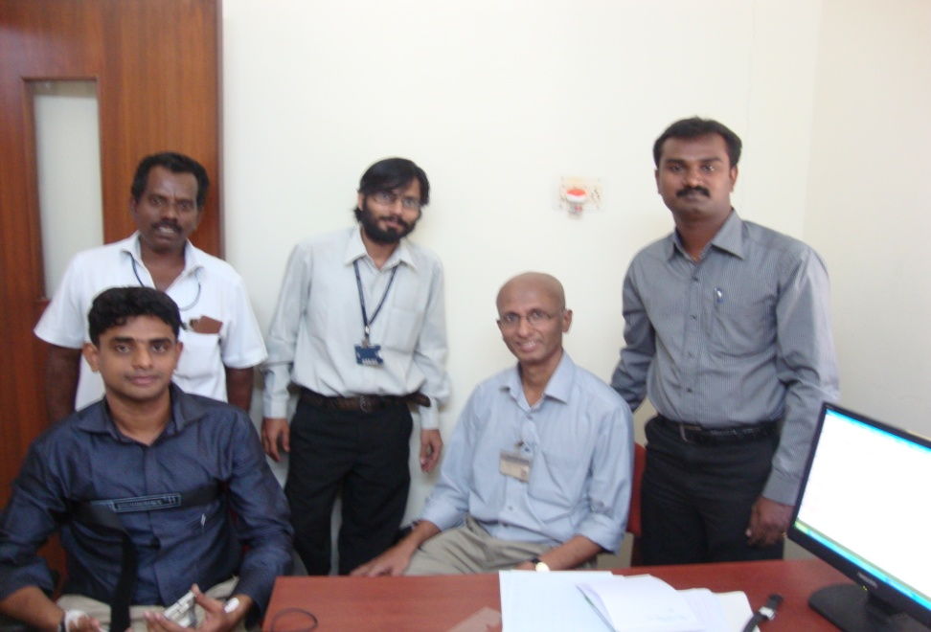
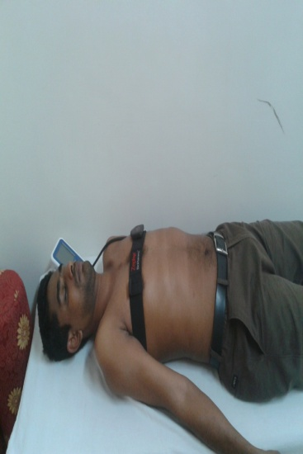
CMC - VELLORE

Slide 25
Techniques of heart rate variability analysis

Slide 26
Frequency -domain analysis

Slide 29
References
1. Berntson GG, Bigger JT, Eckberg DL, Grossman P, Kaufmann PG, Malik M, Nagaraja HN, Porges SW, Saul JP, Stone PH, van der Molen MW (1997) Heart rate variability: origins, methods, and interpretive caveats.B Psychophysiology 34: 623-648.
2. Ewing DJ (1992) Analysis of heart rate variability and other non-invasive tests with special reference to diabetic mellitus. In: Bannister R, Mathias CJ, (eds) Autonomic failure. A textbook of clinical disorders of the autonomic nervous system. 3rd edition. Oxford University Press, NY, p 312-333.
3. Task Force. Heart rate variability: Standards of measurement, physiological interpretation and clinical use. Task Force of the European Society of Cardiology and the North American Society of Pacing and Electrophysiology. Circulation 1996; 93:1043–1065.

Slide 30
OMICS Group
OMICS Group International through its Open Access Initiative is committed to make genuine and reliable contributions to the scientific community. OMICS Group hosts over 400 leading-edge peer reviewed Open Access Journals and organizes over 300 International Conferences annually all over the world. OMICS Publishing Group journals have over 3 million readers and the fame and success of the same can be attributed to the strong editorial board which contains over 30000 eminent personalities that ensure a rapid, quality and quick review process. OMICS Group signed an agreement with more than 1000 International Societies to make healthcare information Open Access.
Contact us at: contact.omics@omicsonline.org

Slide 31
OMICS Group Open Access Membership
OMICS publishing Group Open Access Membership enables academic and research institutions, funders and corporations to actively encourage open access in scholarly communication and the dissemination of research published by their authors.
For more details and benefits, click on the link below:
http://omicsonline.org/membership.php

