Slide 1
Biodiversity, Bioprospecting, Development: Areas of Interest Robert E. Baier, Ph.D., P.E. Biomaterials Graduate Program and Industry/University Center for Biosurfaces, University at Buffalo

Slide 2
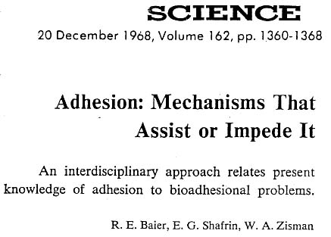

Slide 6
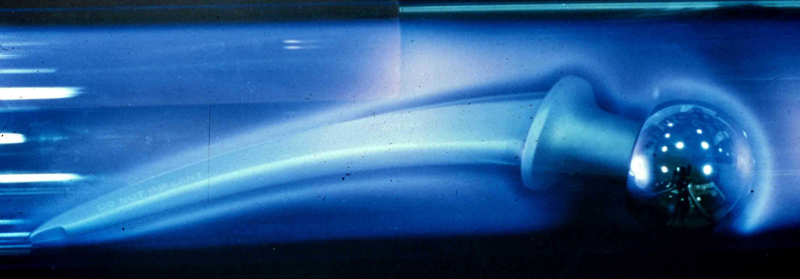

Slide 7
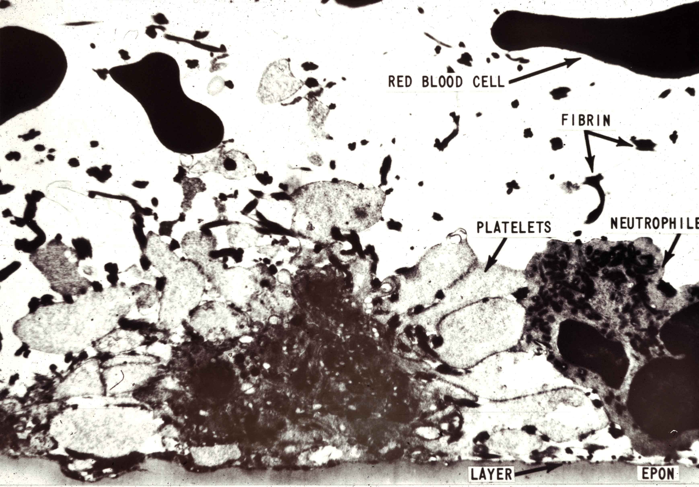

Slide 8
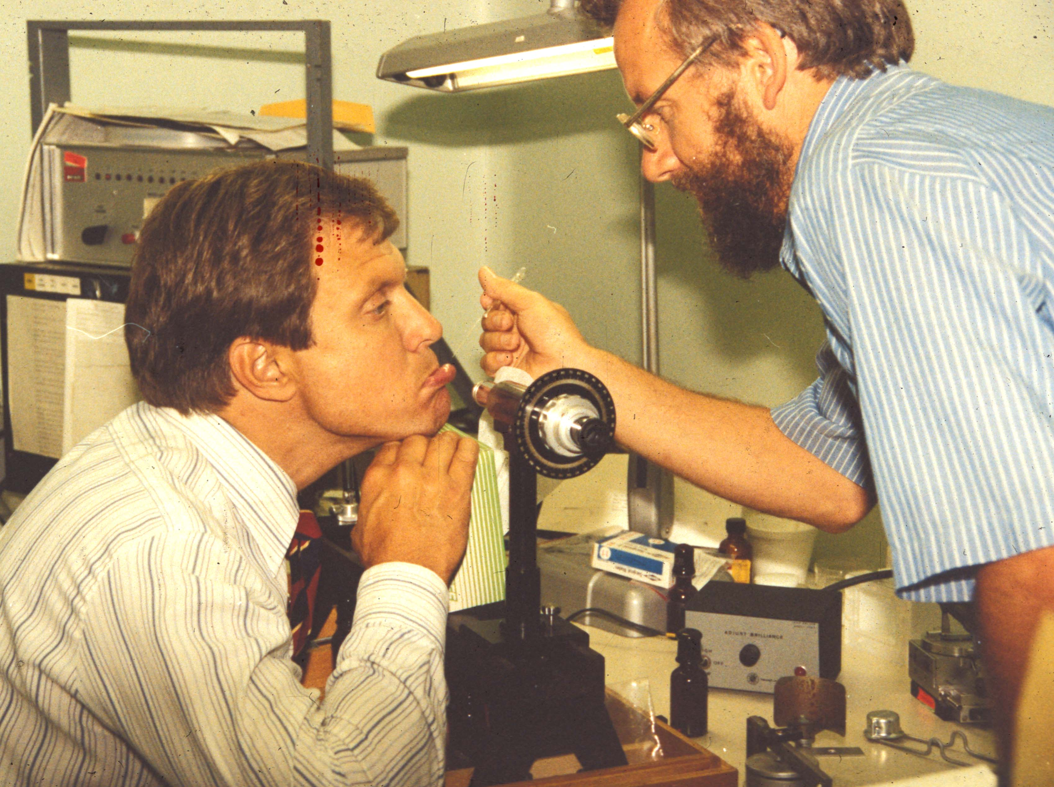

Slide 17
Test samples after 1 month in Atlantic Ocean

Slide 19
Test samples after 1 month in Pearl Harbor, HI
Hydroides elegans
[tubeworms]

Slide 20
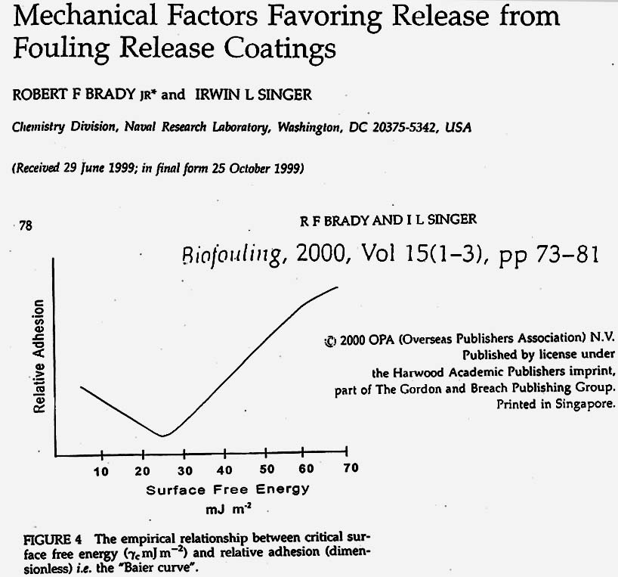

Slide 21
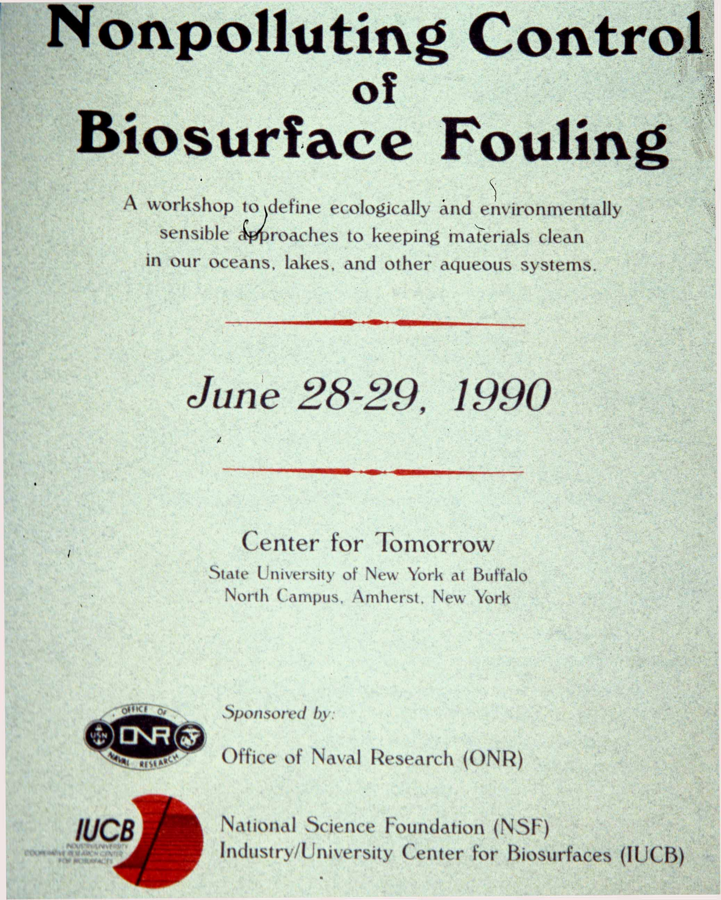

Slide 22
Test panels at Dunkirk, NY (zebra mussel fouling)

Slide 23
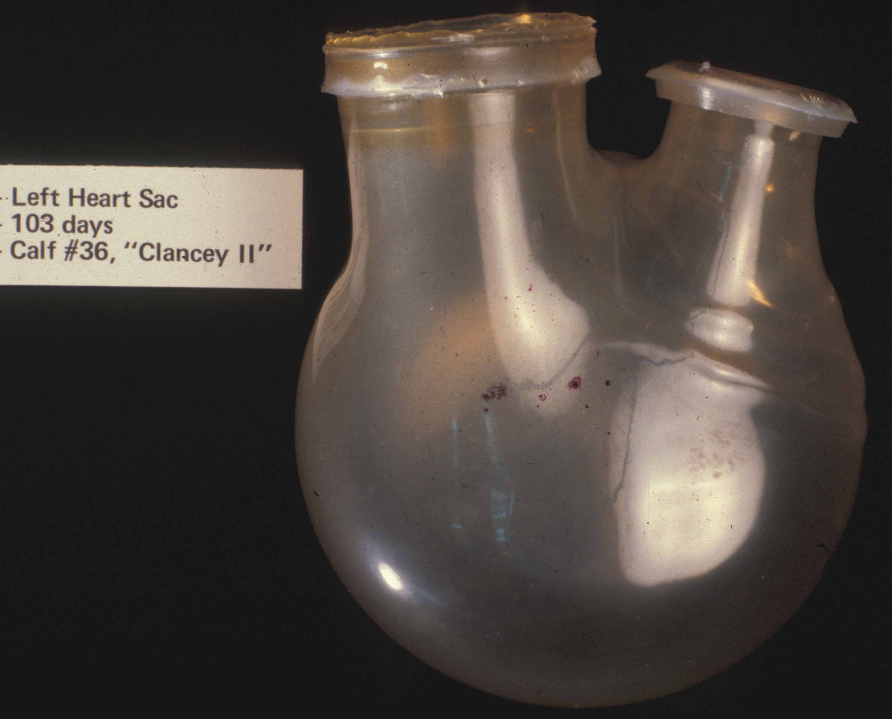

Slide 24
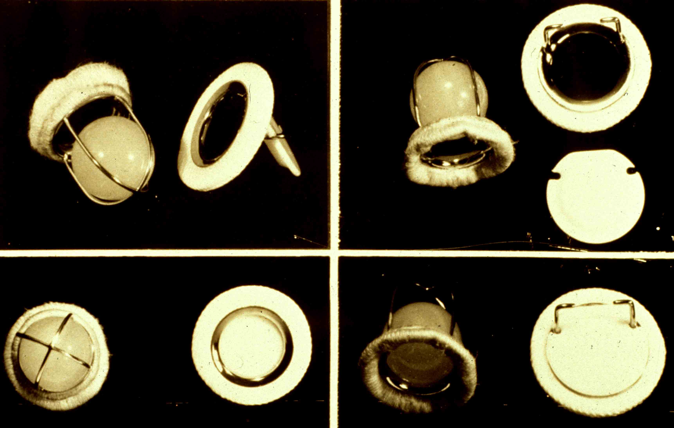

Slide 25
Methyl silicone
Polydimethylsiloxane

Slide 28
Biodiversity, Bioprospecting and Development Related Journals
Journal of Bioprocessing & Biotechniques
Journal of Bioremediation & Biodegradation
Journal of Bioequivalence & Bioavailability
Journal of Biodiversity & Endangered Species

Slide 29
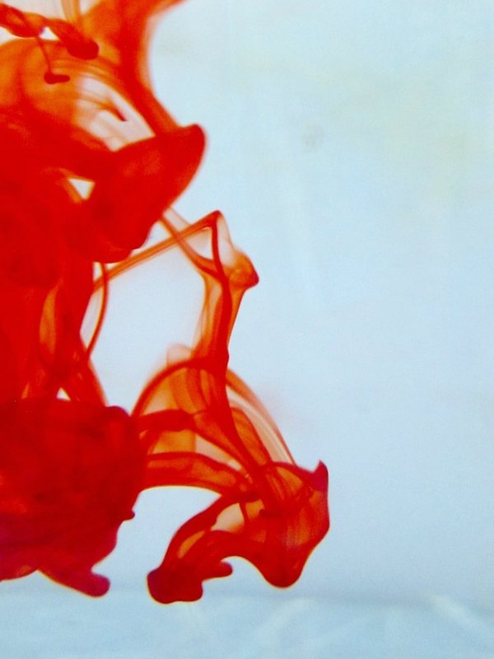
OMICS Group Open Access Membership
OMICS International Membership enables academic and research institutions, funders and corporations to actively encourage open access in scholarly communication and the dissemination of research published by their authors.
For more details and benefits, click on the link below:
http://omicsonline.org/membership.php

