Slide 1
Roshan T. Ramessur, B.SC,M.SC,Ph.D
Editor of
Journal of Coastal Zone Management

Slide 2
Biography
Dr. Roshan T. Ramessur did his B.Sc (Hons) in Marine Biology- Chemistry from University of Wales (1988) and M.Sc in Marine Environmental Protection from University of Wales (1991). He successfully his Ph.D. from University of Mauritius in 2001. Presently, he is working as an Associate Professor for University of Mauritius, Mauritius. Dr. Roshan T. Ramessur has a number of publications in journals, received several awards for his excellent contribution towards the field, professional and committee memberships. Dr. Roshan T. Ramessur has been presenting his research work in various conferences and workshops organised around the globe too.

Slide 3
Research Interests
Coastal and Environmental Sciences Sciences-Nutrients and Trace Metals in Aquatic and Coastal Systems; Integrated Coastal Zone Management.

Slide 4
Recent Publications
Quantifying submarine groundwater discharge in the coastal zone via multiple methods.
Determination of lead, chromium and zinc in sediments from an urbanized river in Mauritius.
Statistical comparison and correlation of zinc and lead in estuarine sediments along the western coast of Mauritius.
Anthropogenic-driven changes with focus on the coastal zone of Mauritius, south-western Indian Ocean.
The relationship of dissolved Pb to some dissolved trace metals (Al, Cr, Mn, and Zn) and to dissolved nitrate and phosphate in a freshwater aquatic system in Mauritius.
Characterization of some trace metals from the export processing zone and a coastal tourist area in Mauritius using inductively coupled plasma mass spectrometry.
Isotopic, geophysical and biogeochemical investigation of submarine groundwater discharge: IAEA-UNESCO intercomparison exercise at Mauritius Island.

Slide 5
Introduction
Integrated coastal management (ICM) is a process for the management of the coast using an integrated approach, regarding all aspects of the coastal zone, including geographical and political boundaries, in an attempt to achieve sustainability.

Slide 6
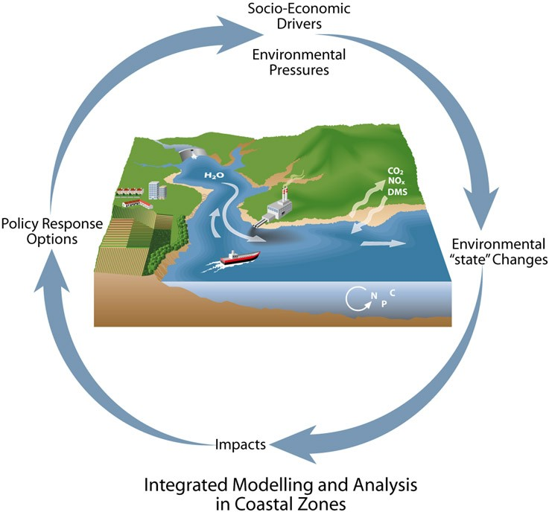

Slide 7
Importance of ICZM
The dynamic processes that occur within the coastal zones produce diverse and productive ecosystems which have been of great importance historically for human populations. Coastal margins equate to only 8% of the worlds surface area but provide 25% of global productivity. Stress on this environment comes with approximately 70% of the world’s population being within a day’s walk of the coast. Two-thirds of the world’s cities occur on the coast.

Slide 8
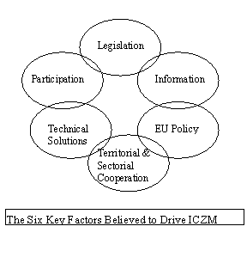

Slide 9
Identified Goals of ICZM
Maintaining the functional integrity of the coastal resource systems;
Reducing resource-use conflicts;
Maintaining the health of the environment;
Facilitating the progress of multisectoral development

Slide 10
Issues that our Profession will face
This first step will include integration between government, sectoral entities and local residents. The assessments also have to be broad in their application. Once the issues and problems have been identified and weighted, an effective management plan can be made. The plan will be specific to the area in question. Thirdly, the adoption of the plan can be carried out. They can be legally binding statutory plans, strategies or objectives which are generally quite powerful or they can be non-statutory processes and can act as a guide for future development.

Slide 11
Issues that our Profession will face
This duality is largely beneficial as the future can be taken into account, but still provide for a firm stance based in the present. The fourth step is implementation, this active phase includes; law enforcement, education, development etc. The implementation activities will be of course, be as unique as their environments and can take many forms. The last phase is evaluation of the whole process.

Slide 12
Definition
Coastal zone management is a dynamic, multidisciplinary and iterative process to promote sustainable management of coastal zones. It covers the full cycle of information collection, planning.

Slide 13
ICZM to be successful it must adhere to the principles that define sustainability and act upon them in ways that are integrated. An optimal balance between environmental protection and the development of economic and social sectors is paramount. As part of the holistic approach ICZM applies, many aspects within a coastal zone are expected to be considered and accounted for. These include but are not limited to: the spatial, functional, legal, policy, knowledge, and participation dimensions.

Slide 14
Management must embrace a holistic viewpoint of the functions that makeup the complex and dynamic nature of interactions in the coastal environment. Management framework must be applied to a defined geographical limit (often complicated) and should operate with a high level of integration. Due to the diverse nature of the world’s coastline and coastal environments, it is not possible to create a framework that is ‘one-size-fits-all.’ Different activities, interests and issues also complicate matters. So management will always be unique to countries, regions and ultimately on a local scale.

Slide 15
Resources
Valuable resources such as fish and minerals are considered to be common property and are in high demand for coastal dwellers for subsistence use, recreation and economic development. Through the perception of common property, these resources have been subjected to intensive and specific exploitation. For example; 90% of the world’s fish harvest comes from within national exclusive economic zones, most of which are within the sight of shore.

Slide 16
Approved By
E-signature:

Slide 17
OMICS Group Open Access Membership
OMICS publishing Group Open Access Membership enables academic and research institutions, funders and corporations to actively encourage open access in scholarly communication and the dissemination of research published by their authors.
For more details and benefits, click on the link below:
http://omicsonline.org/membership.php

