Slide 1
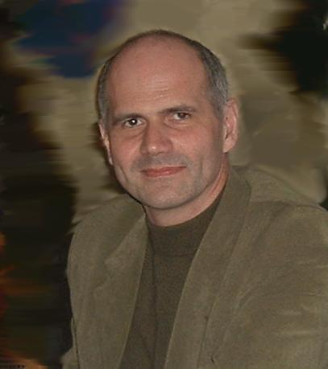
“Dunarea de Jos” University of Galati-Romania Faculty of Electrical & Electronics Engineering Dep. of Electronics and Telecommunications
Assoc. Prof. Rustem Popa, PhD
http://www.etc.ugal.ro/rpopa/index.htm

Slide 2
Contents
About PhD thesis
Teaching experience
Research interests
About Genetic Algorithms
Some results

Slide 3
About PhD thesis (1999)
The development of new algorithms for testing and automatic reconfiguration of digital systems
I have studied some evolutionary algorithms for synthesis, testing and reconfiguration of programmable digital structures in case of single fault, for the purpose of self repair and adaptation to the changes of the environment. I have developed standard genetic algorithms and algorithms obtained by hybridizing genetic algorithms with other search methods, such as search by induction or simulated annealing.

Slide 4
Teaching experience
Undergraduate:
Digital Electronics - since 1992
Medical Electronics - since 1994
Evolutionary Systems - (2000 – 2003)
Graduate:
Audio, Speech and Image Processing - (2006 – 2009)
Signal Processing by Soft Computing - (2006 – 2009)
Audio and Speech Processing - since 2009
Evolutionary Techniques in Signal Processing - since 2009

Slide 5
Research interests
Evolutionary Computation
Evolvable Hardware (EHW)
Digital Electronics, including FPGA technology
Soft Computing
Digital Signal Processing
Medical Electronics
Artificial Consciousness

Slide 6
About Genetic Algorithms
Evolutionary computation is a subfield of artificial intelligence (AI) (or more particularly computational intelligence (CI)), involving combinatorial optimization problems. It may be recognised by the following criteria:
- iterative progress, growth or development
- population based
- guided random search
- parallel processing
- often biologically inspired

Slide 7
About Genetic Algorithms
A typical structure of an Evolutionary Algorithm (EA) :

Slide 8
About Genetic Algorithms
GA begins with a set of solutions (represented by chromosomes) called population. Solutions from one population are selected according to their fitness, and form new solutions (offspring) by using genetic operators (crossover, mutation).
This is motivated by a hope, that the new population will be better than the old one.
This is repeated until some condition (for example number of generations or improvement of the best solution) is satisfied.

Slide 9
About Genetic Algorithms
The structure of a Genetic Algorithm:
begin
generate randomly the initial population of chromosomes;
repeat
calculate the fitness of chromosomes in population;
repeat
select 2 chromosomes as parents;
apply crossover to the selected parents;
calculate the fitness of new child chromosomes;
until end of the number of new chromosomes
apply mutation to the new chromosomes;
update the population;
until end of the number of generations
end

Slide 10
About Genetic Algorithms
Encoding of a chromosome in a GA:
Chromosome 1 | 1101100100110110
Chromosome 2 | 1101111000011110
A chromosome should in some way contain information about solution that it represents. The most used way of encoding is a binary string.
The encoding depends mainly on the solved problem. For example, one can encode directly integer or real numbers, sometimes it is useful to encode some permutations and so on.

Slide 11
About Genetic Algorithms
Crossover:
Chromosome 1 | 11011 | 00100110110
Chromosome 2 | 11011 | 11000011110
Offspring 1 | 11011 | 11000011110
Offspring 2 | 11011 | 00100110110
This example shows a crossover in a single point. There are other ways how to make crossover, for example we can choose more crossover points. Crossover can be quite complicated and depends mainly on the encoding of chromosomes.

Slide 12
About Genetic Algorithms
Mutation:
Original offspring 1 | 1101111000011110
Original offspring 2 | 1101100100110110
Mutated offspring 1 | 1100111000011110
Mutated offspring 2 | 1101101100110100
Mutation operation randomly changes the offspring resulted from crossover. In case of binary encoding we can switch a few randomly chosen bits from 1 to 0 or from 0 to 1. The probability of mutation is low and it prevents the falling of all solutions in the population into a local optimum.

Slide 13
About Genetic Algorithms
Parameters of GA:
Population size
Encoding (binary, permutation, value, tree)
Selection (roulette wheel, elitism, tournament)
Crossover type
Crossover probability
Mutation type
Mutation probability

Slide 14
Some results
Evolvable Hardware (EHW):
Popa Rustem - Genetic Algorithms: An Overview with Applications in Evolvable Hardware published in "Bio-Inspired Computational Algorithms and Their Applications", Dr. Shangce Gao (Ed.), ISBN: 978-953-51-0214-4, InTech - Croatia, march 2012, pp. 105-120
R. Popa, V. Nicolau, S. Epure - A New Quantum Inspired Genetic Algorithm for Evolvable Hardware, The 3-nd International Symposium on Electrical and Electronics Engineering, ISEEE 2010, Galati, Romania, 16-18 September, pp. 64-69 (IEEE Catalog Number CFP1093K-PRT, ISBN 978-1-4244-8407-2)
R. Popa, S. Epure, V. Nicolau - FPGA Circuits for Evolvable Hardware, The 2-nd International Symposium on Electrical and Electronics Engineering, ISEEE 2008, Galati, Romania, 12-13 September, pp. 70-73 (ISSN 1844-8054)
R. Popa, V. Nicolau, S. Epure - Evolvable Hardware in Xilinx PLDs, First International Symposium on Electrical and Electronics Engineering, ISEEE 2006, Galati, Romania, 13-14 October, pp. 108-113 (ISBN (10) 973-627-325-3, ISBN (13) 978-973-627-325-4)

Slide 15
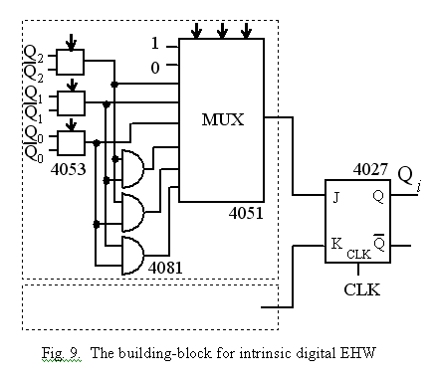
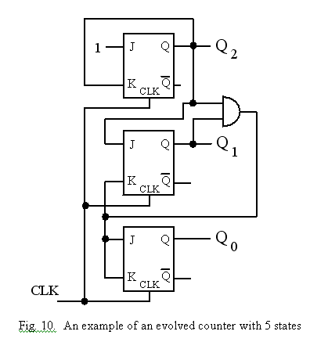
Some results (EHW)
Intrinsic evolution of a modulo 5 counter on a motherboard with CMOS integrated circuits (2004)

Slide 16
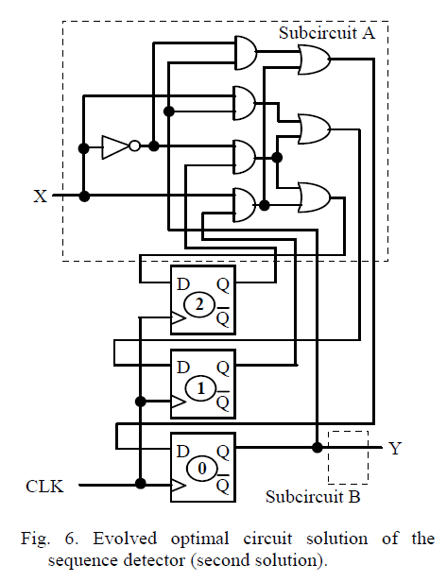
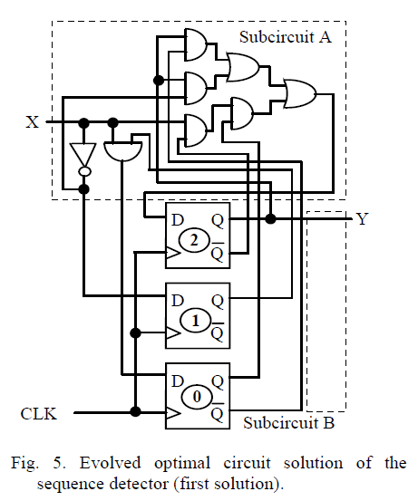
Some results (EHW)
Two examples of extrinsic evolution of a state machine with 8 states (2006)

Slide 17
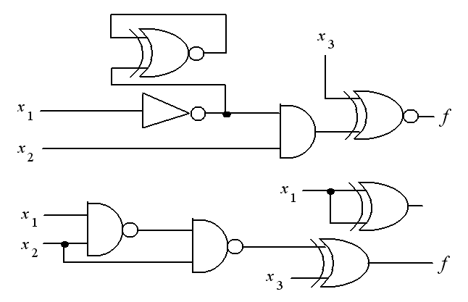
Some results (EHW)
Two examples of extrinsic evolution of a boolean function with 3 variables in a network with 4 gates, using 3 GAs: (2010)
- CGA (Canonical Genetic Algorithm)
- SCQGA (Single Chromosome Quantum Genetic Algorithm)
- QIGA (Quantum Inspired Genetic Algorithm)

Slide 18
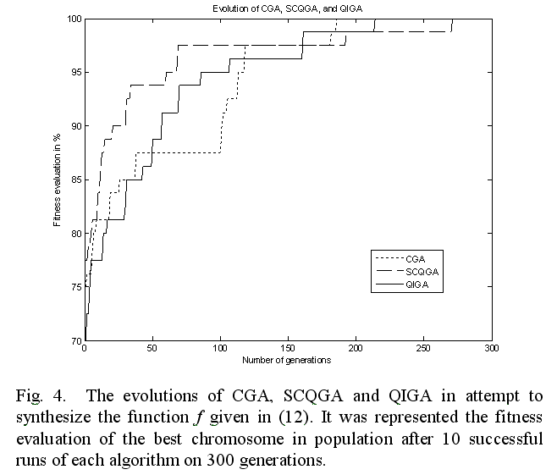

Slide 19
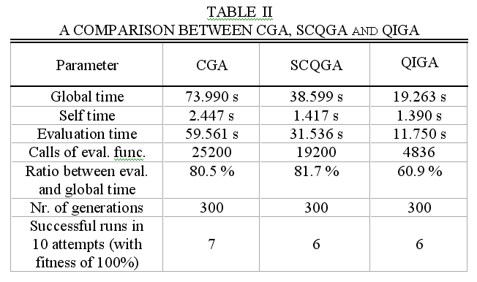
Some results (EHW)

Slide 20
Some results
The Hybridisation of GAs:
R. Popa - The Hybridization of the Selfish Gene Algorithm, 2002 IEEE International Conference on Artificial Intelligence Systems, ICAIS 2002, Divnomorskoe, Russia, 5-10 September, 2002, pp. 345-350 (ISBN 0-7695-1733-1)
R. Popa, D. Aiordachioaie, V. Nicolau - Multiple Hybridization in Genetic Algorithms, The 16-th European Meeting on Cybernetics and Systems Research EMCSR'2002, Vienna, Austria, April 2-5, 2002, pp.536-541 (ISBN 3 85206 160 1)

Slide 21
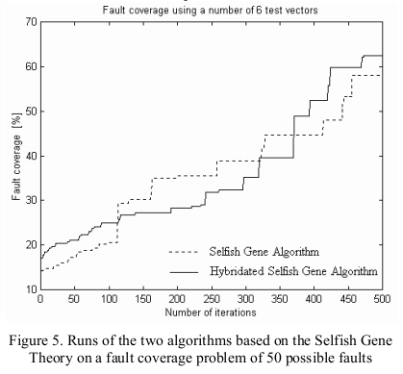
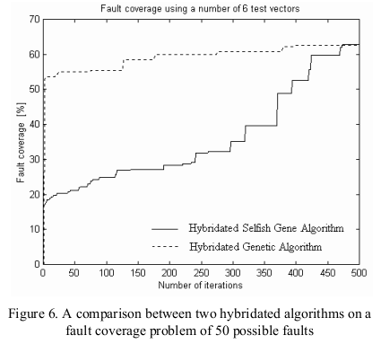
Some results
The Hybridisation of the Selfish Gene Algorithm:

Slide 22
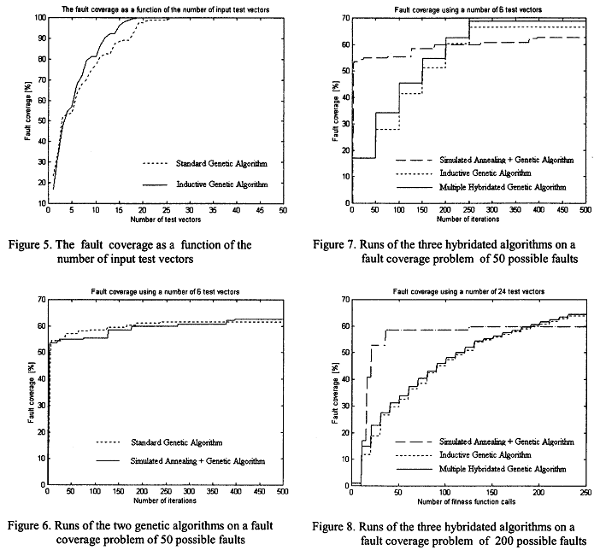
Some results
Multiple Hybridi-sation
in GAs:

Slide 23
Some results
Image Processing with GAs:
Popa Rustem - Melanocytic Lesions Screening through Particle Swarm Optimization published in "Handbook of Research on Novel Soft Computing Intelligent Algorithms: Theory and Practical Applications“ (2 vol.), Dr. Pandian M. Vasant, IGI Global, 2013, ISBN13: 9781466644502, ISBN10: 1466644508, DOI: 10.4018/978-1-4666-4450-2.ch012, pp. 355-384
R. Popa, D. Aiordachioaie - Genetic Recognition of Changes in Melanocytic Lesions, The 8th International Symposium on Automatic Control and Computer Science, SACCS 2004, Iasi, Romania, 22-23 October, 2004, CD-ROM Proceedings - abstract page 69 (ISBN 973-621-083-9)

Slide 24
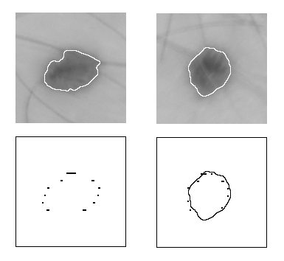
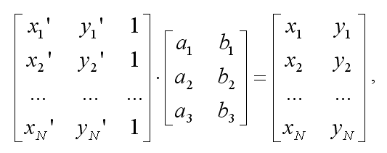
Some results
Two Different Images of the Same Melanocytic Lesion, an Affine Transformation and Two Different Lesions:

