Slide 1


Slide 2
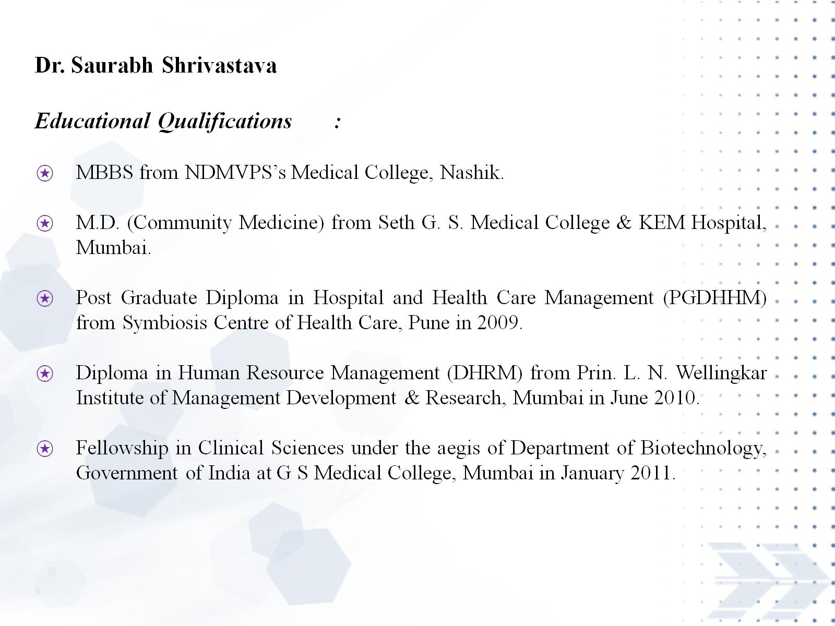

Slide 3
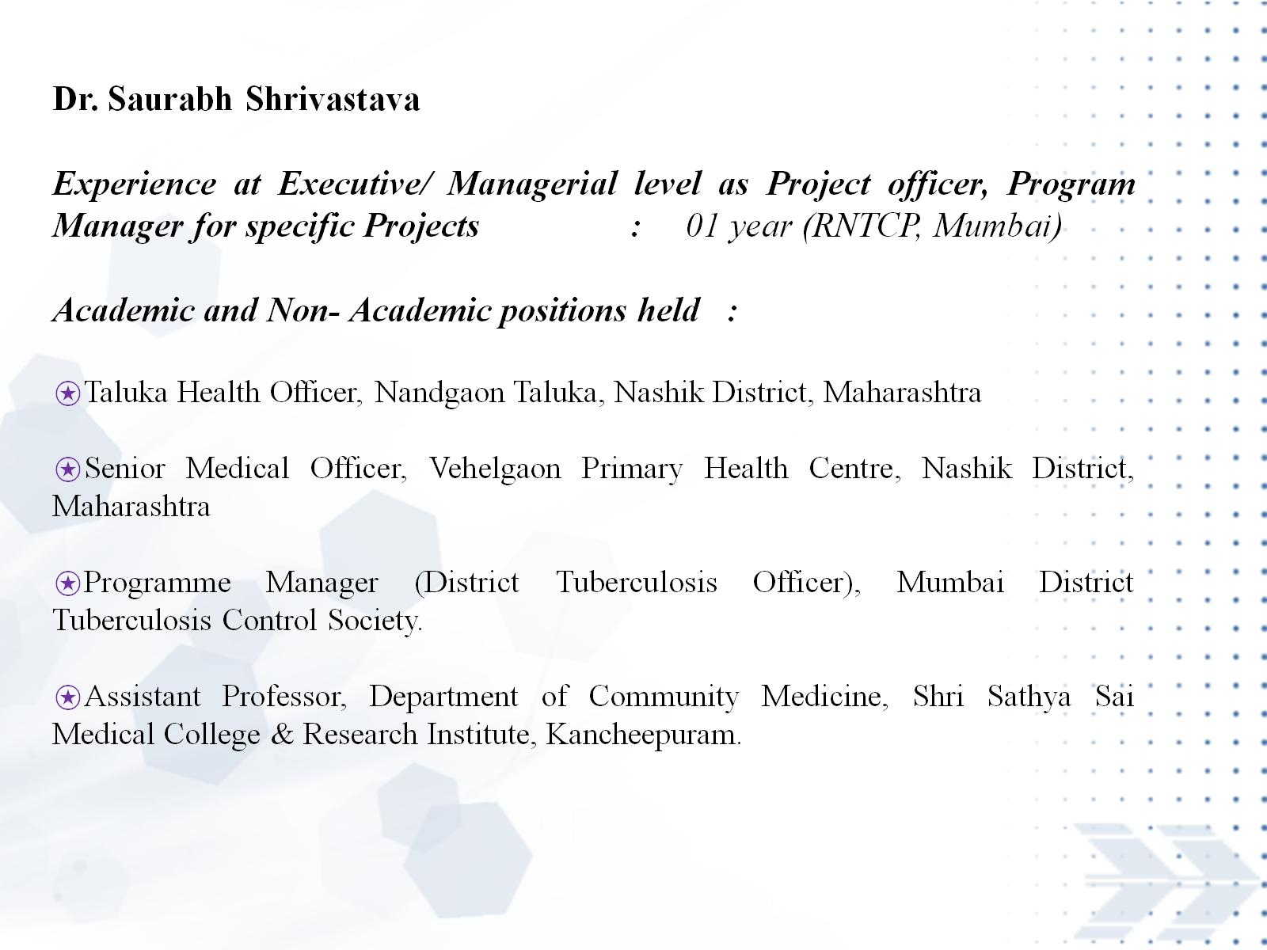

Slide 4
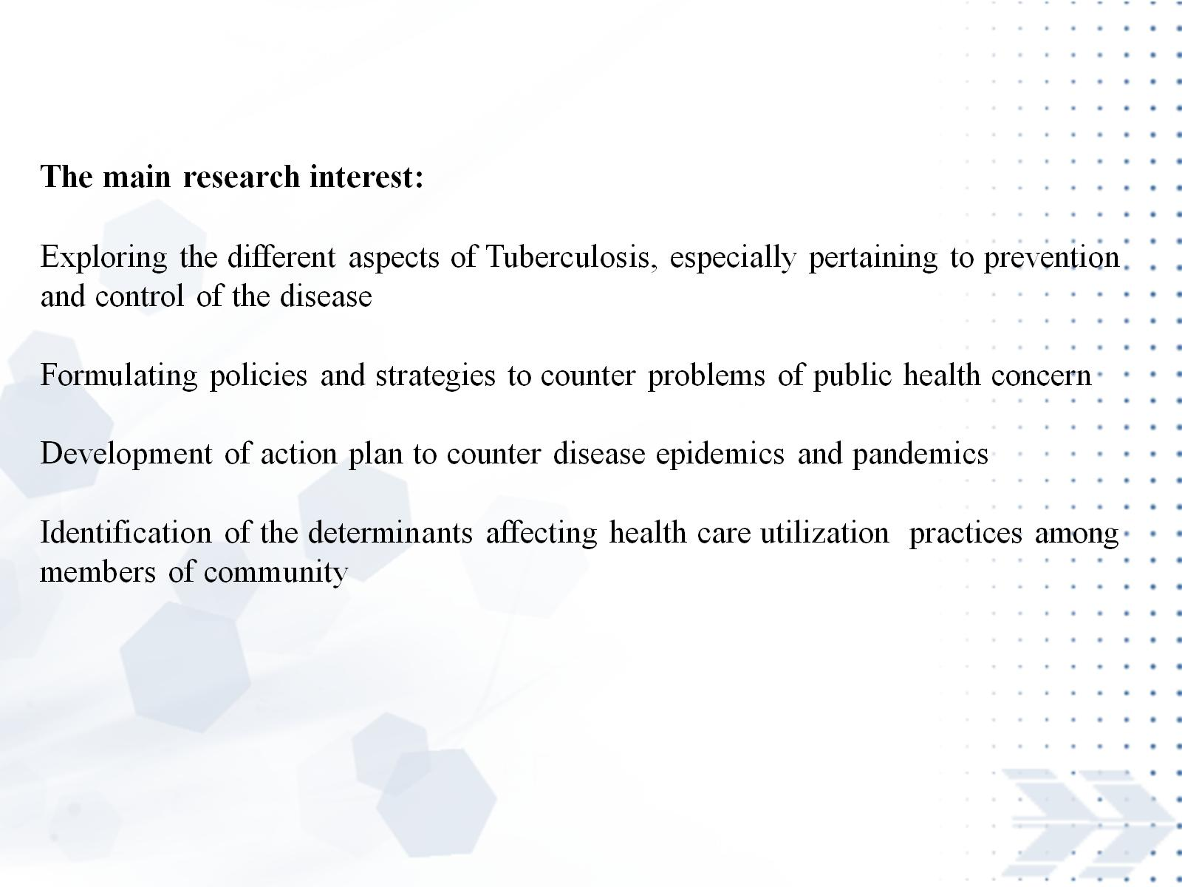

Slide 5
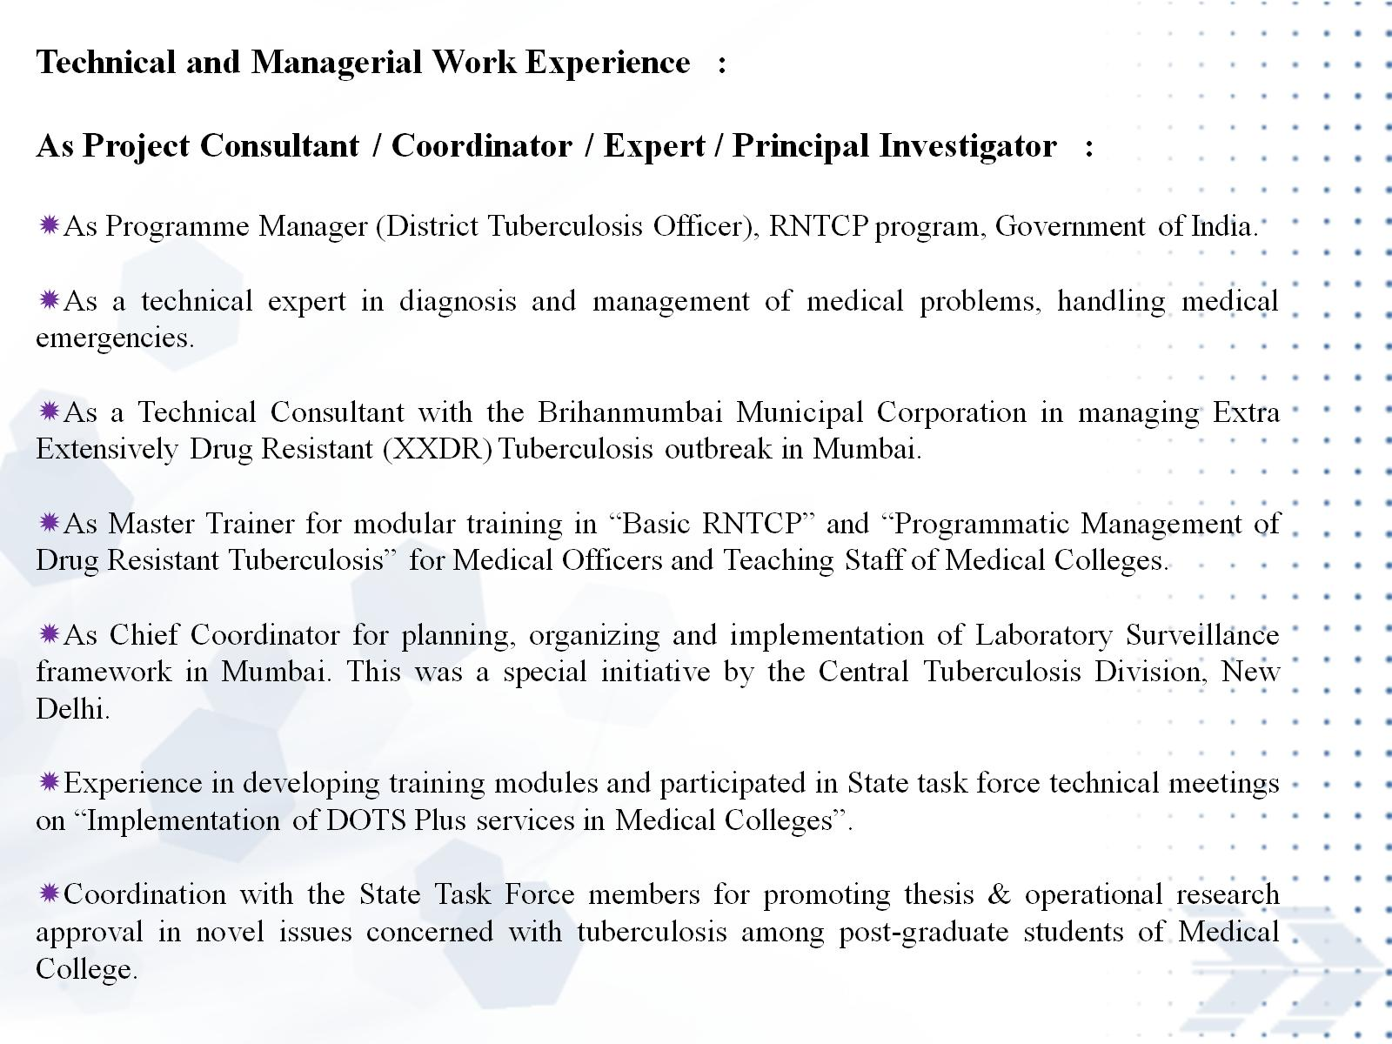

Slide 6
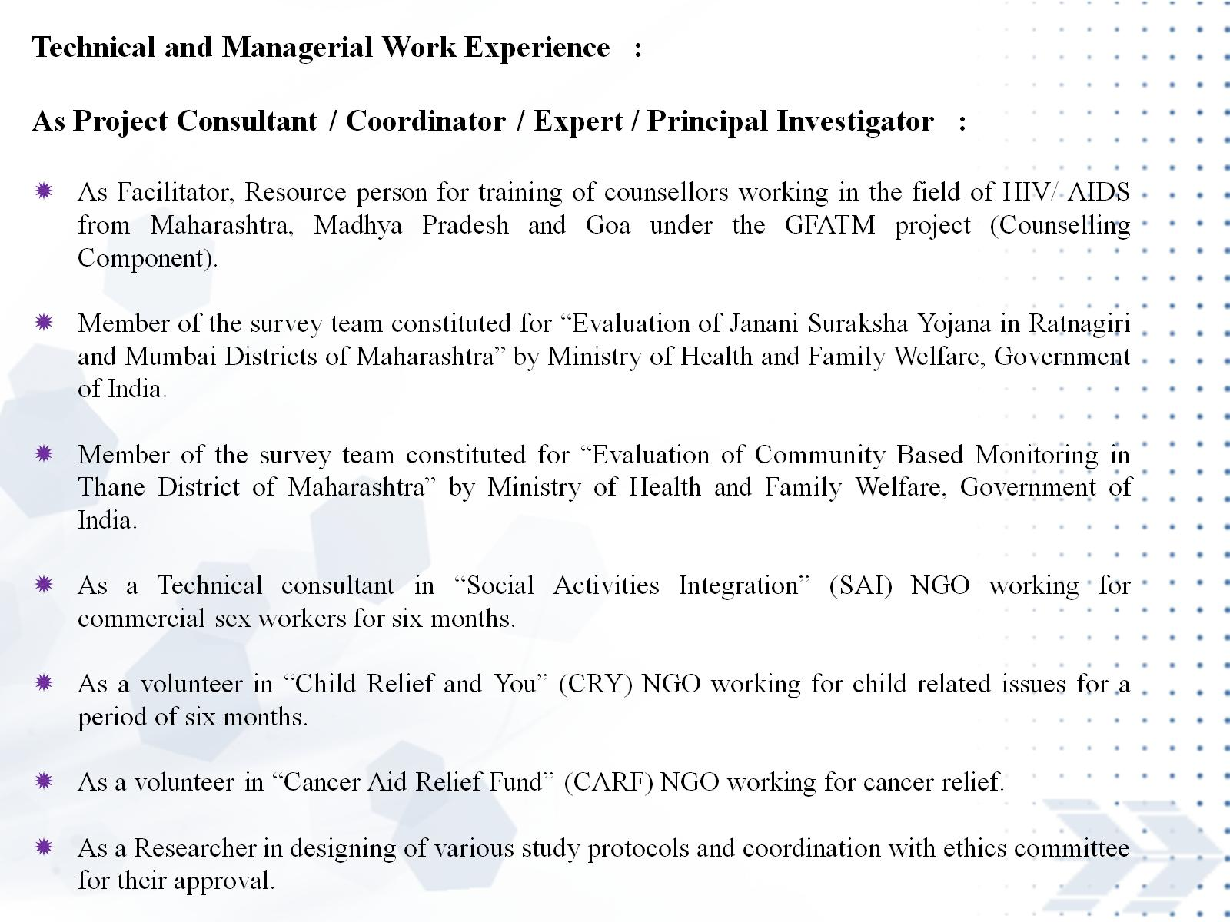

Slide 7


Slide 8
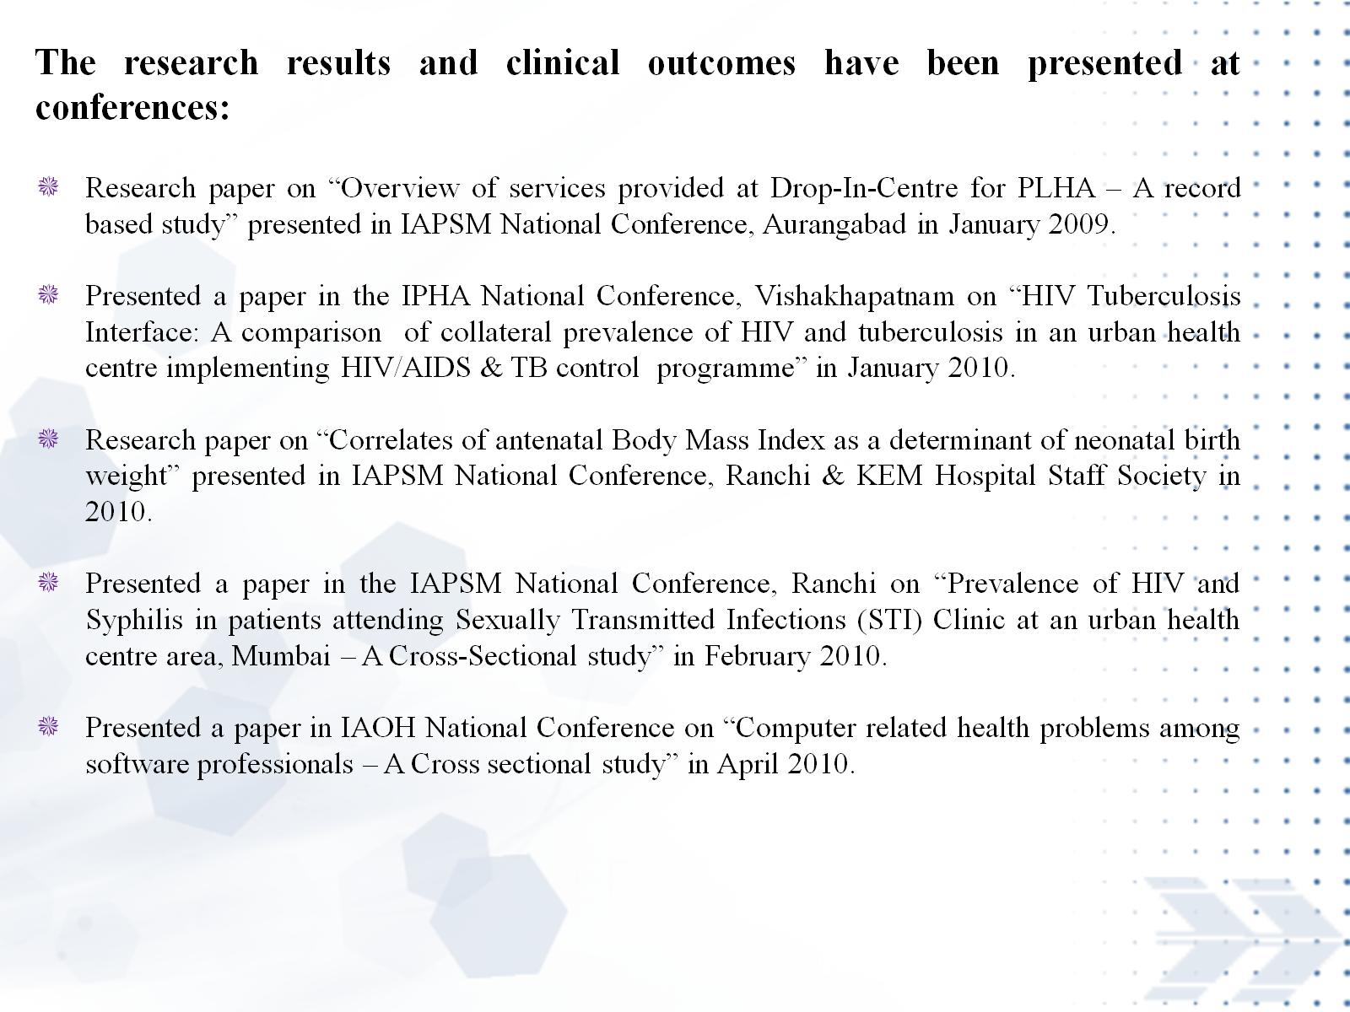

Slide 9


Slide 10
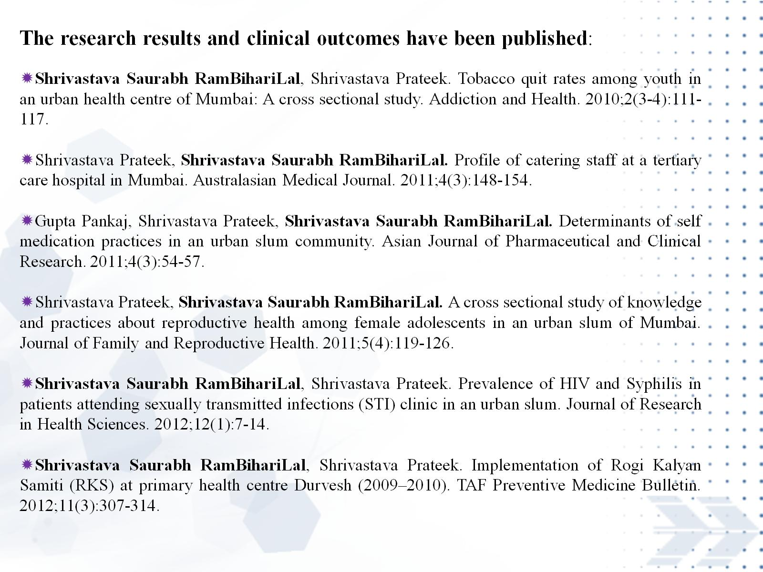

Slide 11


Slide 12


Slide 13


Slide 14
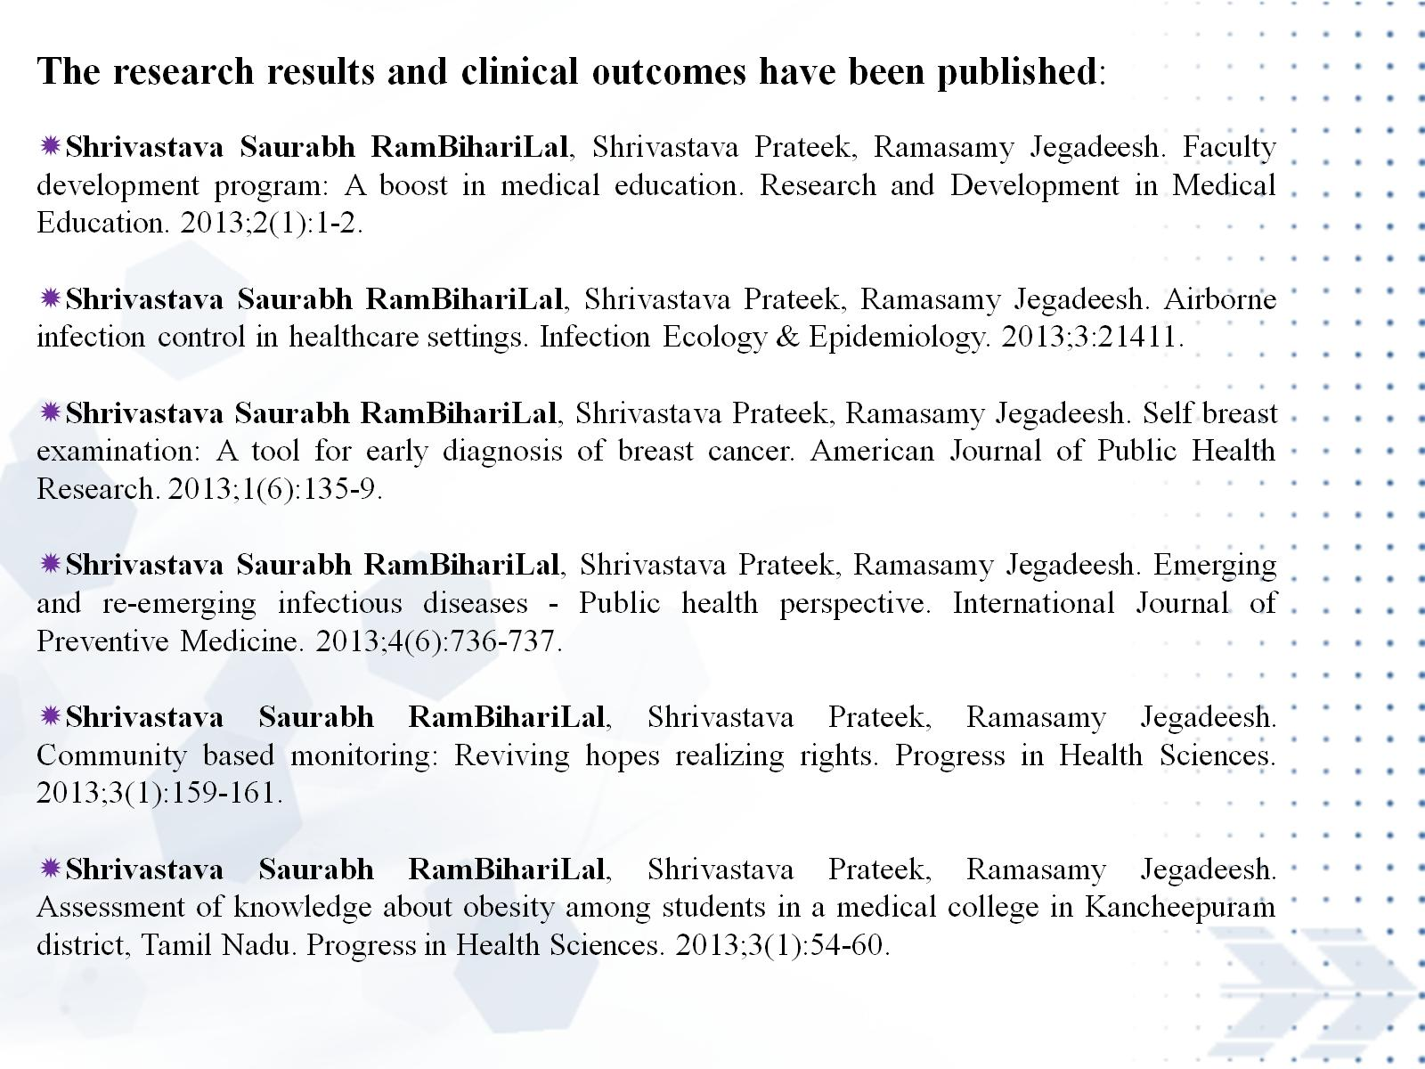

Slide 15


Slide 16
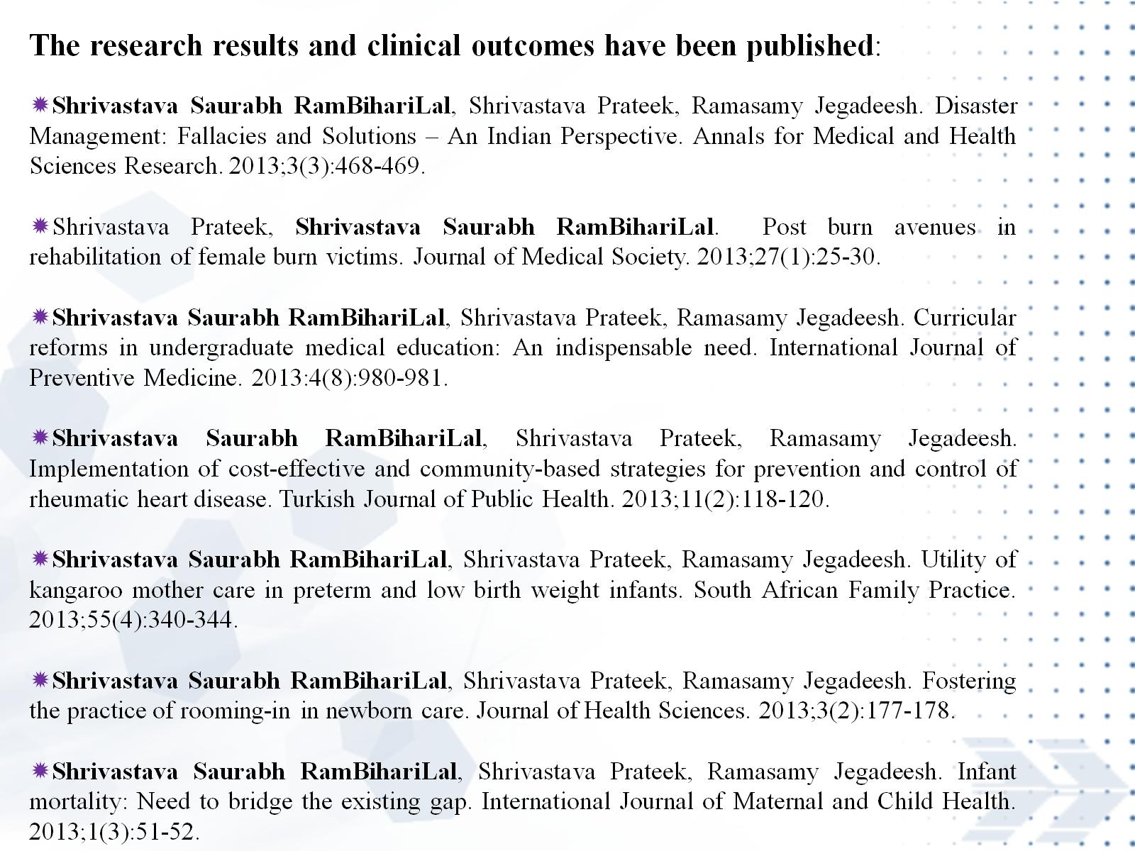

Slide 17
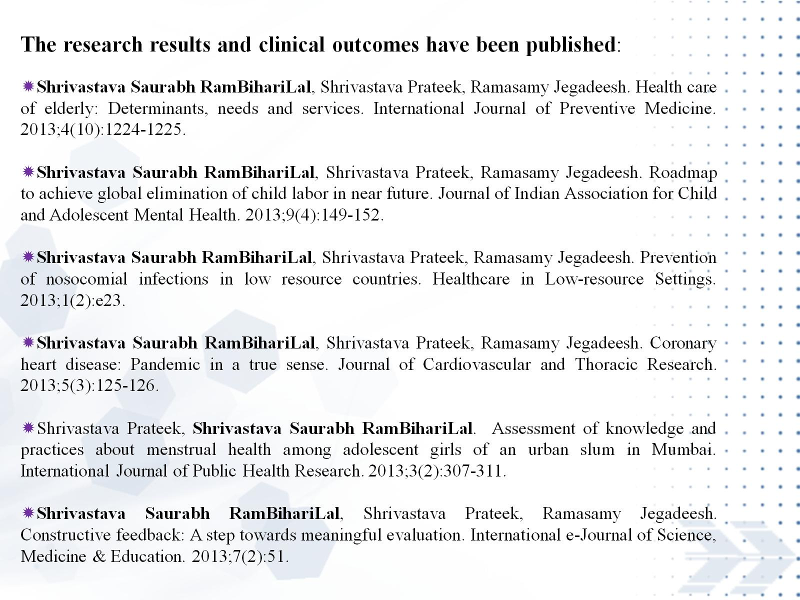

Slide 18


Slide 19


Slide 20
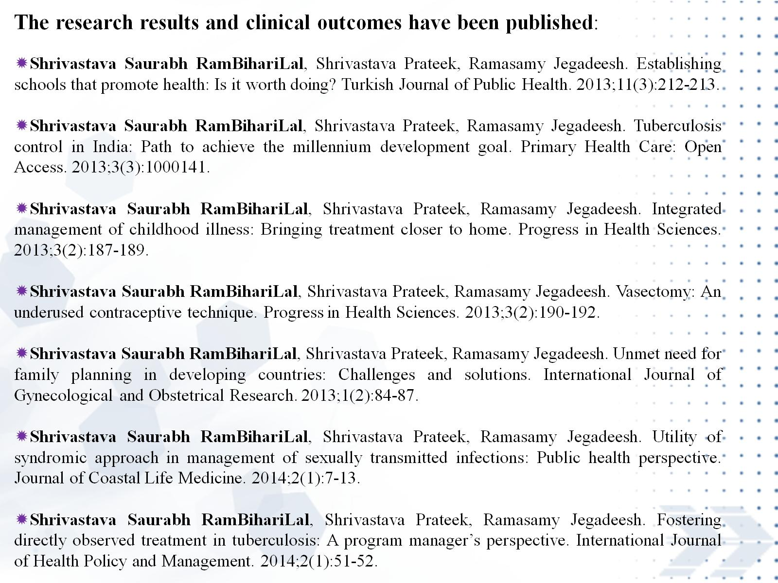

Slide 21
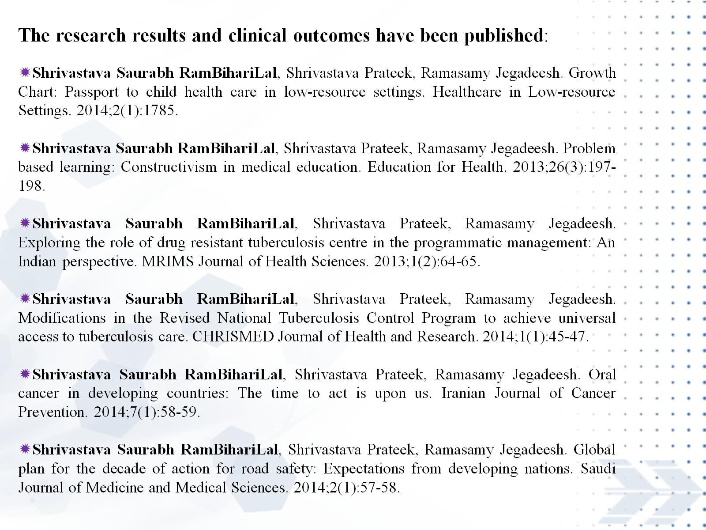

Slide 22
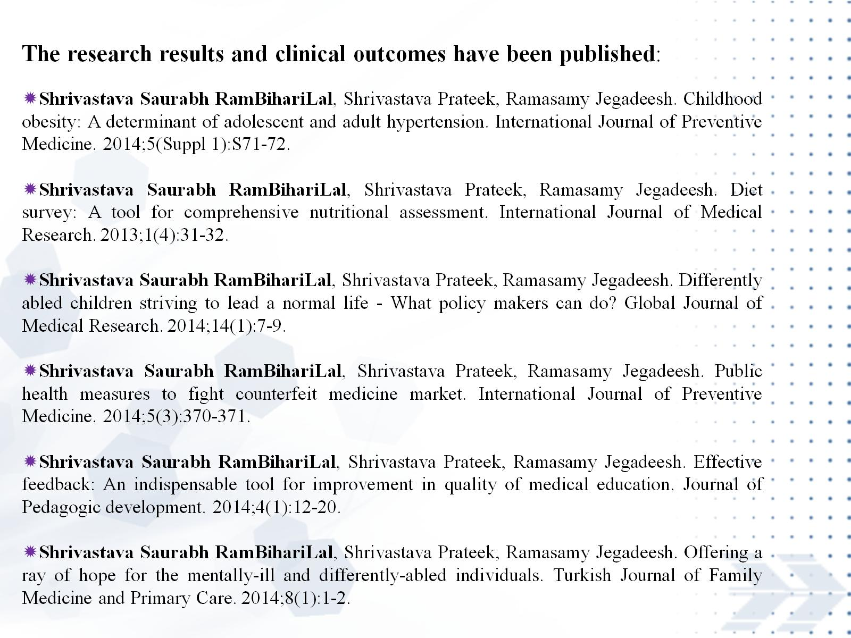

Slide 23


Slide 24
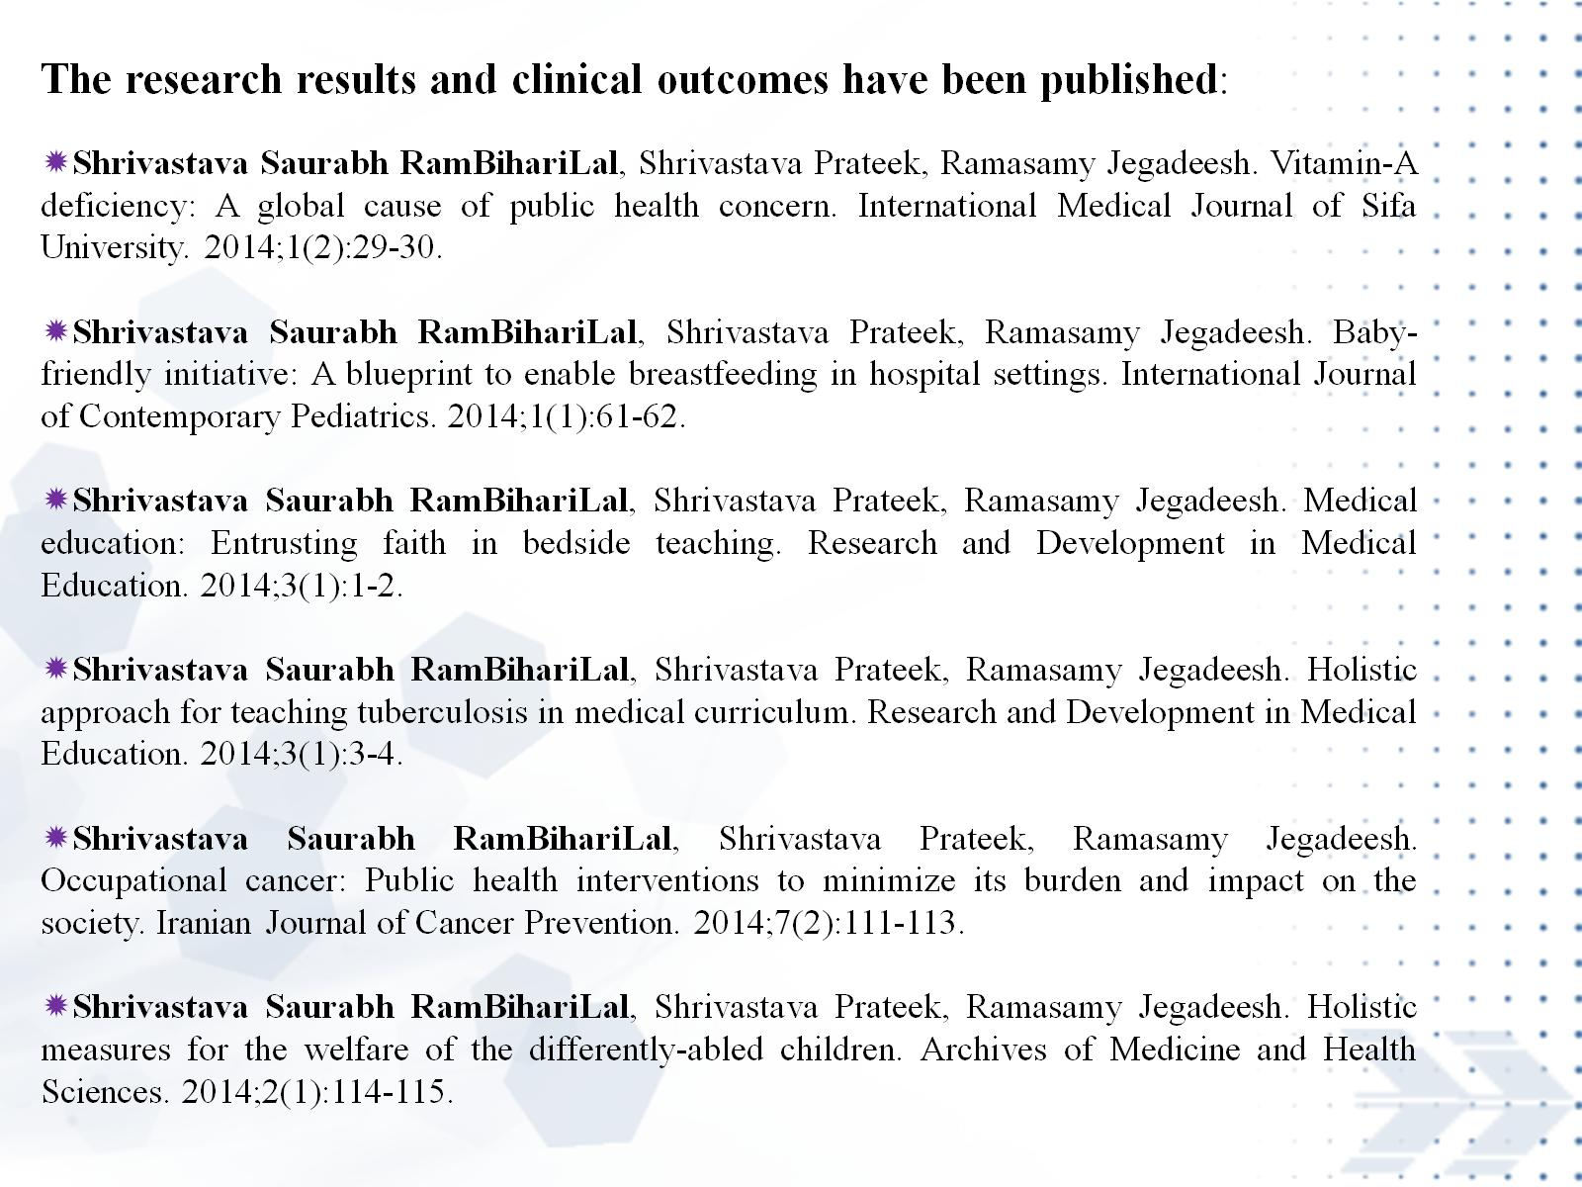

Slide 25
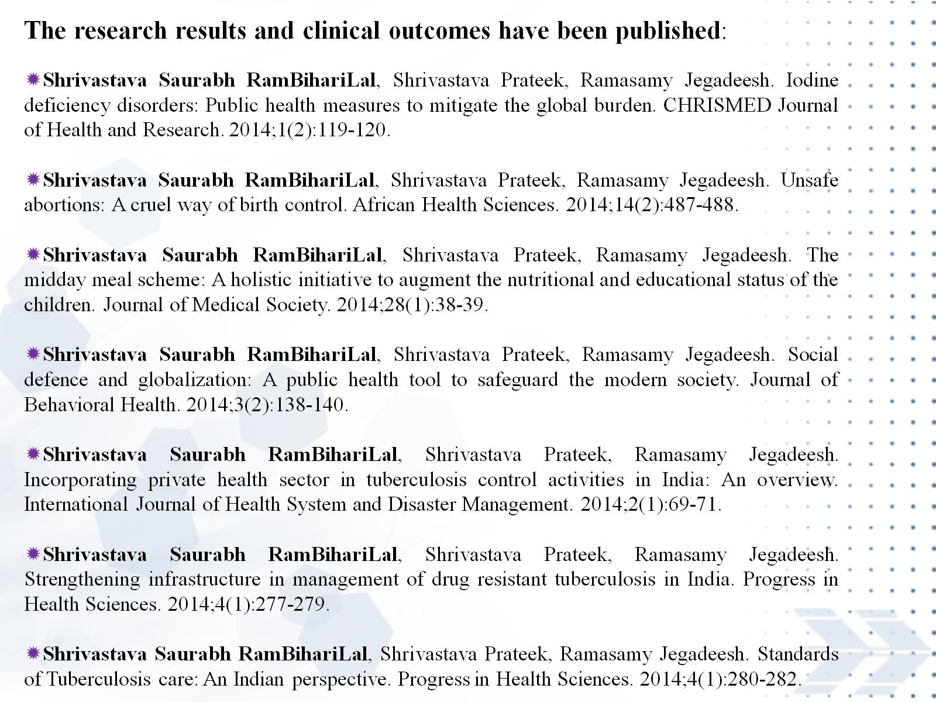

Slide 26


Slide 27


Slide 28
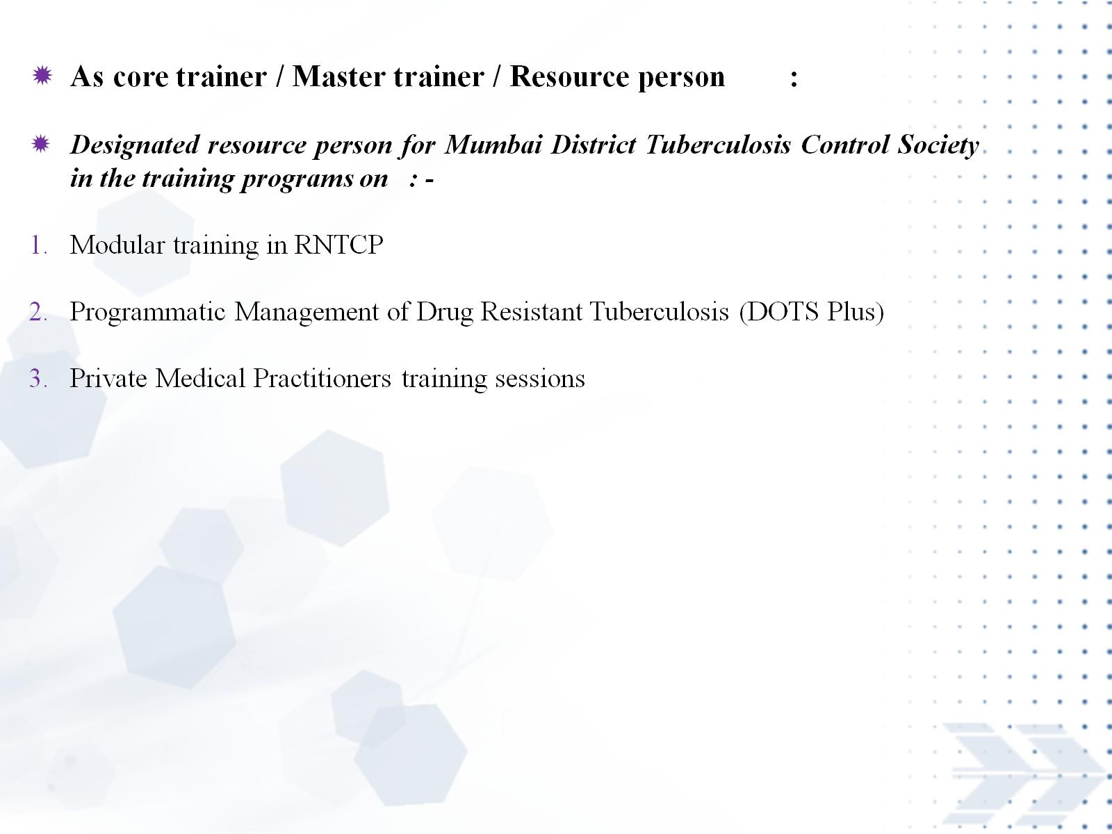

Slide 29
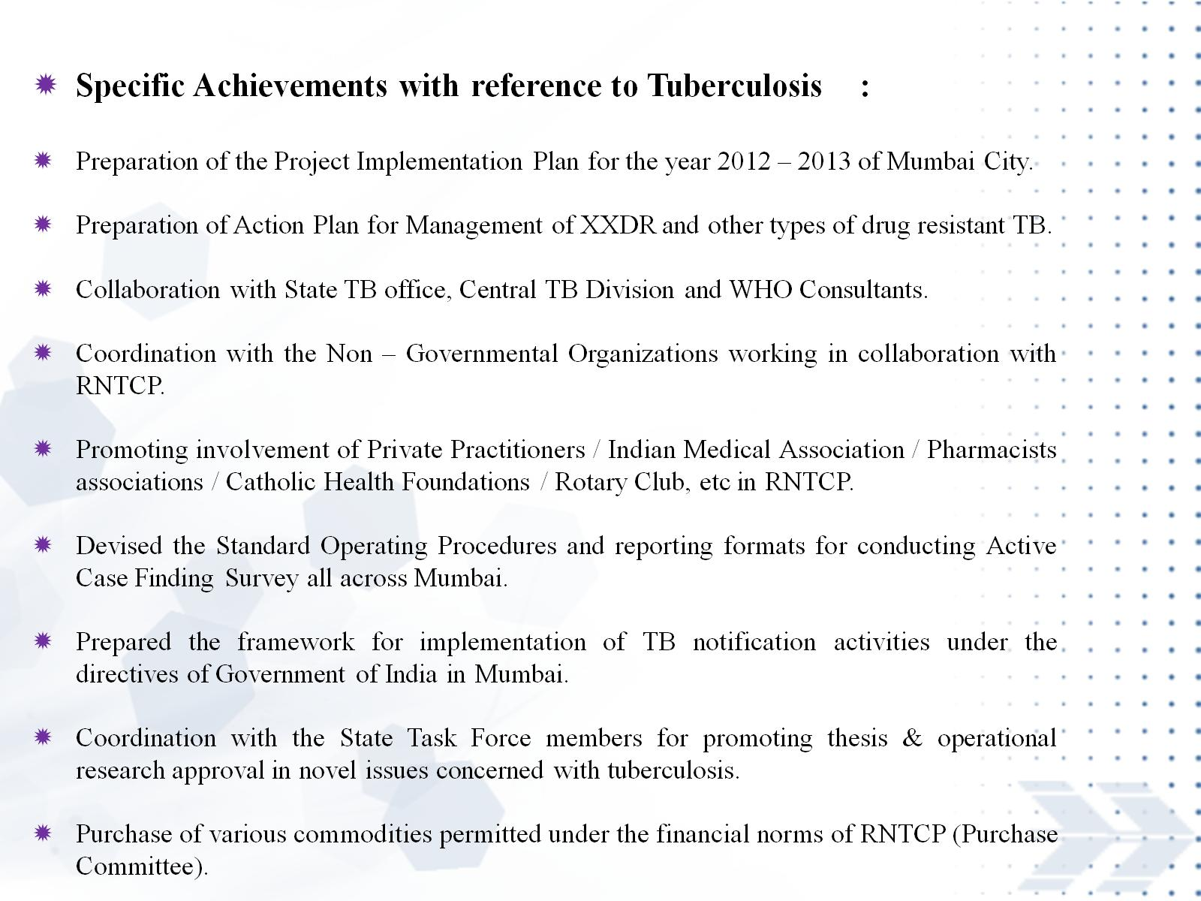

Slide 30
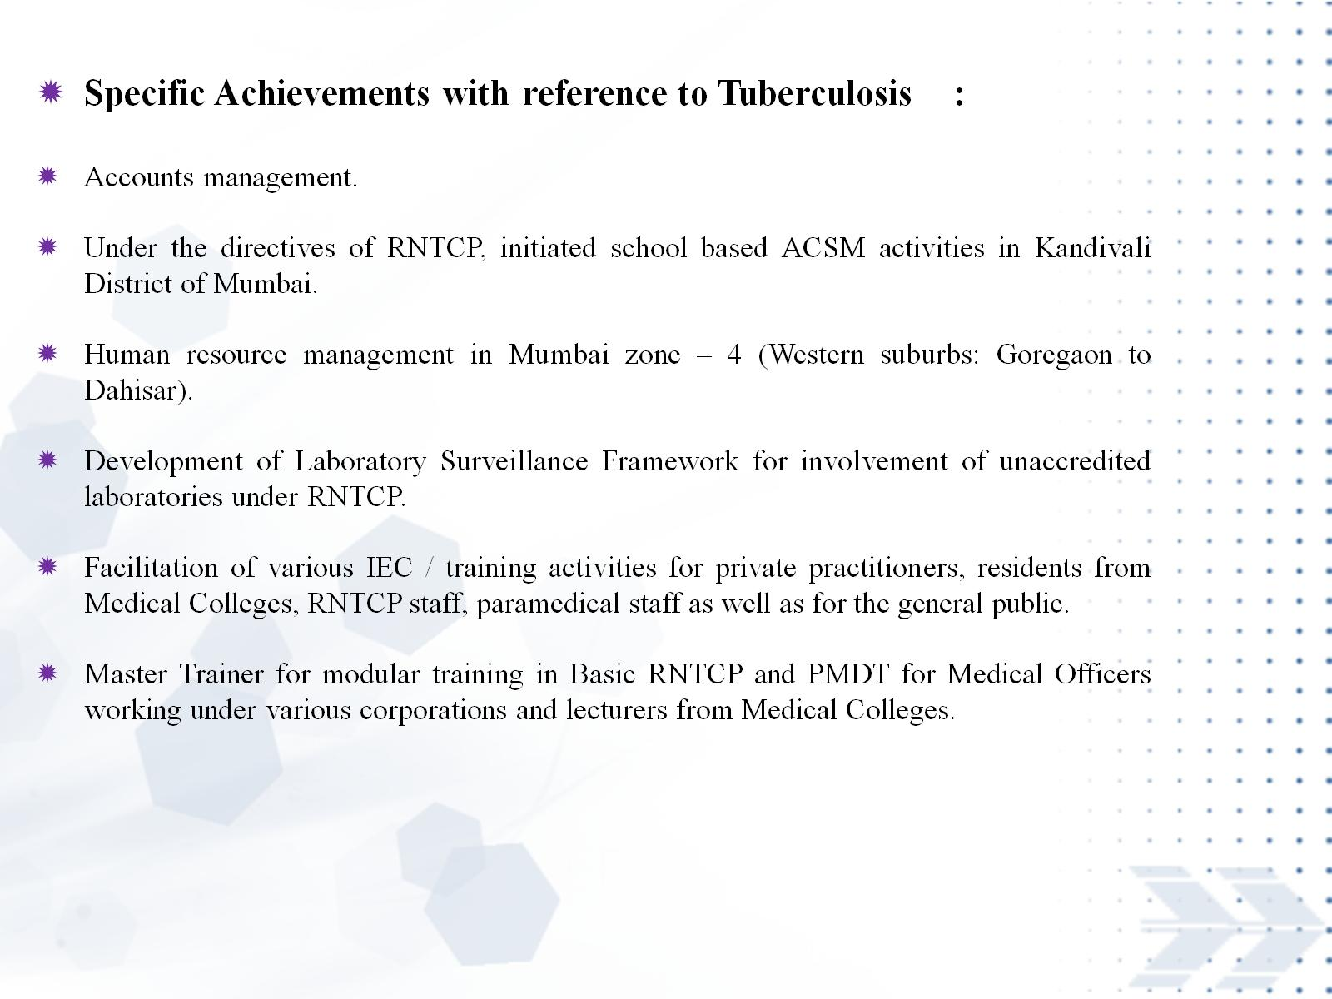

Slide 31


Slide 32
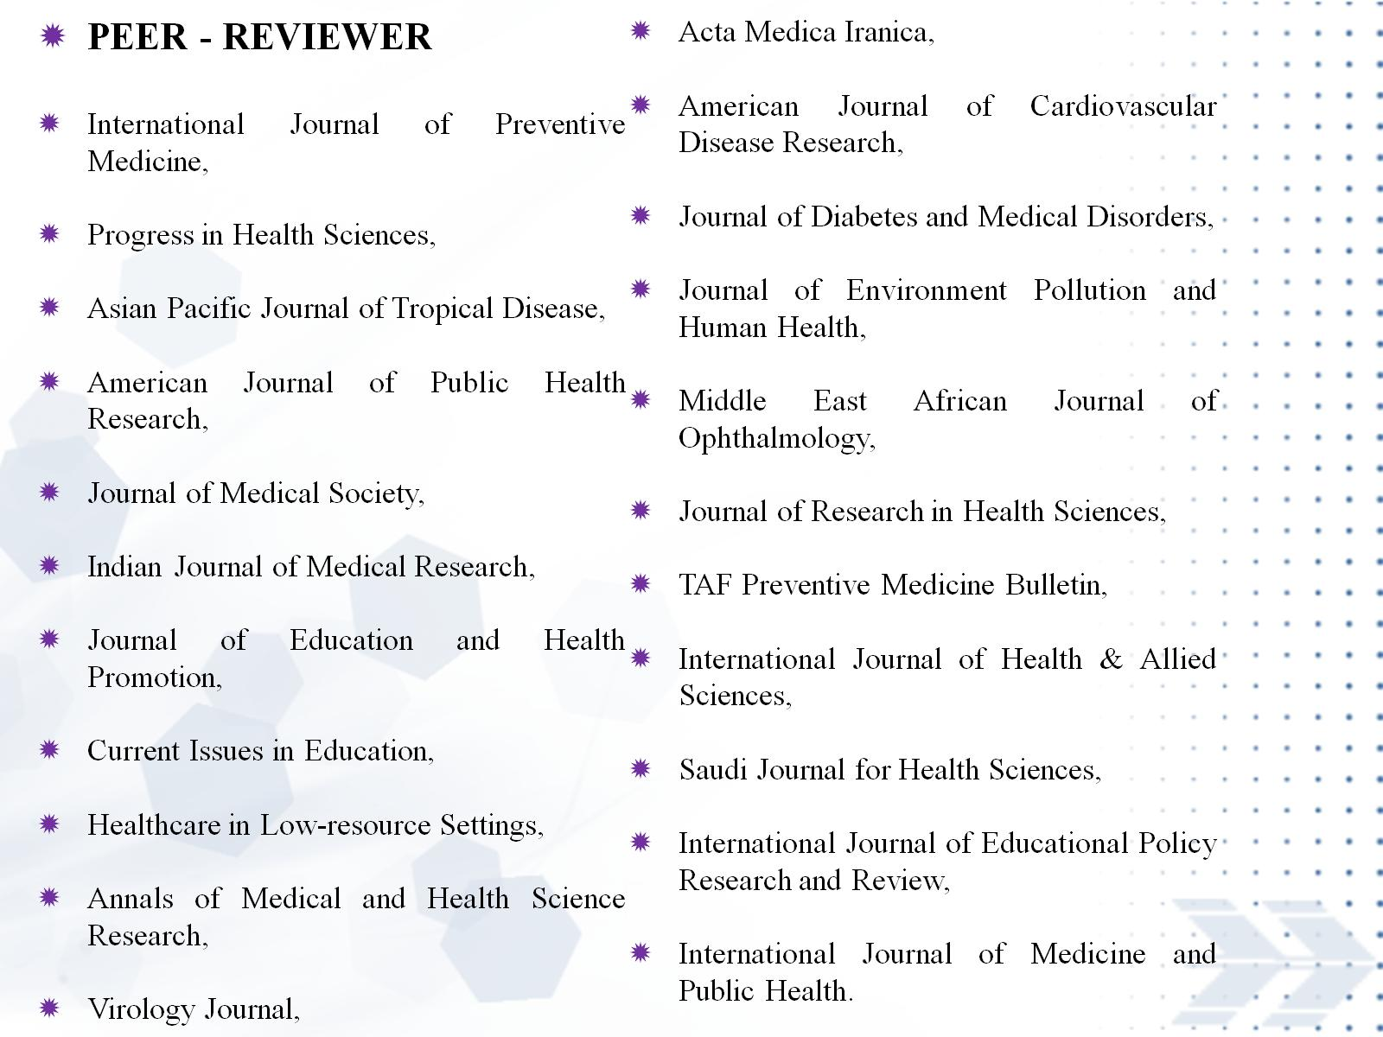

Slide 33
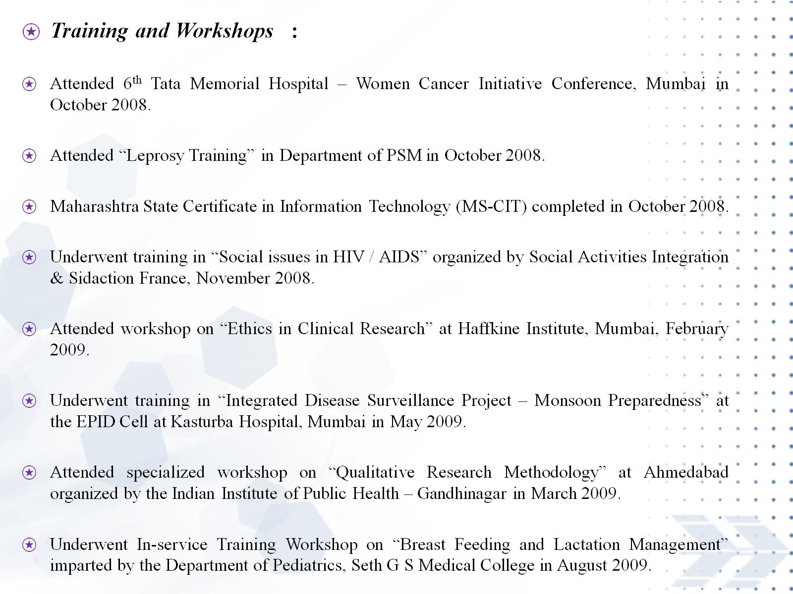

Slide 34
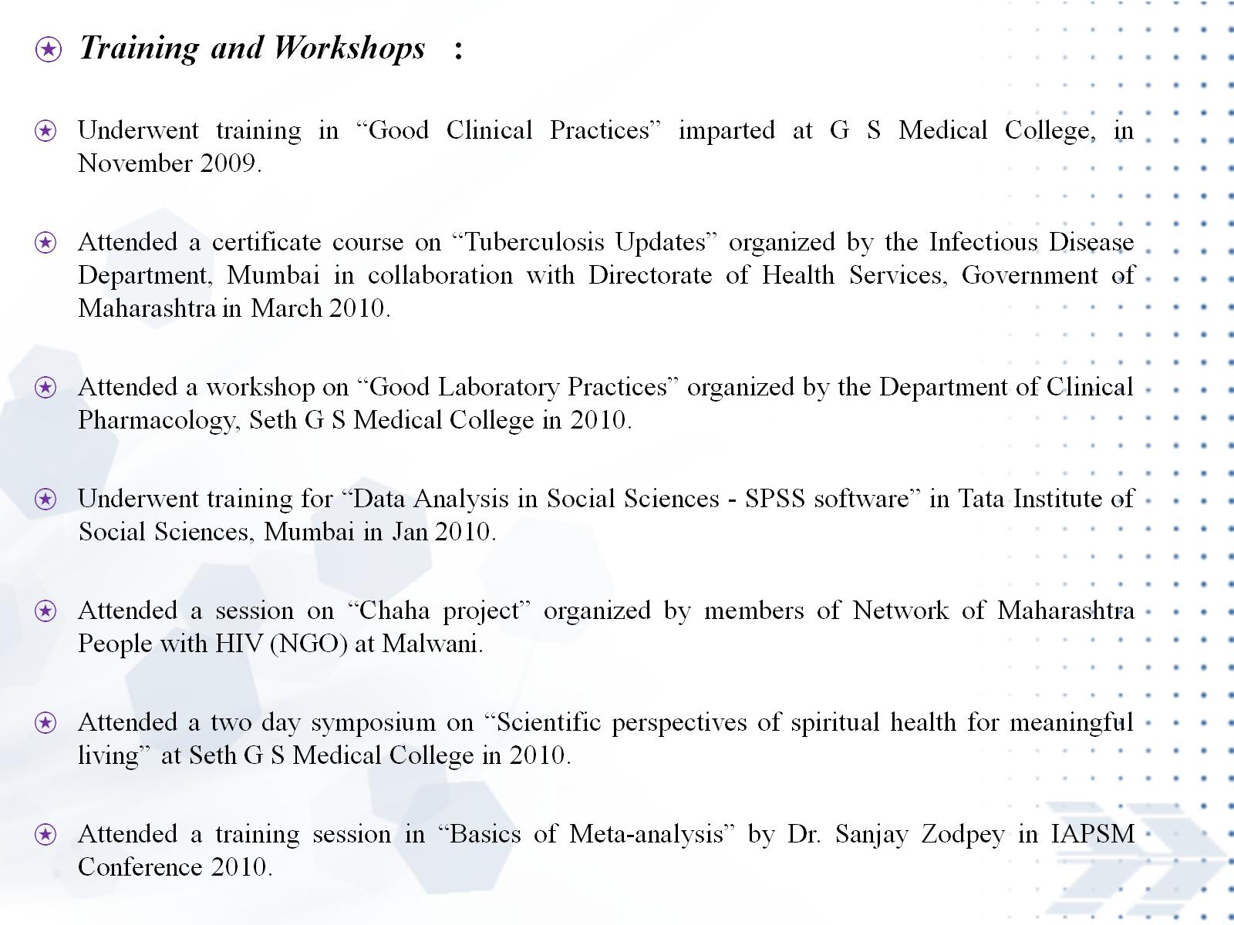

Slide 35
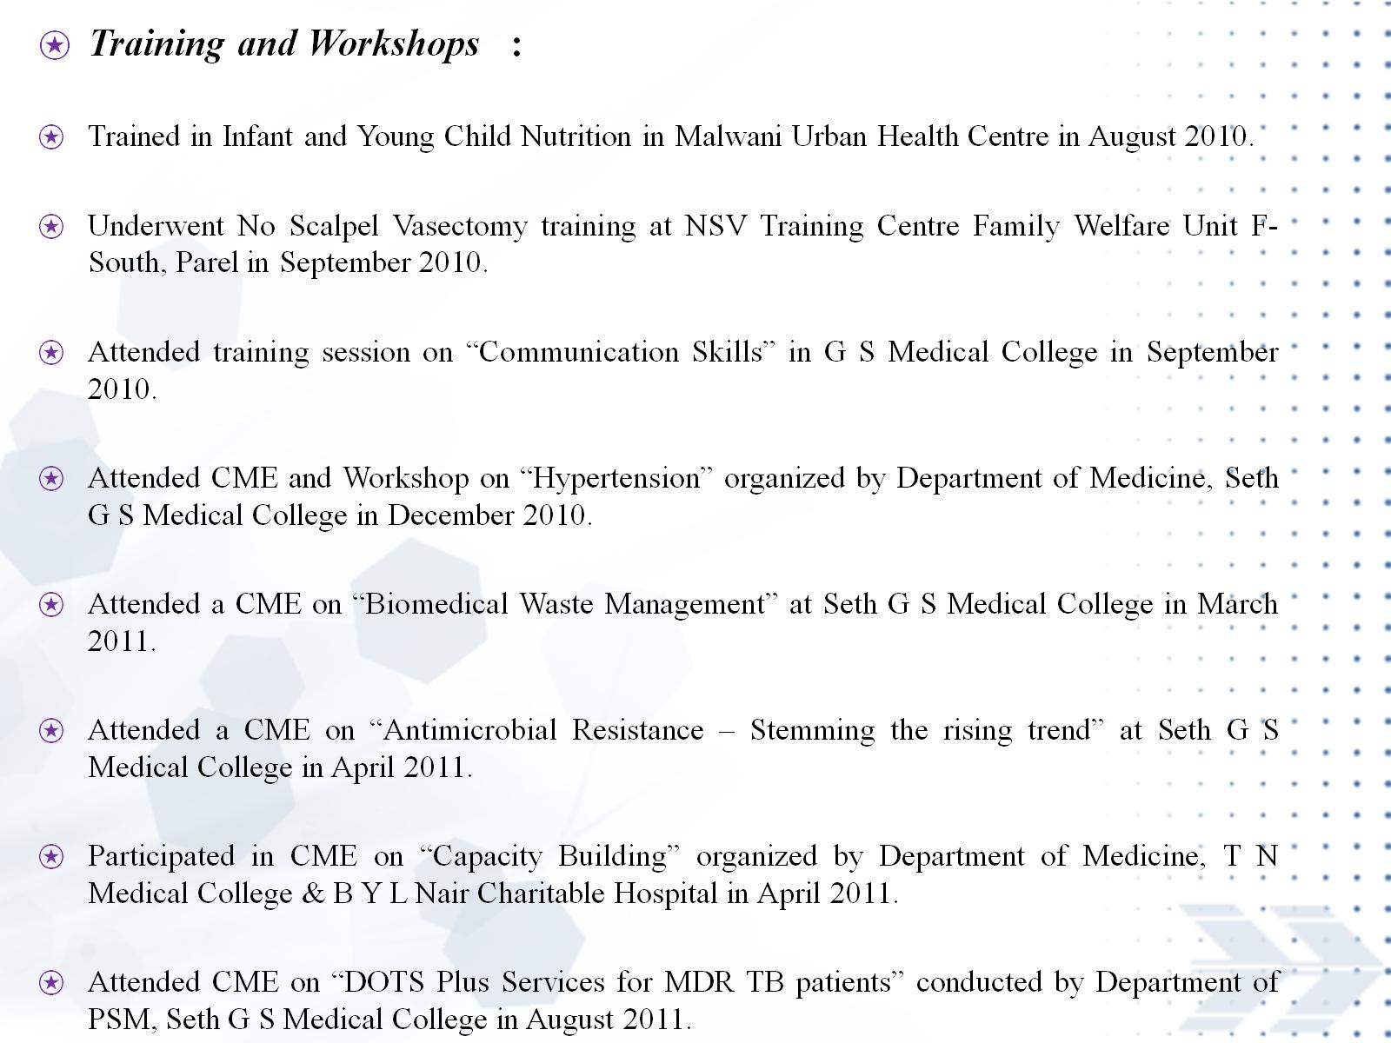

Slide 36


Slide 37


OMICS International
www.omicsonline.org
OMICS International (and its subsidiaries), is an Open Access publisher and international conference Organizer, which owns and operates peer-reviewed Clinical, Medical, Life Sciences, and Engineering & Technology journals and hosts scholarly conferences per year in the fields of clinical, medical, pharmaceutical, life sciences, business, engineering, and technology. Our journals have more than 3 million readers and our conferences bring together internationally renowned speakers and scientists to create exciting and memorable events, filled with lively interactive sessions and world-class exhibitions and poster presentations. Join us!
OMICS International is always open to constructive feedback. We pride ourselves on our commitment to serving the Open Access community and are always hard at work to become better at what we do. We invite your concerns, questions, even complaints. Contact us at contact.omics@omicsonline.org. We will get back to you in 24-48 hours. You may also call 1-800-216-6499 (USA Toll Free) or at +1-650-268-9744 and we will return your call in the same timeframe.
Contact us at: contact.omics@omicsonline.org

Slide 38


Slide 39


Slide 40


