Slide 1
OMICS International
OMICS Group International through its Open Access Initiative is committed to make genuine and reliable contributions to the scientific community. OMICS Group signed an agreement with more than 1000 International Societies to make healthcare information Open Access.
Contact us at: contact.omics@omicsonline.org

Slide 2
OMICS Journals are welcoming Submissions
OMICS International welcomes submissions that are original and technically so as to serve both the developing world and developed countries in the best possible way.
OMICS International Journals are poised in excellence by publishing high quality research. OMICS Group follows an Editorial Manager® System peer review process and boasts of a strong and active editorial board.
Editors and reviewers are experts in their field and provide anonymous, unbiased and detailed reviews of all submissions.
The journal gives the options of multiple language translations for all the articles and all archived articles are available in HTML, XML, PDF and audio formats. Also, all the published articles are archived in repositories and indexing services like DOAJ, CAS, Google Scholar, Scientific Commons, Index Copernicus, EBSCO, HINARI and GALE.
For more details please visit our website: http://omicsonline.org/Submitmanuscript.php

Slide 3
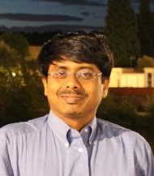
Saugata Datta, Chemical HydroGeology, Associate Professor; sdatta@ksu.edu
B.S. 1993, University of Calcutta, India, Geology
M.S. 1995, University of Calcutta, India, Geology
1996, Queen’s University, Canada, Geological Sciences
PhD. 2001, Western University, Canada, Earth Sciences
Mellon-Barnard, Earth Institute, Columbia Univ, 2001-04
Asst. Professor, Georgia College and State. Univ, 2004-08
Assoc. Professor (with tenure), University of Calcutta, 2005-06
Asst. & Assoc. Professor (with tenure), Geology, K-State, 2008 -

Slide 4
Research Interests
Aqueous Geochemistry & Hydrogeology
Trace Element Biogeochemistry in Waters
Groundwater Contamination and Assessment
Isotope Geochemistry and Urban Waters
Geologic CO2 Storage and Drinking Water
Security
Critical Zone Processes and Chemical Weathering
Societal Impacts of Environmental Pollution

Slide 5
Current Research
1)CO2 Capture and Storage in Saline Aquifers, Kansas and Groundwater Protection
2) Uptake of Toxic Trace Metals by Plants and Food Security – Arsenic and Rice
3) Water Quality Monitoring and Groundwater Contamination
Arsenic groundwater calamity, South-east Asia
Tungsten in Fallon, NV groundwater and sediment
Nitrates in Kansas Groundwater (Sylvan Grove)
Selenium in Kansas Groundwater and Utah surface waters
4) Urban Waters, Watershed Hydrology, Surface Water Protection from Pathogens
5) Protection of Ecosystem and Irrigation Water Cycling
6) Geochemical Modeling and Biogeochemistry

Slide 6
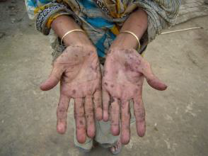
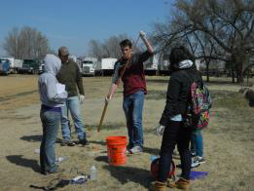
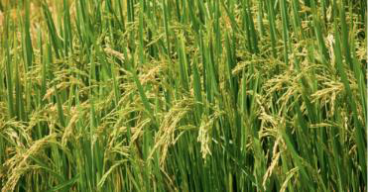
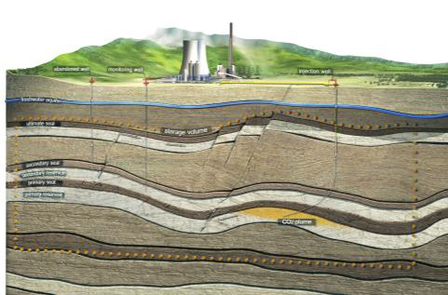
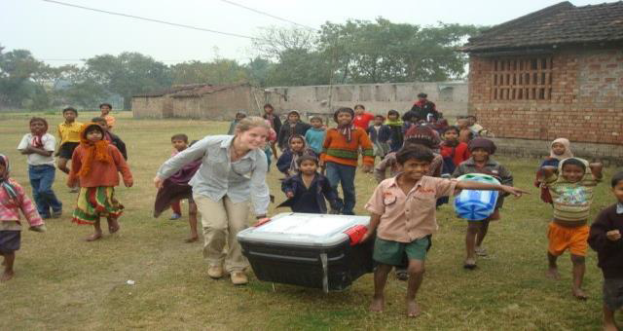
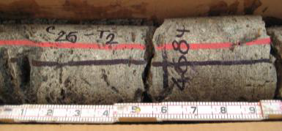

Slide 7
Journal of Environmental Analytical Chemistry Related Journals
Natural Products Chemistry & Research
Organic Chemistry
Environmental & Analytical Toxicology

Slide 8
Journal of Environmental Analytical Chemistry Related Conferences
International Summit on Past and Present Research Systems of Green Chemistry

Slide 9
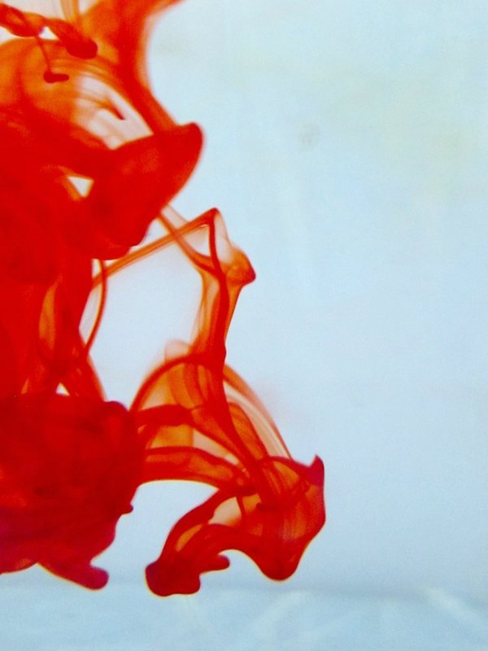
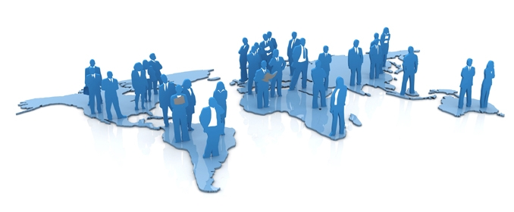
OMICS International Open Access Membership
OMICS International offers Open Access Membership for academic and research institutions, funders and corporations to actively encourage open access in scholarly communication and the dissemination of research published by their authors.
For more details and benefits, click on the link below:
http://omicsonline.org/membership.php

