Slide 1
OMICS Journals are welcoming Submissions
OMICS International welcomes submissions that are original and technically so as to serve both the developing world and developed countries in the best possible way.
OMICS Journals are poised in excellence by publishing high quality research. OMICS International follows an Editorial Manager® System peer review process and boasts of a strong and active editorial board.
Editors and reviewers are experts in their field and provide anonymous, unbiased and detailed reviews of all submissions.
The journal gives the options of multiple language translations for all the articles and all archived articles are available in HTML, XML, PDF and audio formats. Also, all the published articles are archived in repositories and indexing services like DOAJ, CAS, Google Scholar, Scientific Commons, Index Copernicus, EBSCO, HINARI and GALE.
For more details please visit our website: http://omicsonline.org/Submitmanuscript.php

Slide 2
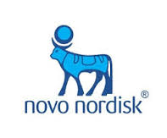
Sergey Zaets Director, Clinical Development Medical & Regulatory Affairs, Novo Nordisk, Inc, Plainsboro, NJ USA
Executive Editor of
Anatomy & Physiology:
Current Research

Slide 3
BIOGRAPHY
Sergey Zaets received MD degree from Moscow Medical Institute and PhD and DSc degrees from Bakoulev Center for Cardiovascular Surgery (Moscow, Russia), and used to work as a pediatric cardiac surgeon until relocation to the USA in 1999. During the years 1999-2005, performed research studies on red blood cell dysfunction in trauma-hemorrhagic shock, burn, gut ischemia, and pancreatitis at the UMDNJ - New Jersey Medical School. In 2005, joined Novo Nordisk Inc. Investigated the role of coagulation Factor XIII in prevention of multiple organ dysfunction after experimental trauma-hemorrhagic shock, burn, gut ischemia, and cardio-pulmonary bypass. Since 2009, is involved in clinical development of new recombinant factors to be used in hemophilia and FXIII congenital deficiency.

Slide 4
RESEARCH INTEREST
Trauma-hemorrhagic shock, sepsis, coagulation disorders, congenital “open-heart” surgery.

Slide 5
ACHIEVEMENTS
Author of more than 200 publications.

Slide 6
PUBLICATIONS
Normal Dimensions of Cardiac Valves: What do Normative Bases Tell us? Sergey Zaets, Anat Physiol 2012, 2: e113
Repair of congenital heart defects associated with single pulmonary artery. Leo A Bockeria, Osman A Makhachev, Titalav Kh Khiriev, Vladimir P Podzolkov, Mikhail A Zelenikin, Aleksey I Kim, Sergey B Zaets
Dynamics of Factor XIII Levels After Open Heart Surgery for Congenital Heart Defects: Do Cyanotic and Acyanotic Patients Differ? Leo A Bockeria, Natalia N Samsonova, Ivan A Yurlov, Ludmila G Klimovich, Elena F Kozar, Eva H N Olsen, Sergey B Zaets
Does Recombinant Factor XIII Eliminate Early Manifestations of Multiple-Organ Injury After Experimental Burn Similarly to Gut Ischemia-Reperfusion Injury or Trauma-Hemorrhagic Shock? Sergey B Zaets, Da-Zhong Xu, Qi Lu, Eleonora Feketova, Tamara L Berezina, Inga V Malinina, Edwin A Deitch, Eva H N Olsen

Slide 7
Palliative surgical treatment of congenital heart defects associated with unilateral absence of the pulmonary artery. Leo A Bockeria, Vladimir P Podzolkov, Osman A Makhachev, Bagrat G Alekyan, Titalav Kh Khiriev, Mikhail A Zelenikin, Konstantin V Shatalov, Sergey B Zaets
Immediate results of bidirectional cavopulmonary anastomosis and Fontan operations in adults. Vladimir P Podzolkov, Mikhail M Zelenikin, Ivan A Yurlov, Dmitry V Kovalev, Ketevan A Mchedlishvili, Neele A Putiato, Sergey B Zaets
Recombinant factor XIII mitigates hemorrhagic shock-induced organ dysfunction. Sergey B Zaets, Da-Zhong Xu, Qi Lu, Eleonora Feketova, Tamara L Berezina, Inga V Malinina, Edwin A Deitch, Eva H Olsen
Effectiveness of stroke education in the emergency department waiting room. Yu-Feng Yvonne Chan, Roxanne Nagurka, Lynne D Richardson, Sergey B Zaets, Michael B Brimacombe, Steven R Levine
Double outlet right ventricle with anomalous left pulmonary artery. Leo A Bockeria, Osman A Makhachev, Andrey V Sobolev, Viktoria V Plakhova, Sergey V Gorbachevsky, Sergey B Zaets

Slide 8
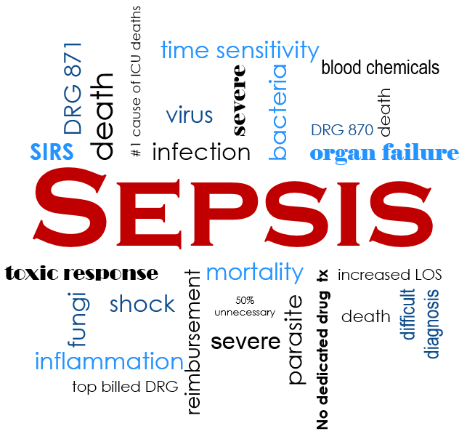

Slide 9
DEFINITION
Sepsis is a potentially life-threatening complication of an infection. Sepsis occurs when chemicals released into the bloodstream to fight the infection trigger inflammatory responses throughout the body. This inflammation can trigger a cascade of changes that can damage multiple organ systems, causing them to fail.
If sepsis progresses to septic shock, blood pressure drops dramatically, which may lead to death.
Anyone can develop sepsis, but it's most common and most dangerous in older adults or those with weakened immune systems. Early treatment of sepsis, usually with antibiotics and large amounts of intravenous fluids, improves chances for survival.

Slide 10
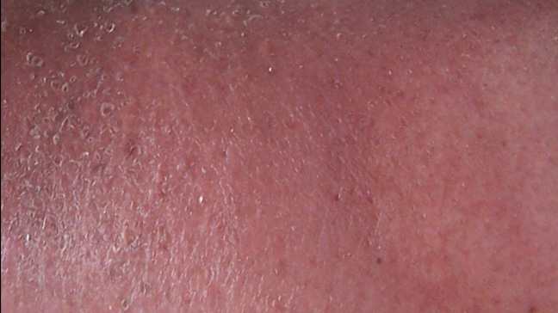
Skin shows the signs of Sepsis

Slide 11
EXPLANATION
It is a illness in the body in which body gives severe response to bacteria and other germs. This response is termed as Systemic Inflammatory Response Syndrome (SIRS).
SIRS is considered as the main symptom towards Sepsis.
Sepsis caused Septic Shock which occurs by high lactate level.
Sepsis causes by the serious infected immune system in the body which becomes the cause of other severe diseases.
Sepsis cause billions of deaths globally each year.

Slide 12
How to diagnose sepsis???
To be diagnosed with sepsis, you must exhibit at least two of the following symptoms:
1. Body temperature above 101 F (38.3 C) or below
96.8 F (36 C)
2. Heart rate higher than 90 beats a minute
3. Respiratory rate higher than 20 breaths a minute
4. Probable or confirmed infection

Slide 13
In case of Severe sepsis
Your diagnosis will be upgraded to severe sepsis if you also exhibit at least one of the following signs and symptoms, which indicate an organ may be failing:
Significantly decreased urine output
Abrupt change in mental status
Decrease in platelet count
Difficulty breathing
Abnormal heart pumping function
Abdominal pain

Slide 14
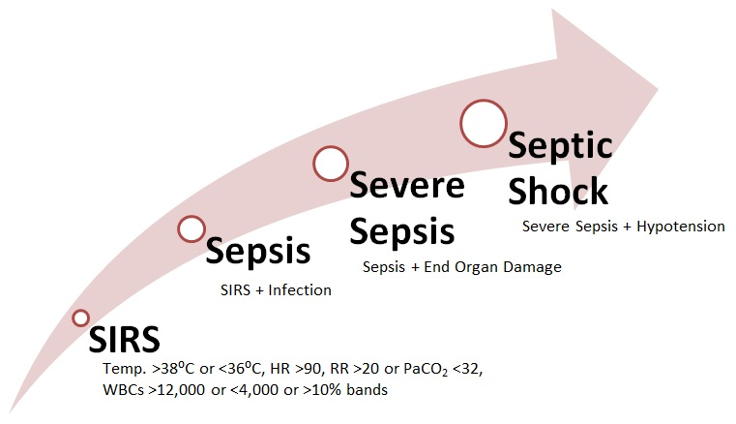

Slide 15
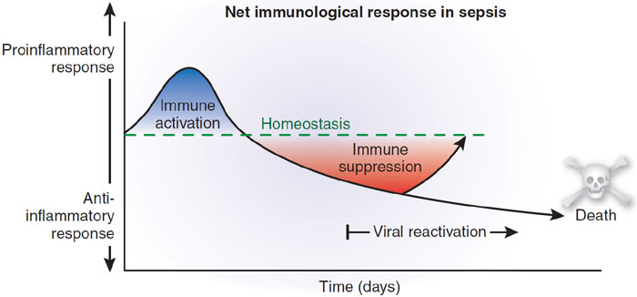

Slide 17
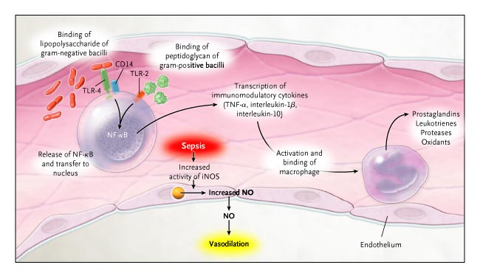

Slide 18
People at high risk of developing sepsis include:
the very young and very old
people with weak immune systems
ICU patients that are already very sick
patients exposed to invasive devices (such as intravenous catheters or breathing tubes)

Slide 19
TREATMENT
Sepsis is required to be treated as soon as possible as the symptoms occurs. This means the rapid administration of antibiotics and fluids through IV route which helps the medicines to go directly into the blood stream. A 2006 study showed that the risk of death from sepsis increases by 7.6% with every hour that passes before treatment begins.
In case of Antibiotics, several antibiotics are prescribed to cure the illness and firstly Broad Spectrum Antibiotics are prescribed against most common type of bacteria’s and germs. It is also administered by IV route only.

Slide 20
Along with Antibiotics, IV Fluids are also required to be administered as it alone wont treat sepsis. The body needs extra fluids to help keep the blood pressure from dropping dangerously low, throwing the patient into shock.
Normal saline is one commonly given fluid. It is a crystalloid fluid. These are fluids that contain minerals, such as sodium, and are water soluble, or dissolve in water. These add fluid to the blood system.
Note: Since all patients are different and have different mode of symptoms of sepsis and not every treatment is suitable for every patient.

Slide 21
LAUGH OFTEN
BE ADVENTUROUS
BIKE MORE EAT BETTER SEE BIG DREAMS REMEMBER SPECIAL MOMENTS MAKE FRIENDS
BE HEALTHY HAVE FAITH ENJOY LIFE SPEND MORE TIME WITH DEAR ONES
STAY FIT SO THAT YOU CAN
KEEP AWAY FROM SEPSIS

Slide 22
Approved By: Sergey Zaets
E-signature: Zaets

Slide 23
OMICS International Open Access Membership
OMICS publishing International Open Access Membership enables academic and research institutions, funders and corporations to actively encourage open access in scholarly communication and the dissemination of research published by their authors.
For more details and benefits, click on the link below:
http://omicsonline.org/membership.php

