Slide 1
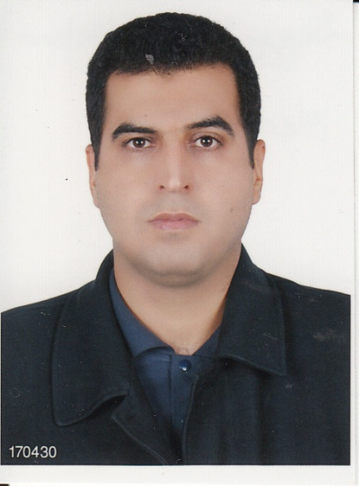
Seyyed Aliakbar Hedayati, B.SC,M.SC,PH.D
Editor of
Journal of Coastal Zone Management

Slide 2
Biography
Dr. Seyyed Aliakbar Hedayati completed his B.Sc. in Fisheries from Isfahan University of Technology– Iran (2003), M.Sc. in Fisheries from Khorramshahr University of Marine Science, Iran in 2006, and his PhD. in Marine Biology from Khorramshahr University of Marine Science, Iran in 2011. during PhD, he passed visiting scholar cours at CRIAcq center, University of Naples, Italy. he currently holds the position of Assistant Professor of Marine Biology - Department of Fishery & Environment, Gorgan University of Agricultural Sciences and Natural Resources, Iran. He is a Member of National Elite Foundation and has a number of International publications and memberships under his feather.

Slide 3
Research Interests
Marine biology, Fisheries.

Slide 4
Recent Publications
Seyyed Morteza Hoseini. Aliakbar Hedayati, Melika Ghelichpour. 2014. Plasma metabolites, ions and thyroid hormones levels, and hepatic enzymes׳ activity in Caspian roach (Rutilus rutilus caspicus) exposed to waterborne manganese. Ecotoxicology and Environmental Safety. 107:84-89.
Hashemi SAR, Ghorbani k, Kaymaram F, Hosseini SA, Eskandari G, Hedayati A, 2014. Estimation of fish composition and catchability coefficient of gillnet in the Shadegan Wetland. Iran. J. Ichthyol. 1: 51–60.
Hashemi SAR, Ghorbani k, Kaymaram F, Hosseini SA, Eskandari G, Hedayati A, 2014. Length-Weight Relationships for some fish Species from Shadegan wetland. Global Advanced Research Journals of Food Sciences and Technology. 3: 76-83.
Forouhar Vajargah M and Hedayati A. 2014. Acute toxicity of trichlorofon on four viviparous fish: Poecilia latipinna, Poecilia reticulata, Gambusia holbrooki and Xiphophorus helleri (Cyprinodontiformes: Poecilidae). Journal of Coastal Life Medicine. 2: 511-514.

Slide 5
Resent publications
Hashemi SAR, Taghavimotlagh SA, Eskandari G, Hedayati A, 2013. Length-Weight Relationships of Five Species of Demersal Fish from North of Persian Gulf, Iran. 1:73-81.
Sadeghi, A. Hedayati, A. 2013. Investigation of acute toxicity of of diazinon deltamthrine, butachlore and pertilachlor on Zebra cichlid. Iranian journal of Toxicology. Volume 8, No 25.
Ali Vaboonian, Abdolali Movahedinia, Alireza Safahieh and Aliakbar Hedayati. 2013. Serum biochemical changes of yellowfin sea bream (Acanthopagrus latus ) in response to sublethal cadmium toxicity. Comp Clin Pathol. DOI 10.1007/s00580-013-1851-0.

Slide 6
Resent publications
Hedayati SAA, Yavari V, Bahmani M, Alizadeh M and Bagheri T. 2007. Examination reciprocal relationship of blood profile in Great sturgeon cultured in brackish water. Proceedings of the 10th International Conference on Environmental Science and Technology. Kos Island. Greece .Pages: B269 - B275.
Hedayati A, Yavari V, Bahmani M. Alizadeh M and Bagheri T. 2007. Investigation of blood serum osmo-ionregulation in Great sturgeon (Huso huso) cultured in brackish water. Proceedings of the International Conference on Environmental, Management, Engineering, Planning and Economics. Skiathos, Greece. Pages: 911-916.

Slide 7
Resent publications
Alizadeh M, Hedayati A, Bahmani M and Bagheri T. 2009. Study of Seasonal Fluctuation of Steroid Hormones in Great Sturgeon (Huso huso) Cultured in Brackish Water Medium. Proceeding of 6th international symposium on sturgeon. China. 89-90.
T. Bagheri and A. Hedayati, 2009. Reciprocal Relationship of Blood Profiles as an Immunological Bioindicator in Great Sturgeon (Huso Huso). Journal of Comparative Pathology. Volume 141, Issue 4, P.280

Slide 8
Membership of Editor
World Sturgeon Conservation Society (WSCS)
World Aquaculture Society (WAS)
Iranian Society of Marine Science & Technology.
Iranian Marine Biology Society.

Slide 9
Introduction
Marine biology is the scientific study of organisms in the ocean or other marine or brackish bodies of water. Given that in biology many phyla, families and genera have some species that live in the sea and others that live on land, marine biology classifies species based on the environment rather than on taxonomy. Marine biology differs from marine ecology as marine ecology is focused on how organisms interact with each other and the environment, while biology is the study of the organisms themselves.

Slide 10
Coral reefs form complex marine ecosystems with tremendous biodiversity

Slide 11
Marine Habitats
Marine habitats can be divided into coastal and open ocean habitats.
Intertidal zones, those areas close to shore, are constantly being exposed and covered by the ocean's tides. A huge array of life lives within this zone.

Slide 12
Professional Prospects
The marine ecosystem is large, and thus there are many sub-fields of marine biology. Most involve studying specializations of particular animal groups, such as phycology, invertebrate zoology and ichthyology.

Slide 13
Main aim of marine biology
An active research topic in marine biology is to discover and map the life cycles of various species and where they spend their time. Marine biologists study how the ocean currents, tides and many other oceanic factors affect ocean life forms, including their growth, distribution and well-being. This has only recently become technically feasible with advances in GPS and newer underwater visual devices.

Slide 14
Definition
Marine biology is a branch of biology and is closely linked to oceanography. It also encompasses many ideas from ecology. Fisheries science and marine conservation can be considered partial offshoots of marine biology (as well as environmental studies). Marine Chemistry, Physical oceanography and Atmospheric sciences are closely related to this field.

Slide 15
Approved By
E-signature:
Aliakbar Hedayati

