Slide 1


Editorial Board Member
Dr. Shankar Swaminathan
Postdoctoral researcher
Hamilton Eye Institute
University of Tennessee Health Science Center
USA
Tel. 857 756 7292

Slide 2
Biography
Dr. Swaminathan is a pharmaceutical scientist and polymer chemist turned into an eye/vision researcher. Dr. Swaminathan received his Ph.D. in Pharmaceutics from the Institute of Chemical Technology, Mumbai, India. He was also a research assistant at the University of Turin, Italy during his Ph.D. He went on to gain research experience in the industry after his Ph.D. specializing in long acting polymeric medical devices for contraception where he was instrumental in getting the product to the scale up stage. He then decided to fortify his repertoire further by gaining postdoctoral research experience in the US in eye/vision research..
> > >

Slide 3
Currently, a postdoctoral researcher at the University of Tennessee Health Science Center. His research revolves around studying genetic modifiers of glaucoma with a special emphasis on intraocular pressure and developing personalized nanomedicine. Research involves gene mining using bioinformatics tools and systems genetics. He is also a part of the team developing novel nano-therapies for dry age related macular degeneration.
Pioneered the work on Nanosponge synthesis and applications in drug delivery.

Slide 4
Research Interests
Pursuing active research in drug delivery technology, nanotechnology, ocular drug delivery, ocular pharmacokinetics, systems biology, bioinformatics, solublization of drug actives, medical devices, etc.
He is also interested in the commercial aspects of research dealing with bench to market transition of a product, and product licensing. He has keen interest in the FDA regulations and IP related issues pertaining to product filings.
> > >

Slide 5
General research interests revolve around providing value added medicine to alleviate diseases by applying polymeric nanoparticle technology, controlled drug delivery, solubilization, cyclodextrin based drug delivery systems, ocular pharmacokinetics and biodistribution. Solid dispersion, drug/particle/pellet coating, pellets into tablet technology, Silicone based controlled release medical devices for contraception, Intrauterine medical devices, anticancer drug therapy optimization by solubilization and bioavailability enhancement, stabilization of macromolecules/proteins by use of nanosponge technology, physicochemical stabilization of molecules.

Slide 6
Publications
Shankar Swaminathan, Monica Jablonski M (2012) Non-Biological Membranes as Drug Delivery Systems. J Membra Sci Technol 2: e108

Slide 7
Nanotechnology
Nanotechnology ("nanotech") is the manipulation of matter on an atomic, molecular, and supramolecular scale. The earliest, widespread description of nanotechnology referred to the particular technological goal of precisely manipulating atoms and molecules for fabrication of macroscale products, also now referred to as molecular nanotechnology.
A more generalized description of nanotechnology was subsequently established by the National Nanotechnology Initiative, which defines nanotechnology as the manipulation of matter with at least one dimension sized from 1 to 100 nanometers.

Slide 8
Ocular Drug Delivery System
Introduction
The external eye is readily accessible for drug administration. As a consequence of its function as the visual apparatus, mechanisms are strongly developed for the clearance of foreign materials from the cornea to preserve visual acuity. This presents problems in the development of formulations for ophthalmic therapy
Topical administration is direct, but conventional preparations of ophthalmic drugs, such as ointments, suspensions, or solutions, are relatively inefficient as therapeutic systems

Slide 9
Following administration, a large proportion of the topically applied drug is immediately diluted in the tear film and excess fluid spills over the lid margin and the remainder is rapidly drained into the nasolacrimal duct
A proportion of the drug is not available for immediate therapeutic action since it binds to the surrounding extraorbital tissues
In view of these losses, frequent topical administration is necessary to maintain adequate drug levels.

Slide 10
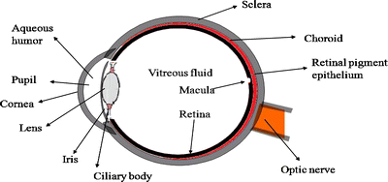
Structure of Eye
The eye is composed of two components
  anterior segment: consists of front one-third of eye that mainly includes pupil, cornea, iris, ciliary body, aqueous humor, and lens
  posterior segment: consists of the back two-thirds of the eye that includes vitreous humor, retina, choroid, macula, and optic nerve

Slide 11
Routes of drug administration
Topical Administration
  Drops
  Perfusion
  Sprays
  Ointments
  Particulates
Intraocular drug delivery
  Liposomes
  Microparticulates and nanoparticles
  Intraocular devices
  Iontophoresis

Slide 12
Drops
The most common form of topical administration is the eye drop. It is apparently easy to use, relatively inexpensive and does not impair vision.
The major problems with these types of formulation are their inability to sustain high local concentrations of drug and they only have a short contact time with the eye
Contact time between the vehicle and the eye can be increased by the addition of polymers such as polyvinyl alcohol and methylcellulose
Drainage from the eye may also be reduced by punctual occlusion or simple eyelid closure, which prolongs the contact time of the drug with the external eye.

Slide 13
Perfusion
Continuous and constant perfusion of the eye with drug solutions can be achieved by the use of ambulatory motor driven syringes that deliver drug solutions through fine polyethylene tubing positioned in the conjunctival sac
The flow rate of the perfusate through a minipump can be adjusted to produce continuous irrigation of the eye surface (3– 6 ml/min) or slow delivery (0.2 ml/min) to avoid overflow
This system allows the use of a lower drug concentration than used in conventional eye-drops, yet will produce the same potency. Side effects are reduced and constant therapeutic action is maintained

Slide 14
Sprays
Spray systems produce similar results to eye-drops in terms of duration of drug action and side effects. Sprays have several advantages over eye-drops:
  a more uniform spread of drug can be achieved
  precise instillation requiring less manual dexterity than for eye-drop administration and is particularly useful for treating patients with unsteady hand movements
  contamination and eye injury due to eye-drop application are avoided
  spray delivery causes less reflex lacrimation.
  Can be used by patients who have difficulty bending their neck back to administer drops.

Slide 15
Ointments
Ointments are not as popular as eye drops since vision is blurred by the oil base, making ointments impractical for daytime use
They are usually applied for overnight use or if the eye is to be bandaged. They are especially useful for paediatric use since small children often wash out drugs by crying.
Ointments are generally non-toxic and safe to use on the exterior of the surface of the eye. However, ointment bases such as lanolin, petrolatum and vegetable oil are toxic to the interior of the eye, causing corneal oedema, vascularization and scarring

Slide 16
Microparticulates and nanoparticles
Microspheres and nanoparticles are retained for extended periods within the eye and can provide slow, sustained release of drugs
The delivery systems are especially attractive because of the ease of manufacturing and improved stability compared to liposomes
The polymers used in the manufacture can be erodible, in which case the drug release is due to the polymer degradation, or non-erodible, where the drug is released is by diffusion through the polymer

Slide 17
Intraocular devices
The administration of medications by implants or depot devices is a very rapidly developing technology in ocular therapeutics. These overcome the potential hazards associated with repeated intravitreal injection such as clouding of the vitreous humor, retinal detachment and endophthalmitis
Implantable devices have been developed that serve two major purposes. First, to release of drug at zero order rates, thus improving the predictability of drug action, and second, to release of the drug over several months, reducing dramatically the frequency of administration.
Vitrasert® is a commercially available sustained release intraocular device for ganciclovir approved for use in-patients suffering from cytomegalovirus

Slide 18
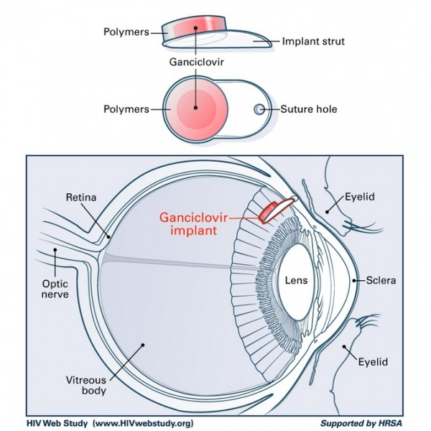
Vitrasert® intraocular device

Slide 19
Iontophoresis
Iontophoresis (see transdermal lecture notes) facilitates drug penetration through the intact corneal epithelium
The solution of the drug is kept in contact with the cornea in an eyecup bearing an electrode. A potential difference is applied with the electrode in the cup having the same charge as the ionized drug, so that the drug flux is into the tissue
This method of administration is very rarely used, except under carefully controlled conditions. Iontophoresis allows penetration of antibiotics that are ionised and therefore do not penetrate by other methods, for example, polymyxin B used in the local treatment of infections

Slide 20
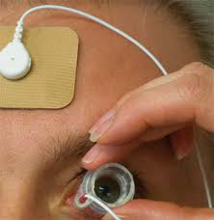
Commonly reported toxic effects include slight retinal and choroidal burns and retinal pigment epithelial and choroidal necrosis, corneal epithelial oedema, persistent corneal opacities and polymorphonuclear cell infiltration. Other disadvantages of iontophoresis include side effects such as itching, erythema and general irritation

Slide 21
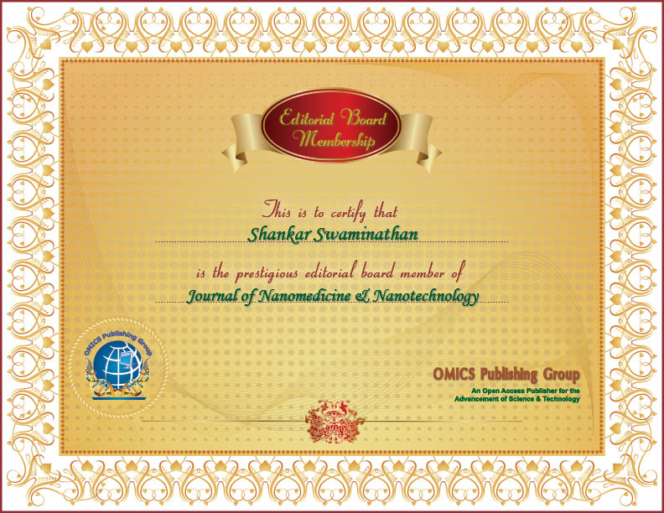

Slide 22
Thank You..!

