Slide 1
Shufeng Zhou Assoicate Dean Department of Pharmaceutical Science University of South Florida

Slide 2
Biography
Dr. Shufeng Zhou is presently a Professor, Associate Dean of International Research, and Chair of the Department of Pharmaceutical Sciences, College of Pharmacy, University of South Florida, Tampa, Florida. Professor Zhou completed his clinical medical training in China in 1989 and obtained his PhD in 2001 from the School of Medicine, the University of Auckland, New Zealand. Since 2002, Dr Zhou has served as a faculty member for the National University of Singapore, Queensland University of Technology, Australia, and RMIT University, Australia.

Slide 3
Recent Publications
Li YC, He SM, He ZX, Li M, Zhou SF et al. (2014) Plumbagin induces apoptotic and autophagic cell death through inhibition of the PI3K/Akt/mTOR pathway in human non-small cell lung cancer cells. Cancer Lett 344:239-259.
Liang S, Zhou Y, Wang H, Qian Y, Ma D, et al.(2014) The effect of multiple single nucleotide polymorphisms in the folic Acid pathway genes on homocysteine metabolism. Biomed Res Int 560183.
Panguluri SK, Sneed KB, Pathak Y, Zhou S (2014) Editorial: current topics in pharmacogenomics. Recent Pat Biotechnol 8:109.
Yin JJ, Sharma S, Shumyak SP, Wang ZX, Zhou ZW, et al. (2013) Synthesis and Biological Evaluation of Novel Folic Acid Receptor-Targeted, β-Cyclodextrin-Based Drug Complexes for Cancer Treatment. PLoS One 8:e62289.

Slide 4
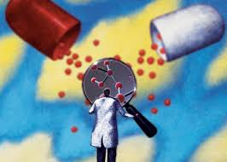
Drug Discovery
The process of drug discovery involves the identification of lead and its target, synthesis, characterization, screening, and assays for therapeutic efficacy of lead.
Average time required to bring a drug to the market range from 12-15 years at an average cost of $600-800 million.

Slide 5
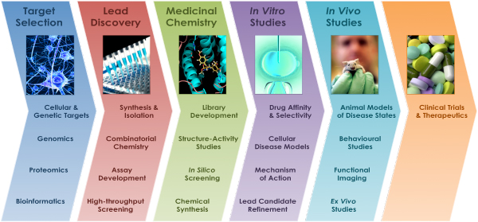

Slide 7
Drug Discovery Process

Slide 8
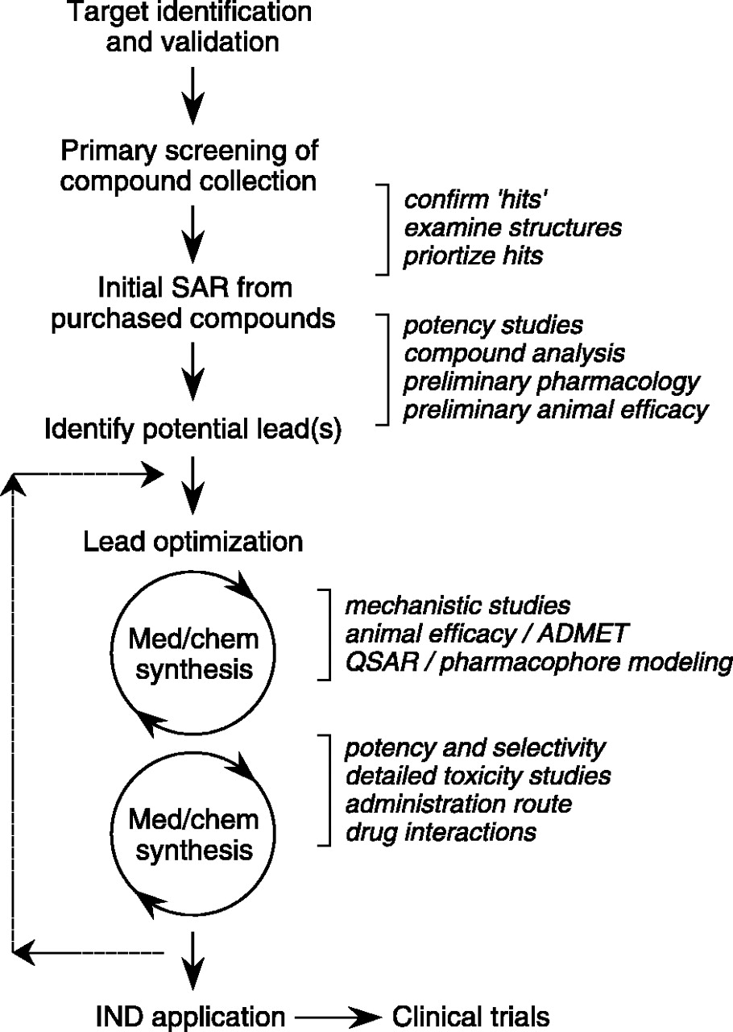

Slide 9
Discovery
Develop an assay to evaluate activity of compounds on the target
- in vitro (e.g. enzyme assay)
- in vivo (animal model or pharmacodynamic assay)
Identify a lead compound
screen collection of compounds (“compound library”)
compound from published literature
screen Natural Products
structure-based design (“rational drug design”)
Optimize to give a “proof-of-concept” molecule-one that shows efficacy in an animal disease model
Optimize to give drug-like properties-pharmacokinetics, metabolism, off-target activities
Safety assessment, Preclinical Candidate!!
Notes:
Here is what we are trying to achieve (refer to slide).
Note that you can comment on:
We conduct basic animal health research in RY, but our animal health care products are marketed by Merial, a joint venture between Merck and Rhone- Poulenc (note that RP is now known as Aventis (RP merged with Hoechst).
Outcomes research is when we attempt to prove that our compounds not only cause important chemical effects in the body (such as reduced blood pressure or reduced cholesterol), but that these effects lead to reduced morbidity and mortality over time. The Zocor 4S study is an example.
The research budget for MRL is $2.4 billion this year.

Slide 10
Drug Discovery—Convergence of Disciplines
Synthetic
Chemistry
Combinatorial
Chemistry
Patent Law
Modelling
Novel
Molecule
Intellectual Property
Physiology
Information
Technology
Design
Structural
Activity
Biochemistry
Physiology
Safety
Pharmaco-
dynamics
Physiology
Metabolism
Pharmacology
Safety
Assessment
Immunology
In Vivo activity
Pharmacokinetic
Properties
DMPK
Pharmacology
Behavior
Pathology
Enzymology
Physiology
Physical
Chemistry
Physiology

Slide 11
Signature
Shufeng Zhou
College of Pharmacy, University of South Florida, Tampa, FL 33612.

Slide 12
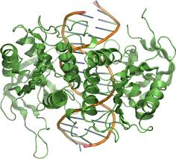
Pharmacoepidemiology & Drug Safety Related Journals
Advances in Pharmacoepidemiology & Drug Safety
Pharmacovigilance
Epidemiology: Open Access
Clinical & Experimental Pharmacology

Slide 13
Pharmacoepidemiology & Drug Safety Related Conferences
For further details regarding the conference please visit:
http://www.conferenceseries.com/pharmaceutical-sciences-meetings/

Slide 14
OMICS Group Open Access Membership
Open Access Membership with OMICS international enables academicians and research institutions, funders and corporations to actively encourage open access in scholarly communication and the dissemination of research published by their authors.
For more details and benefits, click on the link below:
http://omicsonline.org/membership.php

