Slide 1

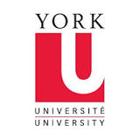
Simone Duarte
Executive Editor
Journal of Oral Hygiene & Health

Slide 2
Biography
Dr. Simone Duarte is an Assistant Professor in the Department of Basic Science and Craniofacial Biology and the course director of Pharmacology at the College of Dentistry. Dr. Duarte’s research focuses on the understanding and control of cariogenic dental biofilms using natural agents.
She is working together with Dr. David Grier, from the department of Physics and Center for Soft Matter Reseach at New York University, trying to establish a new methodology to analyze the physical properties of dental biofilms, using holographic microrheology. This new methodology is very
unique and shows promise for high-throughput combinatorial screening of candidate therapeutic or remedial agents.

Slide 3
In addition, Dr. Duarte’s lab also studies the structural characterization of the biofilm matrix, using Confocal Laser Scanning Microscopy (CLSM); quantifying the structural properties by analyzing the CLSM images using COMSTAT software (Heydorn et al., 2000). Rather than assessing their biological or biochemical influence, holographic microrheology together with CLSM offers direct insight into these agents influence on biofilm matrix’s structure and physical properties.

Slide 4
Research Interest
To find a valuable anti-biofilm therapy to prevent dental caries. During my carrier as a researcher, I have been working on the development of therapies affecting oral biofilms. Furthermore, to better understand the therapies’ mechanisms of action, I am interested on the implementation of innovative methods to study oral biofilms and how treatments will affect them.

Slide 5
Recent Publications
Teixeira HS, Coelho PG, Duarte S, Janal MN, Silva N, Thompson VP (2014) Influence of atmospheric pressure plasma treatment on mechanical proprieties of enamel and sealant bond strength. J Biomed Mater Res B Appl Biomater. 2014 Sep 20.
Paschoal MA, Santos-Pinto L, Lin M, Duarte S (2014) Streptococcus mutans photoinactivation by combination of short exposure of a broad-spectrum visible light and low concentrations of photosensitizers. Photomed Laser Surg. 2014 Mar;32(3):175-180.
Weber K, Delben J, Bromage TG, Duarte S (2014) Comparison of SEM and VPSEM imaging techniques with respect to Streptococcus mutans biofilm topography. FEMS Microbiol Lett 350: 175-179.

Slide 6
Recent Publications
Paschoal MA, Lin M, Santos-Pinto L, Duarte S (2006) Photodynamic antimicrobial chemotherapy on Streptococcus mutans using curcumin and toluidine blue activated by a novel LED device. Lasers Med Sci. 2013 Nov 19.
Duarte S, Gregoire S, Singh AP, Vorsa N, Schaich K, Bowen WH, Koo H (2006) Inhibitory effects of cranberry polyphenols on formation and acidogenicity of Streptococcus mutans biofilms. FEMS Microbiol Lett 257: 50-56.
Duarte S, Rosalen PL, Hayacibara MF, Cury JA, Bowen WH, Marquis RE, Rehder VL, Sartoratto A, Ikegaki M, Koo H (2006) The influence of a novel propolis on mutans streptococci biofilms and caries development in rats. Arch Oral Biol. 2006 Jan;51(1):15-22. Epub 2005 Jul 28.

Slide 7
Recent Publications
Hayacibara MF, Koo H, Rosalen PL, Duarte S, Franco EM, Bowen WH, Ikegaki M, Cury JA (2005) In vitro and in vivo effects of isolated fractions of Brazilian propolis on caries development. J Ethnopharmacol. 2005 Oct 3;101(1-3):110-115.
Duarte S, Koo H, Bowen WH, Hayacibara MF, Cury JA, Ikegaki M, Rosalen PL (2003) Effect of a novel type of propolis and its chemical fractions on glucosyltransferases and on growth and adherence of mutans streptococci. Biol Pharm Bull. 2003 Apr;26(4):527-31.

Slide 8
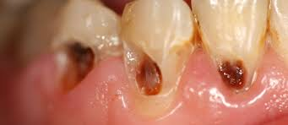
Dental caries
Dental caries also known as tooth decay or a cavity, caries is a biofilm dependent disease, bacterial in origin, that causes demineralization and destruction of the hard tissues of the teeth (enamel, dentin and cementum). It is a result of the production of acid by bacterial fermentation of food debris accumulated on the tooth surface

Slide 9
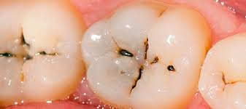
Dental caries
If demineralization exceeds saliva and other remineralization factors such as from calcium and fluoridated toothpastes, these once hard tissues progressively break down, producing dental caries (cavities or carious lesions, that is, holes in the teeth).
Today, caries remains one of the most common diseases throughout the world. Cariology is the study of dental caries.

Slide 10
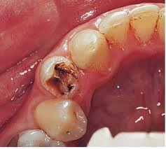
Dental caries
Depending on the extent of tooth destruction, various treatments can be used to restore teeth to proper form, function, and aesthetics, but there is no known method to regenerate large amounts of tooth structure.
Instead, dental health organizations advocate preventive and prophylactic measures, such as regular oral hygiene and dietary modifications, to avoid dental caries.

Slide 11
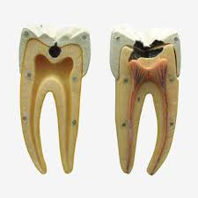
Dental caries
The earliest sign of a new carious lesion is the appearance of a chalky white spot on the surface of the tooth, indicating an area of demineralization of enamel.
This is referred to as a white spot lesion, an incipient carious lesion or a "microcavity”.

Slide 12

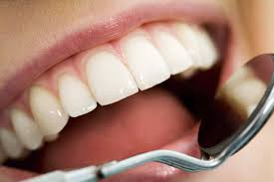
Journal of Oral Health & Hygiene
Oral Cancer
Oral Health
Dentistry
Dental Bonding
Dental caries

