Slide 1
OMICS Group
OMICS Group International through its Open Access Initiative is committed to make genuine and reliable contributions to the scientific community. OMICS Group hosts over 400 leading-edge peer reviewed Open Access Journals and organizes over 300 International Conferences annually all over the world. OMICS Publishing Group journals have over 3 million readers and the fame and success of the same can be attributed to the strong editorial board which contains over 30000 eminent personalities that ensure a rapid, quality and quick review process. OMICS Group signed an agreement with more than 1000 International Societies to make healthcare information Open Access.
Contact us at: contact.omics@omicsonline.org

Slide 2
OMICS Journals are welcoming Submissions
OMICS Group welcomes submissions that are original and technically so as to serve both the developing world and developed countries in the best possible way.
OMICS Journals are poised in excellence by publishing high quality research. OMICS Group follows an Editorial Manager® System peer review process and boasts of a strong and active editorial board.
Editors and reviewers are experts in their field and provide anonymous, unbiased and detailed reviews of all submissions.
The journal gives the options of multiple language translations for all the articles and all archived articles are available in HTML, XML, PDF and audio formats. Also, all the published articles are archived in repositories and indexing services like DOAJ, CAS, Google Scholar, Scientific Commons, Index Copernicus, EBSCO, HINARI and GALE.
For more details please visit our website: http://omicsonline.org/Submitmanuscript.php

Slide 3
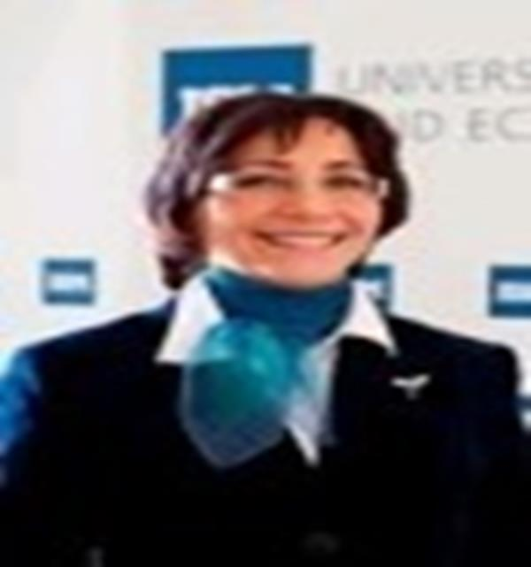
Škudienė Vida
Professor of Marketing Lituania

Slide 4
BRIEF BIOGRAPHY :
Professor Vida Škudiene, Head of General University Education Subject Group, is teaching graduate and bachelor courses in Relationship Marketing and Organizational Behavior at Nagoya University of Commerce and Business, Japan and ISM University of Management and Economics.
Professor worked ten years as economist in Radio plant, Kaunas. During the period of 1992-2002 professor worked at Vytautas Magnus University as lecturer and 2000-2008 she worked as a sales executive responsible for Lithuania at international company Macmillan Education, Oxford, UK.
Main fields of interest are relationship marketing, organizational behavior, leadership and entrepreneurship.

Slide 5
EDUCATION:
Professor Vida studied at South Carolina University, USA; Latvia State University; Vytautas Magnus University and Kaunas Technological University, Lithuania.

Slide 6
RESEARCH INTERESTS :
Relationship marketing
Organizational behavior
Leadership
Entrepreneurship

Slide 7
ACHIEVEMENTS:
Prof. Vida Skudiene has presented her research at international conferences in France, Japan, Israel, US (Hawaii, Chicago), Greece, Croatia, France, Spain, Norway, Jamaica, Sweden, Italy (Boccioni), and published over 30 articles.
In 2008 she won the best paper Award from the US Marketing Management Association. Prof. Vida Skudiene is a member of editorial advisory board of international journals: “Baltic Journal of Management”, “Business and Economics Journal” and “Pecvnia”.
Prof. Vida Skudiene participates in the EU projects on Case Writing in HR Management, as an author, and Fostering Entrepreneurship in Higher Education, as a researcher.

Slide 8
Business and Economics Related Journals
Arabian Journal of Business and Management Review
Business and Economics Journal
International Journal of Economics and Management Sciences
Journal of Public Affairs

Slide 9
Business and Economics Related Conferences
International conference on Business, Economics and Management
International Conference on Advertising and Marketing Expo

Slide 10
OMICS Group Open Access Membership
OMICS publishing Group Open Access Membership enables academic and research institutions, funders and corporations to actively encourage open access in scholarly communication and the dissemination of research published by their authors.
For more details and benefits, click on the link below:
http://omicsonline.org/membership.php

