Slide 1
OMICS Group
OMICS Group International through its Open Access Initiative is committed to make genuine and reliable contributions to the scientific community. OMICS Group hosts over 400 leading-edge peer reviewed Open Access Journals and organizes over 300 International Conferences annually all over the world. OMICS Publishing Group journals have over 3 million readers and the fame and success of the same can be attributed to the strong editorial board which contains over 30000 eminent personalities that ensure a rapid, quality and quick review process. OMICS Group signed an agreement with more than 1000 International Societies to make healthcare information Open Access.
Contact us at: contact.omics@omicsonline.org

Slide 2
OMICS Journals are welcoming Submissions
OMICS Group welcomes submissions that are original and technically so as to serve both the developing world and developed countries in the best possible way.
OMICS Journals are poised in excellence by publishing high quality research. OMICS Group follows an Editorial Manager® System peer review process and boasts of a strong and active editorial board.
Editors and reviewers are experts in their field and provide anonymous, unbiased and detailed reviews of all submissions.
The journal gives the options of multiple language translations for all the articles and all archived articles are available in HTML, XML, PDF and audio formats. Also, all the published articles are archived in repositories and indexing services like DOAJ, CAS, Google Scholar, Scientific Commons, Index Copernicus, EBSCO, HINARI and GALE.
For more details please visit our website: http://esciencecentral.org/journals/alternative-integrative-medicine.php

Slide 3
Stefano Iotti Department of Pharmacy and Biotechnology (FaBit) Università di Bologna Italy
Editor
of
Journal of Alternative & Integrative Medicine

Slide 4
Bio-Sketch
Professor of Biochemistry at the University of Bologna. Since 1990 he has contributed to the development of in vivo magnetic resonance spectroscopy in basic research and in diagnostic applications. In 1987 he gained his master’s degree in Chemistry, and PhD in Biochemistry in 1994. From 1992 to 1993 he has been working at the Department of Biochemistry and Biophysics of the University di Pennsylvania. His scientific activity ranged from organic and physical chemistry to biochemical thermodynamics. At present part of the activity is directed to the study of magnesium homeostasis in living human tissues and in vitro in cell culture. He contributed to the development of a novel procedure to simplify the treatment of the thermodynamics of complex systems making possible to re-unify the two worlds of chemical and biochemical thermodynamics, which so far have been treated separately, and represents a new paradigm in the biochemical thermodynamics.

Slide 5
Research Interests
Biochemistry,
biochemical thermodynamics,
physical chemistry,
cell imaging,
alternative medicine,
science and art integration,
effect of sound on living systems.

Slide 6
Publications
Leoni, A.,Locatelli, A.,Morigi, R.,Rambaldi, M.,Cappadone, C.,Farruggia, G.,Iotti, S.,Merolle, L.,Zini, M.,Stefanelli, C. Substituted E-3-(3-indolylmethylene)1,3-dihydroindol-2-ones with antiproliferative activity. Study of the effects on HL-60 leukemia cells European Journal of Medicinal Chemistry 2014,79: 382-390
.Sargenti A, Farruggia G, Malucelli E, Cappadone C, Merolle L, Marraccini C, Andreani G, Prodi L, Zaccheroni N, Sgarzi M, Trombini C, Lombardo M, Iotti S.A novel fluorescent chemosensor allows the assessment of intracellular total magnesium in small samples. Analyst. 2014;139(5):1201-7.
Farruggia G, Castiglioni S, Sargenti A, Marraccini C, Cazzaniga A, Merolle L, Iotti S, Cappadone Effects of supplementation with different Mg salts in cells: is there a clue? C, Maier JA. Magnes Res. 2014; 27(1):25-34.
Emil Malucelli , Stefano Iotti*, Alessandra Gianoncelli , Michela Fratini, Lucia Merolle , Andrea Notargiacomo, Chiara Marraccini ,Azzurra Sargenti , Concettina Cappadone ,Giovanna Farruggia, Inna Bukreeva, Marco Lombardo, Claudio Trombini, Jeanette A. Maier, Stefano Lagomarsino. Quantitative Chemical Imaging of the Intracellular Spatial Distribution of Fundamental Elements and Light Metals in Single Cells. Anal. Chem. 2014, 86 (10), 5108–5115.
Layec G, Malucelli E, Le Fur Y, Manners D, Yashiro K, Testa C, Cozzone PJ, Iotti S, Bendahan D. Effects of exercise-induced intracellular acidosis on the phosphocreatine recovery kinetics: a 31P MRS study in three muscle groups in humans.NMR Biomed. 2013 26(11):1403-11
. Malucelli, E.,Iotti, S.,Fratini, M.,Marraccini, C.,Notargiacomo, A.,Gianoncelli, A.,Bukreeva, I.,Cedola, A.,Maier, J.,Farruggia, G.,Cappadone, C.,Merolle, L.,Wolf, F.,Trapani, V., Lagomarsino, S. X-ray fluorescence microscopy of light elements in cells: Self-absorption correction by integration of compositional and morphological measurements. Journal of Physics: Conference Series Volume 463, Issue 1, 2013, Article number 012022
.Sgarzi, M.,Lombardo, M.,Trombini, C.,Zaccheroni, N.,Farruggia, G.,Merolle, L.,Sargenti, A.,Iotti, S.,Marraccini, C.,Prodi, L. Expanding the targets of the diaza-18-crown-6 hydroxyquinoline derivatives family to Zn(II) ions for intracellular sensing. Supramolecular Chemistry 2013 25(1), ,7-15.

Slide 7
Publications conti..
Cappadone C, Merolle L, Marraccini C, Farruggia G, Sargenti A, Locatelli A, Morigi R, Iotti S. Intracellular magnesium content decreases during mitochondria-mediated apoptosis induced by a new indole-derivative in human colon cancer cells.Magnes Res. 2012 ;25(3):104-11
S. Lagomarsino, S. Iotti, G. Farruggia, V. Trapani, A. Cedola, M. Fratini, I. Bukreeva, L. Mastrototaro, A. Notargiacomo, I. McNulty, S. Vogt, S. Kim, D. Legnini, J. A. M. Maier, and F. Wolf. Combined X-ray Microfluorescence and Atomic Force Microscopy Studies of Mg Distribution in Whole Cells. AIP Conf. Proc. 2011, 1365: 395-398.
Iotti S, Malucelli. E. Free magnesium concentration in the human brain. In: Magnesium in the Central Nervous System; R. Vink and M. Nechifor. Eds. University Adelaide Press, Adelaide 2011.
88. Sabatini A, Vacca A , Iotti S , Balanced Biochemical Reactions: A New Approach to Unify Chemical and Biochemical Thermodynamics. PLoS ONE 2012, 7(1): e29529. doi:10.1371/journal.pone.0029529
C Marraccini , G Farruggia ,M Lombardo, L Prodi ,M Sgarzi ,V Trapani ,C Trombini , FI. Wolf, N Zaccheroni, S Iotti. Diaza-18-crown-6 hydroxyquinoline derivatives as flexible tools for the assessment and imaging of total intracellular magnesium Chem. Sci. 2012, 3:727-734
S. Lagomarsino, S. Iotti, G. Farruggia, A. Cedola, V. Trapani, M. Fratini, I. Bukreev, A. Notargiacomo, L. Mastrototaro, C. Marraccini, A. Sorrentino,, I. McNulty, S. Vogt, D. Legnini, S. Kim, A. Gianoncelli, J.A.M. Maier, F.I. Wolf. Intracellular concentration map of magnesium in whole cells by combined use of X-ray fluorescence microscopy and atomic force microscopy. Spectrochimica Acta Part B 2011, 66:834–840

Slide 8
Publications Conti…
Marverti G, Ligabue A, Montanari M, Guerrieri D, Cusumano M, Di Pietro ML, Troiano L, Di Vono E, Iotti S, Farruggia G, Wolf F, Monti MG, Frassineti C., Characterization of the cell growth inhibitory effects of a novel DNA-intercalating bipyridyl-thiourea-Pt(II) complex in cisplatin-sensitive and-resistant human ovarian cancer cells., «INVESTIGATIONAL NEW DRUGS», 2011, 29, pp. 73 - 86 [articolo]
S. Iotti, A. Sabatini, A. Vacca,, Chemical and biochemical thermodynamics: from ATP hydrolysis to a general reassessment, «THE JOURNAL OF PHYSICAL CHEMISTRY. B», 2010, 114, pp. 1985 - 1993 [articolo]
M. Alfonsetti, C. Testa, S. Iotti, E. Malucelli, V. Clementi, B. Barbiroli, G. Placidi, A. Sotgiu, M. Alecci., Improved 1.5 T Magnetic Resonance Spectroscopy in the Human Calf with a Spatially Selective Radio Frequency Surface Coil, «THE OPEN SPECTROSCOPY JOURNAL», 2010, 4, pp. 1 - 9 [articolo]
Trapani V., Farruggia G., Marraccini C., Iotti S. , Cittadini A., Wolf F I., Intracellular magnesium detection: imaging a brighter future., «ANALYST», 2010, 135, pp. 1855 - 1866 [articolo]
G. Farruggia, S. Iotti, M. Lombardo, C. Marraccini, D. Petruzziello, L. Prodi, M. Sgarzi, C. Trombini, N. Zaccheroni, Microwave Assisted Synthesis of a Small Library of Substituted N,N'-Bis((8-hydroxy-7-quinolinyl)methyl)-1,10-diaza-18-crown-6 Ethers, «JOURNAL OF ORGANIC CHEMISTRY», 2010, 75, pp. 6275 - 6278 [articolo]
Iotti S., Borsari M., Bendahan D., Oscillation in Energy Metabolism (Review), «BIOCHIMICA ET BIOPHYSICA ACTA-BIOENERGETICS», 2010, 1797, pp. 1353 - 1361 [articolo]
G. Farruggia; S. Iotti; L. Prodi; N. Zaccheroni; M. Montalti; P. Savage; G. Andreani; V. Trapani; F. I. Wolf, A Simple Spectrofluorometric Assay to Measure Total Intracellular Magnesium by a Hydroxyquinoline Derivative, «JOURNAL OF FLUORESCENCE», 2009, 19, pp. 11 - 19 [articolo]
Brevetto n. BO2009A000811, PROCEDIMENTO PER LA SINTESI DI SONDE FLUORESCENTI DI METALLI.
Malucelli E., Manners D.N., Testa C., Tonon C., Lodi R., Barbiroli B., Iotti S., Pitfalls and advantages of different strategies for the absolute quantification of N-acetyl aspartate, creatine and choline in white and grey matter by 1H-MRS., «NMR IN BIOMEDICINE», 2009, 22, pp. 1003 - 1013 [articolo]
Pironi L, Malucelli E, Guidetti M, Lanzoni E, Farruggia G, Pinna AD, Barbiroli B, Iotti S., The complex relationship between magnesium and serum parathyroid hormone: a study in patients with chronic intestinal failure, «MAGNESIUM RESEARCH», 2009, 22, pp. 37 - 43 [articolo]

Slide 9
Publications conti…
S. Iotti, E. Malucelli, In vivo assessment of Mg 2+ in human brain and skeletal muscle by 31P-MRS, «MAGNESIUM RESEARCH», 2008, 21, pp. 157 - 162 [articolo]
S. Iotti, E. Malucelli, C. Testa, C. Tonon, A. Martinuzzi, B. Barbiroli, R. Lodi, DG of ATP hydrolysis and cytosolic [ADP] assessed at the end of exercise by 31P-MRS in the calf muscle of patients with myo-phosphorylase deficiency, in: Proceedings of the International Society of Magnetic Resonance in Medicine (15th Scientific Meeting), s.l, ISMRM, 2007, pp. 3795 - 3795 (atti di: International Society of Magnetic Resonance in Medicine, 15th Scientific Meeting and Exibition, Berlino, Germania, 21 - 25 Maggio 2007) [atti di convegno-abstract]
E. Malucelli, C. Testa, C. Tonon, R. Lodi, B. Barbiroli, S. Iotti, Pitfalls and advantages of different T2 correction strategies for the absolute quantification of Choline, N-Acetil Aspartate in human grey matter by 1H-MRS, in: Proceeding of the International Society of Magnetic Resonance in Medicine(15th scientific meeting), s.l, ISMRM, 2007, pp. 1393 - 1393 (atti di: International Society of Magnetic Resonance in Medicine, 15th scientific meeting and Exibition, Berlino, Germania, 21 - 25 Maggio 2007) [atti di convegno-abstract]
C. Tonon, R. Vetrugno, R. Lodi, R. Gallassi, F. Provini, S. Iotti, G. Plazzi, P. Montagna, E. Lugaresi, B. Barbiroli, Proton Magnetic Resonance Spectroscopy Study of Brain Metabolism in Obstructive Sleep Apnoea Syndrome before and after Continuous Positive Airway Pressure Treatment, «SLEEP», 2007, 30, pp. 305 - 311 [articolo]
G. Farruggia, S. Iotti, L. Prodi, M. Montalti, N. Zaccheroni, P. B. Savage, V. Trapani, P. Sale, F. I. Wolf, 8-Hydroxyquinoline Derivatives as Fluorescent Sensors for Magnesium in Living Cells, «JOURNAL OF THE AMERICAN CHEMICAL SOCIETY», 2006, 128, pp. 344 - 350 [articolo]
L. Pironi, E. Malucelli, C. Guidetti, C. Tonon, C. Testa, R. Lodi, B. Barbiroli, S. Iotti., In vivo assessment by 31P-MRS of skeletal muscle mitochondrial function in patients on long-term Home Parenteral Nutrition, in: Proceedings of the International Society of Magnetic Resonance in Medicine (14th Scientific Meeting), s.l, ISMRM, 2006, pp. 1681 - 1681 (atti di: International Society of Magnetic Resonance in Medicine, 14th Scientific Meeting and Exibition, Seattle, USA, 8-12 Maggio 2006) [atti di convegno-abstract]
L. Pironi, M. Guidetti, G. Spinucci, E. Lanzoni, E. Malucelli, R. Lodi, S. Iotti, In vivo assessment of skeletal muscle mitochondrial function in patients on long-term home parenteral nutrition for chronic intestinal failure, «DIGESTIVE DISEASES AND SCIENCES», 2006, 38, pp. S46 - S46 (atti di: 12 Congresso Nazionale delle Malattie Digestive, Napoli, 1-5 APRILE 2006) [atti di convegno-abstract]
K.K. McCully, E. Malucelli, S. Iotti, Increase of free Mg2+ in the skeletal muscle of chronic fatigue syndrome patients, «DYNAMIC MEDICINE», 2006, 5 [articolo]
Iotti S. , Farruggia G. , Malucelli E., Guidetti C. , Pironi L., Magnesium in Chronic Intestinal Failure, in: Proceeding of 11th International Magnesium Symposium. , OSAKA, s.n, 2006, pp. s.p. - s.p (atti di: 11th International Magnesium Symposium., Osaka, Japan., October 23-26, 2006) [atti di convegno-abstract]

Slide 10
Collaborations
Università degli Studi di VERONA
Silicon Biosystems
Università degli Studi di BOLOGNA
Università degli Studi di BOLOGNA
Università degli Studi di MILANO
Università degli Studi di BOLOGNA
Universitè de la Mediterranèe Aix Marseille II
Università Cattolica del Sacro Cuore
Cyanagen
Università degli Studi di FIRENZE
Consiglio nazionale delle ricerche - CNR
Brigham Young University
Università degli Studi di PAVIA
Università degli Studi di FIRENZE
Università degli Studi di MESSINA
Università degli Studi di BOLOGNA

Slide 11
Introduction
Biochemistry
Biochemistry is the chemistry of living things. It is concerned with the structure and chemical processes of proteins , carbohydrates , lipids , nucleic acids and other molecules found in or produced by organisms.
It is the science in which chemistry is applied to the study of living organisms and the atoms and molecules which comprise living organisms. Take a closer look at what biochemistry is and why the science is important.
Biochemistry is the study of the chemistry of living things. This includes organic molecules and their chemical reactions. Most people consider biochemistry to be synonymous with molecular biology.
The principal types of biological molecules, or biomolecules are:

Slide 12
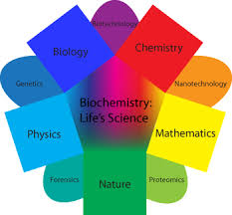
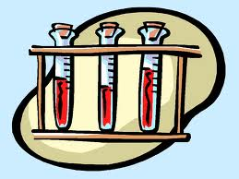
Research

Slide 13
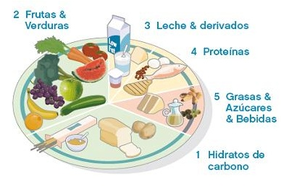
carbohydrates
lipids
proteins
nucleic acids
Many of these molecules are complex molecules called polymers, which are made up of monomer subunits. Biochemical molecules are based on carbon.

Slide 14
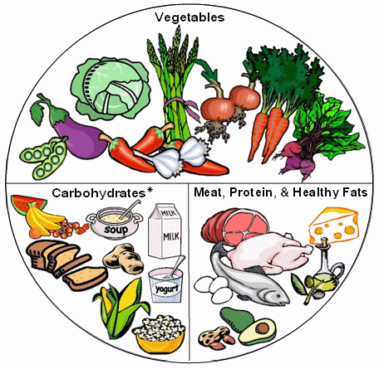
Carbohydrates
Carbohydrates consist of single-sugar units called monosaccharide's, double-monosaccharide units known as disaccharides and multiple-monosaccharide molecules that make up starches. The predominant purpose of the carbohydrates you eat is to provide fuel to your cells. Disaccharides and starches undergo digestion to reduce them to their individual sugars, and, once absorbed, they travel to the cells and tissues throughout your body to power your physical activities. A special type of carbohydrate, known as fiber, passes through your gut undigested. While fiber doesn’t provide you with cellular energy, it improves your digestive health by regulating your bowel function.

Slide 15
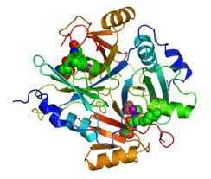
Proteins
The building blocks that make up proteins are called amino acids. Proteins consist of 20 different amino acids, mixed and matched to create a vast array of larger molecules that support every process in your body. Digestion of protein results in a pool of single amino acids that your cells incorporate into new proteins as the need arises in your body. These molecules make up muscles and organs, transmit signals between cells, constitute immune molecules, help create the new proteins your tissues require and can serve as a fuel source in a pinch.

Slide 16
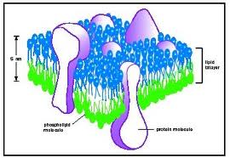
Lipids
Unlike the other macromolecules, lipids are not soluble in water, and they don’t form long sequences made up of similar or repeating smaller units. The fats you consume are molecules called triglycerides, consisting of three fatty acids attached to a glycerol. The chemical nature of the fatty acids contained within the lipid determines its physical characteristics. For instance, a fatty acid that is saturated with as many hydrogen atoms as it can hold is solid at room temperature, while unsaturated fatty acids are liquid. These macromolecules store energy within fat tissue, and they cushion your internal organs against trauma. They also form the structure of cell membranes and contribute to the synthesis of hormones.

Slide 17
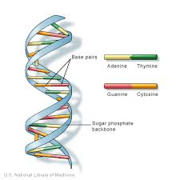
Nucleic Acids
Your cells contain two types of nucleic acids, ribonucleic acid and deoxyribonucleic acid, or RNA and DNA, respectively. They differ from the other macronutrients in that they are not a source of calories in your diet, and their role is strictly to direct the synthesis of new protein molecules. Made up of units called nucleotides, the nucleic acid DNA contains the genetic blueprint that influences your personal characteristics, while the nucleic acid RNA pulls together amino acids to form new proteins as your cells need them.

Slide 18
Biochemistry Used For?
Biochemistry is used to learn about the biological processes which take place in cells and organisms.
Biochemistry may be used to study the properties of biological molecules, for a variety of purposes. For example, a biochemist may study the characteristics of the keratin in hair so that a shampoo may be developed that enhances curliness or softness.
Biochemists find uses for biomolecules. For example, a biochemist may use a certain lipid as a food additive.
Alternatively, a biochemist might find a substitute for a usual biomolecule. For example, biochemists help to develop artificial sweeteners.
Biochemists can help cells to produce new products. Gene therapy is within the realm of biochemistry. The development of biological machinery falls within the realm of biochemistry.

Slide 19
What Does a Biochemist Do?
Many biochemists work in chemistry labs. Some biochemists may focus on modeling, which would lead them to work with computers. Some biochemists work in the field, studying a biochemical system in an organism. Biochemists typically are associated with other scientists and engineers. Some biochemists are associated with universities and they may teach in addition to conducting research. Usually their research allows them to have a normal work schedule, based in one location, with a good salary and benefits.

Slide 20
Disciplines Are Related to Biochemistry
Biochemistry is closely related to other biological sciences that deal with molecules. There is considerable overlap between these disciplines:
Molecular Genetics
Pharmacology
Molecular Biology
Chemical Biology

Slide 21
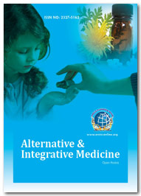
Related Journals
Journal of Community Medicine & Health Education
Internal Medicine: Open Access
General Medicine: Open Access
Journal of Vascular Medicine & Surgery

Slide 22
Related Conferences
2nd International Conference on
Predictive, Preventive and Personalized Medicine & Molecular Diagnostics

Slide 23
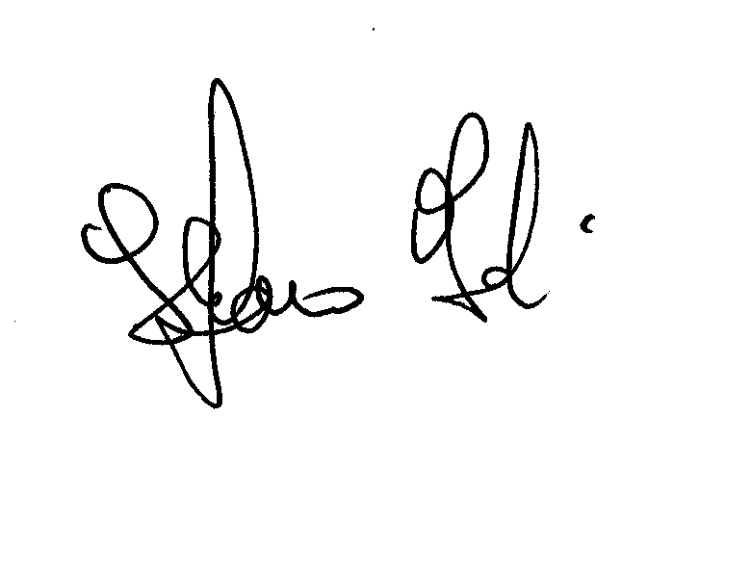
Approved By : Stefano Iotti
E-signature:

Slide 24
OMICS Group Open Access Membership
OMICS publishing Group Open Access Membership enables academic and research institutions, funders and corporations to actively encourage open access in scholarly communication and the dissemination of research published by their authors.
For more details and benefits, click on the link below:
http://omicsonline.org/membership.php

