Slide 1
OMICS Group
OMICS Group International through its Open Access Initiative is committed to make genuine and reliable contributions to the scientific community. OMICS Group hosts over 400 leading-edge peer reviewed Open Access Journals and organizes over 300 International Conferences annually all over the world. OMICS Publishing Group journals have over 3 million readers and the fame and success of the same can be attributed to the strong editorial board which contains over 30000 eminent personalities that ensure a rapid, quality and quick review process. OMICS Group signed an agreement with more than 1000 International Societies to make healthcare information Open Access.
Contact us at: contact.omics@omicsonline.org

Slide 2
OMICS Journals are welcoming Submissions
OMICS Group welcomes submissions that are original and technically so as to serve both the developing world and developed countries in the best possible way.
OMICS Journals are poised in excellence by publishing high quality research. OMICS Group follows an Editorial Manager® System peer review process and boasts of a strong and active editorial board.
Editors and reviewers are experts in their field and provide anonymous, unbiased and detailed reviews of all submissions.
The journal gives the options of multiple language translations for all the articles and all archived articles are available in HTML, XML, PDF and audio formats. Also, all the published articles are archived in repositories and indexing services like DOAJ, CAS, Google Scholar, Scientific Commons, Index Copernicus, EBSCO, HINARI and GALE.
For more details please visit our website: http://omicsonline.org/Submitmanuscript.php

Slide 3
Structure and function of proteins and peptides
Suren A. Tatulian
Ph.D. in Biophysics
Associate Professor, Department of Physics, University of Central Florida, Orlando, Florida, USA

Slide 4
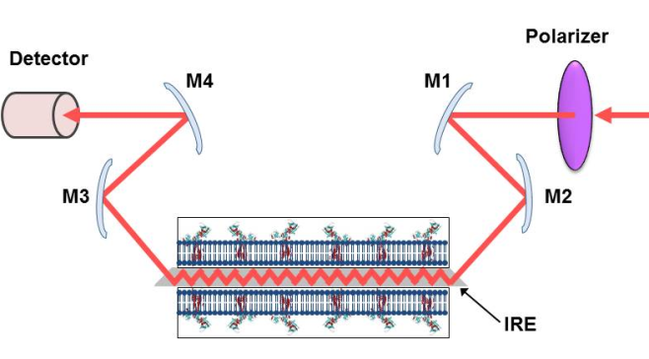
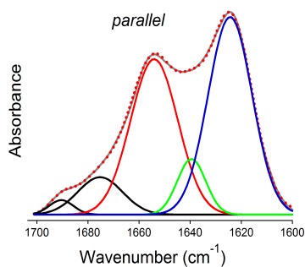
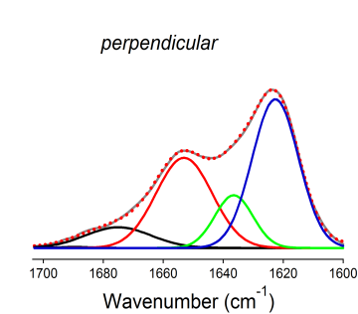
POLARIZED TOTAL INTERNAL REFLECTION INFRARED SPECTROSCOPY
Allows determination of the structure and orientation of membrane proteins
Publications:
Tatulian SA. (2013) Structural characterization of membrane proteins and peptides by FTIR and ATR-FTIR spectroscopy. Methods Mol Biol. 974:177-218.
Tatulian SA (2010) Structural analysis of proteins by isotope-edited FTIR spectroscopy. Spectroscopy 24:37-43.
Tatulian SA (2003) Attenuated total reflection Fourier transform infrared spectroscopy: A method of choice for studying membrane proteins and lipids. Biochemistry 42:11898-907.

Slide 5
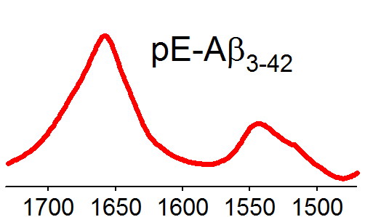
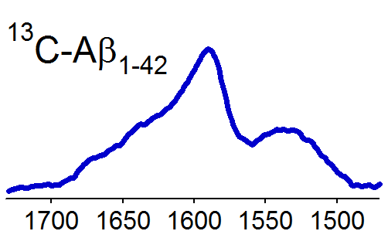
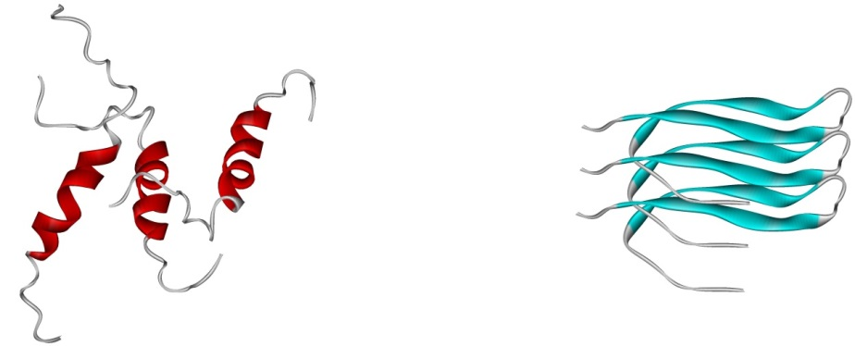
STRUCTURAL BASIS FOR CYTOTOXICITY OF ALZHEIMER’S AMYLOID β PEPTIDE
Absorbance
Wavenumber, cm⁻¹
FTIR spectra of pyroglutamylated Aβ_{pE3-42} (left) and uniformly ¹³C-labeled Aβ₁₋₄₂ (right) peptides identify an augmented α-helical propensity of the former.
100 nm
The pyroglutamylated Aβ peptide may form hypertoxic α-helical intermediates and convert the Aβ peptide into similar assemblies of increased cytotoxicity.
100 nm
Publication:
Matos JO, Goldblatt G, Jeon J, Chen B, Tatulian SA (2014) Pyroglutamylated amyloid-β peptide reverses cross β-sheets by a prion-like mechanism. J. Phys. Chem. B 118(21):5637-43
Transmission electron micrographs of amyloid β peptide Aβ₁₋₄₂ (above) and the pyroglutamylated Aβ_{pE3-42} (below).

Slide 6
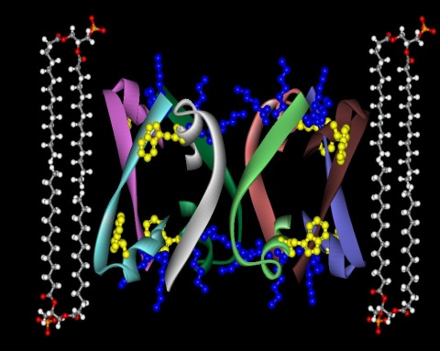
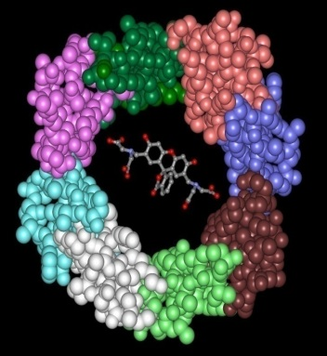
STRUCTURE OF A MEMBRANE PORE FORMED BY EIGHT PEPTIDE MONOMERS
A
B
The C-terminal 20-residue peptide of Bax protein was shown to form large pores in lipid bilayer membranes. The pore was shown to assume a previously unknown structure, an α/β ring, where 8 peptide molecules, each partially α-helical and partially β-strand, form the pore.
Publications:
Garg P, Nemec KN, Khaled AR, Tatulian SA (2013) Transmembrane Pore Formation by the Carboxyl Terminus of Bax Protein. Biochim. Biophys. Acta 1828:732-42.
Tatulian SA, Garg G, Nemec KN, Chen B, Khaled AR (2012) Molecular Basis for Membrane Pore Formation by Bax Protein Carboxyl Terminus. Biochemistry 51(46):9406-9419.

Slide 7
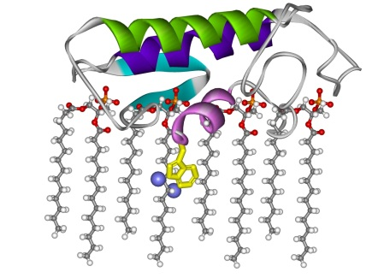
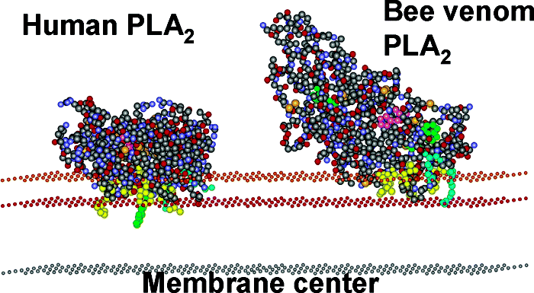
PHYSICAL MECHANISMS OF INTERFACIAL ENZYMES
The depth of membrane insertion of human pancreatic phospholipase A2 (PLA2) is determined by tryptophan fluorescence quenching by bromines attached at different positions of membrane lipids.
Human and bee venom PLA2s bind to membranes with distinct modes, which explains differences in their interfacial activation.
Publications:
Ray S, Scott JL, Tatulian SA (2007) Effects of Lipid Phase Transition and Membrane Surface Charge on the Interfacial Activation of Phospholipase A₂. Biochemistry 46:13089-100.
Pande AH, Qin S, Nemec KN, He X, Tatulian SA (2006) Isoform-specific membrane insertion of secretory phospholipase A₂ and functional implications. Biochemistry 45:12436-47.
Pande AH, Qin S, Tatulian SA (2005) Membrane fluidity is a key modulator of membrane binding, insertion, and activity of 5-lipoxygenase Biophys. J. 88:4084-94.

Slide 8
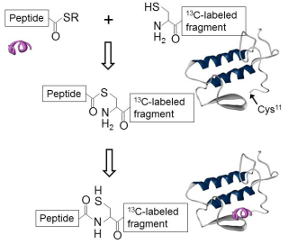
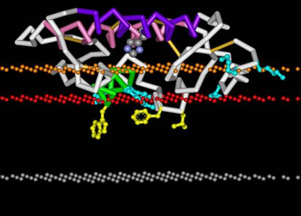
NATIVE CHEMICAL LIGATION OF PROTEINS, SEGMENTAL ISOTOPE LABELING FOR STRUCTURAL STUDIES
The peptide is synthesized with a thioester group at the C-terminus, which is reacted with the N-terminal cysteine of a recombinant, ¹³C-labeled fragment to create a segmentally ¹³C-labeled protein.
Analysis of the segmentally ¹³C-labeled PLA2 by polarized FTIR and fluorescence quenching allows positioning of the protein in a membrane (PDB entry 1ysk).
Publications:
Tatulian SA, Qin S, Pande AH, He X. (2005) Positioning membrane proteins by novel protein engineering and biophysical approaches. J. Mol. Biol. 351:939-947
Qin S, Pande AH, Nemec K N, He X, Tatulian SA. (2005) Evidence for the regulatory role of the N-terminal helix of secretory phospholipase A₂ from studies on native and chimeric proteins. J. Biol. Chem. 280:36773-83.

Slide 9
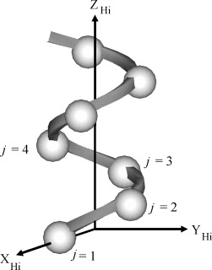
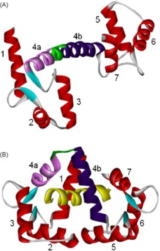
ALGORITHMS FOR PROTEIN STRUCTURE ANALYSIS
An algorithm, named HELO (Helix Orientation), has been developed to determine the interhelical angles and helical bends or twists, using alalytical geometry operations with the protein’s atom coordinates. Conformational changes in calmodulin upon binding to a target peptide were described at greater detail.
Publication:
Tatulian SA. (2008) Determination of helix orientations in proteins. Comput. Biol. Chem. 32:370-374.

Slide 10
OTHER PUBLICATIONS DURING THE LAST 7 YEARS
Dow BA, Sukumar N, Matos JO, Choi M, Schulte A, Tatulian SA, Davidson VL. (2014) The sole tryptophan of amicyanin enhances its thermal stability but does not influence the electronic properties of the type 1 copper site. Arch. Biochem. Biophys. 550-551:20-7.
Taylor M, Burress H, Banerjee T, Ray S, Curtis D, Tatulian SA, Teter K. (2014) Substrate-induced unfolding of protein disulfide isomerase displaces the cholera toxin A1 subunit from its holotoxin. PLoS Pathog. 10(2):e1003925.
Ray S, Taylor M, Banerjee T, Tatulian SA, Teter K. (2012) Lipid rafts alter the stability and activity of the cholera toxin A1 subunit. J. Biol. Chem. 287(36):30395-405.
Katoch J, Kim SN, Kuang Z, Farmer B, Naik R, Tatulian SA, Ishigami M. (2012) Structure of a peptide on graphene and graphite. Nano Letters 12(5):2342-6.
Xie X, Gong Z, Mansuy-Aubert V, Zhou QL, Tatulian SA, Sehrt D, Gnad F, Brill LM, Motamedchaboki K, Chen Y, Czech MP, Mann M, Krüger M, Jiang ZY. (2011) C2 domain-containing phosphoprotein CDP138 regulates GLUT4 insertion into the plasma membrane. Cell Metabolism 14:378-89.
Ray S, Taylor M, Burlingame M, Tatulian SA, Teter K. (2011) Modulation of toxin stability by 4-phenylbutyric acid and negatively charged phospholipids. PLoS One 6(8):e23692.
Taylor M, Banerjee T, Ray S, Tatulian SA, Teter K. (2011) Protein disulfide isomerase displaces the cholera toxin A1 subunit from the holotoxin without unfolding the A1 subunit. J. Biol. Chem. 286:22090-100.
Taylor, M, Banerjee T, Navarro-Garcia F, Huerta J, Massey S, Burlingame M, Pande AH, Tatulian SA, Teter K. (2011) A therapeutic chemical chaperone inhibits cholera intoxication and unfolding/translocation of the cholera toxin A1 subunit. PLoS One 6:e18825.
Banerjee T, Pande A, Jobling MG, Taylor M, Massey S, Holmes RK, Tatulian SA, Teter K. (2010) Contribution of subdomain structure to the thermal stability of the cholera toxin A1 subunit. Biochemistry 49:8839-46.
Nemec KN, Scaglione P, Navarro-García F, Huerta J, Tatulian SA, Teter K. (2010) A host-specific factor is necessary for efficient folding of the autotransporter plasmid-encoded toxin. Biochimie. 92:171-7.
Massey S, Banerjee T, Pande AH, Taylor M, Tatulian SA, Teter K. (2009) Stabilization of the tertiary structure of cholera toxin A1 subunit inhibits toxin dislocation and cellular intoxication. J. Mol. Biol. 393:1083-96.
Guerra L, Nemec KN, Massey S, Tatulian SA, Thelestam M, Frisan T, Teter K. (2009) A novel mode of translocation for cytolethal distending toxin. Biochim. Biophys. Acta 1793:489-95.
Yu BZ, Kaimal R, Bai S, El Sayed KA, Tatulian SA, Apitz RJ, Jain MK, Deng R, Berg OG. (2009) Effect of guggulsterone and cembranoids of commiphora mukul on pancreatic phospholipase A₂: Role in hypocholesterolemia. J. Nat. Prod. 72:24-8.
Scaglione P, Nemec KN, Burlingame KE, Grabon A, Huerta J, Navarro-Garcia F, Tatulian SA, Teter K. (2008) Structural characteristics of the plasmid-encoded toxin from enteroaggregative Escherichia coli. Biochemistry 47:9582-91.

Slide 11
Journal of Physical Chemistry & Biophysics Related Journals
Journal of Electrical & Electronic Systems
Journal of Lasers, Optics & Photonics

Slide 12
Gynecology & Obstetrics Related Conferences
3rd International Conference and Exhibition on
Lasers, Optics & Photonics

Slide 13
OMICS Group Open Access Membership
OMICS publishing Group Open Access Membership enables academic and research institutions, funders and corporations to actively encourage open access in scholarly communication and the dissemination of research published by their authors.
For more details and benefits, click on the link below:
http://omicsonline.org/membership.php

