Slide 1

Journal of Primary Health Care: Open Access
Executive Editor Dr. Tamer Edirne
M.D., Assoc. Prof. at the Dept. of Family Medicine, Medical Faculty, Pamukkale University, Denizli, Turkey

Slide 2
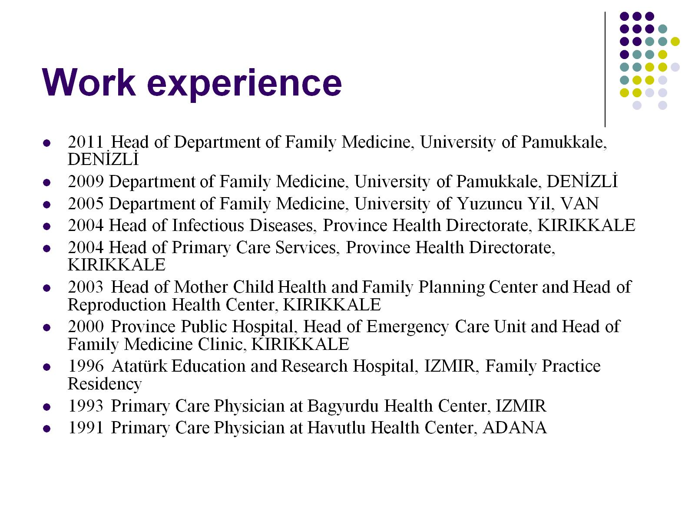
Work experience

Slide 3

My basic research interests

Slide 4

Primary health care

Slide 5
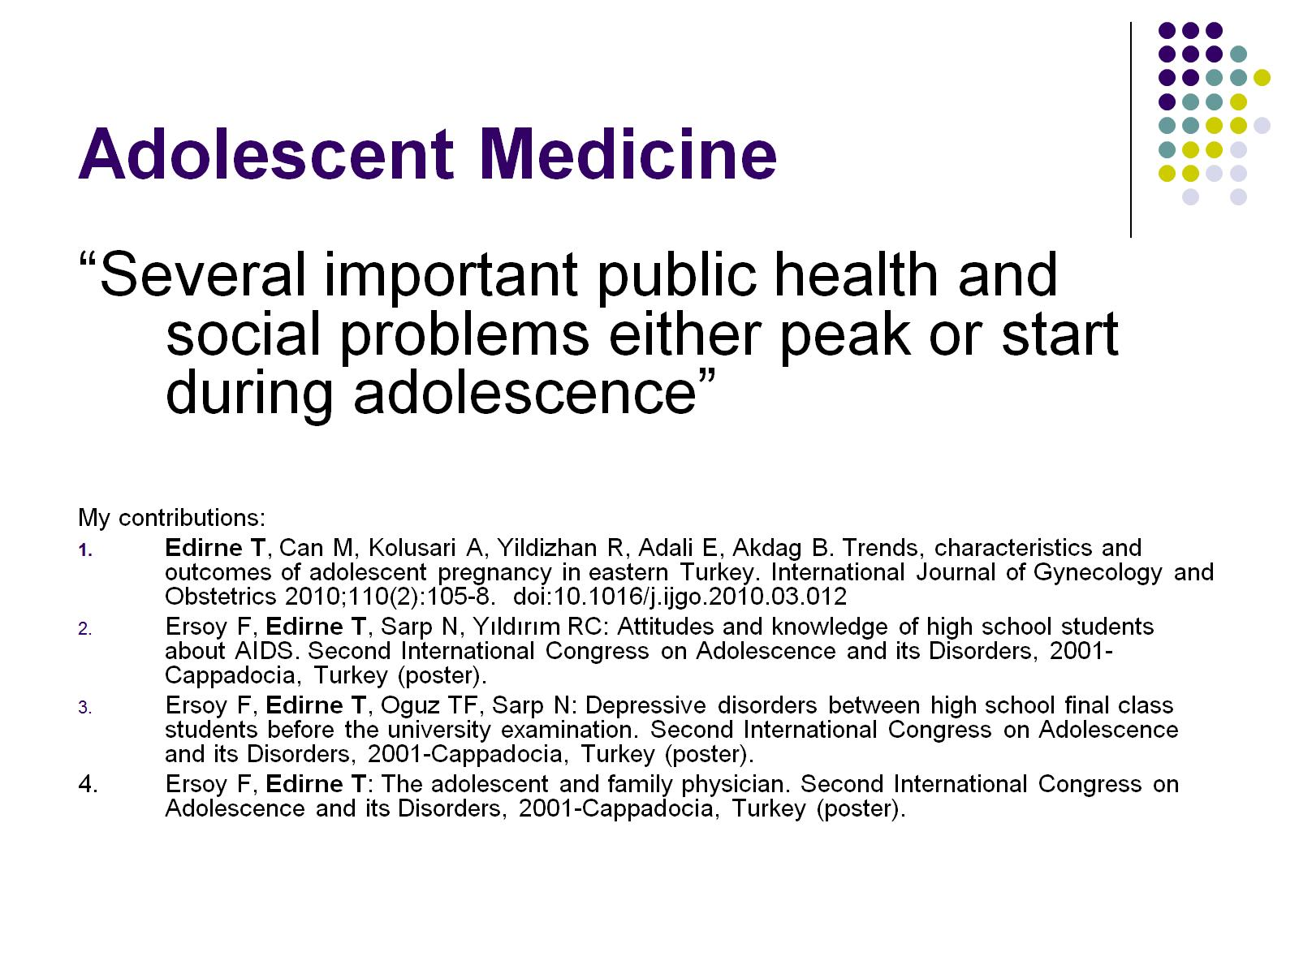
Adolescent Medicine

Slide 6
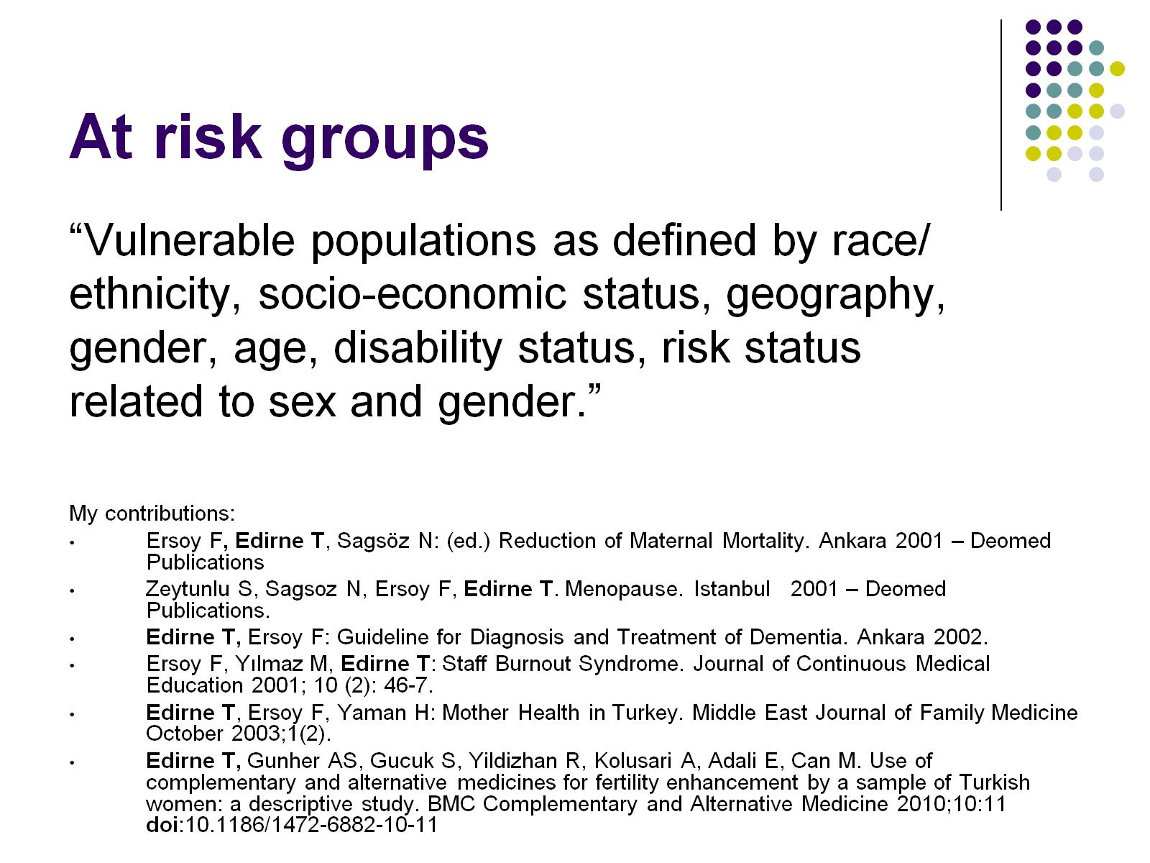
At risk groups

Slide 7

Complementary and alternative medicine/ folk medicine

Slide 8

Prevention

Slide 9

Women's’ health

Slide 10


OMICS International
www.omicsonline.org
OMICS International (and its subsidiaries), is an Open Access publisher and international conference Organizer, which owns and operates peer-reviewed Clinical, Medical, Life Sciences, and Engineering & Technology journals and hosts scholarly conferences per year in the fields of clinical, medical, pharmaceutical, life sciences, business, engineering, and technology. Our journals have more than 3 million readers and our conferences bring together internationally renowned speakers and scientists to create exciting and memorable events, filled with lively interactive sessions and world-class exhibitions and poster presentations. Join us!
OMICS International is always open to constructive feedback. We pride ourselves on our commitment to serving the Open Access community and are always hard at work to become better at what we do. We invite your concerns, questions, even complaints. Contact us at contact.omics@omicsonline.org. We will get back to you in 24-48 hours. You may also call 1-800-216-6499 (USA Toll Free) or at +1-650-268-9744 and we will return your call in the same timeframe.
Contact us at: contact.omics@omicsonline.org

Slide 11


Slide 12


Slide 13


