Slide 1
OMICS Group
OMICS Group International through its Open Access Initiative is committed to make genuine and reliable contributions to the scientific community. OMICS Group hosts over 400 leading-edge peer reviewed Open Access Journals and organizes over 300 International Conferences annually all over the world. OMICS Publishing Group journals have over 3 million readers and the fame and success of the same can be attributed to the strong editorial board which contains over 30000 eminent personalities that ensure a rapid, quality and quick review process. OMICS Group signed an agreement with more than 1000 International Societies to make healthcare information Open Access.
Contact us at: contact.omics@omicsonline.org

Slide 2
OMICS Journals are welcoming Submissions
OMICS Group welcomes submissions that are original and technically so as to serve both the developing world and developed countries in the best possible way.
OMICS Journals are poised in excellence by publishing high quality research. OMICS Group follows an Editorial Manager® System peer review process and boasts of a strong and active editorial board.
Editors and reviewers are experts in their field and provide anonymous, unbiased and detailed reviews of all submissions.
The journal gives the options of multiple language translations for all the articles and all archived articles are available in HTML, XML, PDF and audio formats. Also, all the published articles are archived in repositories and indexing services like DOAJ, CAS, Google Scholar, Scientific Commons, Index Copernicus, EBSCO, HINARI and GALE.
For more details please visit our website: http://omicsonline.org/Submitmanuscript.php

Slide 3
Autoimmune Pancreatitis
*Amendment of the Japanese Consensus Guidelines for Autoimmune Pancreatitis, 2013
III. Treatment and prognosis of autoimmune pancreatitis.
Kamisawa T, et al. J Gastroenterol 2014; 49: 961-970
*Recent advances in autoimmune pancreatitis: type 1 and type 2.
Kamisawa T, et al. Gut 2013; 62: 1373-1380

Slide 4
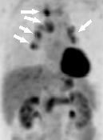
IgG4-related Disease
*IgG4-related disease.
Kamisawa T, et al. Lancet, in press
*IgG4-related sclerosing disease.
Kamisawa T, et al. World J Gastroenterol 2008; 14: 3948-3955

Slide 5
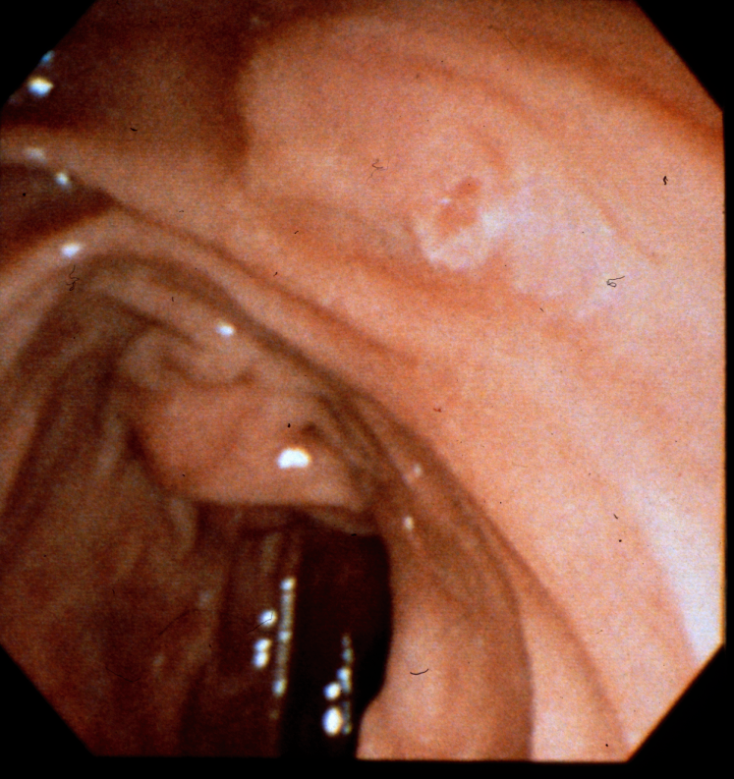
Minor Duodenal Papilla
*Clinical implication of accessory pancreatic duct.
Kamisawa T, et al. World J Gastroenterol 2010; 16: 4499-4503
*Pancreatographic investigation of embryology of complete and incomplete pancreas divisum
Kamisawa T, et al. Pancreas 2007; 34: 96-102

Slide 6
Pancreaticobiliary Maljunction
*Diagnostic criteria for pancreaticobiliary maljunction 2013
Kamisawa T, et al. J Hepatobiliary Pancreat Sci 2014; 21: 159-161
*Japanese clinical practice guidelines for pancreaticobiliary maljunction
Kamisawa T, et al. J Gastroenterol 2012; 47: 731-759

Slide 7
OMICS Group Open Access Membership
OMICS publishing Group Open Access Membership enables academic and research institutions, funders and corporations to actively encourage open access in scholarly communication and the dissemination of research published by their authors.
For more details and benefits, click on the link below:
http://omicsonline.org/membership.php

