Slide 1
Research interests of Tetsuya Mine
Professor and Chief
Division of Gastroenterology and Hepatology,
Department of Internal Medicine,
University of Tokai School of Medicine
Japan

Slide 2
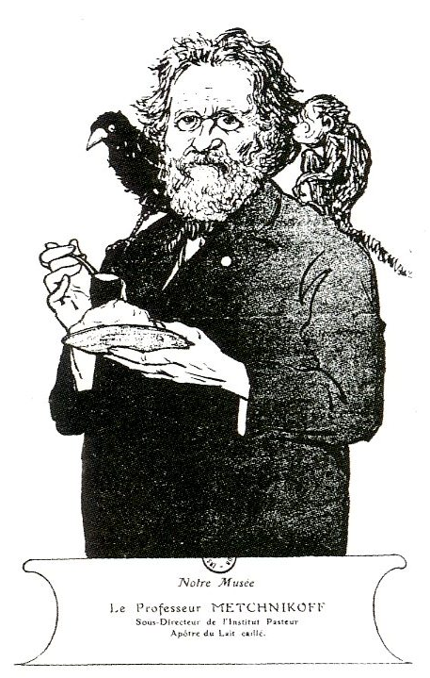
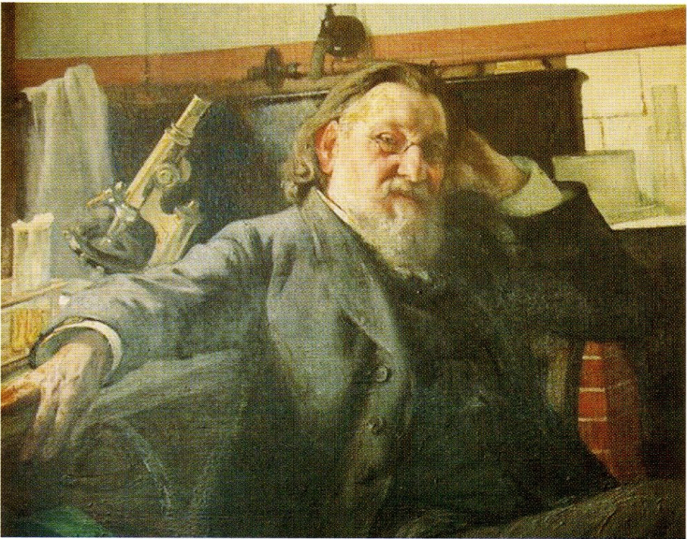
no death due to yogurt

Slide 3
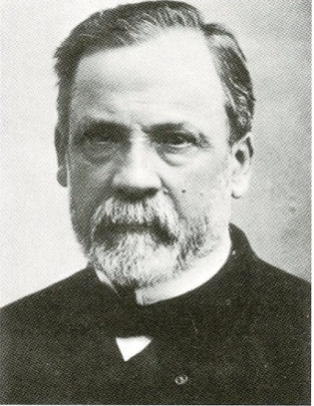
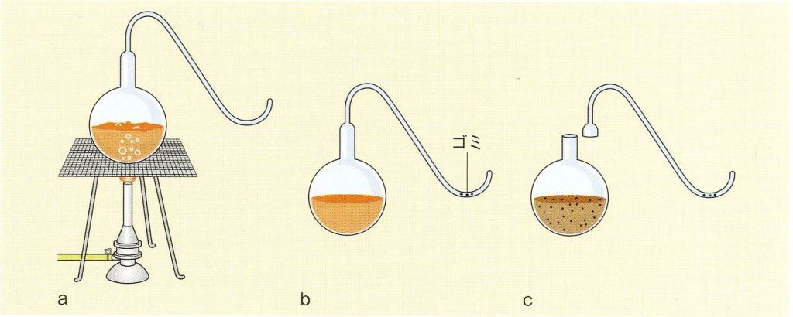
trash
trash
Experiments by Pasteur

Slide 4
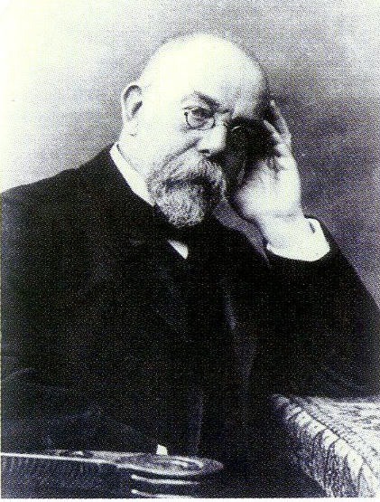

Slide 5
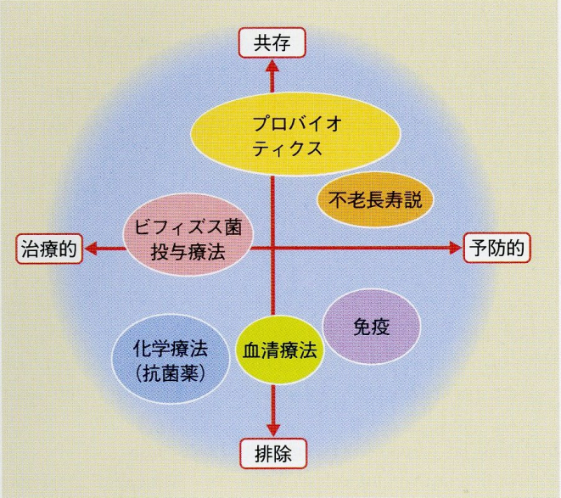
coexist
coexistence
Probiotics
no death
treatment
Bifidobacterium
prevention
immune
anti serum
therapy
Chemo therapy
exclusion
Position of Probiotics

Slide 6
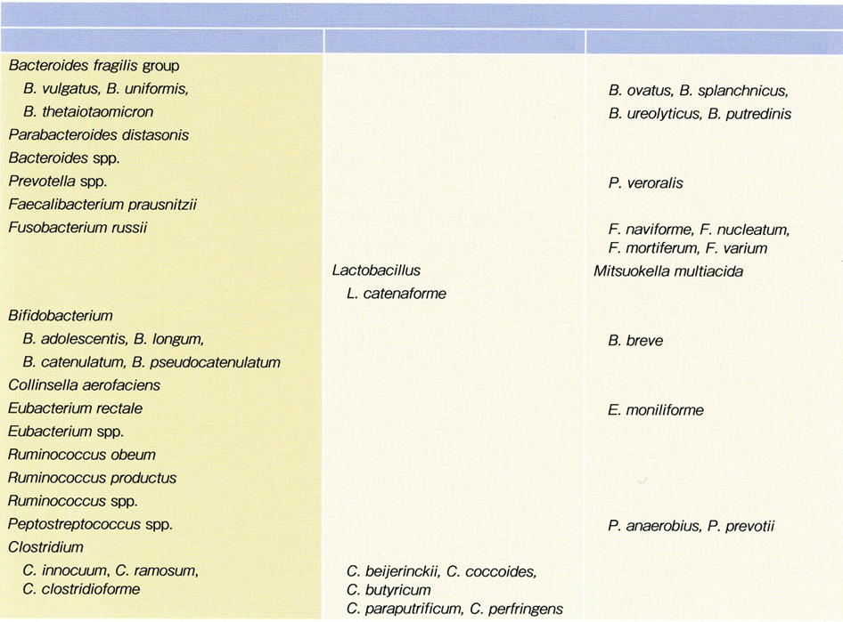
Intestional flora healthy volunteer (by culture)
High incidence (>60%)
middle (>30%>60%)
low incidence (<30%)
Benno Y, et al

Slide 7
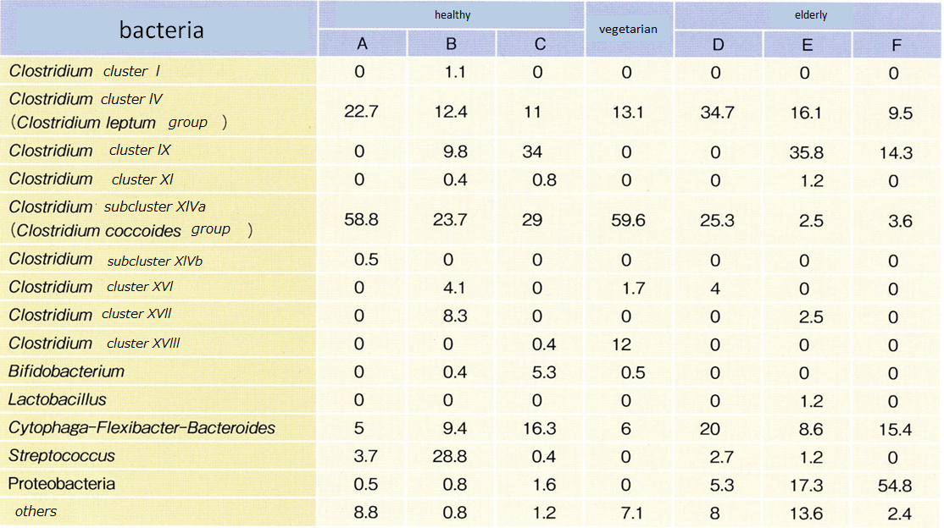
Intestinal flora (16SrDNA) in healthy volunteer
Hayashi H. et al.

Slide 8
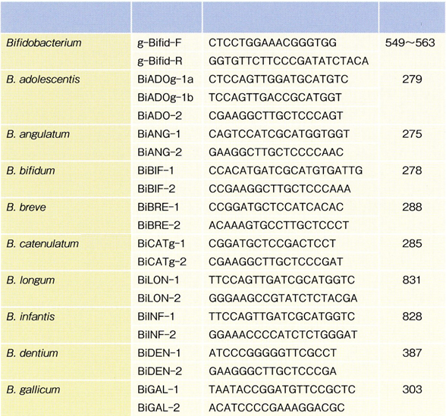
bacteria
primer
Specific array
size
Matsuki T. et al
Specific primer for Bifidobacterium

Slide 9
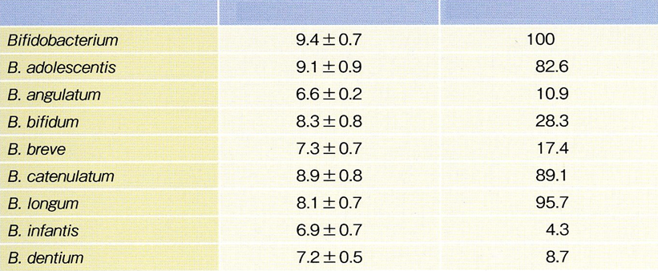
Numbers of bacteria in stool of healthy volunteer
bacteria
M ±SD
Positive(%)
Matsuki T, et al.

Slide 10
Analysis of bacteria in healthy volunteer
bacteria
Matsuki T, et al

Slide 11
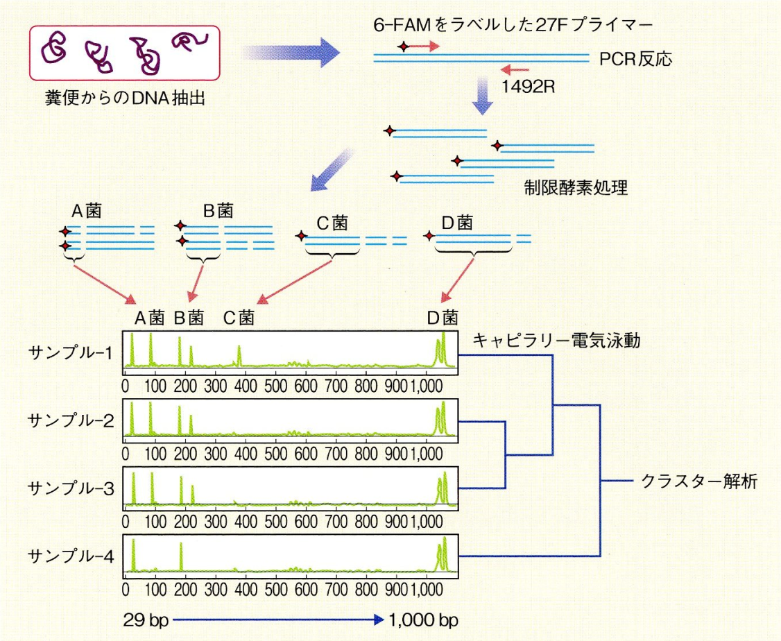
Primer labeled with 6-FAM
v
DNA extraction from stool
ristrictive enzyme
v
v
v
v
v
v
v
electrophresis
sample
sample
sample
Cluster analysis
sample
Analysis of intestinal flora

Slide 12
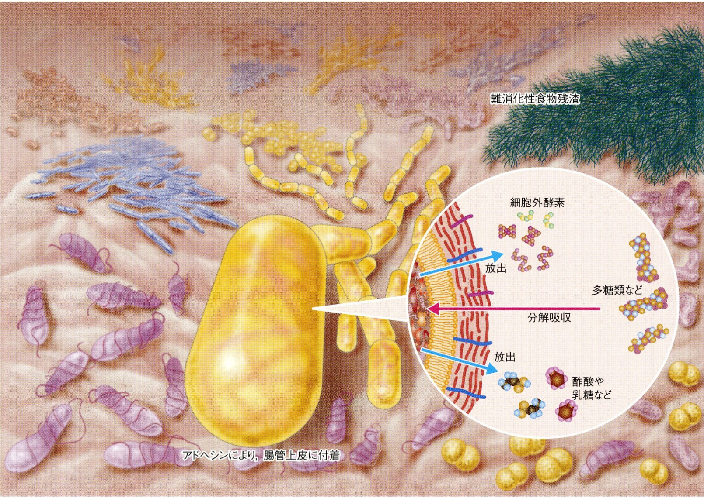
residual
extracellular
enzyme
polysaccharide
release
degredation
release
Acetic acid
galactose
Fixed by adhesin
Image of Intestinal flora

Slide 13
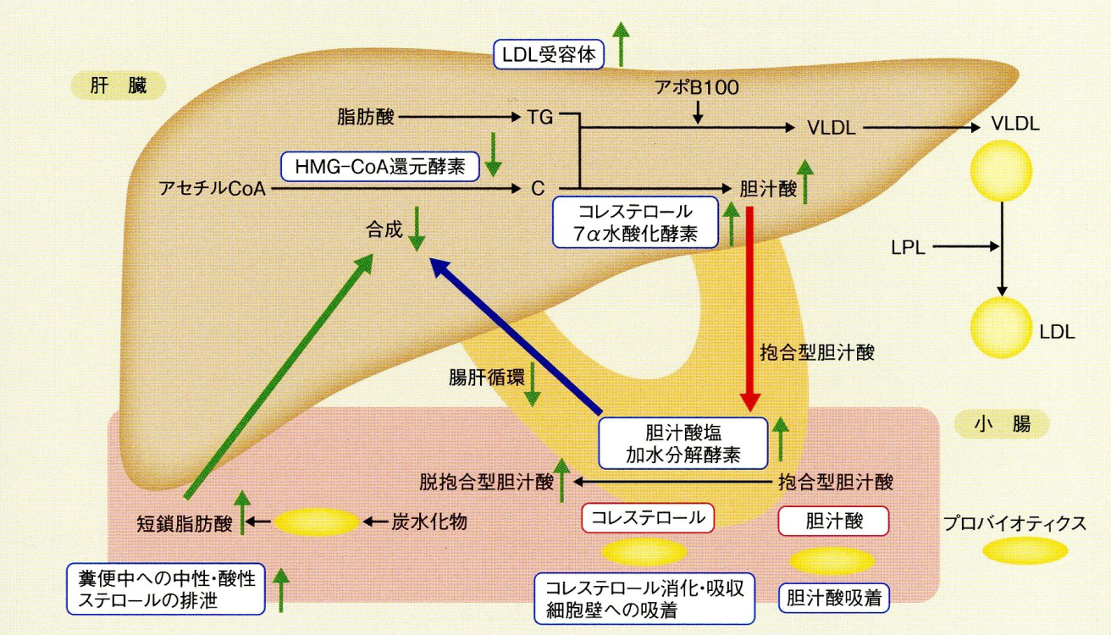
LDL receptor
liver
Apoβ 100
Fatty acid
HMG-CoA reductase
Acetyl CoA
cholic acid
Cholesterol 7 α hydroxylase
Conjugated
Entero hepatice circulation
Cholic acid
Small intestine
deconjugated
cholic acid
Cunjugated cholic acid
Short chain faty acid
Ribosome
carbohydrate
cholesterol
Cholic acid
probiotics
Excretion of sterol
Absorption of cholesterol
Adhesion to cholic acid
Decrease of serum cholesterol by probiotics

Slide 14
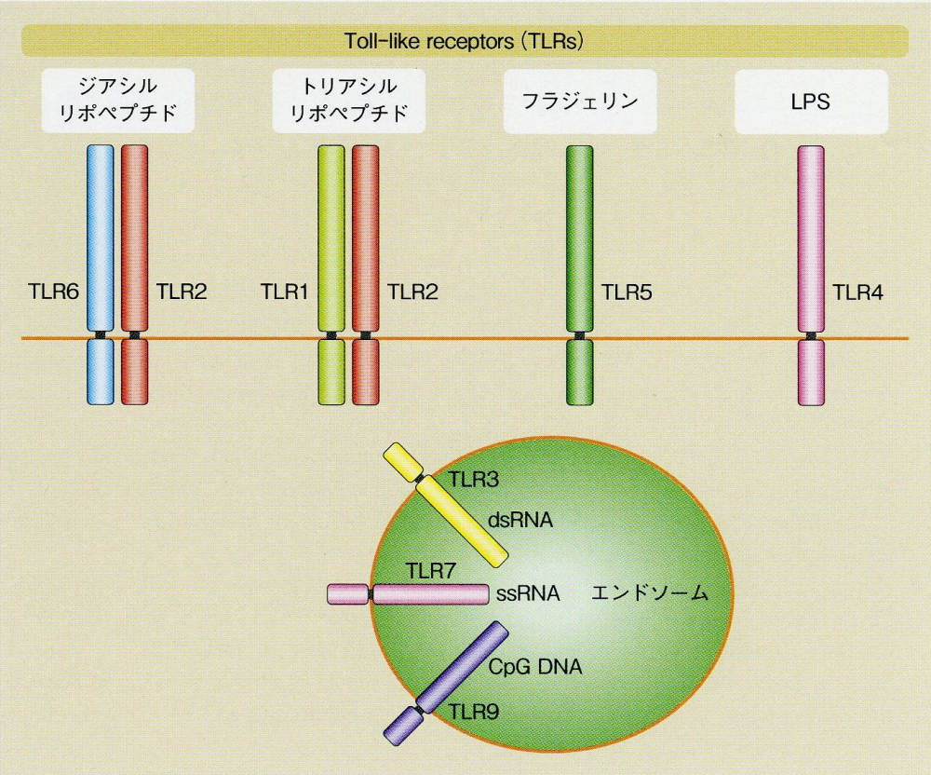
Diacyl
lipopeptide
Triacyl
lipopeptide
flagellin
Apoβ 100
endosome
TLR and Ligands

Slide 15
Immune system in mucosa
Intestinal flora
dendric cell
Excretion of IgA
Control by IEL
Immune tolerance
allergy
IBD
defense for infection
Immune system by intestinal flora

Slide 16
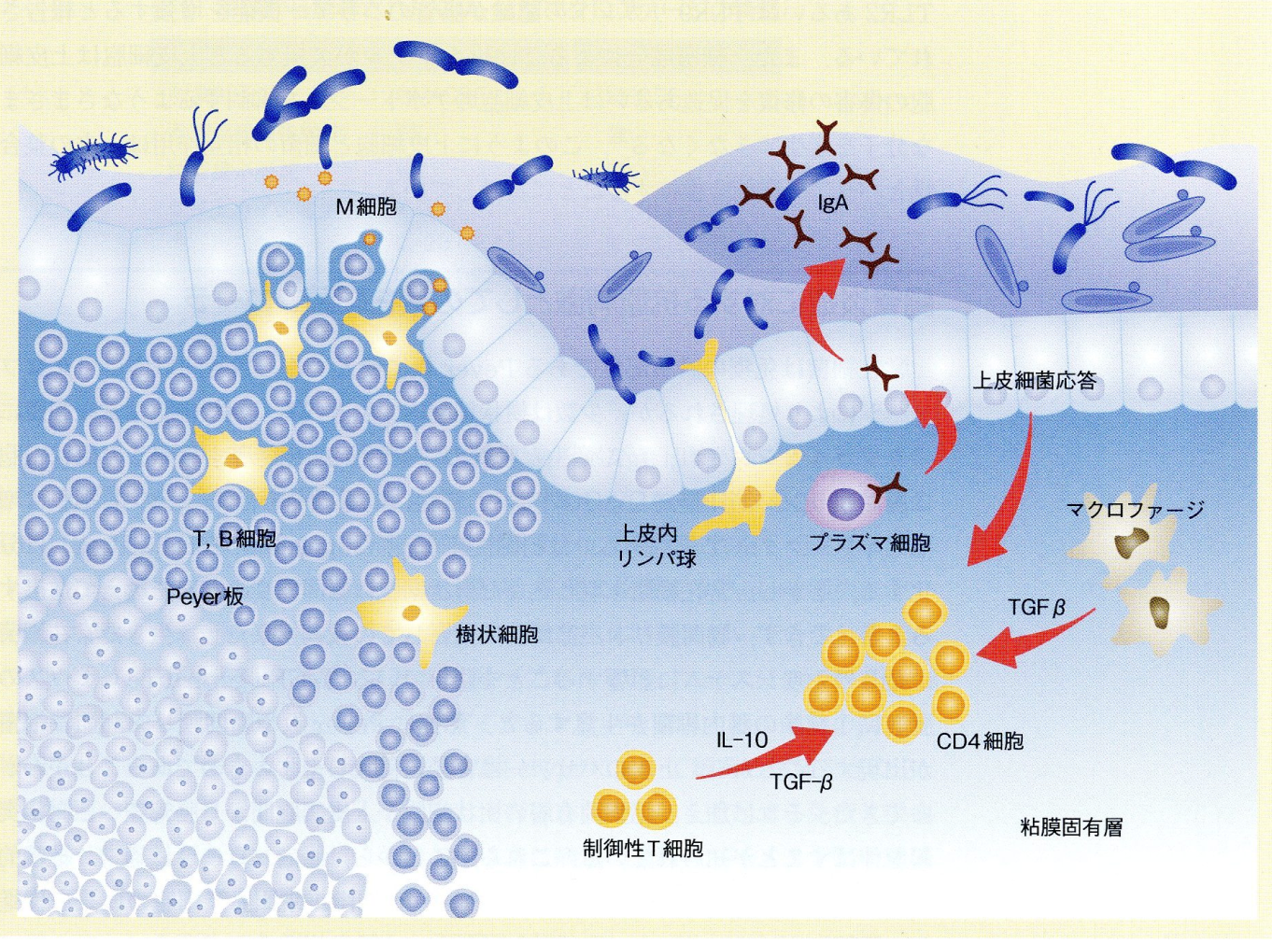
M cell
Response by epithelium
macrophage
T cell , B cell
lymophocyte
Plasma cell
Peyer system
TGF-β
dendric cell
IL 10
CD4 cell
TGF-β
Lamina propria
Regulatory T cell
Defense system in mucosa

Slide 17
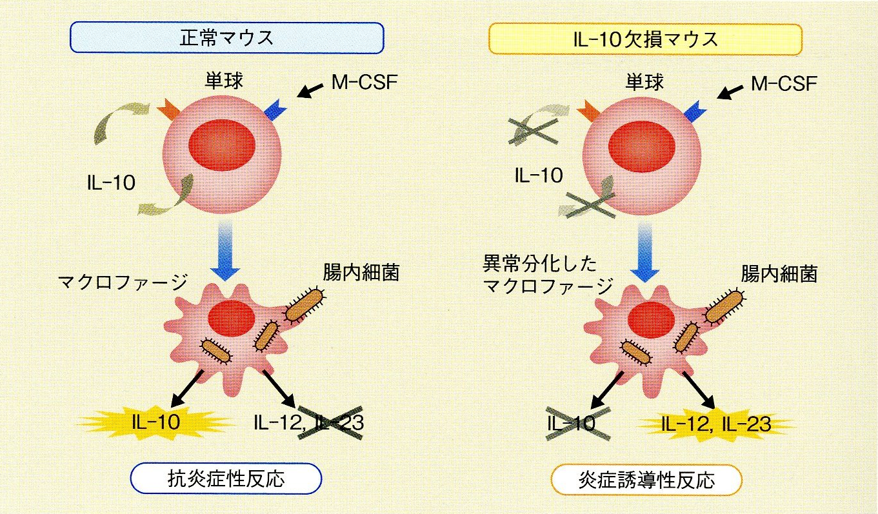
normal
IL-10 KO mouse
monocyte
M-CSF
bacteria
bacteria
macrophage
Abnormal
differentiation
Anti-inflammation
Inflammation
Production of cytokine

Slide 18
OMICS International Open Access Membership OMICS International Open Access Membership enables academic and research institutions, funders and corporations to actively encourage open access in scholarly communication and the dissemination of research published by their authors.
For more details and benefits, click on the link below:
http://omicsonline.org/membership.php

