Slide 1
OMICS Journals are welcoming Submissions
OMICS International welcomes submissions that are original and technically so as to serve both the developing world and developed countries in the best possible way.
OMICS Journals are poised in excellence by publishing high quality research. OMICS International follows an Editorial Manager® System peer review process and boasts of a strong and active editorial board.
Editors and reviewers are experts in their field and provide anonymous, unbiased and detailed reviews of all submissions.
The journal gives the options of multiple language translations for all the articles and all archived articles are available in HTML, XML, PDF and audio formats. Also, all the published articles are archived in repositories and indexing services like DOAJ, CAS, Google Scholar, Scientific Commons, Index Copernicus, EBSCO, HINARI and GALE.
For more details please visit our website: http://omicsonline.org/Submitmanuscript.php

Slide 2
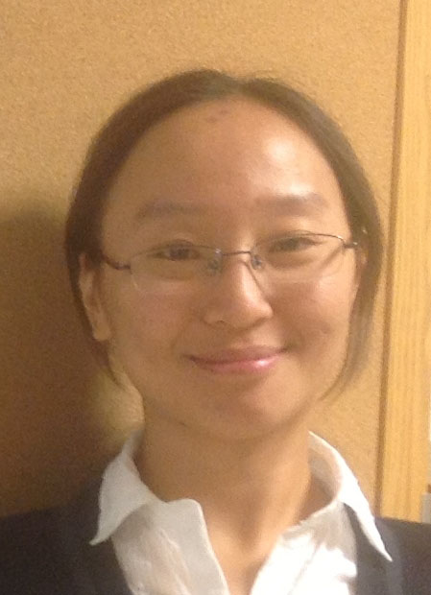
Ti Zhang

Slide 3
Biography
Ti Zhang obtained her PhD in Pharmaceutics and Drug Delivery at the Department of Pharmaceutical Chemistry of the University of Kansas. She got her BS in Chemistry from Nankai University (Tianjin, China) in 2006, followed by a MS in Analytical Chemistry in 2008 at Wuhan University (Hubei, China). Her research interests include the development of tumor-targeted contrast agent for photoacoustic imaging as well as polymeric nanocarriers that allow anti-cancer agents delivery in a controlled manner to the tumors and treatment specifically in response to the external energy.

Slide 4
Research Interests
Lymphatic drug delivery
Nanomedicine
Photoacoustics
Contrast imaging of biological tissues with carbon nanoparticles
Controlled release of anti-cancer drugs

Slide 5
Journal of Blood and Lymph Related Journals
Blood Disorders and Transfusion
Bone marrow Research

Slide 6
Journal of Blood and Lymph Related Conferences
Second international conference on Hematology and blood Disorders.

Slide 7
OMICS Group Open Access Membership
OMICS International Open Access Membership enables academic and research institutions, funders and corporations to actively encourage open access in scholarly communication and the dissemination of research published by their authors.
For more details and benefits, click on the link below:
http://omicsonline.org/membership.php

