Slide 1
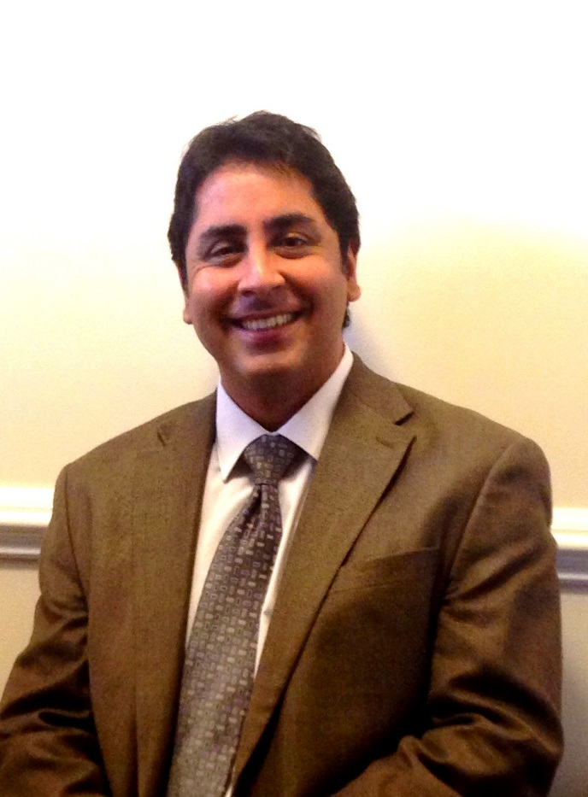
Vineet K Dhar, BDS, MDS, PhD
Dr. Dhar is an associate Professor and graduate program director in the division of Pediatric Dentistry. A board certified pediatric dentist, he has a unique background that includes high achievement in professional education, successful private practice of dentistry, administration and teaching in dental school environment, leadership, service and scholarship. He has several publications and presentations to his credit and serves as a reviewer and is on the editorial board of many national and international journals.
Dr. Dhar completed his undergraduate dental training from Bharati-Vidyapeeth Dental College, Pune, India in 1995. This was followed by several advanced degrees, including a Master’s of Science program in Pediatric and Preventive Dentistry from Manipal College of Dental Surgery in 1999 with thesis entitled, “Comparative evaluation of pit and fissure sealants using invasive and non-invasive technique-an in vitro study”; and a Post Graduate Diploma in Hospital and Health Care Management. In 2009 he received a PhD from MLS University, India, with a thesis entitled “Cariology and its Prevention in Pediatric Dentistry” and in 2013 he was awarded the Certificate in Pediatric Dentistry from University of Maryland School of Dentistry.
Dr. Dhar is a Fellow, American Academy of Pediatric Dentistry; he currently serves as President (Elect) of Maryland Academy of Pediatric Dentistry, as a member NE District, Council on Post-doctoral Education (American Academy of Pediatric Dentistry) and as a member of Expert Panel for ADA center for Evidence-Based Dentistry update of the Evidence-Based Clinical Recommendations for the Use of Pit and Fissure Sealants.

Slide 2
Editorial Responsibilities
2014- Present Editorial Board Pediatric Dentistry Journal (AAPD)
2013- Present Editorial Board Oral Health and Dental Management
OMICS Publishing Group
2012-Present Editorial Board International Journal of Clinical Pediatric Dentistry, J. P. Publishers, New Delhi
2010-Present Associate Editor International Journal of Oral and Maxillofacial Pathology
Current areas of research interest are preventive dentistry, fissure sealants, pulp therapies and soft tissue lasers.

Slide 3
Ongoing Project
Research on Biodentin and MTA
This research will hopefully provide some critical information on the effectiveness of various vital pulp therapies.

