Slide 1
OMICS international
OMICS International through its Open Access Initiative is committed to make genuine and reliable contributions to the scientific community. OMICS International signed an agreement with more than 1000 International Societies to make healthcare information Open Access.
Contact us at: contact.omics@omicsonline.org

Slide 2
OMICS Journals are welcoming Submissions
OMICS international welcomes submissions that are original and technically so as to serve both the developing world and developed countries in the best possible way.
OMICS Journals are poised in excellence by publishing high quality research. OMICS international follows an Editorial Manager® System peer review process and boasts of a strong and active editorial board.
Editors and reviewers are experts in their field and provide anonymous, unbiased and detailed reviews of all submissions.
The journal gives the options of multiple language translations for all the articles and all archived articles are available in HTML, XML, PDF and audio formats. Also, all the published articles are archived in repositories and indexing services like DOAJ, CAS, Google Scholar, Scientific Commons, Index Copernicus, EBSCO, HINARI and GALE.
For more details please visit our website: http://omicsonline.org/Submitmanuscript.php

Slide 3
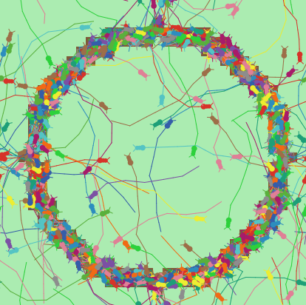
Artificial Intelligence and Intelligent Agents Research Group, Bangor University
Dr. Bill Teahan

Slide 4
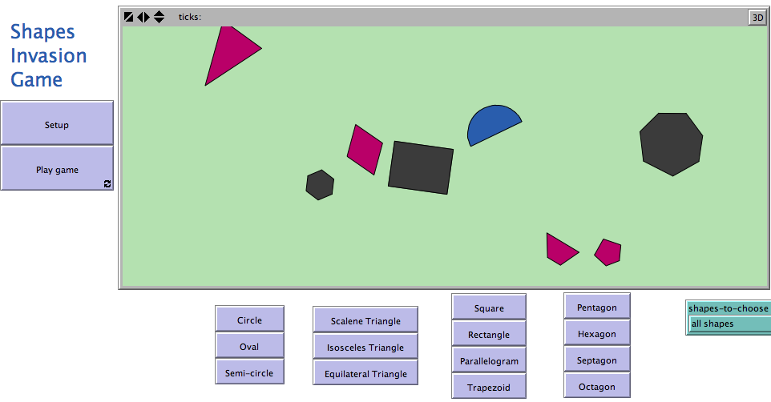
Some current research projects
Virtual Humans
Virtual Creatures
Novel evolutionary algorithms
Simulation of natural and social phenomena using NetLogo
NetLogo for E-learning

Slide 5
Virtual Humans Project
Realistic animation of virtual humans
Develop effective conversational agents (Chatbots)
Chatbot interface to Question Answering and Information Retrieval systems
Many possible uses
e.g. Avatars, Website Tour Guide, Computer Games, A.I. Research, E-learning etc.

Slide 6
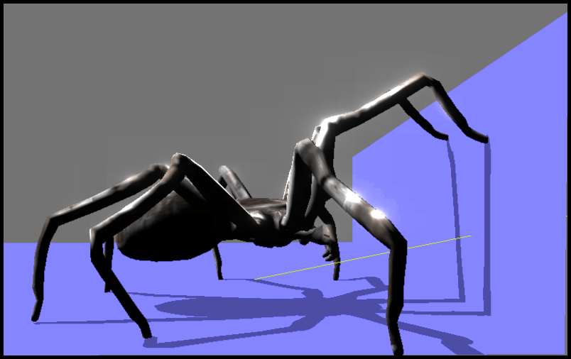
Virtual Creatures Project
Develop realistic virtual creatures (e.g. spiders)
These creatures “exist” in a virtual environments
They can sense and react to what they “see”, “feel” in that environment
Many possible uses
e.g. Phobia Therapy, Movies, Avatars, Computer Games, Artificial Life Research etc.

Slide 7
Simulations of natural & social phenomena & NetLogo
Agent-oriented programming language for rapid prototyping of simulations of natural and social phenomena

Slide 8
NetLogo for E-Learning
Develop models to teach Maths and other subjects to school children:

Slide 9
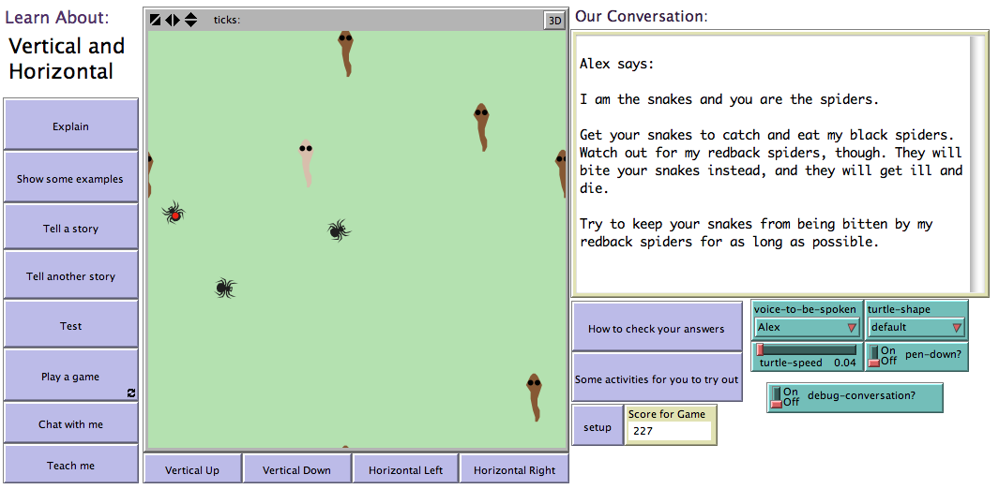
NetLogo for E-Learning
Develop models to teach Maths and other subjects to school children:

Slide 10
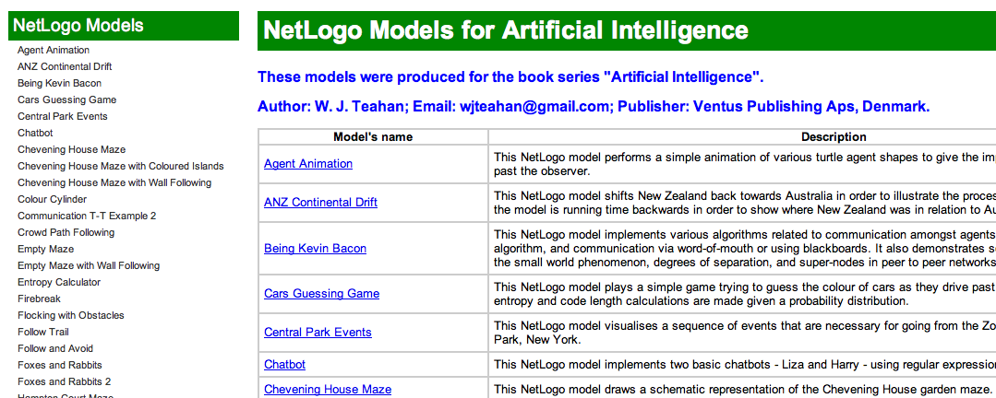
Animating AI: An agent-oriented approach to teaching using NetLogo
Several NetLogo models have been develop to teach AI concepts and algorithms using basic animation techniques.
These are available to use and download from files.bookboon.com/ai:

Slide 11
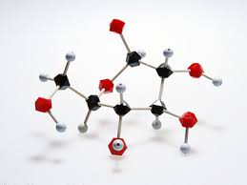
Journal of Computer Science & Systems Biology Related Journals
Data Mining in Genomics & Proteomics
Proteomics & Bioinformatics
Current Synthetic and Systems Biology
Current Synthetic and Systems Biology

Slide 12
Journal of Computer Science & Systems Biology Related Conferences
International Conference and Expo on Computer Graphics & Animation
International Conference on Big data analysis and Data Mining

Slide 13
OMICS International Open Access Membership
OMICS International Open Access Membership enables academic and research institutions, funders and corporations to actively encourage open access in scholarly communication and the dissemination of research published by their authors.
For more details and benefits, click on the link below:
http://omicsonline.org/membership.php

