Slide 1
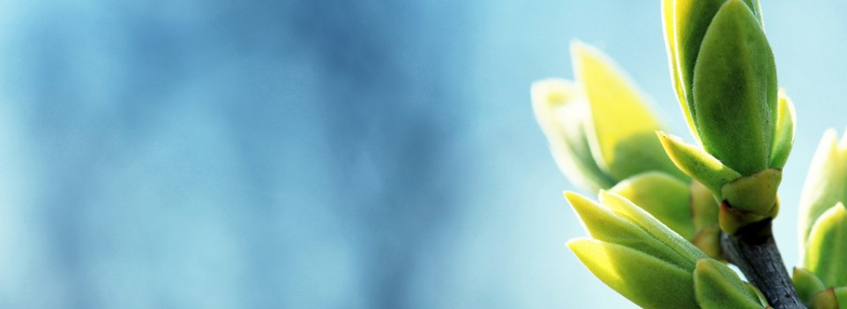
OMICS International
OMICS International through its Open Access Initiative is committed to make genuine and reliable contributions to the scientific community. OMICS International signed an agreement with more than 1000 International Societies to make healthcare information Open Access.
Contact us at: contact.omics@omicsonline.org

Slide 2
OMICS Journals are welcoming Submissions
OMICS Group welcomes submissions that are original and technically so as to serve both the developing world and developed countries in the best possible way.
OMICS Journals are poised in excellence by publishing high quality research. OMICS Group follows an Editorial Manager® System peer review process and boasts of a strong and active editorial board.
Editors and reviewers are experts in their field and provide anonymous, unbiased and detailed reviews of all submissions.
The journal gives the options of multiple language translations for all the articles and all archived articles are available in HTML, XML, PDF and audio formats. Also, all the published articles are archived in repositories and indexing services like DOAJ, CAS, Google Scholar, Scientific Commons, Index Copernicus, EBSCO, HINARI and GALE.
For more details please visit our website: http://omicsonline.org/Submitmanuscript.php

Slide 3
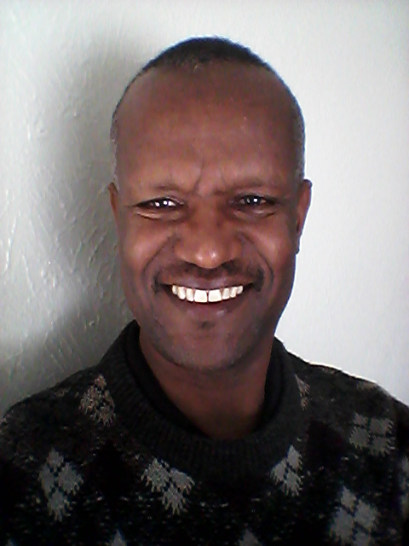
Worku L. Mulat, PhD Associate Professor of Applied Ecology

Slide 4
Education and training
Asmara University, B.Sc., Biology (1987), supervisor Prof. Endashaw Bekele
Gent University, Belgium, M.Sc, Environmental Sanitation (1993), supervisor Prof W. Verstrate
Cork University, Ireland, PhD in Applied Ecology (2001), supervisors Prof. Paul Giller and Prof. John O’Halloran

Slide 5
Work Experience
University of Connecticut, A/Professor, Civil and Environmental Engineering, Storrs, CT (2012 on)
Tree Foundation, Researcher(2009 on )
Accdon Company, Science Editor(2009 on)
Jimma University, Assoiciate Professor (1987-2006)
Wollo University, A/President(2005-2006)
Grarbet, Deputy Secretary (2006)

Slide 6
Teaching philosophy
At the beginning of my career, I considered teaching to be my duty; over the years it has come to be my passion. Teaching is a lofty profession, that has to be constantly nurtured with life long learning.
Through teaching and research, I prepare students to be agents of social change. As educator of science, here is my mission: help students develop critical thinking and skills required to thrive in the 21 century.

Slide 7
Major contributions
Won 120 million grant for water & health research
Published 2 books and more than 30 articles.
Trained Environmental Science students that became agents of social and environmental change
Established the first undergraduate Environmental Science School and applied research in Ethiopia
Taught water quality, health and sanitation for 2 decades
Established the first environmental quality laboratory
Developed Environmental health curriculum for training 30,000 Extension Health Workers
Implemented construction of springs and toilets for rural communities through outreach program
Protected springs constructed in southwest Ethiopia.

Slide 8
Major contributions cont..
Establishment of Wollo University, Ethiopia
Establishment of Ethiopian Institute of Water Resources, Ethiopia
Founder of School of Environmental Health
Undergraduate/graduate student supervision
Published several public and environmental health lecture notes
Edited and reviewed several articles for publication

Slide 9
Initiatives at village level
Born in a remote village from peasants:
Became a role model in changing lives via education
http://treefoundation.org/2011/11/15/from-a-remote-village-to-bill-gates-neighborhood/
Motivated parents to send children to school
Mobilizing resources from his own family:
Constructed functional toilets for his village(2006)
Built a church within walking distance(2006)
His tiny village got water within 5 minutes walk (2009)
The village is connected to electric grid, for the first time (2014)

Slide 10
Initiatives at institutional level
Developed biogas plant from toilet and connected the plant to student cafeteria at JU
Developed constructed wetland to treat kitchen waste generated from JU
Developed rainwater harvesting system to be used by the student cafeteria of JU
Developed outreach program to:
Protect springs
Construct toilets
Spread health Education and information

Slide 11
Publications-Books/Chapters
Water Supply and Sanitation in Ethiopia (2006)
Personal Hygiene (2004)
http://www.cartercenter.org/resources/pdfs/health/ephti/library/lecture_notes/health_extension_trainees/LN_HEW_Personal_Hygiene_Final.pdf
Water Resources Management in Ethiopia (2010):
http://www.cambriapress.com/cambriapress.cfm?template=6&bid=357
Conservation story for children in Ethiopia (2014)
http://www.amazon.com/Beza-Saved-Forests-Ethiopia-Church/dp/1614932522
Water Pollution chapter (2010)

Slide 12
Publications-Journals
Assessment on the approaches used for water and sanitation programs in Ethiopia: http://link.springer.com/article/10.1007/s11269-012-0145-7
Factors Affecting Drinking water quality: www.ju.edu.et/cphms/node/171?q=node/239
Sanitary chemical analysis of protected springs:
http://ejhd.uib.no/index/ejhd-index-1984-1999.htm#1999
Malaria and water resource development: http://www.malariajournal.com/content/8/1/21

Slide 13
Publication continued
Water resource development in Ethiopia http://www.nrcresearchpress.com/doi/abs/10.1139/er-2013-0076
Ecological Assessment of Cheffa wetland in Ethiopia http://www.sciencedirect.com/science/article/pii/S1470160X11002986
Physicochemical and biological characterization of Anopheles mosquito http://www.ncbi.nlm.nih.gov/pmc/articles/PMC4029358/

Slide 14
Publication continued
Solar disinfection http://www.ijehse.com/mostviewed/alltime?page=3&itemsPerPage=25
Assessment of water and sanitation program http://link.springer.com/article/10.1007%2Fs11269-012-0145-7
Human myiasis in southwestern Ethiopia http://www.ajol.info/index.php/ejhd/article/view/10045
The impact of traditional coffee processing on water http://connection.ebscohost.com/c/articles/82142196/impact-traditional-coffee-processing-river-water-quality-ethiopia-urgency-adopting-sound-environmental-practices

Slide 15
Voluntary work
http://www.grarbetmahber.org/
http://treefoundation.org
http://www.eiwr.org/
http://www.eircca.org/
http://omicsonline.org/editorialboard-environmental-analytical-toxicology-open-access.php
http://www.ccsenet.org/journal/index.php/enrr/about/editorialTeam
http://www.accdon.com/

Slide 16
On going research
Suitability of Bamboo to treat wastewater
Constructed wetlands to treat mixed wastewaters in Ethiopia
Water quality and water resource management in Ethiopia
Determinants of diarrheal disease in slums of Addis Ababa
Treatment of leachate arising from landfill in Addis Ababa
Conservation of natural resources

Slide 17
Journal of Environmental & Analytical Toxicology Related Journals
Journal of Environmental Analytical Chemistry
Journal of Pollution Effects & Control

Slide 18
Journal of Environmental & Analytical Toxicology Related Conferences
International Summit on Past and Present Research Systems of Green Chemistry
International Summit on Toxicology & Applied Pharmacology

Slide 19
OMICS International Open Access Membership
OMICS International Open Access Membership enables academic and research institutions, funders and corporations to actively encourage open access in scholarly communication and the dissemination of research published by their authors.
For more details and benefits, click on the link below:
http://omicsonline.org/membership.php

