Slide 1
OMICS Journals are welcoming Submissions
OMICS International welcomes submissions that are original and technically so as to serve both the developing world and developed countries in the best possible way.
OMICS Journals are poised in excellence by publishing high quality research. OMICS International follows an Editorial Manager® System peer review process and boasts of a strong and active editorial board.
Editors and reviewers are experts in their field and provide anonymous, unbiased and detailed reviews of all submissions.
The journal gives the options of multiple language translations for all the articles and all archived articles are available in HTML, XML, PDF and audio formats. Also, all the published articles are archived in repositories and indexing services like DOAJ, CAS, Google Scholar, Scientific Commons, Index Copernicus, EBSCO, HINARI and GALE.
For more details please visit our website: http://omicsonline.org/Submitmanuscript.php

Slide 2
 |  | Yan Guo Professor Department of Cancer Biology Vanderbilt University USA

Slide 3
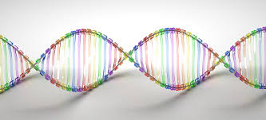
Biography
Yan Guo received his PhD in computer science from University of South Carolina in 2009. Currently, he is an assistant professor at the Vanderbilt Center for Quantitative Sciences, Department of Cancer Biology department. He is also serving as the Technical Director of Bioinformatics for Vanderbilt Technologies for Advanced Genomics Analysis and Research Design (VANGARD). His research is focused on sequencing data analysis in cancer and development of bioinformatics methodology and analysis approaches for high dimensional genomic data.

Slide 4
Research Interest
Research on developing bioinformatics methodologies and analytical approaches, especially in cancer research.

Slide 5
Oncogenomics
Yan Guo Professor Department of Cancer Biology
Vanderbilt University USA

Slide 6
Oncogenomics (Cancer Genomics)
Oncogenomics is a relatively new sub-field of genomics that applies high throughput technologies to characterize genes associated with cancer.
Cancer is a genetic disease caused by accumulation of mutations to DNA leading to unrestrained cell proliferation and neoplasm formation.
The goal of oncogenomics is to identify new oncogenes or tumor suppressor genes that may provide new insights into cancer diagnosis, predicting clinical outcome of cancers, and new targets for cancer therapies.
The success of targeted cancer therapies such as Gleevec, Herceptin, and Avastin raised the hope for oncogenomics to elucidate new targets for cancer treatment.

Slide 7
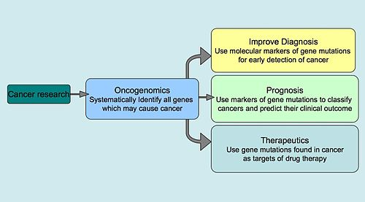
Overall Goals of Oncogenomics

Slide 8
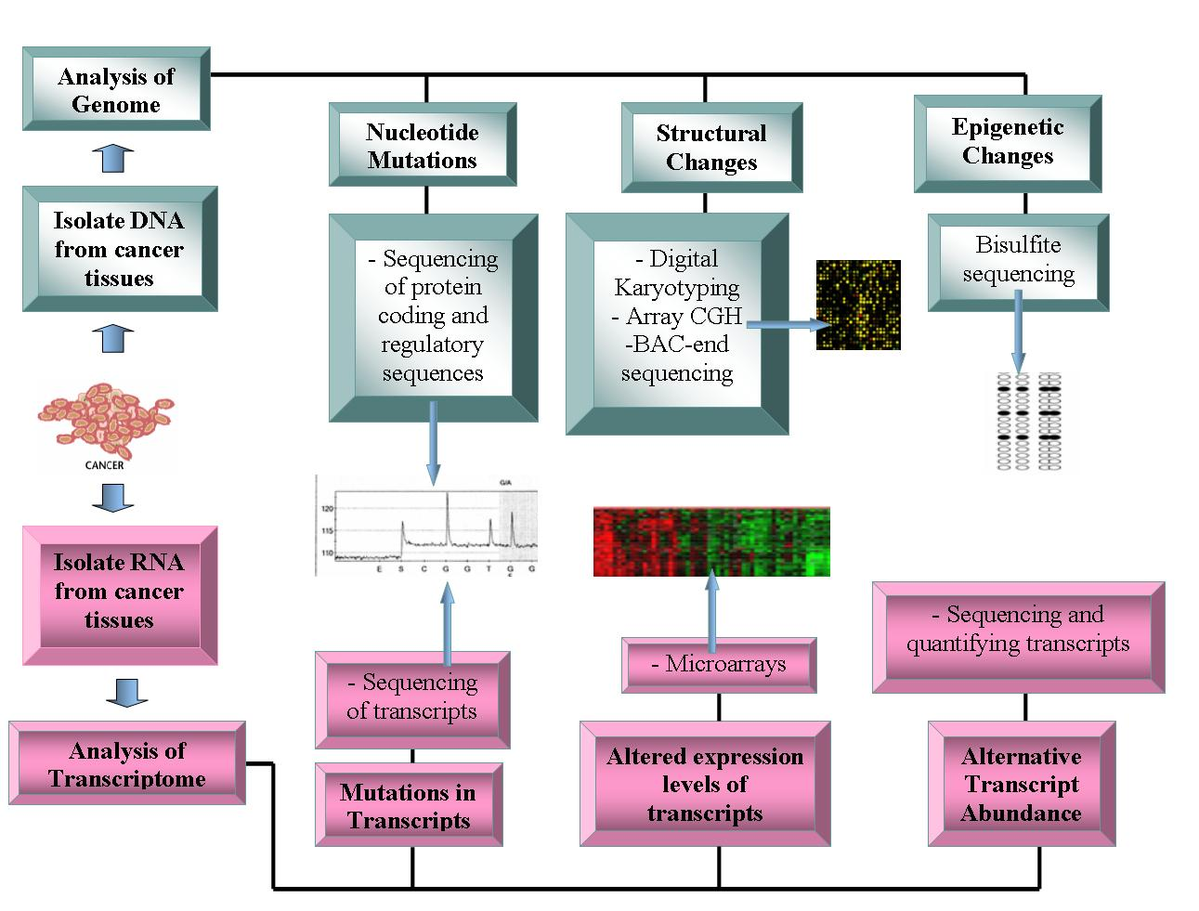
Current Technology being used in Oncogenomics

Slide 9
Databases for Cancer Research
Cancer Genome Project is an initiative to map out all the somatic intragenic mutations in cancer.
COSMIC is a resource
Oncomine has compiled data from cancer transcriptome profiles.
IntOGen integrates multidimensional human oncogenomic data classified by tissue type using the ICD-O terms.
International Cancer Genome Consortium is so far the biggest project to collect human cancer genome data. The data is accessible through the ICGC website.

Slide 10
Advances from Oncogenomics
Mutational analysis of entire gene families has been a powerful approach to oncogenomics which has been informative. Genes of the same family have similar functions, as predicted by similar coding sequences and protein domains, have been systematically sequenced in cancerous genomes to identify particular pathways which may be associated with cancer progression.
Drug therapies have already been developed to inhibit PIK3CA. Another example is the BRAF gene was identified in 2004, which was one of the first genes ever to be implicated in melanomas.
BRAF encodes a serine/threonine kinase which is involved in the RAS-RAF-MAPK growth signaling pathway, and they found that mutations in BRAF causing constitutive phosphorylation and activity were found in 59% of melanomas. Before BRAF, there was very little understanding of the genetic mechanism of the development of melanomas, and therefore, prognosis for patients was poor.

Slide 11
Potential Diagnostic Applications
Currently anticancer drugs have been manufactured to target mtDNA and have shown positive results in killing tumor cells. There has also been research done in using mitochondrial mutations as biomarkers for cancer cell therapy.
It is easier to target mutation within the mitochondrial DNA as opposed to nuclear DNA because the mitochondrial genome is much smaller and therefore easier to screen for specific mutations. It is also thought that the mtDNA content alterations found in blood samples might be able to serve as a screening marker for predicting future cancer susceptibility as well as tracking malignant tumor progression.
with these potential helpful characteristics of mtDNA, it is also not under the control of the cell cycle and it is important for maintaining ATP generation and mitochondrial homeostasis. These characteristics make targeting mtDNA a practical therapeutic strategy.

Slide 12
Journal of Next Generation Sequencing & Applications Related Journals
Advancements in Genetic Engineering
Journal of Computer Science & Systems Biology
Journal of Proteomics & Bioinformatics
Transcriptomics: Open Access

Slide 13
Journal of Next Generation Sequencing & Applications
Upcoming Conferences
http://www.conferenceseries.com/

