Slide 1
Editorial Board Member
Dr. Yanyun Zhao Professor
Department of Food Science and Technology
Oregon State University,
USA
Tel: 541-737-9151

Slide 2
Biography
Yanyun Zhao is a Professor in the Department of Food Science & Technology, Oregon State University (OSU) with combined research, Extension and education responsibilities in value-added food processing. She received her BS and MS from University of Shanghai for Science and Technology (former Shanghai Institute of Mechanical Engineering) in 1982 and 1987, respectively, and PhD from Louisiana State University in 1993. She then joined Iowa State University as a Post-Doctoral Research Associate (1993-1995) and an Assistant Professor (1995-1996).

Slide 3
Research Interest
Investigation of the Impacts of Different Food Processing and Packaging Technologies on the Physiochemical, Nutritional and Microbial Qualities of Foods and Development of Strategies to Retain Food Quality and Enhance Food Safety.
Development of Antimicrobial Edible Coatings for Enhancing Quality and Safety of Fresh Produce and Processed Foods.
Development of Novel Food Processing Approaches to Develop Value-Added Food Products.

Slide 4
Publications
Deng, Y., Yang, G., Yue, J., Qian, B., Liu, Z., Wang, D., Zhong, Yu and Zhao, Y. 2014. Influences of ripening stages and extracting solvents on the polyphenolic compounds, antimicrobial and antioxidant activities of blueberry leaf extracts, Food Control, In Press.
Deng, Y., Wang, Y., Yue, J., Zhong, Yu and Zhao, Y. 2014. Thermal Behavior, Microstructure and Protein Quality of Squid Fillets Dried by Far-Infrared Assisted Heat Pump Drying. Food Control. 36(1), 102-110.
Jung, J. and Zhao, Y. 2013. Impact of the structural differences between α- and β-chitin on the depolymerizing reaction and antibacterial activity of α- and β-chitosan. J. Agric. Food Chem. 61(37) 8783-8789.
Zhao, Y., Lian, Z, and Yue, Jin. 2013. Recent Development in Food Packaging, Invited review article. Journal of Chinese Institute of Food Science and Technology, 13(4), 1-10.

Slide 5
Books
Zhao Y. Editor. 2012. Specialty foods: processing technology, quality, and safety. Taylor and Francis Group, LLC, Boca Raton, FL. ISBN-10: 1439854238.
Zhao Y. Editor. 2007. Berry fruits: Value-added products for health promotion. Taylor and Francis Group, LLC, Boca Raton, FL. ISBN-10: 0849358027.

Slide 6
Food Safety
Food safety a scientific discipline describing handling, preparation, and storage of food in ways that prevent foodborne illness. Food can transmit disease from person to person as well as serve as a growth medium for bacteria that can cause food poisoning.

Slide 7
Importance of Food Rheology
Food rheology is important in quality control during food manufacture and processing
Long food can be stored
The study of food rheology is more complicated than study in fields such as the rheology of polymers.

Slide 8
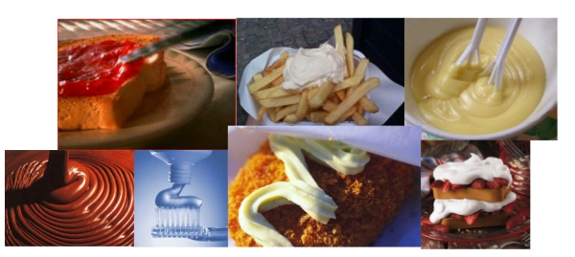
Rheology in Daily Life
We normally take for granted a lot of things in life and
these include some of the “rheological events”.
The pictures show the different roles of rheology in
food and nonfood products.

Slide 9
Examples of Rheological Properties
Viscosity
Elasticity
Peanut butter in the jar
Ketchup is commonly used an example
The textural properties of a peanut butter and jelly sandwich

Slide 10
Rheological and Functional Properties in Cheese
Cheese
Cheese is a nutritious Food made mostly from Cow’s milk.
Curded by Lactic Acid Bacteria
It is a source of protein and calcium
Containing additional nutrients
Types of Cheese
Asiago Cheese
Bleu Cheese
Goat Cheese
Cream Cheese
Vegetarian Cheese

Slide 11
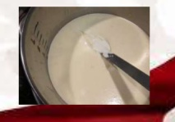
Rheological Tests
Three categories
Empirical- supply basic single point information
Imitative-try to imitate the forces and deformations associated with a specific process
Fundamental- gives information as to the element properties of a material

Slide 12
Rheological Methods
Small Strain
Used to define both the elastic and the viscous nature of cheese.
Cheese is a time dependent material
Useful in understanding mechanisms of some endues functions.
Used to determine changes caused by processing and storage parameters of cheeses
Large Strain
Used to determine cheese texture
These measurements occur outside of linear viscoelastic region
Characterize the non linear and fracture properties of the material
Relate well to sensory properties since mastication is a large strain action

Slide 13
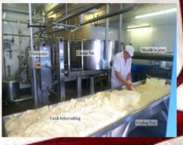
Factors affecting Rheological and Functional Properties
Can be categorized as below
Properties of milk
Cheese composition
Cheese making procedures
Post manufacturing processes

Slide 14
Industrial Aspect of Rheology
Responsible for any formulation, production, appearance, usage, and finally affect stability
Affects final cost of product
If a material is pumped, sprayed, extended, extruded, molded, coated, mixed, chewed, swallowed, rubbed, transported, stored, heated, cooled, aged …Rheology is important

Slide 15
Examples of Complex Fluids
Foods
Emulsions (mayonnaise, ice cream)
Foams (ice cream, whipped cream)
Suspensions (mustard, chocolate)
Gels (cheese)
Bio fluids
Suspension (blood)
Gel (mucin)
Solutions (spittle), etc.,

Slide 16
Thank You..!

