Slide 1
SENSOR NETWORKS AND DATA COMMUNICATIONS
Open Access
Yaochun Shen,
Ph.D.,

Slide 2
BIOGRAPHY
Dr. Yao-Chun Shen is a Senior Lecturer at Department of Electrical Engineering and Electronics, University of Liverpool since June 2007. Before that he has worked on terahertz-related technology for many years, first as a Research Associate at the Cavendish Laboratory, University of Cambridge, and then as a Senior Scientist at TeraView Limited, Cambridge. He has been awarded 6 patents, published 3 book chapters and over 100 peer-reviewed papers that are highly cited with an h-index of 27 (http://scholar.google.co.uk/citations?user=2oPuJqQAAAAJ). His current research interests include spectroscopy and imaging technologies in general, and particularly the development of novel terahertz (THz) spectroscopic imaging and optical coherency tomography (OCT) techniques for non-contact and non-destructive evaluation and industry applications.

Slide 3
RESEARCH INTERESTS
Terahertz devices, systems and industrial applications, Terahertz pulsed spectroscopy and imaging, Optical Coherency Tomography, Infrared spectroscopy and imaging, Non-destructive and non-invasive evaluation and inline monitoring.

Slide 4
OPTICAL COHERENCE TOMOGRAPHY (OCT)
OCT use low-coherence interferometry to produce a two or three dimensional image of optical scattering from internal tissue microstructures.
Michelson interferometer is used to perform low-coherence interferometry
OCT measures intensity of reflected infrared light.

Slide 5
INTRODUCTION OF OCT
James G. Fujimoto, 1991
What is OCT:
diagnostic medical imaging techonology
Why OCT: better diagnose and treat disease
Main application areas:
heart disease and cancer

Slide 6
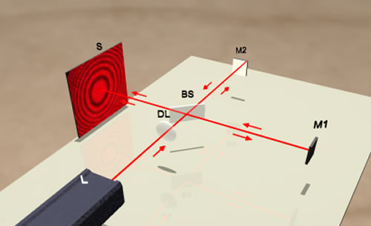
MICHELSON INTERFEROMETER

Slide 7
FUNDAMENTAL OCT SCHEMATIC
SLD
PZT
Sample
Detector
Demodulator
AD
Reference
Computer

Slide 8
ADVANTAGE OF OCT
Broad dynamic range,
High resolution
Rapid data acquisition rate,
Small inexpensive catheter/endoscope design
Compact portable structure
(fiber optically based, making possible the development of small catheters and endoscopes)
The frame rate for OCT systems are four to eight frames per second.(assume an image size of 256 by 512 pixels.)

Slide 9
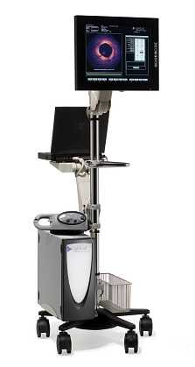
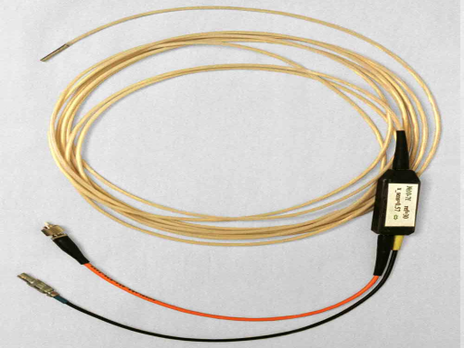
NOWADAYS AND FUTURE EQUIPMENT
Low-coherence Superluminescent diode:800 –1300 nm center waveength and severl milliwatts power.
DISPLAY
AND
KEYBOARD
INTEROMETER ELECTRONICS
AND
OPTICS
+COMPUTER
FIBEROPTIC PROBE
Not available for sale Pending 510(k)

Slide 10
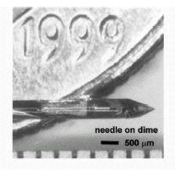
NEEDLE FOR OCT

Slide 11
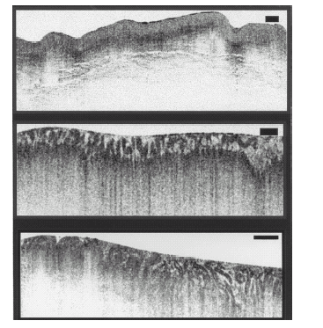
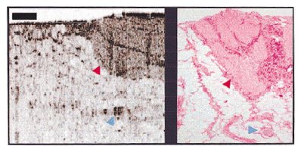
OCT APPLICATION
Esophagus & epithelium & early cancer
Vulnerable plaque
B Reduce Biopsy Hazardous
Prostate
A Reduce High False-Negative Rates
Applied in guiding microsurgical procedure

Slide 12
LIMITATION
Penetration: 2-3mm Ideal: 4mm
Resolution :
catheter/endoscope based image: 10μm, noncatheter: 4 μm,
1. femtosecond laser is expensive (1 μm)
2. transverse resolution needs to be similar to axial resolution, below 10 μm need short confocal parameter which results in the focus falling off rapidly.
Acquisition rate: <10franes/second
Lack of large-scale clinical trials

Slide 13
FUTURE WORKS
Peneration and Resolution:
1. Need to develop with similar median wavelength, power, and bandwidth to those of the mode locked laser.
2. Need more complex catheter/ endoscope designs to alleviate the focus falling off rapidly.
Acquisition rates: video rate is anticipated with future embodiments.

Slide 14
UNDERWAY WORK
Combine OCT with Doppler velocimetry and measurement of birefringence properties.
The potential of giving OCT the ability to make both structural and dynamic assessments.

Slide 15
RECENT PUBLICATIONS
Ke Su, Y.C. Shen, and J. Axel Zeitler, Terahertz sensor for non-contact thickness and quality measurement of automobiles paints of varying complexity, IEEE Trans. Terahertz Science and Technology, 4 (2014) 432-439 (10.1109/TTHZ.2014.2325393)
W. Tu, S. Zhong, Y.C. Shen, Q. Zhou, and L. Yao (2014) FDTD-based quantitative analysis of terahertz wave detection for multilayered structures. J. Optical Society of America A, 31 (2014) 2285–2293
N. Khiabani, Y. Huang, L. E. Garcia-Muñoz, Y.C. Shen, A. Rivera-Lavado, A Novel Sub-THz Photomixer with Nano-Trapezoidal Electrodes, IEEE Trans. Terahertz Science and Technology (IF>4.0), 4 (2014) 501 – 508 (10.1109/TTHZ.2014.2320824)
C. Li, J.A. Zeitler, Y. Dong, Y.C. Shen, Nondestructive evaluation of Polymer Coating Structures on Pharmaceutical Pellets using Full Field Optical Coherence Tomography, J. Pharmaceutical Sciences (IF>3.0), 103 (2014) 161-166 (10.1002/jps.23764)
Y.C. Shen, Terahertz Time-Domain Spectroscopy and Imaging, J. Electrical & Electronic Systems 3 (2013) e113 (Editorial, doi:10.4172/2332-0796.1000e113)
R.K. May, K. Su, L. Han, S. Zhong, J.A. Elliott, L.F. Gladden, M. Evans, Y.C. Shen, J.A. Zeitler, Hardness and density distributions of pharmaceutical tablets measured by terahertz pulsed imaging. J. Pharmaceutical Sciences (IF>3.0), 102 (2013) 2179-86
N. Khiabani, Y. Huang, and Y.C. Shen, (2013) Theoretical modelling of THz Photoconductive Antennas in a Pulsed System. IEEE Trans on Antennas and Propagation, 61 (2013) 1538-1546
H. Shen, L. Gan, N. Newman, Y. Dong, C. Li, Y. Huang and Y.C. Shen, Spinning disk for compressed imaging, Optics Letters (IF>3.0), 37 (2012) 46-48

Slide 16
SENSOR NETWORKS AND DATA COMMUNICATIONS RELATED JOURNALS
Biosensors & Bioelectronics
Biosensors Journal

Slide 17
SENSOR NETWORKS AND DATA COMMUNICATIONS RELATED CONFERENCES
Global Summit on Electronics and Electrical Engineering, November 03-05, 2015 Valencia, Spain
4th International Conference and Exhibition on Biometrics & Biostatistics, November 16-18, 2015 San Antonio, USA
2ndInternational Conference on Big Data Analysis and Data Mining, November 30-December 02, 2015 San Antonio, USA
2nd International Conference and Business Expo on Wireless & Telecommunication April 21-22, 2016 Dubai, UAE

Slide 18
OMICS International Open Access Membership
OMICS International Open Access Membership enables academic and research institutions, funders and corporations to actively encourage open access in scholarly communication and the dissemination of research published by their authors.
For more details and benefits, click on the link below:
http://omicsonline.org/membership.php

