Slide 1

OMICS Journals are welcoming Submissions
OMICS International welcomes submissions that are original and technically so as to serve both the developing world and developed countries in the best possible way.
OMICS Journals are poised in excellence by publishing high quality research. OMICS International follows an Editorial Manager® System peer review process and boasts of a strong and active editorial board.
Editors and reviewers are experts in their field and provide anonymous, unbiased and detailed reviews of all submissions.
The journal gives the options of multiple language translations for all the articles and all archived articles are available in HTML, XML, PDF and audio formats. Also, all the published articles are archived in repositories and indexing services like DOAJ, CAS, Google Scholar, Scientific Commons, Index Copernicus, EBSCO, HINARI and GALE.
For more details please visit our website: http://omicsonline.org/Submitmanuscript.php

Slide 2
Yasuhiro Kuramitsu, M.D., Ph.D
Associate Professor
Departments of Biochemistry and Functional Proteomics Yamaguchi University Graduate School of Medicine, Ube, Japan
E-mail: climates@yamaguchi-u.ac.jp

Slide 3
Pancreatic cancer remains one of the diseases with poor prognosis, and the most patients have no chance to be operated when they are diagnosed as pancreatic cancer. Their 5-year survival rate is less than 5%. Gemcitabine is one of the most effective chemotherapeutic drugs for pancreatic cancer, but the therapeutic effect is insufficient because many types of pancreatic cancer are resistant. We have reported that HSP27 was one of the important factors related to gemcitabine-resistance. We treated gemcitabine-resistant pancreatic cancer cells with interferon-gamma or KNK-437, which were reported as HSP27-suppressors, and showed the suppressive effects of HSP27 and combinatorial effects on inhibition of proliferation against gemcitabine-resistant pancreatic cancer cells.
AHCC is an extract of basidiomycete mushroom and includes polysaccharide, and has been used as health food to enhance the therapeutic effects and reduce the adverse effects of chemotherapy. In the present study we investigated the effects of AHCC on the expression of HSP27, and the effects of combinatorial treatment of AHCC and gemcitabine on the gemcitabine-resistant pancreatic cancer cells, and AHCC down-regulated HSP27 and showed an anti-proliferative effect on gemcitabine-resistant cells.

Slide 4
Prognosis of pancreatic cancer
JPS-stage at the time of diagnosis
Therapy and prognosis
Stage | n | 5 year survival rate
StageⅠ | 128 | 58.6%
StageⅡ | 192 | 51.0%
StageⅢ | 1039 | 25.9%
StageⅣa | 1809 | 11.9%
StageⅣb | 4661 | 2.8%
Method of therapy | 5 year survival rate
Resection | 12.2%
Palliative operation | 0%
Laparotomy | 2.0%
Non- operation | 0%
SUIZOU 2003 (Japanese).

Slide 5
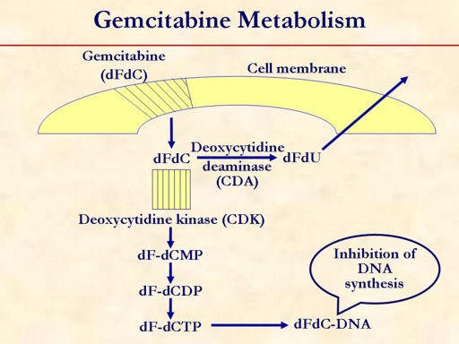
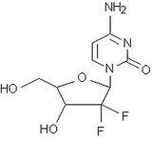
Gemcitabine(gemzar, GEM), a drug used for chemotherapy against pancreatic cancer
Figure from Pancreatic cancer: highlights from the 42nd annual meeting of the American Society of Clinical Oncology, Saif MW , JOP. J Pancreas (Online) 2006; 7:337-348.

Slide 6
Materials 1 : Pancreatic cancer cell lines
 | differentiated | origin
MiaPaCa-2 | undifferentiated | pancreas
Panc-1 | undifferentiated | pancreas
BxPC-3 | poorly diff. | pancreas
AsPC-1 | moderately diff. | ascites
PK45ｐ | unknown | pancreas
PK59 | unknown | pancreas
The cytotoxicity of gemcitabine (GEM) to the cells was evaluated by MTT assay
cell line | MiaPaCa-2 | Panc-1 | BxPC-3 | AsPC-1 | PK45p | PK59
IC50μg/ml | 6.81 | 8.07 | 6.67 | 1.05 | 417.45 | 294.72
GEM-sensitive lines
GEM-resistant
Mol Med Rep. 2008 May-Jun;1(3):429-34.

Slide 7
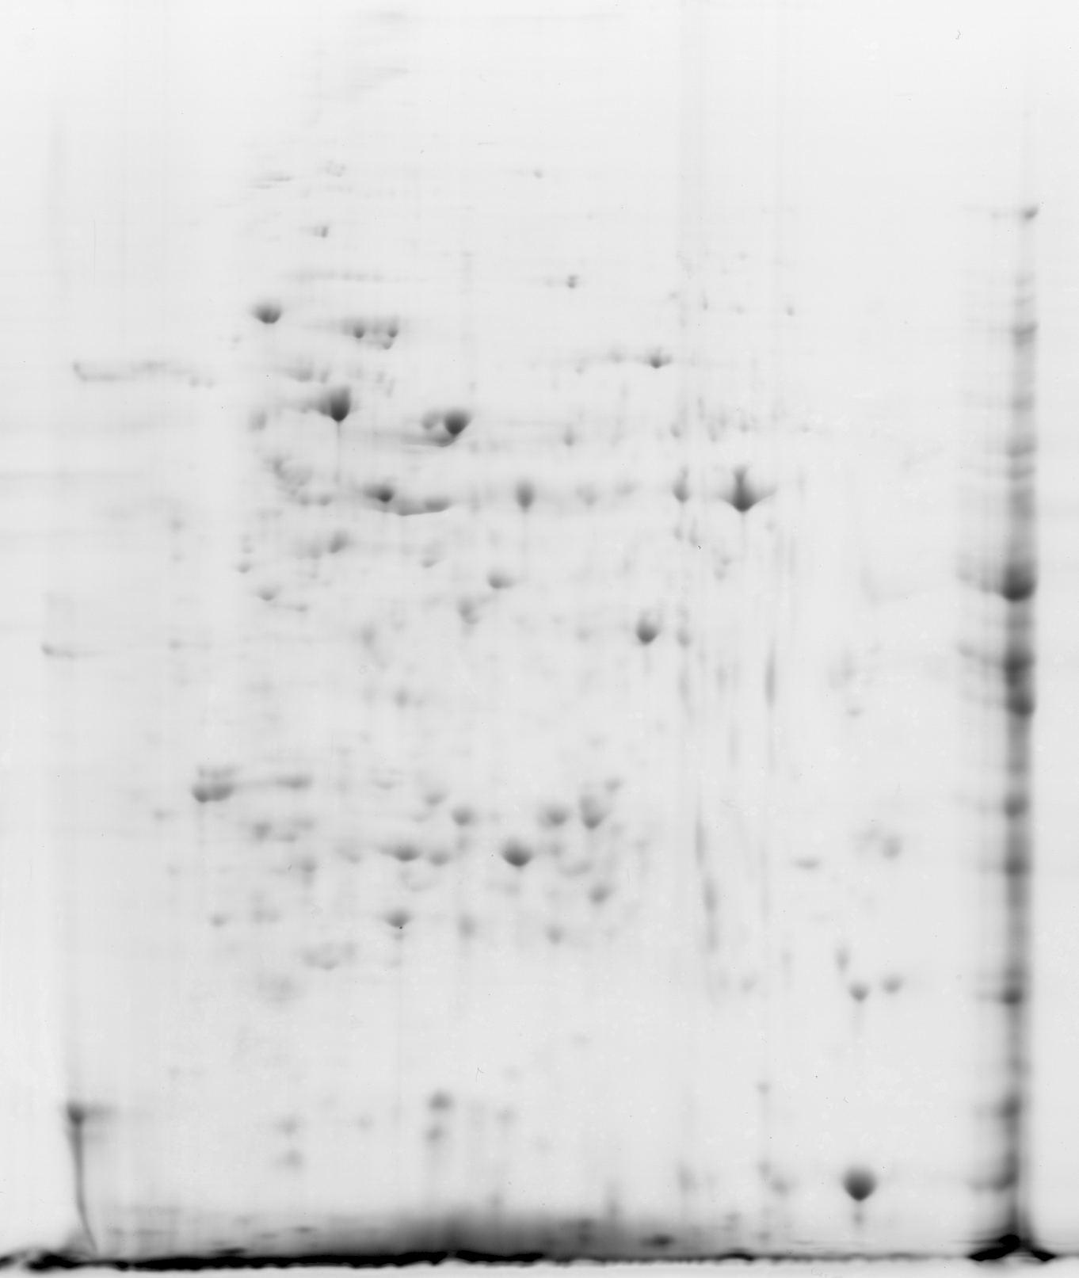
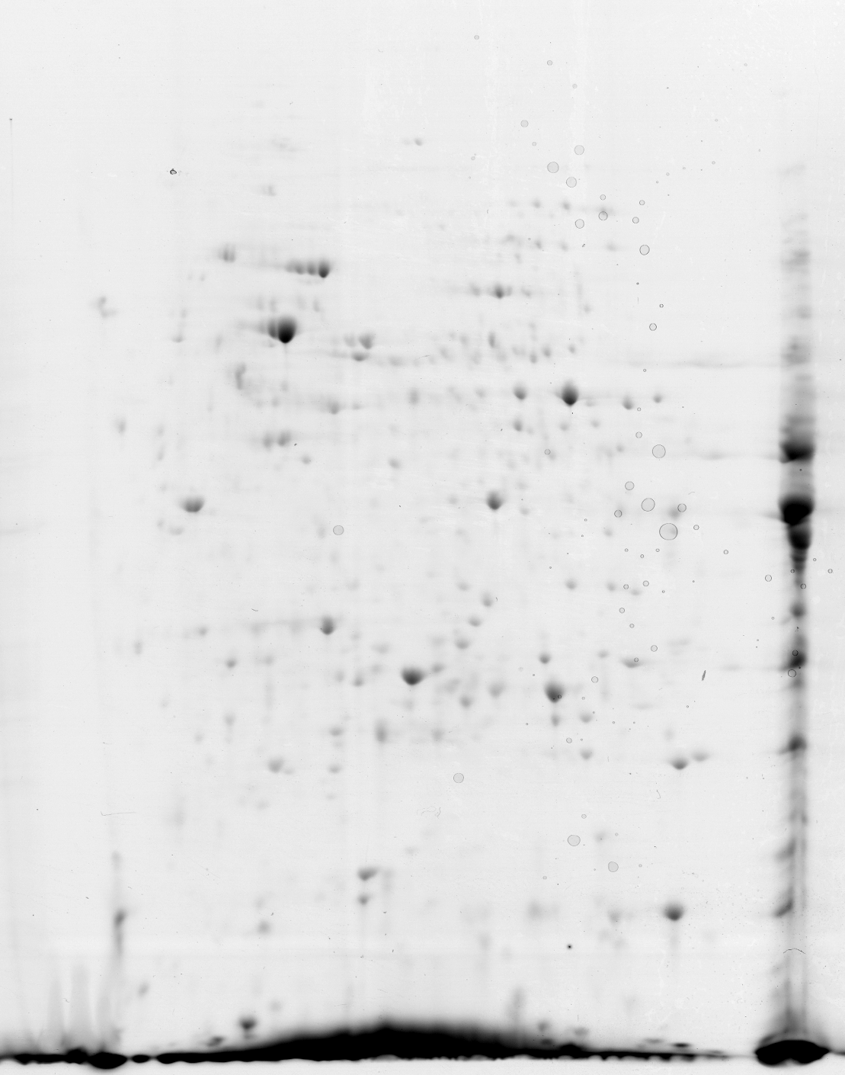
2-DE pattern of MiaPaCa-2 (sensitive) and PK59 (resistant)
MiaPaCa-2 (GEM-sensitive)
PK-59 (GEM-resistant)
kDa
116
97.4
66
45
29
unidentifiable
stress-induced-phosphoprotein 1
lamin A/C
ezrin
α-enolase
nucleophosmin
6-phosphogluconolactonase
triosephosphate isomerase
HSP27
Five spots were expressed a weakly in GEM-resistant cells than in –sensitive cells.
Five spots were higher levels in GEM-resistant cells than in –sensitive cells.
Mol Med Rep. 2008 May-Jun;1(3):429-34.
Notes:
6種類の細胞株よりそれぞれ蛋白を抽出し、2次元電気泳動を行いました。感受性株の代表としてMiaPaCa2を耐性株の代表としてPK59の二次元電気泳動をお示しします。すべての細胞株で3回ずつ二次元電気泳動を行い、感受性株群と耐性株群においてすべての細胞で、2倍以上の発現差が得られたスポットを切り出し、質量分析計を用いてタンパク質を同定しました。同定した蛋白をこちらに示しています。この中で、一番発現差が高かったHsp27について今回は検討していきました。

Slide 8


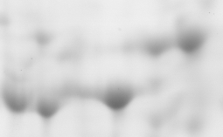

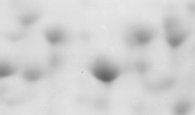
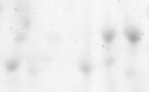
Expression analysis of HSP27 (2DE)
Sensitive lines Resistant lines
6
**
5
*
* p<0.05
** p<0.01
4
spot 1
3
spot 2
2
**
spot 3
*
1
0
Sensitive
Resistant
MiaPaCa
Panc-1
PK-45p
3
3
1
3
1
1
2
2
2
AsPc-1
BxPC-3
PK-59
3
3
1
3
1
Mol Med Rep. 2008 May-Jun;1(3):429-34.
2
2
1
2
Notes:
二次元元気泳動において耐性株で増加する3つのスポットがHsp27であることがわかりました。MiaPaca-2のスポットを基準として、それぞれの細胞で得られたスポットの濃さと面積をratioでグラフに示したものですが。3つとも耐性株であるPK45P,PK59で発現が更新していました。感受性株と耐性株に2群に分類したところ有意に耐性株群において発現が亢進していることがわかりました

Slide 9
Immunoblot analysis of HSP27
GEM-sensitive
GEM-resistant
BxPC-3 AsPC-1 MiaPaCa-2 Panc-1 PK45p PK59
25kDa →
HSP 27
50kDa →
actin
37kDa →
Mol Med Rep. 2008 May-Jun;1(3):429-34.
Notes:
Western blotでHSP 27の発現が耐性株で増加していることをかくにんしました

Slide 10
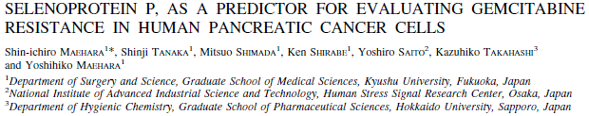
Materials 2 : Acquired resistant cell line to gemcitabine
KLM1（Sensitive line）
(%) MTT assay of KLM1 and KLM1-R
GEM 10μg/ml
1 w incubation
GEM free medium
KLM1-R(resistant)
KLM1(sensitive)
2 w incubion
Repeat 4 times
KLM1-R（Resistant line）
Int J Cancer. 2004 Nov 1;112(2):184-9.
Int J Oncol. 2007 Dec;31(6):1345-50
Notes:
そこで、次にgemcitabine投与により獲得する耐性について検討しました。
Gemcitabine にたいする感受性の高いKLM1より樹立した、Gemcitabine resistant KLM1 （KLM1-R）を九州大学より分けていただきました。当科にてgemcitabine感受性をMTTassayにて評価したところ、KLM1-Rにおいてgemcitabine耐性となっていることがわかりました

Slide 11
Expression of HSP 27 in KLM1 and KLM1-R
KLM1 KLM1-R
HSP27
actin
Int J Oncol. 2007 Dec;31(6):1345-50
Notes:
KLM1とKLM1-RについてHsp27の特異抗体を用いてWesternblotを施行したところ、耐性株におけるHSP27の発現増加を認めました。

Slide 12
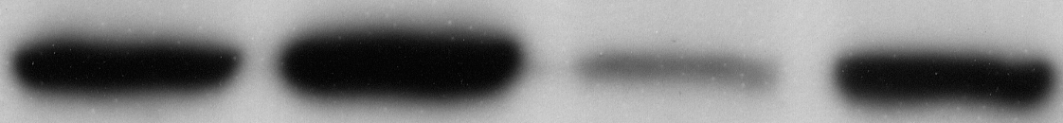
Decreasing resistance to GEM in HSP27- knocked down KLM1-R cells
KLM1 KLM1-R HSP27siRNA control siRNA
HSP27
actin
◆KLM1
■KLM1-R
▲control siRNA LM1-R
× HSP27siRNA KLM1-R
% Growth
Int J Oncol. 2007 Dec;31(6):1345-50
Notes:
siRNAを用いてHSP27の発現を落としたgemcitabine耐性株KLM1-RとコントロールsiRNAで同様に処理したKLM1-R、それから未処理のKLM1-R、KLM1の4種類の細胞のgemcitabine感受性をMTTで評価しました。
HSP27発現を落とすことにより、gemcitabine耐性が改善していることがわかります。
クリック
KLM1-RとHSP27ノックダウンKLM1-RのみのMTTです。HSP27発現抑制により各濃度で有意に感受性が更新しました。

Slide 13
The immunopositive rate of HSP27 in
progressive disease(PD) and stable disease(SD)
%
p=0.0066
Immunopositive rate
Int J Oncol. 2007 Dec;31(6):1345-50

Slide 14
Survival Curves of Pancreatic Cancer Patients (HSP27-positive and HSP27-negative) treated with GEM（Kaplan-Meier）
1
Logranc test
P=0.0106
.8
HSP27-negative
group (<30%)
.6
Survival rate
.4
.2
HSP27-positive
group (30%<)
0
0
200
400
600
800
1000
1200
(Hours)
Int J Oncol. 2007 Dec;31(6):1345-50
Notes:
Gemcitabine投与症例における生存率とHSP27発現を検討した結果、HSP27発現が高かったP群で有意に生存期間が短いことがわかりました。

Slide 15
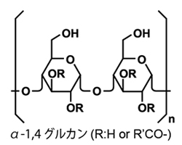
Active Hexose-Correlated Compound(AHCC)
Active hexose-correlated compound (AHCC), an extract of basidiomycete mushroom called Lentinula edodes, is composed of polysaccharides, amino acids, lipids and minerals. The predominant components of AHCC are oligosaccharides and their major portions are 5 kDa molecules named α1,4-glucans. AHCC is used as a health food to support the therapeutic effects and alleviate adverse effect of chemotherapy owing to immunomodulatory and antitumor effects of AHCC.

Slide 16
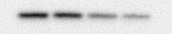
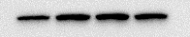
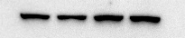
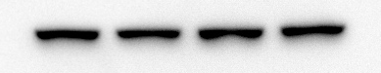
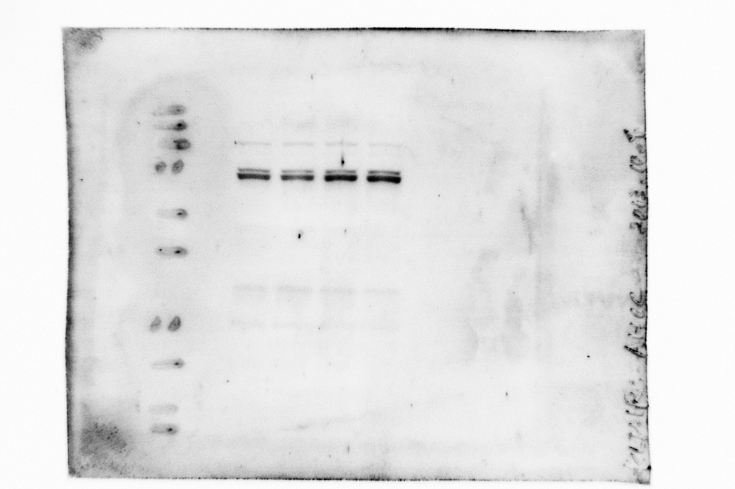
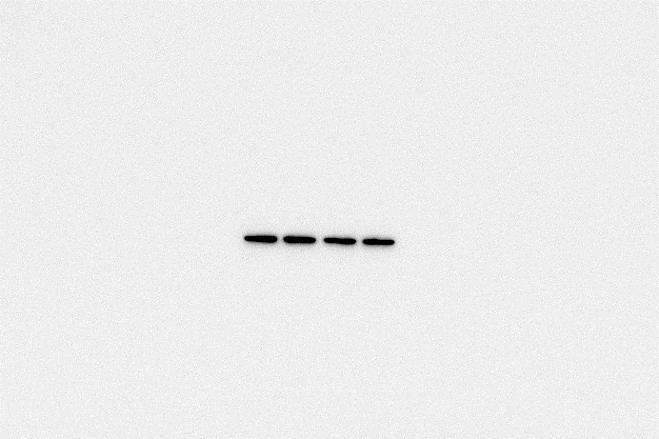
Expression levels of HSP family proteins in KLM1-R cells treated with AHCC.
HSP27
27 kDa
HSP60
60 kDa
HSP70
70 kDa
HSC70
70 kDa
GRP78
78 kDa
Actin
43 kDa
AHCC
0
1
5
10
mg/ml
Anticancer Res. 2014 Jan;34(1):141-6

Slide 17
The intensity of the HSP27/actin bands in KLM1-R cells treated with AHCC.
*
*
*
*
*
HSP27/Actin (%)
AHCC (mg/ml)
Anticancer Res. 2014 Jan;34(1):141-6

Slide 18
Cytotoxic effect of AHCC on KLM1-R cells.
*
Proliferation rate (%)
Cyclodextrin
Concentration (mg/ml)
Anticancer Res. 2014 Jan;34(1):141-6

Slide 19
The cytotoxic effect of the combinatorial treatment of AHCC and GEM on KLM1-R cells.
*
*
*
*
*
Proliferation rate (%)
Anticancer Res. 2014 Jan;34(1):141-6

Slide 20
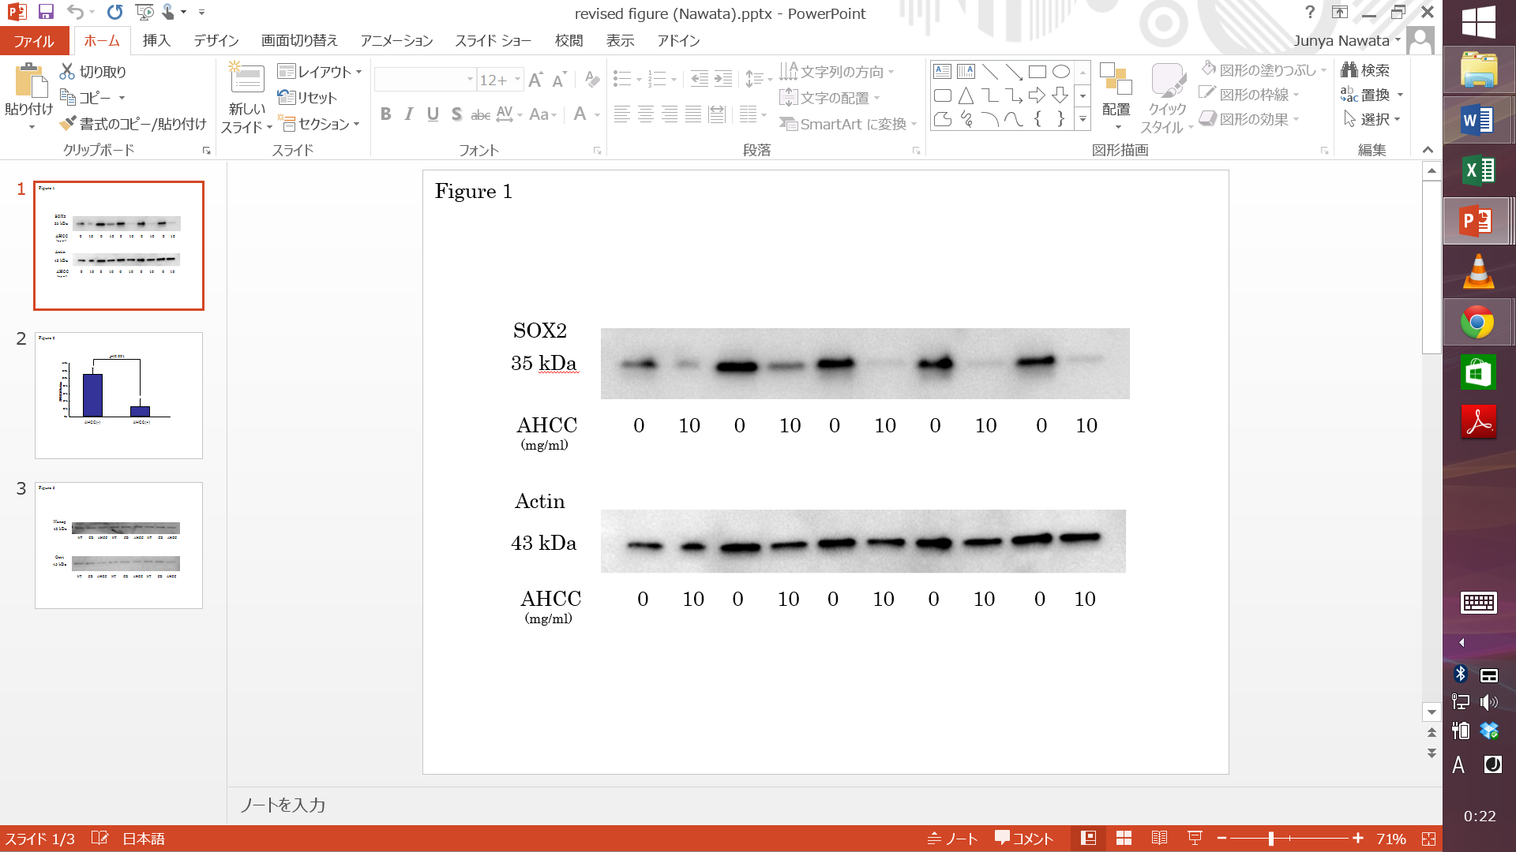
Expression levels of SOX2 in KLM1-R cells-1
Anticancer Res. 2014 (in press)

Slide 21
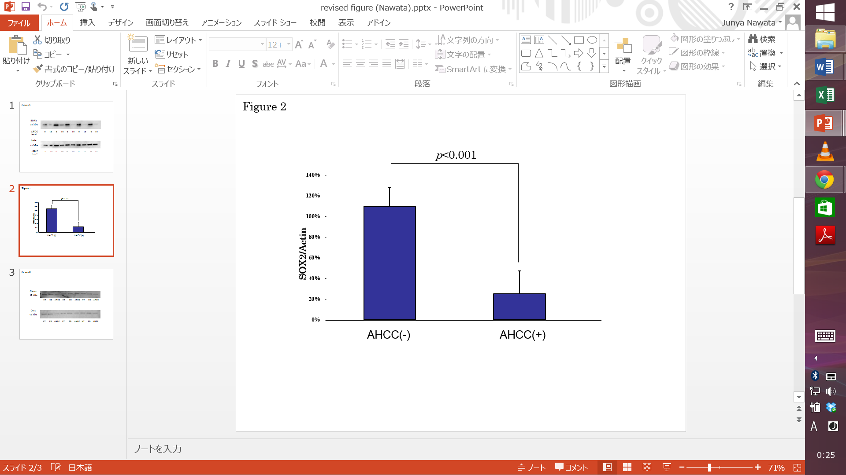
Expression levels of SOX2 in KLM1-R cells-2
Anticancer Res. 2014 (in press)
calculated by Student’s t test

Slide 22


Journal of Proteomics & Bioinformatics
Related Journals
Transcriptomics: Open Access
Journal of Pharmacogenomics & Pharmacoproteomics
Journal of Data Mining in Genomics & Proteomics

Slide 23
For more details on Conferences Related
Journal of Proteomics & Bioinformatics please visit:
http://www.conferenceseries.com/biochemistry-meetings

Slide 24
Open Access Membership with OMICS International enables academicians, research institutions, funders and corporations to actively encourage open access in scholarly communication and the dissemination of research published by their authors.
For more details and benefits, click on the link below:
http://omicsonline.org/membership.php

