Slide 1
Dr. Yue Zhang
Executive Editor
Journal of Nuclear Medicine & Radiation Therapy
Harvard University USA
Notes:
Dr.George Perry

Slide 2
BIOGRAPHY
He is now an instructor in Department of Radiation Oncology, Beth Israel Deaconess Medical Center (BIDMC) /Harvard Medical School. He completed his PhD program in Cellular and Developmental biology in 2006 at University of Fribourg, Switzerland, and identified the differentially expressed downstream targets of human nucleosome remodelling Mi-2 orthologue LET-418 and explored the influence of TOR kinase on lifespan in C. elegans using genetics. Then he carried out his postdoctoral training at Institute of Ageing and Pittsburgh Institute of neurodegenerative diseases, University of Pittsburgh. In 2008, he moved to Dept of Radiation Oncology/BIDMC first as research fellow and was promoted to current position in August, 2010. He have authored and coauthored 15 publications in journals, such as Nature, Developmental biology, BMC developmental biology, PLOS Genetics, PLOS one, J. Vis Exp, Cancer informatics, Gene regulation and Systems biology. He served as a reviewer in some journals, including Cellular and Molecular Life Science, Transgenic Research, Knowledge-based Systems, and the La –Press journals.

Slide 3
Recent Publications
Cancers with Stem-Like Attractors and Â“Loss Of DifferentiationÂ” Novel Hallmark: Does the Â“Cyto-EducationÂ” with Stem Cell Therapy Help?
Yue Zhang
The Potential Â“CoreÂ” of Vitamin D Receptor and Vitamin D Hypothesis: Synthesis of Common Basis of Some Autoimmune Diseases and Associated Cancers via Autophagy
Yue Zhang
Emerging Vitamin D Receptor-Centered Patterns of Genetic Overlap across Some Autoimmune Diseases and Associated Cancers
Yue Zhang
Synthetic and Systems Biology: Toward Achieving Impossible Missions and Deciphering Human Complex Disease Genetics
Yue Zhang
Authorship: an Engine for Research, and a Guarantee of Quality of Publication and Currency for Career Development
Yue Zhang
Ideal Open Access (OA2) and the Lineage of Reproducibility
Yue Zhang
Cancer Embryonic Stem Cell-like Attractors alongside Deficiency of Regulatory Restraints of Cell-Division and Cell-Cycle
Zhang Yue

Slide 4
Research Interests
Genetics and Epigenetics, Systems biology, SLAC ( Stem cell biology, longevity /Ageing and cancer biology) with a focus on chromatin remodelers w/o the stressors, particularly radiation, heat shock, and nutrient deprivation by using both C.elegans model organisms and mammalian systems.

Slide 5
Cancers with Stem-Like Attractors and “Loss Of Differentiation” Novel Hallmark: Does the “Cyto-Education” with Stem Cell Therapy Help?
Currently, cancer, with its unrestricted cellular growth, remains as one most significant medical and socio-economic problem. Because of the chaos and dynamics of genome-wide gene expression, cells in multicellular organisms heavily rely on master regulators for chromatin remodelling and /or cell cycle to make different fate decisions, such as proliferation or differentiation into specialized cells which eventually lead to normal tissue specification and /or organ formation. Such cell fate determination should include cell fate induction and the proper execution of the terminally differentiated cell fates originated at stem-/ progenitor- /precursor cells. Previous theoretical studies of genomewide gene regulatory networks (GRN) suggest that GRN needs to ensure cell fate trajectory on a right track with a manifestation of its ordered (stable) dynamics . Having checked their genome-wide gene expression profiling data by gene expression dynamics inspector (GEDI), we can show that cell attractors converge to a common metastable stem-like state along with aberrant expression of such masters, which, including Mi-2 β, Rb, EZH2, MTA1 and l(3)mbt, are involved in carcinogenesis and/or cancer metastasis . This supports ‘loss of differentiation” as a novel hallmark of cancer hereby via incorporating elements from systems biology.
http://omicsonline.org/open-access/cancers-with-stemlike-attractors-and-loss-of-differentiation-novel-hallmark-does-the-cytoeducation-with-stem-cell-therapy-help-2332-0737.1000e104.php?aid=28663

Slide 6
The Potential “Core” of Vitamin D Receptor and Vitamin D Hypothesis: Synthesis of Common Basis of Some Autoimmune Diseases and Associated Cancers via Autophagy
Nutrigenomics may tell us how various nutrients interact with the genome and potentially cause alteration of gene expressions. One nutrient of particular interest is vitamin D, deficiency of which may lead to diseases in various human organ and muscle systems. Decoding the genetics of complex diseases such as autoimmune diseases and/ or cancers associated with the aging process is vital to understand the controversies the beneficial effects of vitamin D supplementation on these diseases. Based on comparative advantages of different model system and recent ChIPseq/ ChIP-chip studies, we previously proposed one novel insightful hypothesis: the genetic regulatory network of Vitamin D Receptor (VDR, homologue of DAF-12 in Caenorhabditis elegans) may act as a common basis in preventing some autoimmune diseases and associated cancers. Further, such diseases may burst up with polygenic genetic mutations and/or variations in that deficiency of vitamin D and lacking of UVB lead to the mal-functional DAF-12/ VDR and lose its buffering potential as a capacitor. The aberrance of environmental factor-induced DAF-12/VDR may counter-intuitively lead to in situ dys-regulation of the expression of an array of its target genes and locallyinduced autoimmunity because of the citrullination of in situ dys-regulated genes, which may be mediated by the VDR-orchestrated autophagy process. Being consistent with the “hygiene hypothesis” and the “danger signals” theory, some VDR/DAF-12 targets may be directly involved in these processes. Several testable predictions will be briefly discussed.

Slide 7
Model of autophagy-mediated DAF-12/VDR prevention from some ADs and cancers

Slide 8
Autoimmune Diseases and Associated Cancers
GRN of VDR may be Consider as Common Basis for ADs and Associated Cancers?
Although further testing is awaiting for, one GWAS reveals that one allelic VDR variant may link to clinical autoimmune antibodies including anti-p150 (TRIM33/ TIF-1γ)/p140(TRIM24/TIF-1α) whose natural self-antigens may correlate with protein products encoded by TIF-1γ/α, whose homologues flt-1 and nhl-2 are direct targets of DAF-12/VDR [8,9]. DAF-12/VDR target genes from our ChIP-chip screening showed many overlaps with validated homologues identified in human VDR studies and significantly enriched near genes that are pathologically associated with ADs and cancer [8]. But it is necessary to experimentally test these overlaps in human VDR.
http://omicsonline.org/emerging-vitamin-d-receptorcentered-patterns-of-genetic-overlap-across-some-autoimmune-diseases-and-associated-cancers-2157-7412.1000e123.php?aid=21837

Slide 9
Synthetic and Systems Biology
Many pioneering works have inspired researchers to stay up-todate on synthetic and system biology. Several cases that were originally thought to be exceptionally difficult, if not impossible, have been carried out successfully, such as Craig Venter’s creation of the world’s first synthetic life form. At a system level, nucleic reprogramming succeeded in frog half a century ago (reviewed in ); but doubts about whether or not this was impossible lingered until 40 years later, when a cocktail of four transcriptional factors systematically reprogrammed the somatic cells to stem cells . Other cases include that telomerase reactivation may lead to the reversal of tissue degeneration in aged telomerase-deficient mice and muscle-derived stem/progenitor cell dysfunction acts as a healthspan and lifespan limiting factor for murine progeria reversal.
http://omicsonline.org/synthetic-and-systems-biology-achieving-impossible-missions-deciphering-human-complex-disease-genetics-2332-0737.1000e102.php?aid=20353

Slide 10
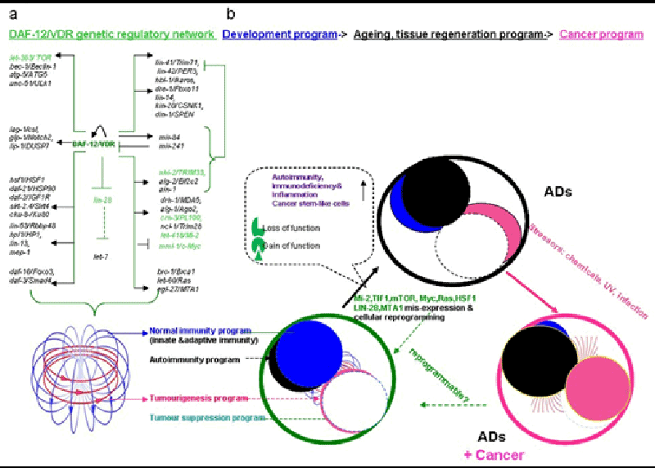
Autoimmune Immunity, Autoimmune Diseases and Associated Cancers
Multi-level control of the genes involved in development by DAF-12/VDR. The nuclear receptor directly regulates the expression of genes associated with autophagy, the Notch pathway, longevity, the heterochronic circuit, miRNA biogenesis and miRISC at the transcriptional level. Other regulators of miRNA activity, such as lin- 28 and stemness factors as mml-1/c-Myc are repressed by DAF-12. Together, miRNA and miRISC regulate the levels and translation of many heterochronic genes. Finally, DAF-12/VDR regulates its own expression and is also a target for miRNA. The system of different programs could intertwine well and merges as one perfect unit at beginning.
http://omicsgroup.org/journals/genetic-basis-of-dafvitamin-d-receptor-vdr-in-autoimmune-immunity-autoimmune-diseases-and-associated-cancers-2168-9849.1000e105.php?aid=19207

Slide 11
Research Reproducibility
Medical science is troubled by questions of economics, and we see a trend towards hidden conflicts of interest (COI), and/or irreproducibility. Traditional subscription journals represent the standard and have better COI control, but the sooner they move into OA, the better. If our heritage of reproducibility risks to end, we will need stronger systems to maintain this heritage, with a need for formal external incentives and regulations. The policy of copyright law and intellectual property crediting system should align with OA. Law has a debt to science. Authors have to abide by them to ensure high quality, ethics and scientific rigor for primary research publications. Funding agencies may make this mandatory, or a “sting” could be carried out at the discretion of reviewers or editors. Obviously, extended experiment verification is expensive.
http://esciencecentral.org/journals/open-access-oa-and-the-heritage-of-research-reproducibility-2329-8847.1000e104.php?aid=18678

Slide 12
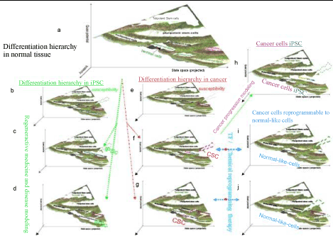
Cellular Reprogramming
Here is a concise historical review and some perspectives on the spotlighted nuclear transplantation (cloning) and induced pluripotent stem cells (iPSC). Besides, we propose that iPSC may be hypothetically considered one exceptional case among “cancerous” cells. The argument between stochastic and elite model of iPSC is briefly discussed.

Slide 13
Engineered Genes, Genome Editing, and /or Transgenics
To date, the luciferase in reporter assays and the gateway toolkit are among our routinely- used reagents, and the latter also facilitates the large-scale gene cloning so that we can switch to pick up ones of interest from the genome-wide ready- to- use collections However, it was particularity a small number of enzymes that probably have advanced huge successful stories in research of biology and medicine. They actually help us perform the special- pediment DNA cloning, genome editing and transgenics. This has greatly enlightened us. Interestingly, the toolkit equipped with one of them, e.g. Cre/lox (Flp /FRT) recombinase system for gene targeting has already been awarded the Nobel Prize.
http://omicsgroup.org/journals/less-is-more-enzymes-inspiring-the-breakthroughs-alongside-shining-on-engineered-genes-genome-editing-and-or-transgenics-2329-6674.1000e101.php?aid=4257

Slide 14
New Concepts of Germline Gene –Reactivated Cancer
The mechanism that ectopic expression of germline genes result in somatic tumors such as melanoma and brain tumors remains a big challenge . A century of unproductive concentration on the cancer- is -a- cell-based -disease. Somatic Mutation Theory of carcinogenesis (SMT) , the paradigmatic instability is coming to eyes, for instance, the tissue level [e.g. the Tissue Organization Field Theory of carcinogenesis (TOFT)] has been repeatedly suggested as one competitive strategy. Most recently, at the genome regulatory network level (GRN), the cancer attractors hypothesis naturally explains tumorigenesis , but such a new network-based intellectual framework is still quite abstract and also remains incompletely understood what its evolutionary origin is and what causes normal somatic cells be entrapped in.
http://omicsonline.org/new-concepts-of-germline-gene-reactivated-cancer-2161-0436.1000e101.php?aid=2013

Slide 15
New Frontiers of Aging Reversal and Aging-Related Diseases Reprogramming
Caner is certainly the leading ageing –related lethal disease. Through Mi-2/NuRD chromatin remodeling –related cancer attractors theory, we could understand better the carcinogenesis, especially for germline gene - reactivated cancers, and hence develop strategy to reprogram the cancerous diseased cells to normallike cells. Hereby we focus on another ageing -related disease. It is well-known that cartilage makes the movement of joints smooth and the fading- away and breakdown of articular cartilage by injury or age-related “wear and tear” causes osteoarthritis (OA), the most common degenerative chronic disease, which is further characterized by synovial inflammation, pain, subchondral bone alterations, loss of tissue cellularity and extracellular matrix (ECM) damages, a major cause of decreased quality of life in adults in the world. Yet therapy remains a challenge because cartilage has minimal ability to repair and renew itself. Alongside studies for decades, in clinical trials in patients with established or advanced OA, candidate disease-modifying drugs have failed to show efficacy, as the case in cancer research.
http://omicsgroup.org/journals/new-frontiers-of-aging-reversal-and-aging-related-diseases-reprogramming-2169-0111.1000e101.php?aid=4093

Slide 16
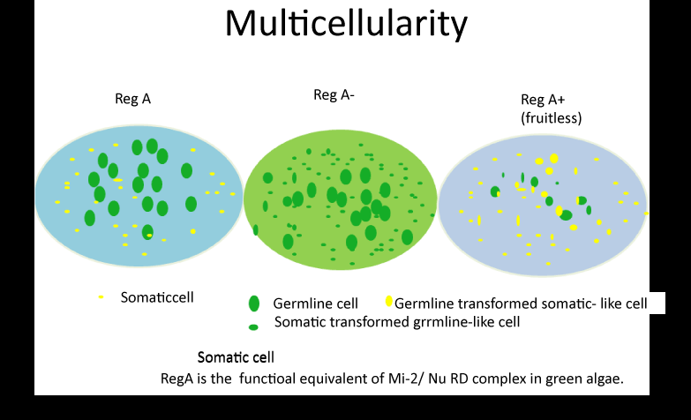
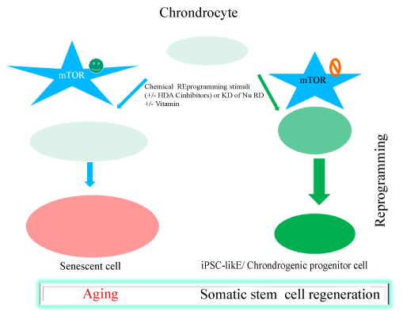

Slide 17
Up-regulation of endogenous egr1 in UV treated and heat-shocked Hela cells (qRT-PCR assays)

Slide 18
Model of EGR1 -mediated stress-induced autophagy
Heat shock, UV
p38MAPK
MEK1/2
EGR1
Apoptosis
lc3B
LC3B I
Neurodegenerative
Diseases
?
?
LC3B II
Autophagy
Notes:
18

Slide 19
Approved By
E-signature:

Slide 20
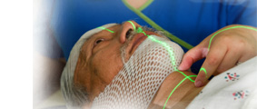
Nuclear Medicine & Radiation Therapy Related Journals
OMICS Journal of Radiology
Chemotherapy: Open Access
Journal of Cancer Science & Therapy

Slide 21
Nuclear Medicine & Radiation Therapy
Related Conferences
Conferenceseries.com

