Slide 1
Journal of Astrobiology and Outreach
Dr. Yuk L. Yung
Editorial Board member
Professor
Department of Geological and Planetary Sciences
California Institute of Technology
USA

Slide 2
Biography
Dr. Yuk L. Yung
Yuk L. Yung obtained his B.S. from the University of California in 1969, Ph.D. from Harvard University in 1974. Presently he is working as a professor, department of Geological and Planetary Sciences at California Institute of Technology.
Professor Yung's research interests consist of six major overlapping areas: planetary atmospheres, planetary evolution, atmospheric chemistry, atmospheric radiation, astrobiology and global change, with a strong emphasis on interaction and synergy among modeling, laboratory experiments and field observations, often in collaboration with colleagues at Caltech and the Jet Propulsion Laboratory (JPL).

Slide 3
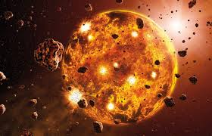
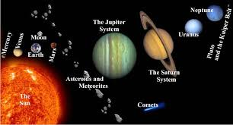
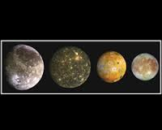
Research Interests
Planetary Atmospheres
Planetary Evolution
Atmospheric Chemistry
Atmospheric Radiation
Astrobiology
Global Change
Synergistic Interactions Between Modeling, Laboratory
Experiments And Field Observations.

Slide 4
Sample of Publications
Yung, Y. L. and M. B. McElroy. (1977). Stability of an Oxygen Atmosphere on Ganymede. Icarus 30(1): 97-103.
Yung YL, Allen M, Pinto JP. (1984). Photochemistry of the atmosphere of Titan: comparison between model and observations, Astrophysical Journal Supplement Series, 55(3), 465-506.
Gladstone GR, Allen M, Yung YL. (1996). Hydrocarbon photochemistry in the upper atmosphere of Jupiter, Icarus 119(1), 1-52.
Liang, M. C., B. F. Lane, R. T. Pappalardo, M. Allen and Y. L. Yung. (2005). Atmosphere of Callisto. J. Geophys. Res.: 110, E2003, doi:10.1029/2004JE2322.
Parkinson, C. D., M. C. Liang, H. Hartman, C. J. Hansen, G. Tinetti, V. Meadows, J. L. Kirschvink, and Y. L. Yung. (2007). Enceladus: Cassini observations and implications for the search for life. Astronomy & Astrophysics, 463, 353-357.
Parkinson, C. D., M. C. Liang, Y. L. Yung and J. L. Kirschvink. (2008). Habitability of Enceladus: Planetary Conditions for Life, Origins of Life and Evolution of Biospheres. 38(4): 355-369, doi 10.1007/s11084-008-9135-4.

Slide 5
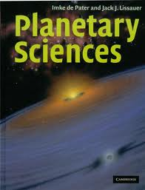
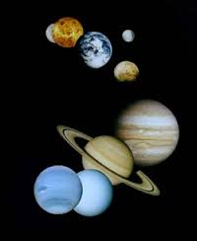

Slide 6
The Planets
There are 8 planets (Mercury, Venus, Earth, Mars, Jupiter, Saturn, Uranus, Neptune (Mercury nearest and Neptune farthest from the Sun) that revolve around Sun in their specific orbits, which lie more or less in the Sun’s equatorial plane.
There are moons or natural satellites, which revolve around planets.
It is natural to think that planetary bodies have evolved from the Sun and the moons from their central bodies. However earth’s moon has been found to be older than earth and has its own history of evolution.
The biggest planet, Jupiter, is more akin to the Sun than to other planets. In fact Mercury, Venus and Mars show surface features similar to our moon.

Slide 7
The planets can be divided into two categories:
The inner planets: Mercury, Venus, Earth, Mars, which have densities of the order of 5 or more and sizes comparable to that of earth.
The outer planets (Jupiter, Saturn, Uranus, Neptune) quite large in size and have low densities ≈ 1.5 (Jupiter-like, hence called Jovian planets).
In our planetary system there are bodies which have little or no atmosphere and magnetic field (Moon, Mercury)
There are bodies which have substantial atmospheres but very little or no magnetic field (Venus and Mars) and bodies having both atmosphere and intrinsic magnetic field (Earth, Jupiter)

Slide 8
The solar flux expected at the orbit of planet outside its atmosphere, its albedo (measure of the reflectance of the surface) and effective computed temperature T_{eff} are listed in Table 3.
Actual temperature would depend on the presence or absence of atmosphere, sunlit or dark condition etc. For earth the actual temperature 288 K is warmer than the effective temperature.

Slide 9
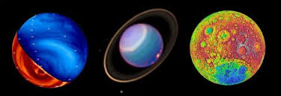

Slide 10
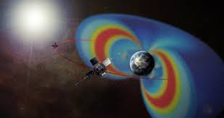
Notes:
m/s should be km/s

Slide 13
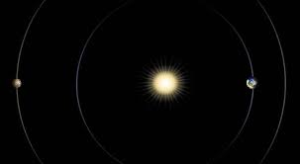

Slide 14
According to Professor Yung's research interests
Planetary scientists study the earth, planets in our solar system and extra-solar planets, as a matter of intellectual curiosity, as a window on the origin and evolution of the solar system, and also as laboratories in which theories and models of our own atmosphere can be tested.
Professors Yung's research has covered the planets Mars, Venus, Jupiter, Uranus and Neptune, the moons Io (Jupiter), Ganymede (Jupiter), Callisto (Jupiter), Titan (Saturn) and Triton (Neptune), as well as extra-solar planets such as HD209458b.
He has studied a wide variety of gases in these atmospheres, including H₂, O₂, O₃, N₂, N₂O, H₂O, HDO, CO, CO₂, halogens, methane and higher hydrocarbons, ammonia, sulfur compounds and aerosols.

Slide 15
In his work on planetary observations, Professor Yung collaborates with spacecraft teams. He is a co-investigator on the Ultraviolet Imaging Spectrometer (UVIS) Experiment on the Cassini mission to Saturn (1987-present), the Orbital Carbon Observatory-2 (OCO-2), a project to map CO₂ concentrations for the Earth (launched 2014). He is an Interdisciplinary Scientist for Venus Express, an European Space Agency mission (2005-present).
Atmospheric Radiation: Theoretical Basis with R.M. Goody (Oxford University Press 1989) and Photochemistry of Planetary Atmospheres with W. B. DeMore (Oxford University Press 1999). He is the author or co-author of over 285 peer-reviewed scientific articles.
The chemistry of the atmosphere of Mars is like the hydrogen atom of the solar system. It is, to paraphrase Einstein, "as simple as possible but not simpler".

Slide 16
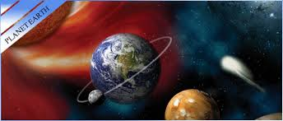
Venus is our sister planet. There is great similarity between the catalytic chemistry of Venus and Earth.
The chemistry of the atmosphere of the outer solar system is characterized by organic synthesis and production of aerosols known as tholins.
The chemistry of the atmosphere of the earth offers intriguing comparisons to the planets. The bromine chemistry on earth is similar to the chlorine chemistry on Venus.
The hydrogen chemistry in the terrestrial mesosphere resembles that on Mars

Slide 17
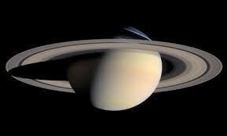
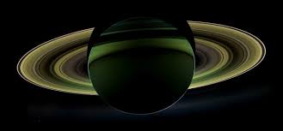
Dr. Yung's fundamental contributions on radiative transfer and photochemical processes of the atmospheres of extrasolar planets have produced numerous new research areas.
In collaboration with a former Caltech postdoc Dr. Giovanna Tinetti and former student Dr. Liang Mao-Chang, Dr. Yung's team reported the first conclusive discovery of the presence of water vapor in the atmosphere of the planet HD189733b, 63 light-years away, in the constellation Vulpecula.
This is a significant step towards the search for life beyond our Solar System, and the first step towards demonstrating that we are not alone in the universe.

Slide 18
Global warming due to relatively small concentrations (a few hundred parts per million) of greenhouse gases such as CO₂ is already affecting the climate.
The apparently inexorable melting of the polar ice caps and a possible but counter-intuitive mini ice age in the northern hemisphere are constantly in the news and even in the cinema.
Planetary science, and in particular the understanding of the delicate planetary atmospheres, have been recognized as academic subjects of very great importance and a critical issue for the future of mankind.
Professor Yung pioneered the study of radiation and chemistry in the terrestrial atmosphere, with emphasis on the human impact on climate change.

Slide 19
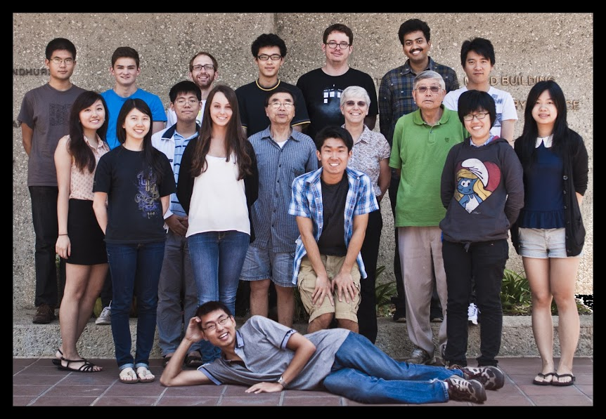

Slide 20
Approved By
Professor Yuk L. Yung
E-signature: y yung

Slide 21
OMICS International Open Access Membership
OMICS International Open Access Membership enables academic and research institutions, funders and corporations to actively encourage open access in scholarly communication and the dissemination of research published by their authors.
For more details and benefits, click on the link below:
http://omicsonline.org/membership.php

