Slide 1

OMICS International
OMICS International through its Open Access Initiative is committed to make genuine and reliable contributions to the scientific community. OMICS International signed an agreement with more than 1000 International Societies to make healthcare information Open Access.
Contact us at: contact.omics@omicsonline.org

Slide 2

OMICS Journals are welcoming Submissions
OMICS International welcomes submissions that are original and technically so as to serve both the developing world and developed countries in the best possible way.
OMICS Journals are poised in excellence by publishing high quality research. OMICS International follows an Editorial Manager® System peer review process and boasts of a strong and active editorial board.
Editors and reviewers are experts in their field and provide anonymous, unbiased and detailed reviews of all submissions.
The journal gives the options of multiple language translations for all the articles and all archived articles are available in HTML, XML, PDF and audio formats. Also, all the published articles are archived in repositories and indexing services like DOAJ, CAS, Google Scholar, Scientific Commons, Index Copernicus, EBSCO, HINARI and GALE.
For more details please visit our website: http://omicsonline.org/Submitmanuscript.php

Slide 3

Research and Exploration of Sericultural Resources on Purpose of Edible and Medicinal Products
Dr. Yuxiao Zou
Faculty of Sericultural & Agri-Food Research Institute, Guangdong Academy of Agricultural Sciences, Guangzhou, PR China.
Journal of Medicinal Chemistry editorial board member.

Slide 4
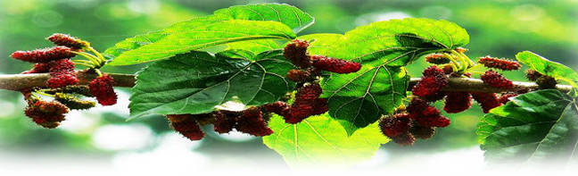
Contents
Research Background
Research interest

Slide 5
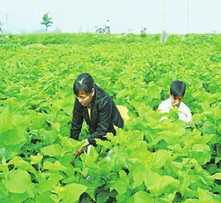
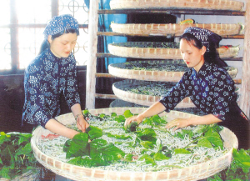
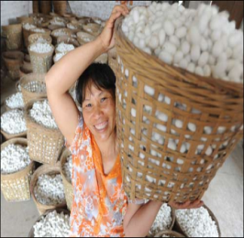
Research Background (1)
  Trditional Sericulture
  Sericulture is a traditional and characteristic industry with 5000-year history in China； Farmers plant muberry trees and collect leaves to feed silkworms and make money on cocoons.
  China ranks first among countries with sericultural industry and over three quarters silk are from China in the world.
  Lots of sericultural resources including mulberry, mulberry stems, pupa, as well as extra mulberry leaves are wasted.
Planting Mulberry Trees
Feeding Silkworms
Selling Cocoons

Slide 6
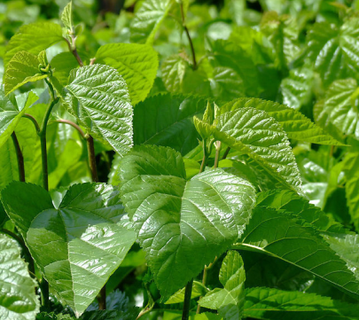
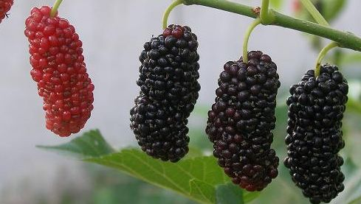
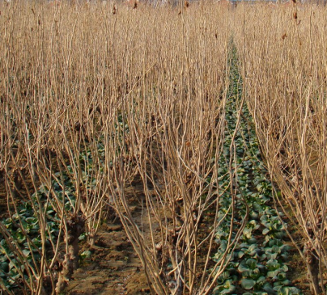
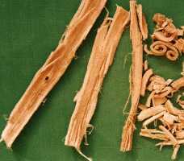
Research Background (2)
Sericultural resources are consist of mulberry leaves, fruits, stems, phloem of roots from mulberry trees, as well as eggs, lavae, pupae, cocoons and adults from silkworms. However, only mulberry leaves are used for cocoons production.
All the sericultural resources are benificial products for human health in consideration of nutritional and bioactive constituents.
There is a close relationship between mulberry and silkworm resources, because silkworms are oligophagous insects and exclusively eat mulberry leaves in the larval stage.
leaf
fruit
Stem
Phloem of Root

Slide 7
Research Background (3)
Specially mulberry leaf, fruit, pupa and moth are by-products and they mean worthless compared to cocoons in traditional sericultural industry. Research and exploration of sericultural resources including mulberry leaf, fruit, pupa and moth on purpose of edible and medicinal products are becoming hotspots due to their potential healthy promotion effects reported by scientist over the last few decades.
Mulberry leaf: Rich in nutrients like protein, essential amino acids, Vit A, E, B1 and B2, calcium, iron, potassium zinc ect. And bioactive phytochemicals like polysaccharides, phenolics, polyhydroxylated piperidine alkaloids etc.
Fruit: Be classified as berries, rich in nutrients Vit C, fructose, calcium, iron etc. And bioactive phytochemicals like anthocyanins, polysaccharides, phenolics, polyhydroxylated piperidine alkaloids etc.
Pupa: Resources of protein, fat, essential amino acid, n-3 polyunsatured fat, Vit A, B2 and D, β-carotene, ergosterol etc.
Moth: Rich in protein, unsaturated fat, Vit B12, selenium, cytochrome C, phospholipids, juvenile hormone, and ecdysone etc.

Slide 8
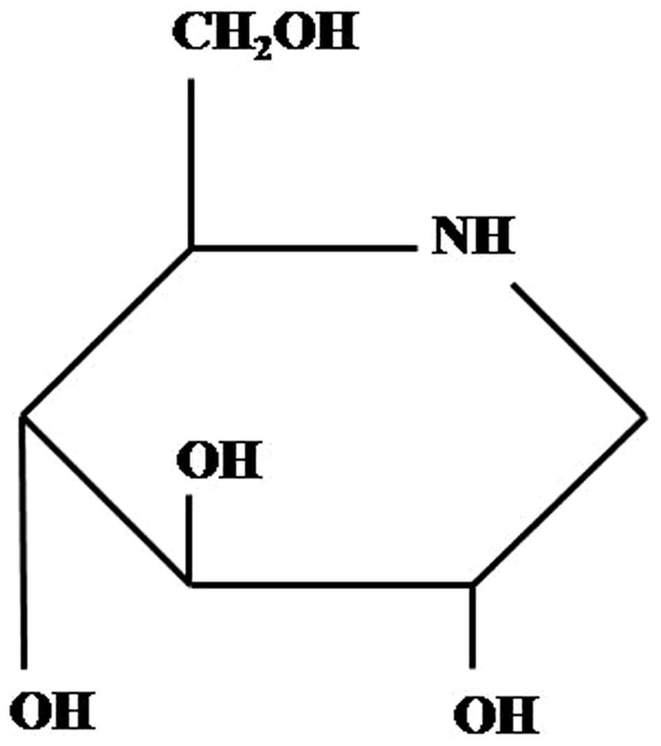
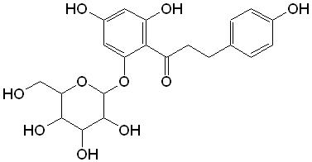
Research Background (4)
Several characteristic phytochemicals with bioactivities found in sericultural resources.
1-Deoxynojirmycin. The most important constituent found in leaf, fruit, stem, root phloem, egg, larva, pupa and moth, and is demonstrated with antidibetic, antivirus and antiobesity effects etc.
Resveratrol. A powerful antioxidant found in fruit and leaf , and is demonstrated with antioxidative, antiatherosclerotic , antitumor and antifungal effects etc.
Cyanidin 3-O-glucoside. The most abundant anthocyanin individual in mulberry. It is a well-known in antioxidative, anti-inflammatory,an antiatherosclerotic and antiobesity effects etc.

Slide 9
Research interest
My research interest is focus on several issues as follow:
Evaluation of bioactive effects (including antidibetic, antioxidant and , antitumor and antiobesity effects ) of phytochemicals from sericultural resources and correlated mechanisms based on results in vitro and in vivo, as well as interactions among different compounds with bioactivity. For example, 1-deoxynojirmycin and structural and functional analogs, fagomine.
Change law or dynamics of bioactive compounds from sericultural resources depending on cultivar, harvest time and physilogical stages.
Technique optimization of bioactive compounds from sericultural resources
formulating optimization of functional food made by sericultural resources and bioactivity stabilizing technology during processing.

Slide 10

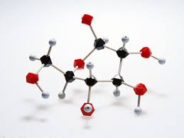
Medicinal chemistry
Related Journals
Drug Designing: Open Access
Biochemistry & Pharmacology
Advances in Pharmacoepidemiology & Drug Safety

Slide 11

Medicinal chemistry
Related Conferences
3rd International Conference on Medicinal Chemistry &
Computer Aided Drug Designing
3rd International Conference and Exhibition on Pharmacognosy, Phytochemistry & Natural Products

Slide 12
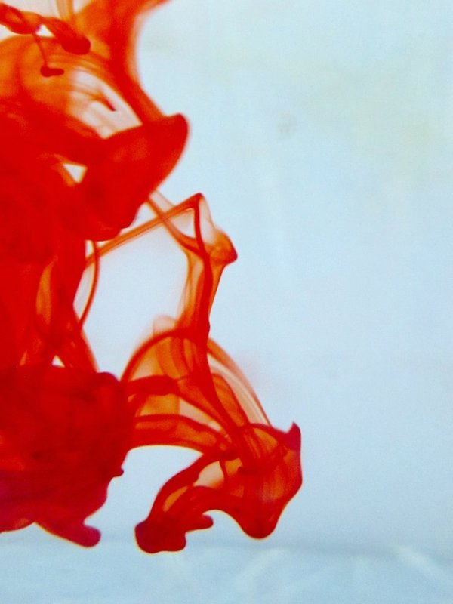

OMICS International Open Access Membership
OMICS International Open Access Membership enables academic and research institutions, funders and corporations to actively encourage open access in scholarly communication and the dissemination of research published by their authors.
For more details and benefits, click on the link below:
http://omicsonline.org/membership.php

