Slide 1
OMICS Journals are welcoming Submissions
OMICS International welcomes submissions that are original and technically so as to serve both the developing world and developed countries in the best possible way.
OMICS Journals are poised in excellence by publishing high quality research. OMICS International follows an Editorial Manager® System peer review process and boasts of a strong and active editorial board.
Editors and reviewers are experts in their field and provide anonymous, unbiased and detailed reviews of all submissions.
The journal gives the options of multiple language translations for all the articles and all archived articles are available in HTML, XML, PDF and audio formats. Also, all the published articles are archived in repositories and indexing services like DOAJ, CAS, Google Scholar, Scientific Commons, Index Copernicus, EBSCO, HINARI and GALE.
For more details please visit our website: http://omicsonline.org/Submitmanuscript.php

Slide 2
Zefeng Wang
Associate Professor
Department of Pharmacology
University of North Carolina at Chapel Hill
USA

Slide 3
Biography
Prof. Zefeng Wang received his Ph.D. degree from Johns Hopkins Medical School, worked as a Damon Runyon fellow at Massachusetts Institute of Technology before becoming an assistant professor at University of North Carolina at Chapel Hill. Dr. Wang’s research focuses on the regulation of gene expression in RNA level. He has made significant contribution to the filed of RNA biology by developing a series of new methods to study RNA splicing and degradation, and has pioneered the filed of engineering RNA binding proteins. His work was recognized by several research awards.

Slide 4
Research Interests
Systematic study of the regulation of alternative splicing
Mechanisms and functional roles of splicing mis-regulation in cancers
Manipulation of RNA processing with artificial protein factors

Slide 5
Recent Publications
Wang Y, Cheong CG, Hall TM and Wang Z. Engineering splicing factors with designed specificities (2009). Nature Method. 6(11):825-30. Epub 2009 Oct 4
Wang Y, Ma M, Xiao XS and Wang Z. Intronic splicing enhancers, cognate splicing factors and context dependent regulation rules. (2012) Nature Structure Molecular Biology, doi:10.1038/nsmb.2377. Epub Sep 16.
Choudhury R, Dominguez D, Wang Y and Wang Z. Engineering RNA endonucleases with customized sequence specificities (2012). Nature Communication 23;3:1147. doi: 10.1038/ncomms2154.
Wang Y, Xiao X, Zhang J, Choudhury R, Robertson A, Li K, Ma M, Burge CB, Wang Z. A complex network of factors with overlapping affinities represses splicing through intronic elements. (2013) Nat Struct Mol Biol. 20(1):36-45. doi: 10.1038/nsmb.2459. PMCID: PMC3537874
Zhang W, Wang Y, Dong S, Choudhury R, Jin Y and Wang Z Treatment of type 1 Myotonic Dystrophy by engineering site-specific RNA endonucleases that target (CUG)_{n} repeats. (2013) Molecular Therapy. Oct 23 doi: 10.1038/mt.2013.251 Epub ahead of print
Choudhury R, Ghose Roy S, Tsai YS, Tripathy A , Graves LM and Wang Z. The splicing activator DAZAP1 integrates splicing control into MEK/Erk regulated cell proliferation and migration. Nature Communications (2014) Jan 23;5:3078. doi: 10.1038/ncomms4078
Matera AG* and Wang Z* (co-corresponding author). Ribonucleoprotein assembly and dynamics: A day in the life of the spliceosome. Nature Review Molecular Cell Biology (2014) Jan 23;15(2):108-21. doi: 10.1038/nrm3742
Tsai YS, Gomez SM, and Wang Z. Prevalent RNA recognition motif duplication in the human genome. RNA (2014) May;20(5):702-12. doi: 10.1261/rna.044081.113. Epub 2014 Mar 25
Wang Y, Chen D, Qian H, Tsai YS, Shao S, Dominguez D and Wang Z. The splicing factor RBM4 controls apoptosis, proliferation, and migration to suppress tumor progression. Cancer Cell (2014) Sep 8; 26(3):374-89. doi: 10.1016/j.ccr.2014.07.010.

Slide 6
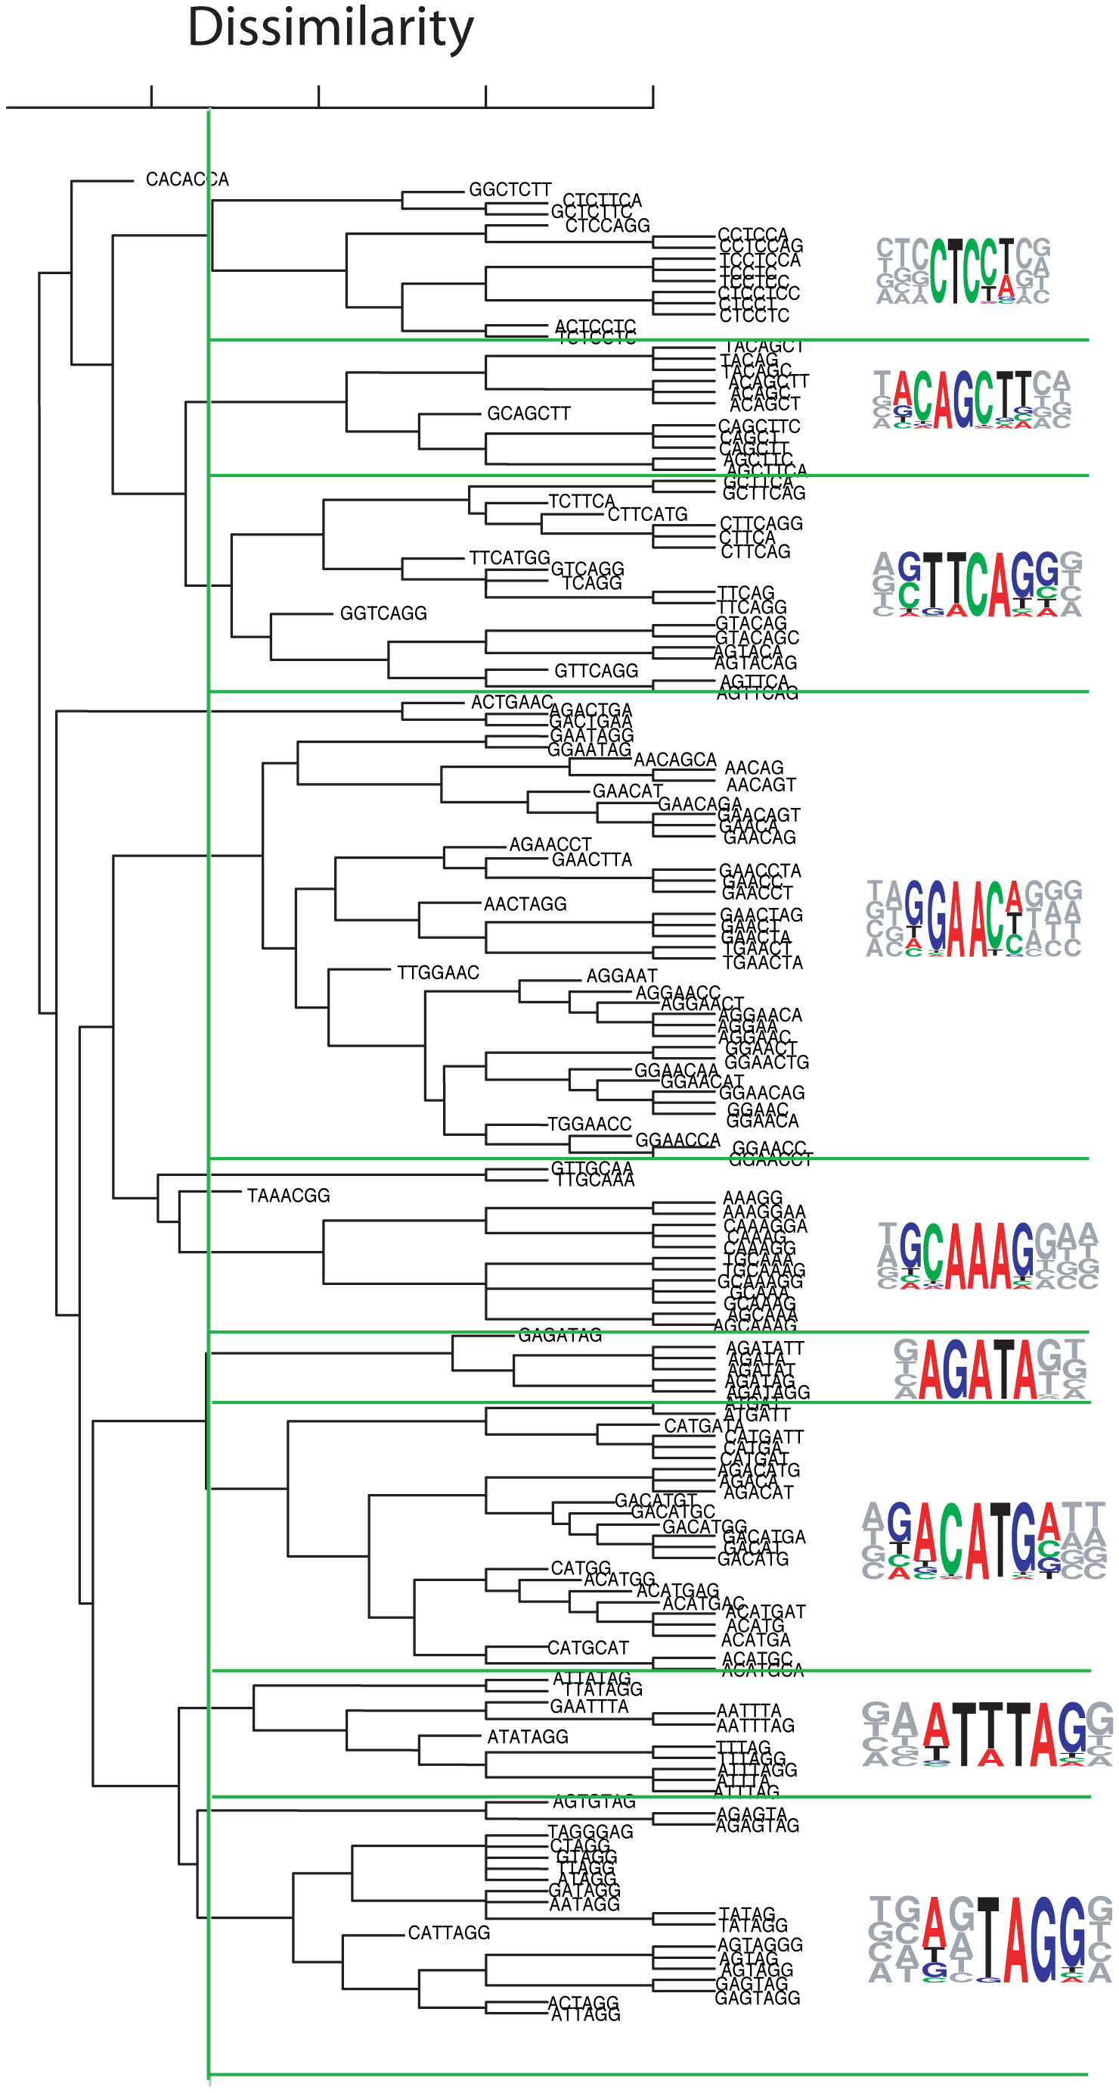
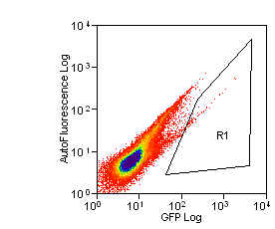
Systematic Identification of Intronic Splicing Silencers with FAS-ISS
Representative
k-mers/mutations
ISS
groups
Random 10mer
A CTCCTC / CGCATC\
B TACAGCT / TACGGCT
C CTTCAG / CGTCAC
D GAACAG / GTACCG
E CAAAGGA /CATACGA
F AGATATT / AGCTGTT
G ACATGA / ACGTGA
H AATTTA / AGTGTC
I AGTAGG / AGCAGT
U CACACCA /CATAGCA
G
FP
Hyg
Stable transfection
Normal splicing
GFP
Exon skipping due to ISS
Red Fluorescence
Green Fluorescence
Sort and clone green cells,
recover ISS insertion
Yang Wang et al, NSMB 2013

Slide 7
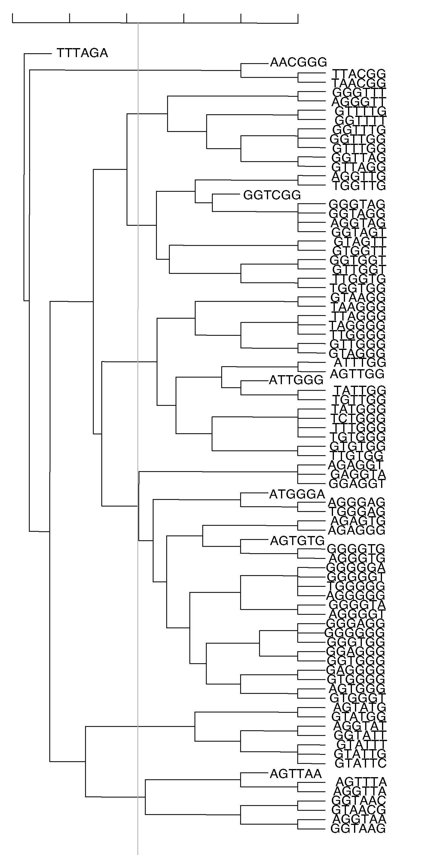
Identify intronic splicing enhancers by FAS-ISE
Dissimilarity
ISE
group
Representative
6-mer
Random region
3 2 1
Weak intron
G
FP
A GGGTTT
B GGTGGT
C TTTGGG
D GAGGGG
E GGTATT
F GTAACG
Exon1
Exon3
Stable transfection
Unspliced mRNA
GFP mRNA
FACS sorting
Cloning
PCR & Sequencing
ISE sequences
117 ISE decamers, 109 unique
All ISE function as ESS (i.e., inhibit splicing) when inserted in exons
Wang Y et al, 2012 NSMB

Slide 8
An Overlapping Network of trans-factors
Recognize ISSs and ISEs
CAAAGGA
UACAGCU
AGAUAUU
ACAUGA
CACACCA
AGUAGG
GAACAG
CUCCUC
AAUUUA
CUUCAG
D
C
E
G
U
B
F
A
I
H
A complex connectivity map => regulatory plasticity
GRSF-1
Nono
RBM45
SFRS1
SFPQ
hnRNP L
KHSRP
hnRNP UL
YB-1
DAZAP1
hnRNP Q
hnRNP H1
G3BP1
nPTB
hnRNP DL
G3BP2
hnRNP F
PTB
hnRNP A1
hnRNP D
CIRBP
hnRNP A2
hnRNP A3
hnRNP A0
GGGTTT
Factors involved in tumor patheogenesis
GGTGGT
TTTGGG
GAGGGG
GGTATT
GTAACG
A
B
C
D
E
F
FUS
hnRNP D
ZCCHC8
DHX36
SFPQ
TIA1
CNBP
ZRANB1/2
SmB
RBM4
hnRNP M
hnRNP H
GRSF1
DAZAP1
hnRNP H2
U1A
hnRNP F
Wang Y et. al, Nat Struc & Mol Bio 2012
Wang Y et. al, Nat Struc & Mol Bio 2013

Slide 9
DAZAP1 integrates splicing control into MEK/Erk regulated cell proliferation and migration
DAZAP1
DAZAP1
DAZAP1
1
2
External cues
ERK1/2
MEK
DAZAP1
DAZAP1
hnRNPA1
Regulating splicing of >300 genes;
Control cell growth & proliferation
Chundhury et, al. 2014 Nature Communications

Slide 10
RBM4-mediated splicing regulation balance controls cell growth/proliferation
Pro-apoptotic
Anti-apoptotic
Bcl-xS
Bcl-xL
RBM4
SRSF1
cancer-related AS (CD44, TEAD4 ...)
mTOR
cancer-related AS (BIN1, RON, S6k1...)
P
P
S6K
4EBP1
Cell proliferation & translation
Wang Y et. al, Cancer Cell, 2014

Slide 11
Engineered splicing factors:
Restore normal splicing in cancer
Splicing inhibition by PUF-Gly
Splicing activation by PUF-RS
Gly-rich domain
RS domain
Artificial site-specific RNA endonuclease:
Cleave toxic RNA
Gene silencing in mitochondrion & chloroplast
PIN
3’
5’
Wang Y et al, 2009 Nature Methods
Chundhury et al, 2012, Nature Communications

Slide 12
Journal of Proteomics & Bioinformatics Related Journals
Transcriptomics: Open Access
Journal of Pharmacogenomics & Pharmacoproteomics
Journal of Data Mining in Genomics & Proteomics

Slide 13
For more details on Conferences Related
Journal of Proteomics & Bioinformatics please visit:
http://www.conferenceseries.com/biochemistry-meetings

Slide 14
Open Access Membership with OMICS International enables academicians, research institutions, funders and corporations to actively encourage open access in scholarly communication and the dissemination of research published by their authors.
For more details and benefits, click on the link below:
http://omicsonline.org/membership.php

