Slide 1
OMICS Group
OMICS Group International through its Open Access Initiative is committed to make genuine and reliable contributions to the scientific community. OMICS Group hosts over 400 leading-edge peer reviewed Open Access Journals and organizes over 300 International Conferences annually all over the world. OMICS Publishing Group journals have over 3 million readers and the fame and success of the same can be attributed to the strong editorial board which contains over 30000 eminent personalities that ensure a rapid, quality and quick review process. OMICS Group signed an agreement with more than 1000 International Societies to make healthcare information Open Access.
Contact us at: contact.omics@omicsonline.org

Slide 2
OMICS Journals are welcoming Submissions
OMICS Group welcomes submissions that are original and technically so as to serve both the developing world and developed countries in the best possible way.
OMICS Journals are poised in excellence by publishing high quality research. OMICS Group follows an Editorial Manager® System peer review process and boasts of a strong and active editorial board.
Editors and reviewers are experts in their field and provide anonymous, unbiased and detailed reviews of all submissions.
The journal gives the options of multiple language translations for all the articles and all archived articles are available in HTML, XML, PDF and audio formats. Also, all the published articles are archived in repositories and indexing services like DOAJ, CAS, Google Scholar, Scientific Commons, Index Copernicus, EBSCO, HINARI and GALE.
For more details please visit our website: http://omicsonline.org/Submitmanuscript.php

Slide 3
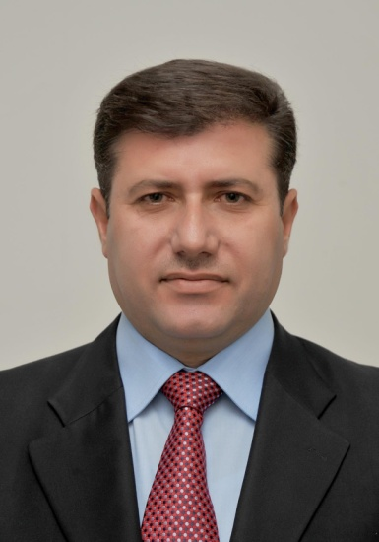
Dr. Ziad N. Al-Dwairi
Associate Professor of Fixed and Removable Prosthodontics and Implant Dentistry
Jordan University of Science and Technology

Slide 4
Education
Dr. Ziad N. Al-Dwairi works as an Associate Professor of Fixed and Removable Prosthodontics and Implant Dentistry at Jordan University of Science and Technology, holds PhD in Prosthodontics, Queens University/Belfast, UK in 2001 and Fellowship of The International Academy of Dento Facial Esthetics (FIADFE) in 2012.

Slide 5
Administrative Experience
He is the President of Jordanian Section of International Association for Dental Research.
He is Jordan’s Representative at OSAP ( Organization for Safety and Asepsis Procedures).

Slide 6
Administrative Experience
He worked as vice president of the Restorative Dentistry Committee/ Jordan Medical Council and currently Member of the National Committee for contentious medical education/Jordan Medical Council and member of the advisory team of Dooox.

Slide 7
Administrative Experience
He is a former member of University Council/Jordan University of Science and Technology and
Worked as Chairman of the Prosthodontics Department, Faculty of Dentistry/Jordan University of Science and Technology and
a Former Dean Assistant/ Faculty of Dentistry/ Jordan University of Science and Technology.

Slide 8
Honors and Awards
The senior prize The Elida Gibbs Travel Award 2000 from the Irish Division of International Association for Dental Research (IADR)
The Procter and Gamble Research award 2000. Oral and Dental Research Trust, London
(BSSPD research Prize 2001). British Society for the study of Prosthetic Dentistry First Research Prize
Certificate of recognition from IADR and AADR 2002, Get a member Campaign

Slide 9
Honors and Awards
Member of the Advisory Group For Dental Ethics Manual, FDI
Executive Committee of African and Middle East Federation of IADR
Oral presenter at the 3rd Asian Family Health Research Award, Iran-Tehran 2007
The first research prize in Prosthodontics from Society of Arab Dental Faculties (SARDF) 2010
Fellowship of the International Academy for Dento-Facial Esthetics FIADFE/2012

Slide 10
Honors and Awards
He was a Member of the advisory group formed by FDI for publishing the Dental Ethics Manual in 2007 and carried out its translation into Arabic Language to be available to all Arabic natives.

Slide 11
Teaching Experience
He is currently involved in teaching undergraduate and graduate students in all field of Prosthodontics in addition to involvement in advanced programs for MFDS Trainees, High specialty trainees and Advanced clinical trainees in Prosthodontics

Slide 12
Teaching Experience
He supervised several MSc students as a main and a co advisor and as an examiner for more than 25 theses in all disciplines of Prosthodontics

Slide 13
Reviewer and Editorial Board member
He works as a reviewer for 18 local and International Peer reviewed Journals and on editorial board of 7 International Journals

Slide 14
Professional organizations
Member of more than 10 International Research and education Organizations

Slide 15
Conferences and Workshops
He participated in more than 40 International Dental Conference and attended more than 10 workshops in dental and Prosthodontics disciplines

Slide 16
Research Interests:
• Standards of clinical and laboratory procedures for construction of fixed and removable prostheses
• Oral Infections related to removable prostheses
• Infection Control
• Esthetics Dentistry
• Implant Dentistry
• Restoration of Endodontically treated teeth
• Periodontics-Restorative Dentistry Interface
• Shortened Dental arch

Slide 17
Publications
More than 30 published articles in peer reviewed high impact international Journals in addition at a pending list of manuscripts submitted for publications

Slide 18
Books
1. Member of the advisory group formed by FDI for publishing the
Dental Ethics Manual, 2007
2. Arabic translation of FDI Dental Ethics Manual:

