Slide 1


OMICS Group
OMICS Group International through its Open Access Initiative is committed to make genuine and reliable contributions to the scientific community. OMICS Group hosts over 400 leading-edge peer reviewed Open Access Journals and organizes over 300 International Conferences annually all over the world. OMICS Publishing Group journals have over 3 million readers and the fame and success of the same can be attributed to the strong editorial board which contains over 30000 eminent personalities that ensure a rapid, quality and quick review process. OMICS Group signed an agreement with more than 1000 International Societies to make healthcare information Open Access.
Contact us at: contact.omics@omicsonline.org

Slide 2

OMICS Journals are welcoming Submissions
OMICS Group welcomes submissions that are original and technically so as to serve both the developing world and developed countries in the best possible way.
OMICS Journals are poised in excellence by publishing high quality research. OMICS Group follows an Editorial Manager® System peer review process and boasts of a strong and active editorial board.
Editors and reviewers are experts in their field and provide anonymous, unbiased and detailed reviews of all submissions.
The journal gives the options of multiple language translations for all the articles and all archived articles are available in HTML, XML, PDF and audio formats. Also, all the published articles are archived in repositories and indexing services like DOAJ, CAS, Google Scholar, Scientific Commons, Index Copernicus, EBSCO, HINARI and GALE.
For more details please visit our website: http://omicsonline.org/Submitmanuscript.php

Slide 3
Zlatina Kazlacheva, PhD
Associate Professor
Faculty of Technics and Technologies
Trakia University, Bulgaria

Slide 4

Zlatina Kazlacheva got her PhD in Design from Technical University of Sofia, Bulgaria. She is an Associate Professor in Fashion Design and Pattern Making at Trakia University, Faculty of Technics and Technologies, Yambol, Bulgaria and now is Vice Dean of International and Scientific Activities. Zlatina Kazlacheva has published over 80 papers and 7 books.
Research interests: Fashion Design, Pattern Making, CAD.

Slide 5
Research Interests
In Details…

Slide 6
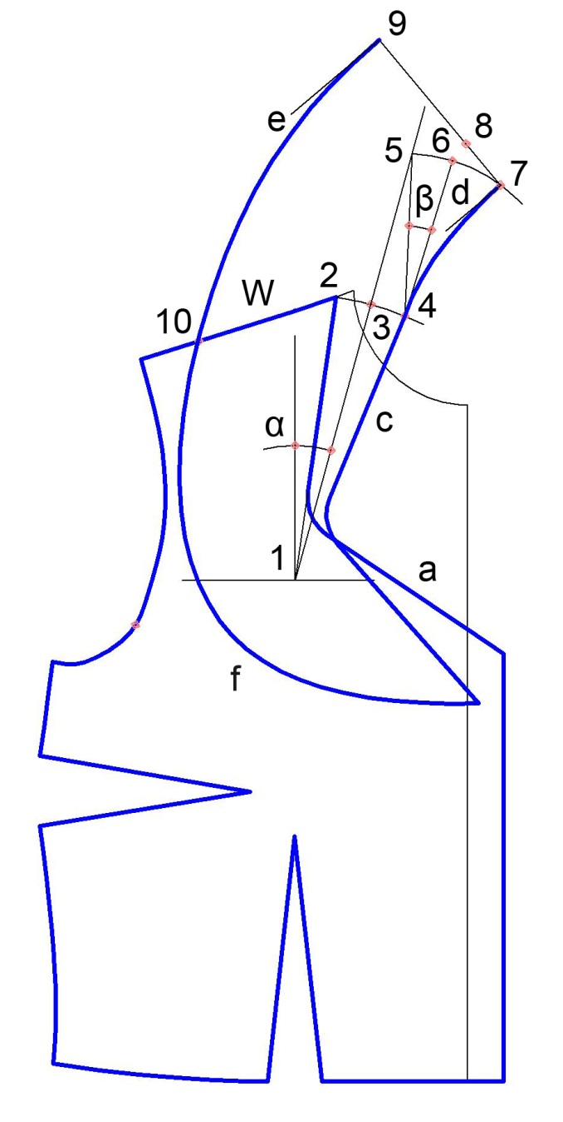
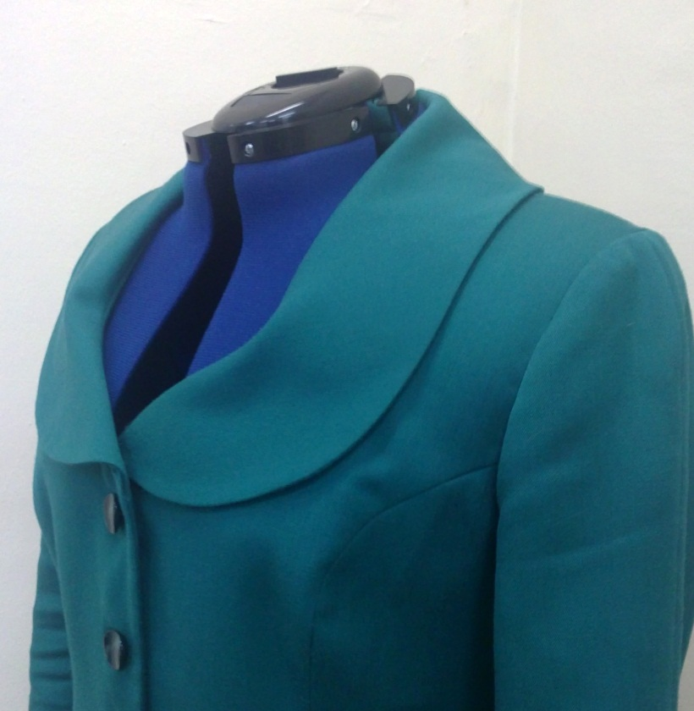
Correct and Facilitated
Pattern Making:
Development of Constructional Geometrical Models…

Slide 7
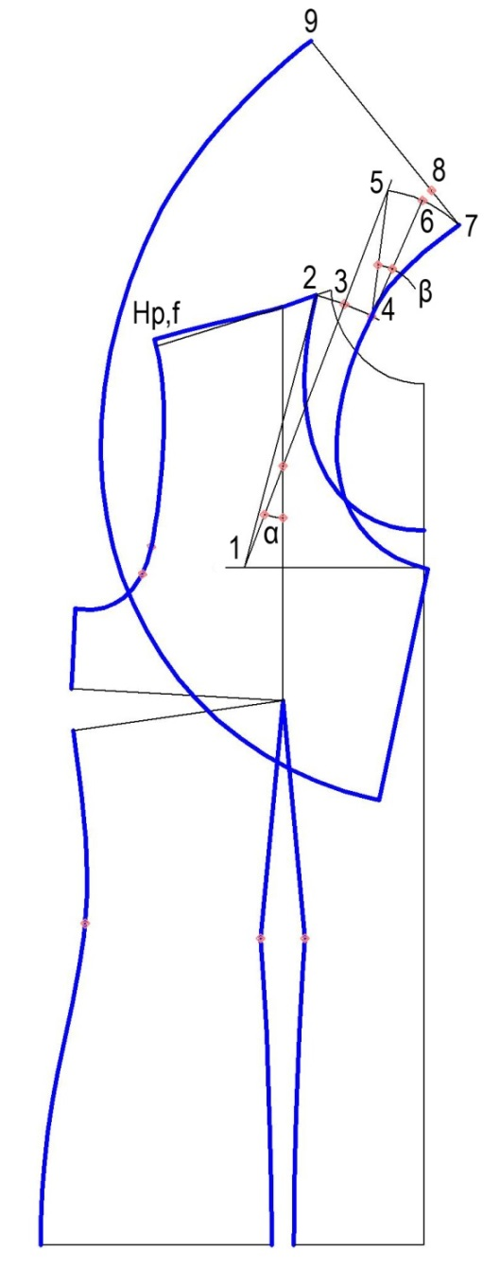
… on the Base of New Dependences between the Dimensions of Design Elements…

Slide 8
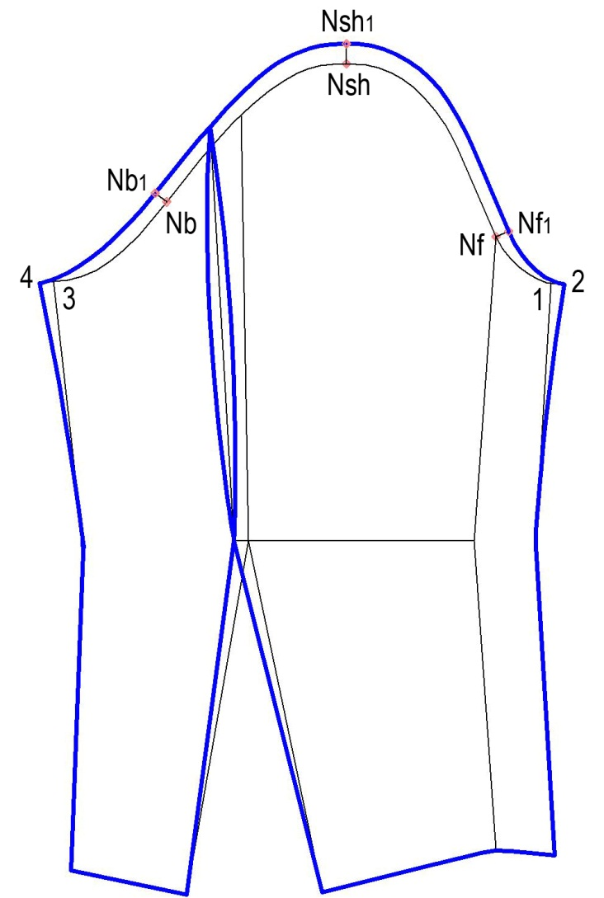
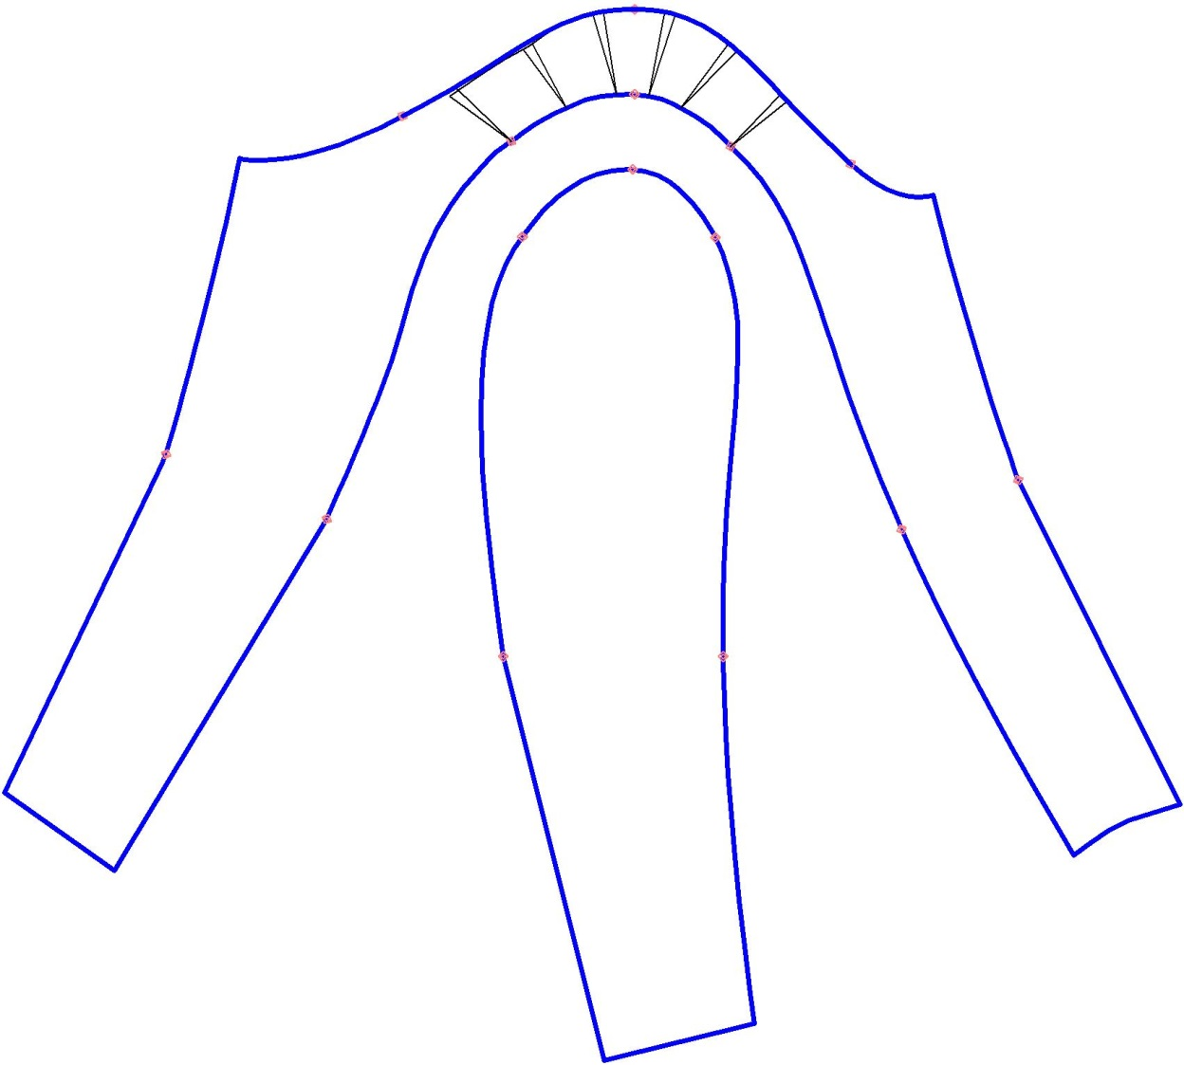
… and on the Base of Connections between Constructional Elements

Slide 9
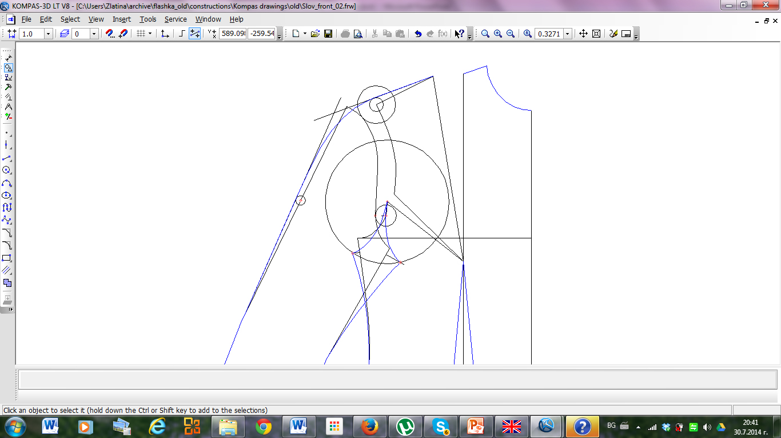
Optimal Use of Drawing and Modify Tools in CAD Design

Slide 10

Investigation of Connections between Design Elements of Clothing according to the Fashion Trends and Design Theory and Use of the Results in Fashion Design

Slide 11

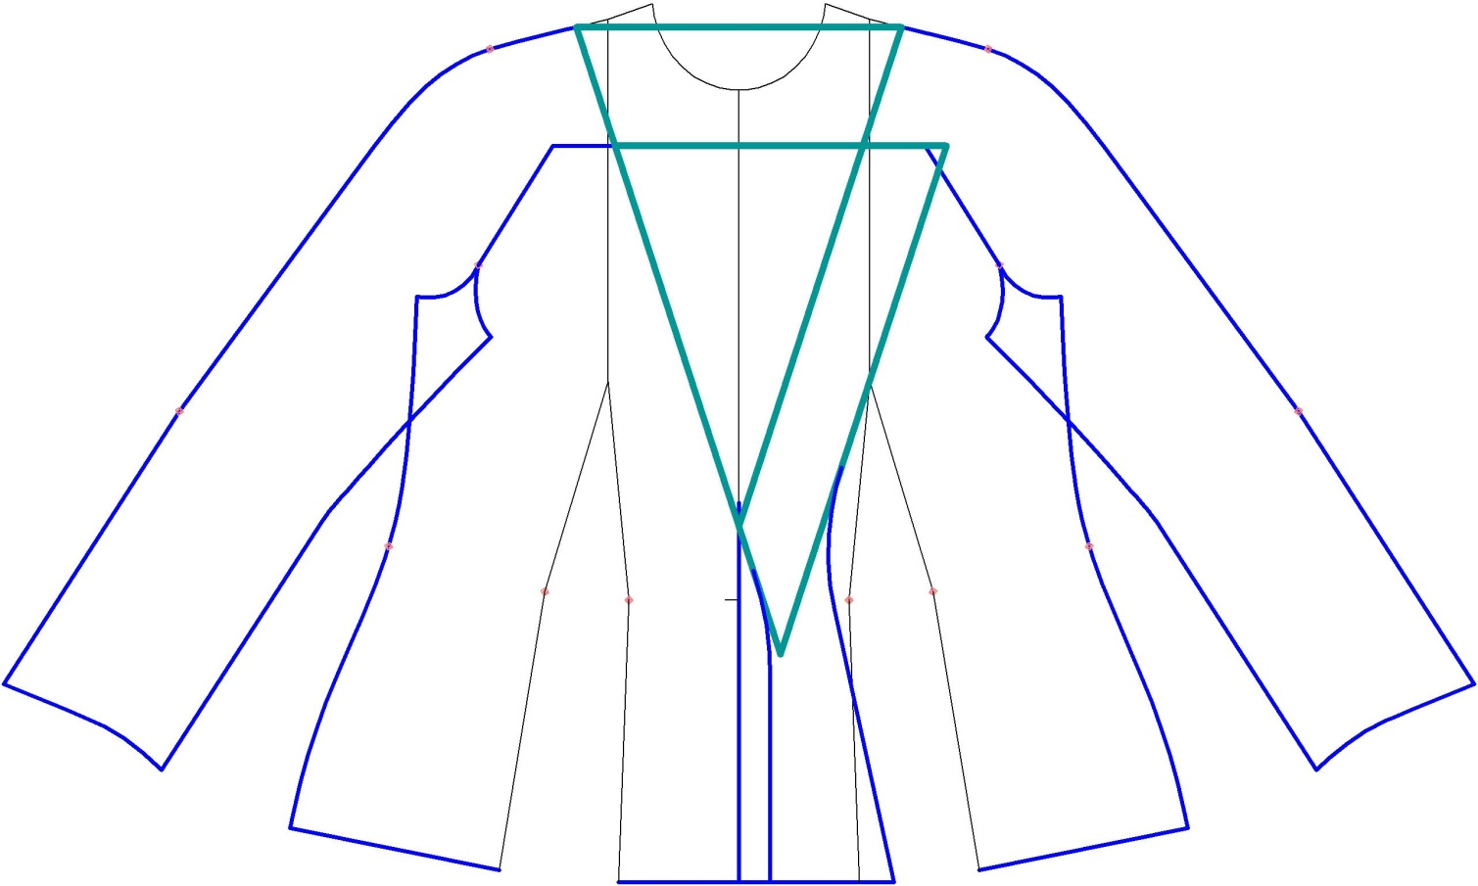
Geometry in Fashion Design:
Golden Section, Fibonacci Sequence, Tilings, etc.

Slide 12
Natural Forms in
Fashion Design

Slide 13


Journal of Textile Science & Engineering Related Journals
Journal of Material Sciences & Engineering
Industrial Engineering & Management
Modern Chemistry & Applications
 | Journal of Material Sciences & Engineering

Slide 14


OMICS Group Open Access Membership
OMICS publishing Group Open Access Membership enables academic and research institutions, funders and corporations to actively encourage open access in scholarly communication and the dissemination of research published by their authors.
For more details and benefits, click on the link below:
http://omicsonline.org/membership.php

