Slide 1

OMICS Journals are welcoming Submissions
OMICS International welcomes submissions that are original and technically so as to serve both the developing world and developed countries in the best possible way.
OMICS Journals are poised in excellence by publishing high quality research. OMICS International follows an Editorial Manager® System peer review process and boasts of a strong and active editorial board.
Editors and reviewers are experts in their field and provide anonymous, unbiased and detailed reviews of all submissions.
The journal gives the options of multiple language translations for all the articles and all archived articles are available in HTML, XML, PDF and audio formats. Also, all the published articles are archived in repositories and indexing services like DOAJ, CAS, Google Scholar, Scientific Commons, Index Copernicus, EBSCO, HINARI and GALE.
For more details please visit our website: http://omicsonline.org/Submitmanuscript.php

Slide 2


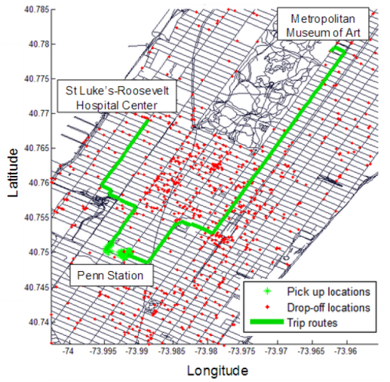
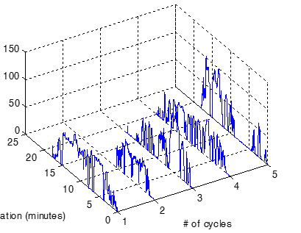
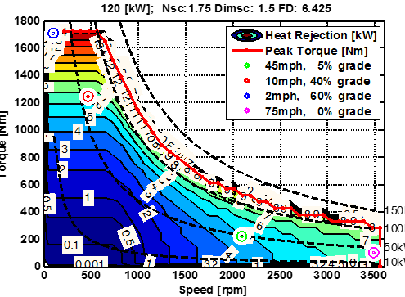
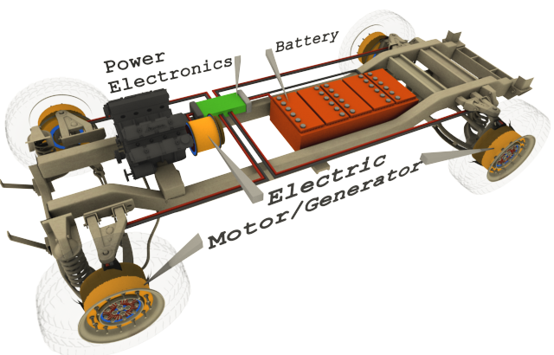
Andrej Ivanco
Personal Introduction
Assistant Research Professor
Dept. of Automotive Engineering
  Vehicle powertrain SYSTEM modeling
Infrastructure
Driving
Vehicle
Component
Component | Vehicle | Driving | Infrastructure

Slide 3
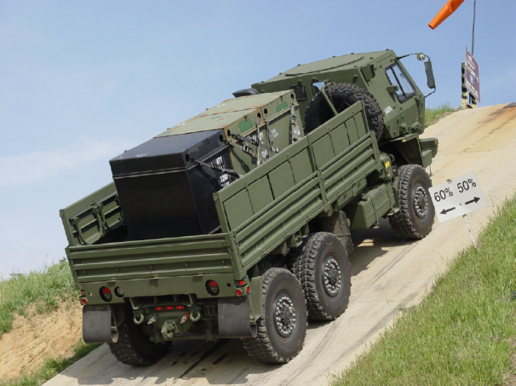
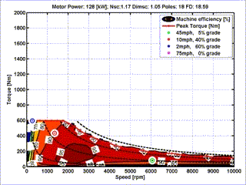
Electric Machine Design Optimization
Optimization Framework
Simulation Run
Component | Vehicle | Driving | Infrastructure

Slide 4
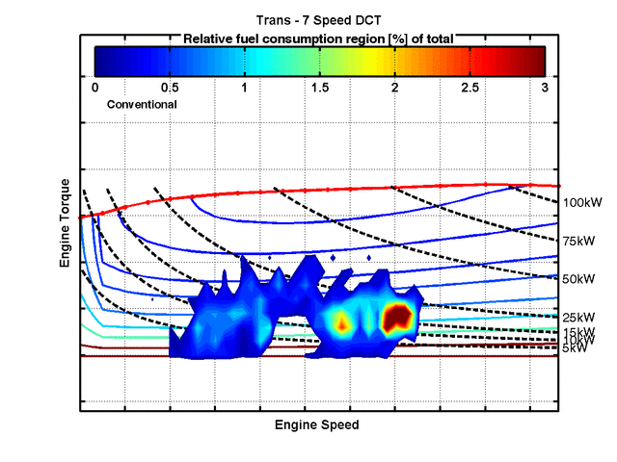
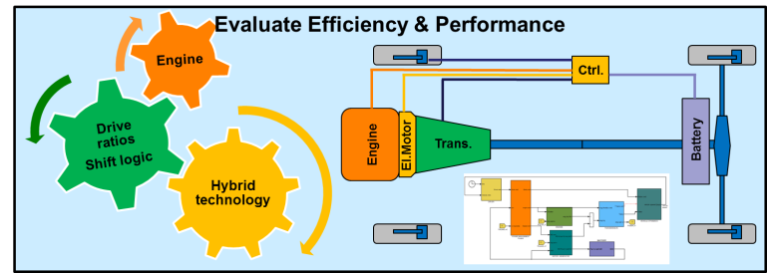
Powertrain System: Evaluation of Advanced Transmissions
4,7 and 10 speed transmissions
coupled with engines and compared under consistent assumptions
More gears enable gain in both,
0-60 time and fuel economy
Final Drive Optimization
Engine
Operation
Fuel economy
Performance
Better
4 speed
7 speed
10 speed
Component | Vehicle | Driving | Infrastructure

Slide 5

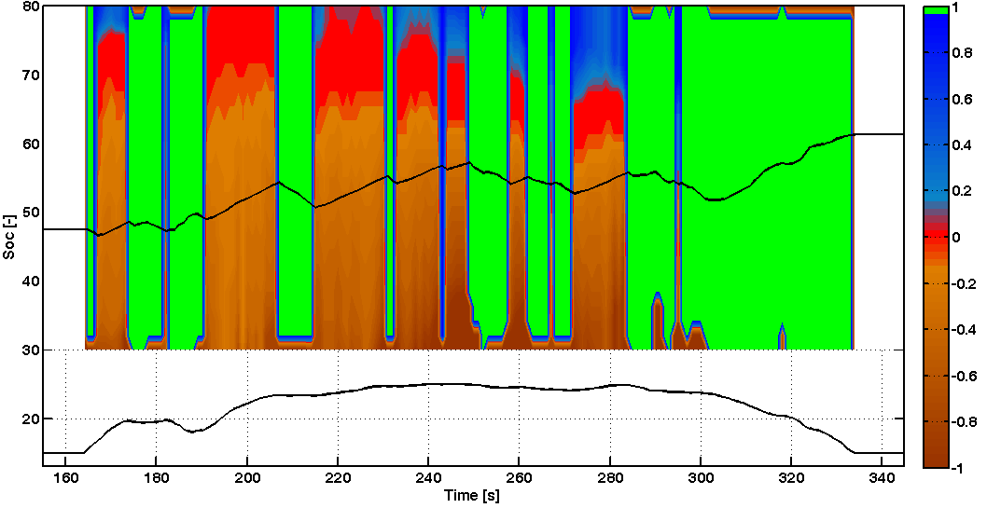
Energy Management Optimization Algorithm
The main role of the supervisory control is to decide about the power split between the engine and electric machine for given conditions
EV
Motor
Engine only
SoC [-]
Generator
SOC
All Electric
Conventional
Split Ratio
Part of the city driving
Charging
Time [sec]
Component | Vehicle | Driving | Infrastructure

Slide 6
Driving patterns & Drive Cycles for EV Studies
How are people driving?
  One trip vs. Daily distance (battery capacity)
  Time between trips (charging opportunities)
How is the car being used?
  Is fast charging necessary?
  What is the EV range – distance to empty
Fuel economy benefits
  Generate a representative test cycle
  Adapt the calibration to the driver
One Trip
Daily drive
Data → Information → Knowledge
Energy & distance
Data from CA household travel survey 2001
Component | Vehicle | Driving | Infrastructure

Slide 7
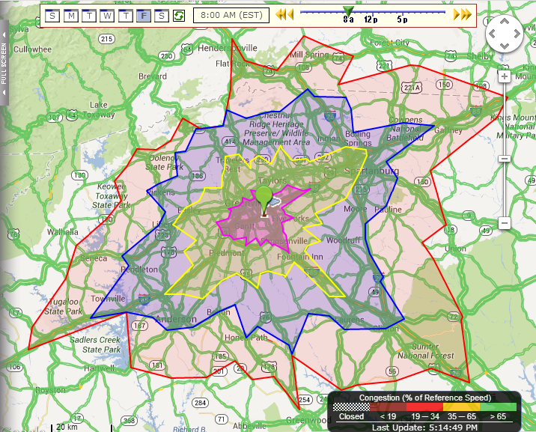
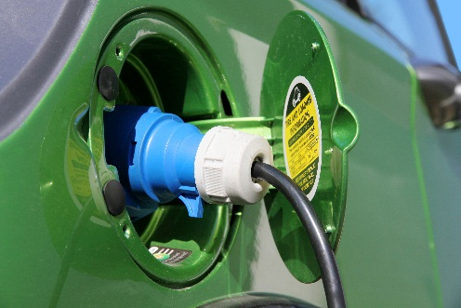
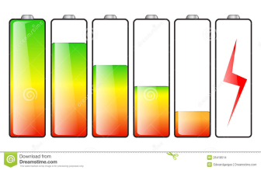

EV driving range estimation
Distance to empty estimation
Road and Traffic information joined
Driving style matters
Component | Vehicle | Driving | Infrastructure

Slide 8
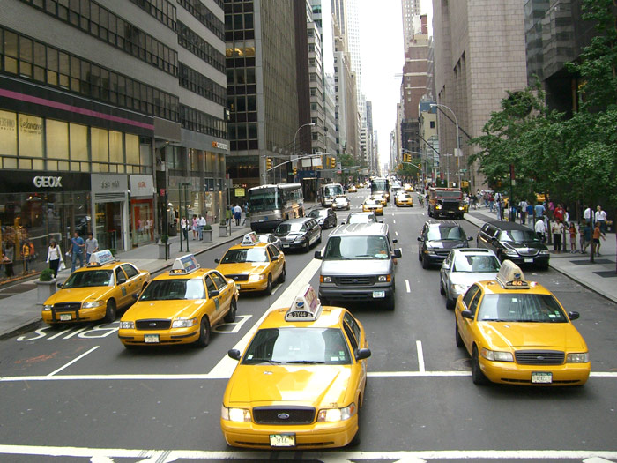
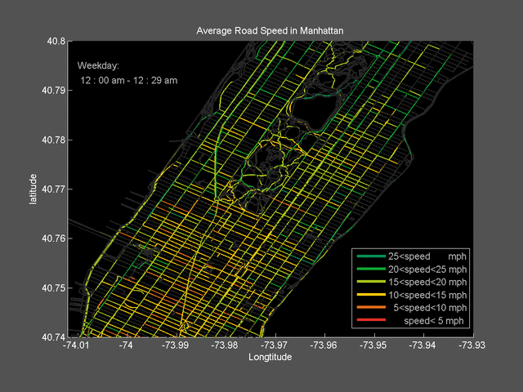
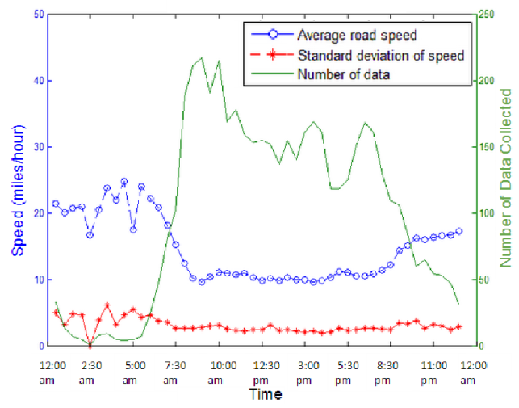
Traffic Flow Reconstruction and Routing
Transportation Modeling
Network Routing
Traffic Allocation
Daytime
Manhattan Traffic Flow Estimation
Component | Vehicle | Driving | Infrastructure

Slide 9









Thanks to our sponsors!
System Level Perspective
Component | Vehicle | Driving | Infrastructure
Dr. Andrej IVANCO
Research Assistant Professor
e-mail: aivanco@clemson.edu
P: 864-283-7241 M: 734-757-5637

Slide 10



Industrial Engineering and Management
Journal of Stock and Forex Trading
Related Journals

Slide 11

For upcoming Conference visit
http://www.conferenceseries.com/

