Slide 1
OMICS Group
OMICS Group International through its Open Access Initiative is committed to make genuine and reliable contributions to the scientific community. OMICS Group hosts over 400 leading-edge peer reviewed Open Access Journals and organizes over 300 International Conferences annually all over the world. OMICS Publishing Group journals have over 3 million readers and the fame and success of the same can be attributed to the strong editorial board which contains over 30000 eminent personalities that ensure a rapid, quality and quick review process. OMICS Group signed an agreement with more than 1000 International Societies to make healthcare information Open Access.
Contact us at: contact.omics@omicsonline.org

Slide 2
OMICS Journals are welcoming Submissions
OMICS Group welcomes submissions that are original and technically so as to serve both the developing world and developed countries in the best possible way.
OMICS Journals are poised in excellence by publishing high quality research. OMICS Group follows an Editorial Manager® System peer review process and boasts of a strong and active editorial board.
Editors and reviewers are experts in their field and provide anonymous, unbiased and detailed reviews of all submissions.
The journal gives the options of multiple language translations for all the articles and all archived articles are available in HTML, XML, PDF and audio formats. Also, all the published articles are archived in repositories and indexing services like DOAJ, CAS, Google Scholar, Scientific Commons, Index Copernicus, EBSCO, HINARI and GALE.
For more details please visit our website: http://omicsonline.org/Submitmanuscript.php

Slide 3
Abdelmoneim Awad
Editor PPT

Slide 4
Biography
Abdelmoneim Awad is an Associate Professor of Clinical Pharmacy and Chairman of the Department of Pharmacy Practice, Faculty of Pharmacy, Kuwait University.
Dr. Awad is a reviewer of 23 professional journals, and member of the Editorial Board of Journal of Advanced Clinical Pharmacology and Journal of Archives of Pharmacy Practice.
He is a member of the American College of Clinical Pharmacy, Gulf College of Clinical Pharmacy, European Society of Clinical Pharmacy and the International Association of Drug Therapeutic Monitoring and Clinical Toxicology.
Dr. Awad has published 37 peer-review papers in journals such as European Journal of Clinical Pharmacology, Annals of Pharmacotherapy, Journal of Pharmacy and Pharmaceutical Sciences, American Journal of Tropical Medicine and Hygiene, Epilepsia, BMC Public Health, Journal of Antimicrobial Chemotherapy and International Journal of Clinical Pharmacy. These papers have been cited 308 times. He has an h-index of 10.

Slide 5
Research Interests
Pharmacoepidemiology: studies of drug use practices in specific diseases including diabetes, asthma and cardiovascular diseases; assessment of different interventional methods to improve patterns of drug use; and studies of self-medication practices among the public.
Pharmaceutical Care and Pharmacy Practice: implementation and evaluation of pharmaceutical care services for patients with chronic diseases particularly asthma, diabetes and cardiovascular diseases; assessment of pharmacy practice in hospitals and community pharmacies; studies of public knowledge, attitudes and perceptions towards specific diseases including epilepsy, cardiovascular diseases and diabetes; and pharmacy education at undergraduate level.
Clinical pharmacokinetics studies
Drug Therapy Evaluation Studies

Slide 6
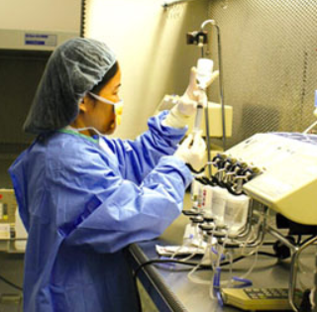
Pharmaceutical Care

Slide 7
Changes in Pharmacy Practice
The need for pharmacists to provide patient care practice
What is Pharmaceutical Care?
The Pharmacist becomes more
specialised as a therapeutic advisor

Slide 8
Pharmacy practice has evolved through the last 50 years to type of pharmacy practice today
Pharmaceutical-Centered Practice
Emphasizes product identification, preparation, dispensing, availability, and selection
⇓
Disease and Condition-Centered Practice
Emphasizes signs, symptoms, pharmacotherapy and outcomes of a particular disease
Clinical Pharmacy (ACCP definition 1990’s)
⇓
Patient care Practice
Clinical Pharmacy (ACCP definition 2005)
Pharmaceutical care
Medication therapy management
Patient-Centered Pharmaceutical care

Slide 9
SHIFTING FOCUS OF PHARMACY PRACTICE
MOVING FROM: TO:
Product oriented service Focusing on therapeutic outcomes
Serving Customers Caring for Patients
Knowledge based education Building problem solving skills
Little communication Increased communication
Fragmented services Continuity of care
Independent professional Being member of healthcare team
Answering questions Teaching appropriate
medicine usage
Dispensing Providing pharmaceutical care

Slide 10
Current concerns worldwide about patient safety & quality of health care
Prominently include concerns about drug therapy
The need for this professional practice results from:
Multiple prescriptions for a single patient without coordination & communication between medical doctors.
Large number of medications with overwhelming amount of drug information.
Increase in medicine use.
Increase in self-treatment with complementary and alternative medicine.
Increase in complexity of drug therapy.
6. Increase in drug related problems and medication error.
7. Increase in drug related morbidity and mortality.
8. Increase in health care cost

Slide 11
All these drug therapy concerns have prompted a call for an enhanced role for pharmacists as
Experts of medication use to ensure effective, & safe drug use & optimal medication therapy outcomes
Their role is both unique & important
because no other health care provider focuses attention on all of a patient’s medication
They focus their attention on the patient’s drug related needs

Slide 12
Pharmaceutical care
“Pharmaceutical care is the direct, responsible provision of medication-related care for the purpose of achieving
definite outcomes
that improve
a patient’s quality of life.’’
Cure of the disease
Elimination or reduction
of symptoms
Arrest or slowing of a
disease process
Prevention of disease
or symptoms
Hepler CD and Strand LM (1990)

Slide 13
Since Hepler and Strand first introduced the concept of Pharmaceutical care (PC), the American Society of Health-System Pharmacists (ASHP) and the American Pharmacists Association (APhA) have expanded the initial description.
APhA principles delineate five key characteristics of PC:
A professional relationship between the patient and the pharmacist must be established and maintained.
Patient-specific medical information must be collected, organized, recorded and maintained.
Patient-specific medical information must be evaluated and a drug therapy plan developed mutually with the patient.
The pharmacist assures that the patient has all supplies, information and knowledge necessary to carry out the drug therapy plan.
The pharmacist reviews, monitors, and modifies the therapeutic plan as necessary and appropriate, in concert with the patient and healthcare team.
ASHP’s statement described five primary elements of PC:
It is medication-related;
It is care that is directly provided to the patient;
It is provided to produce definite outcomes; these outcomes are intended to improve the patient’s quality of life; and
The provider (pharmacist) accepts personal responsibility for the outcomes.

Slide 14
PHARMACEUTICAL CARE PRACTITIONER RESPONSIBILITIES
Four primary responsibilities
To ensure that patient’s health care needs are met at all times
Establish a therapeutic relationship with the patient to recognize his/her concerns & needs
Incorporate patients’ ideas, feelings & expectations into treatment planning & care

Slide 15
PHARMACEUTICAL CARE PRACTITIONER RESPONSIBILITIES
2.To ensure that patient’s drug-related needs are met at all times. This means that
All of a patient’s drug therapy is/are appropriately indicated for each medical condition
All of a patient’s indications (medical problems/complaints) being treated with drug therapy (if appropriate)?
Patient’s drug therapy is/are the most effective available;
Patient’s drug therapy is/are the safest possible; and
The patient drug therapy is the most convenient to take & the most economical

Slide 16
PHARMACEUTICAL CARE PRACTITIONER RESPONSIBILITIES
3. To identify patient’s actual and potential DTPs, resolve actual DTPs or prevent potential DTPs
4. To ensure that the patient’s therapeutic goals are met for each of the medical conditions

Slide 17
Core areas of development needed
by a Pharmacist to provide patient-centered PC
1. Philosophy of Practice
5. Identifying the patient’s health care needs
6. Clinical Practice Skills
Physical Assessment Skills
Clinical Assessment Skills
Drug Information & Evidence-Based Practice skills
Communication Skills & Patient Counseling Skills
Caring Behaviour Skills
Professional Behaviour Skills
Proficient Documentation Skills
Learning to be reflective in practice
7. Clinical Reasoning (Clinical Problem Solving or Clinical Scientific Method)
2. Personal Beliefs & Professional Judgments
3. Responsibility as Patient Advocate
8. Prioritizing Patient Care in a Busy Practice
4. Learn how to establish therapeutic relationship with each patient – Use of Care as Prevention and Treatment

Slide 18
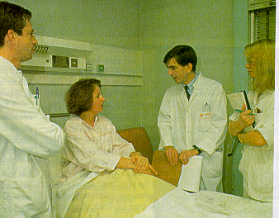
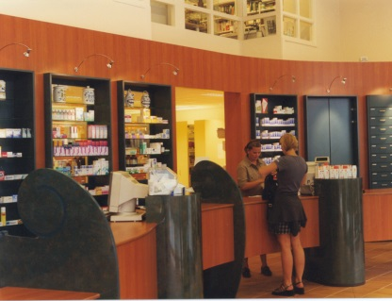
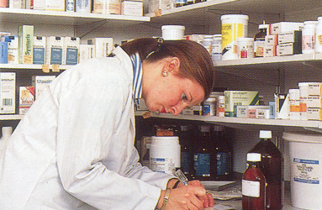
Clinical Pharmacist serves 60 beds
Clinical Pharmacist
integrates into
medical specialties
Pharmacist as
ward visitor
serves 120
beds
Emergence of the Teacher-Practitioner
Variety of models
Pharmacy Patient
Computer Records
and Services to
Elderly Nursing
Homes
Primary Care
Pharmacy
Targeted Services
Community Pharmacy
Patient
Medication Records
Innovations in Pharmacy Services
1970s
1980s
1990s
2000s
30th Nov. 2013

Slide 19
Clinical Management Plan
Verifying
Treatment
Monitoring
Treatment
Confirming Outcomes
of Treatment
Transferring care

Slide 20
Verification
Confirmation of outcomes
Profile of Patient’s Characteristics
Patient Comprehension/Participation
Confirmation of Need
Achievement of
Treatment Goals
Confirmation of Safety
Drug History
Contra-indications/Interactions
Treatment Plan
Conformity to Guidelines
Unwanted Symptoms
Recorded
Adverse Reaction
Monitoring
Individualised Dose,
Dose Frequency,
Means of Administration
Clinical Monitoring
Laboratory Markers
Adherence
to Treatment

Slide 21
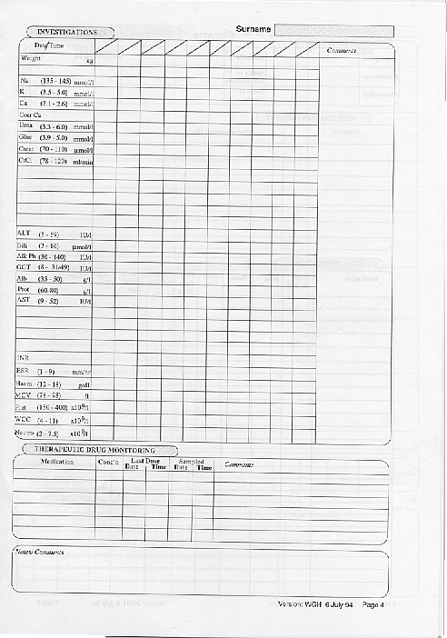
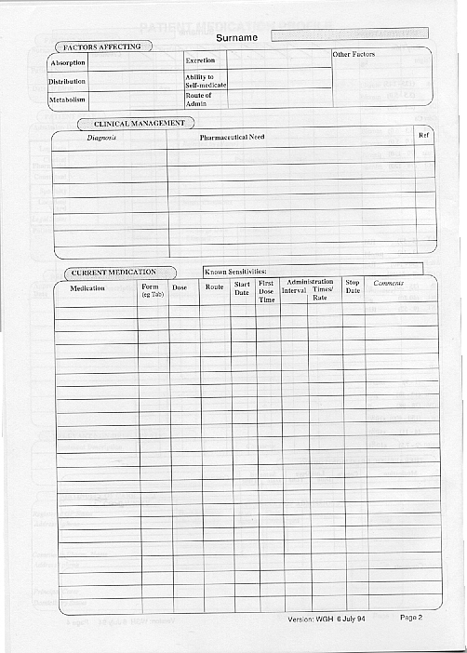
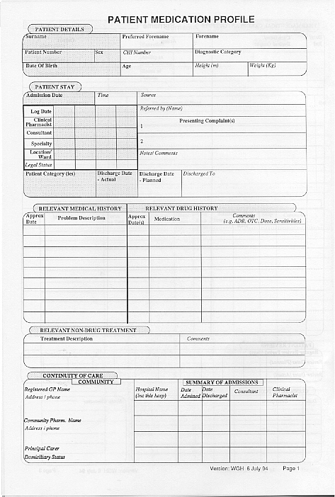
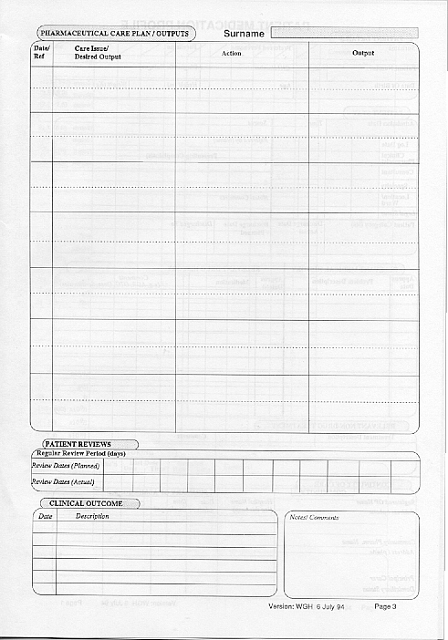
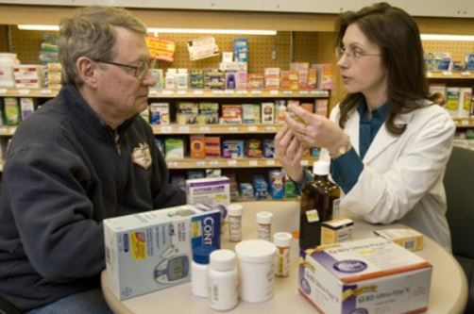
Documentation
Laboratory tests
Pharmaceutical care plan
Medication
Patient Profile
Responsibility

Slide 22
References
Pharmaceutical Care Practice: The Clinician’s Guide. Robert J.Cipolle, Linda M. Strand, Peter C. Morley. 3rd edition.
Patient Centered Care for Pharmacists. Kimberly A. Galt & Michael A. Galt. American Society of Health-System Publications.

Slide 23
OMICS Group Open Access Membership
OMICS publishing Group Open Access Membership enables academic and research institutions, funders and corporations to actively encourage open access in scholarly communication and the dissemination of research published by their authors.
For more details and benefits, click on the link below:
http://omicsonline.org/membership.php

Slide 24
Signature
Abdelmoneim Ismail Awad

