Slide 1
Alessandro Landi
Executive Editor
Orthopedic & Muscular System: Current Research

Slide 2
Biography
He is working as Assistant Neurosurgeon in the University of Rome “Sapienza”, and he is the member of AANS, NASS, EANS, AOSpine

Slide 3
Research Interest
Anterior and Posterior spine surgery; cranio-cervical junction surgery, pain therapy; minimally invasive and endoscopic spine surgery; spinal neurooncology, Application of hemocomponents in spine surgery; spine trauma, neurotraumatology, biomolecular research for bone augmentation

Slide 4
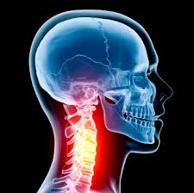
spine trauma
A spinal cord injury (SCI) is an injury to the spinal cord resulting in a change, either temporary or permanent, in the cord's normal motor, sensory, or autonomic function. Common causes of damage are trauma (car accident, gunshot, falls, sports injuries, etc.) or disease (transverse myelitis, polio, spina bifida, Friedreich's ataxia, etc.).

Slide 5
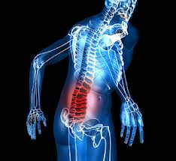
spine trauma
The spinal cord does not have to be severed in order for a loss of function to occur. Depending on where the spinal cord and nerve roots are damaged, the symptoms can vary widely, from pain to paralysis to incontinence.

Slide 6
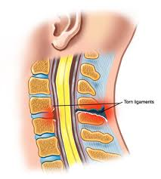
spine trauma
Spinal cord injuries are described at various levels of "incomplete", which can vary from having no effect on the patient to a "complete" injury which means a total loss of function. Treatment of spinal cord injuries starts with restraining the spine and controlling inflammation to prevent further damage.

Slide 7
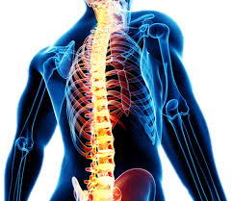
spine trauma
The actual treatment can vary widely depending on the location and extent of the injury. In many cases, spinal cord injuries require substantial physical therapy and rehabilitation, especially if the patient's injury interferes with activities of daily life.

Slide 8
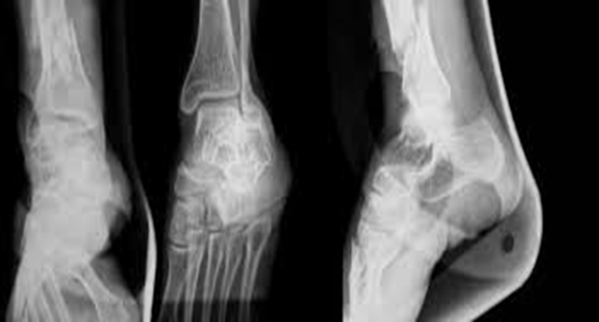
Orthopedic & Muscular System: Current Research
Physiotherapy
Sports Medicine
Doping Studies
Orthopedic surgery
musculoskeletal systems
Spine
Arthritis

