Slide 1
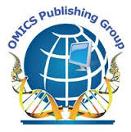
OMICS Group
OMICS Group International through its Open Access Initiative is committed to make genuine and reliable contributions to the scientific community. OMICS Group hosts over 400 leading-edge peer reviewed Open Access Journals and organizes over 300 International Conferences annually all over the world. OMICS Publishing Group journals have over 3 million readers and the fame and success of the same can be attributed to the strong editorial board which contains over 30000 eminent personalities that ensure a rapid, quality and quick review process. OMICS Group signed an agreement with more than 1000 International Societies to make healthcare information Open Access.
Contact us at: contact.omics@omicsonline.org

Slide 2
OMICS Journals are welcoming Submissions
OMICS Group welcomes submissions that are original and technically so as to serve both the developing world and developed countries in the best possible way.
OMICS Journals are poised in excellence by publishing high quality research. OMICS Group follows an Editorial Manager® System peer review process and boasts of a strong and active editorial board.
Editors and reviewers are experts in their field and provide anonymous, unbiased and detailed reviews of all submissions.
The journal gives the options of multiple language translations for all the articles and all archived articles are available in HTML, XML, PDF and audio formats. Also, all the published articles are archived in repositories and indexing services like DOAJ, CAS, Google Scholar, Scientific Commons, Index Copernicus, EBSCO, HINARI and GALE.
For more details please visit our website: http://omicsonline.org/Submitmanuscript.php

Slide 3
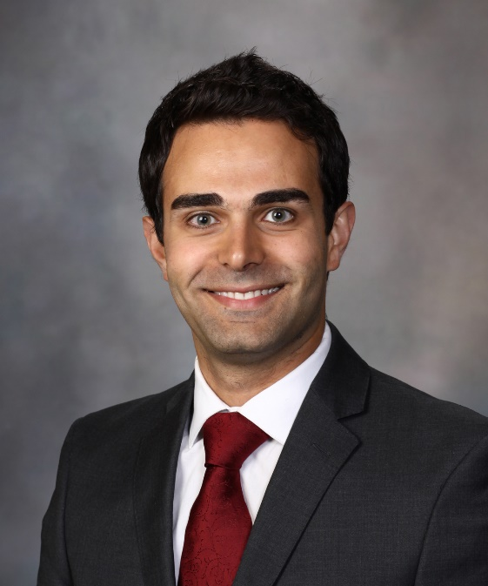
Editorial Board Member
Ali Izadpanah, MD, MSc, FRCSC Division of Plastic and Reconstructive Surgery McGill University Health Centre Canada

Slide 4
Biography
Dr. Ali Izadpanah belongs to Division of Plastic and Reconstructive Surgery at McGill University Health Centre, Canada.
He has published many scientific papers.
> > >

Slide 5
Research Interests
Dr. Ali Izadpanah research interests are in Plastic and Reconstructive Surgery and Hand/Microsurgery
Dr. Izadpanah has finished a Fellowship at Mayo Clinic in Hand/Upper Exremity and Microsurgery. He has additional fellowship training in Burn Surgery at Sunnybrook Hospital, University of Toronto
> > >

Slide 6
Publications
Analgesic Consumption Following Outpatient Carpal Tunnel Release: Are We Prescribing Too Many?
Arash Izadpanah, Thomas Fudge, Blair Peters, Avinash Islur, Ali Izadpanah
Population Preferences of Undergoing Brachioplasty for Arm Laxity.
Ahmed M S Ibrahim, Hani H Sinno, Ali Izadpanah, Joshua Vorstenbosch, Tassos Dionisopoulos, Bernard T Lee, Samuel J Lin

Slide 7
Publication bias in plastic and reconstructive surgery: a retrospective review on 128 abstracts presented to the Annual EURAPS Meeting
Arash Izadpanah, ali izadpanah, Avi islur, hani sinno
Abdominal compartment syndrome following abdominoplasty: A case report and review.
Arash Izadpanah, Ali Izadpanah, Mihiran Karunanayake, Christian Petropolis, Dan L Deckelbaum, Mario Luc

Slide 8
Living with a Unilateral Mastectomy Defect: A Utility Assessment and Outcomes Study.
Hani Sinno, Ali Izadpanah, Joshua Vorstenbosch, Tassos Dionisopoulos, Ahmed M S Ibrahim, Adam M Tobias, Bernard T Lee, Samuel J Lin
Dupuytren Contracture in the Pediatric Population: A Systematic Review.
Ali Izadpanah, Alex Viezel-Mathieu, Arash Izadpanah, Mario Luc
Thigh Laxity After Massive Weight Loss: A Utilities Outcomes Assessment.
Ali Izadpanah, Hani Sinno, Joshua Vorstenbosch, Bernard T Lee,Samuel J Lin

Slide 9
Reconstructive Surgery
Reconstructive surgery is, in its broadest sense, the use of surgery to restore the form and function of the body, although maxillo-facial surgeons, plastic surgeons and otolaryngologists do reconstructive surgery on faces after trauma and to reconstruct the head and neck after cancer.
Other branches of surgery (e.g., general surgery, gynecological surgery, pediatric surgery, cosmetic surgery, podiatric surgery) also perform some reconstructive procedures. The common feature is that the operation attempts to restore the anatomy or the function of the body part to normal.

Slide 10
Reconstructive plastic surgeons use the concept of a reconstructive ladder to manage increasingly complex wounds. This ranges from very simple techniques such as primary closure and dressings to more complex skin grafts, tissue expansion and free flaps.
Cosmetic surgery procedures include breast enhancement, reduction and lift, face lift, forehead lift, upper and lower eyelid surgery (blepharoplasty), laser skin resurfacing (laser resurfacing), chemical peel, nose reshaping (rhinoplasty), reconstruction liposuction, nasal reconstruction using the paramedian flap, as well as tummy tuck (abdominoplasty).
Many of these procedures are constantly being improved.

Slide 11
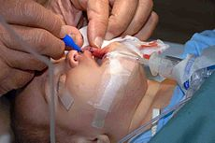
Biomaterials are, in its simplest form, plastic implants used to correct or replace damaged body parts. The process involves scientific and medical research to ensure that the biomaterials are biocompatible and that they can assume the mechanical and functioning roles of the components they are replacing.

Slide 12
Plastic surgery
Plastic surgery is a medical specialty concerned with the "correction" or restoration of form and function. Though cosmetic or aesthetic surgery is the best-known kind of plastic surgery, plastic surgery is not necessarily cosmetic; and includes many types of reconstructive surgery, Craniofacial surgery, hand surgery, microsurgery, and the treatment of burns.

Slide 13
OMICS Group Open Access Membership
OMICS publishing Group Open Access Membership enables academic and research institutions, funders and corporations to actively encourage open access in scholarly communication and the dissemination of research published by their authors.
For more details and benefits, click on the link below:
http://omicsonline.org/membership.php

