Slide 1
Ana Priscila Perini, MD, PhD
Researcher –USP - Brazil
University of Sao Paulo
priscila.perini@usp.br

Slide 2
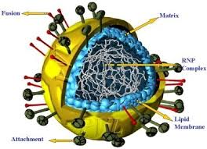
The main research interests
Respiratory Viruses
Epidemiology
Basic research
Cell culture
Molecular Biology

Slide 3
The research results have been presented at conferences
Genetic diversity of Parainfluenza virus 1, 2 and 3, identified from samples taken at the University Hospital of São Paulo University, during 1995 to 2005.
Perini AP¹, Sacramento PR¹, Oliveira DBL², Giglio A³, Vieira SE³, Tenório ECN¹, Stewien KE², Durigon EL², Botosso VF¹
Annual Meeting of Butantan Institute – Brazil - 2013
STANDARDIZATION OF AVIDITY TEST FOR IGG ANTIBODIES ANTI-VIRAL PROTEIN VIRUS CAPSID EPSTEIN-BARR "Perini, A.P.; Oliveira, A.N.; Barros, M.R.C.B.; Siciliano, S.; Grantao, C.F.H.
44⁰ Congresso Brasileiro de Patologia Clinica – Medicina Laboratoria l- Rio de Janeiro – RJ (Set/2010).
"PREVALENCE OF HERPES SIMPLEX TYPE ANTICORPOSANTI-1 (HSV-1) and 2 (HSV-2) IN MEN AND WOMEN IN AGE DIFERENTESGRUPOS"
Granato, C.F.H.; Perini, A.P.; Barros, M.R.; Benfica, D.R.; Leser, P.G.; Moura, M.E.G.; Snege, M.
37⁰ Congresso Brasileiro de Patologia Clinica – Medicina Laboratoria l- Rio de Janeiro – RJ (Set/2003).
XIII Encontro Científico Fleury – São Paulo
Dezembro/2003
"Prevalence in São Paulo of Respiratory Viruses in children attending outpatient, inpatient and ICU, during the years 2000-2002".
Benfica, D.; Perini, A.P.; Araújo, P.; Leser, P.G.; Granato, C.
XII Encontro Científico Fleury – São Paulo
Agosto/2002
37⁰ Congresso Brasileiro de Patologia Clinica – Medicina Laboratoria l- São Paulo – SP (Set/2002).

Slide 4
"Prevalence of serotypes of coxsackievirus B (1-6) in clinical samples sent to Fleury Diagnostic Center Medicia"
Araújo, P; Perini A. P.; Benfica, D.; Leser, P.G.; Granato, C.
XII Encontro Científico Fleury – São Paulo
Agosto/2002
37⁰ Congresso Brasileiro de Patologia Clinica – Medicina Laboratoria l- São Paulo – SP (Set/2002).
"COMPARISON AMONG DIFFERENT CELL LINES (HELA-I, HEP-2, NCI-H292) FOR ISOLATION OF HRSV IN CLINICAL SAMPLES"
Perini, A. P.; Barbosa, M. L.; Takahashi, V. N. van O.; Kuroda, C. K.; Moraes, C. T. P.; Gomes, M. C. S.; Vieira, S. E.; Gilio, A. E.; Lopes, J. M.; Stewien, K. E. & Durigon, E. L.
11th National Meeting of Virology and 3rd Mercosul Meeting of Virology – São Lourenço - MG
Novembro de 2000
"OCURRENCE OF RESPIRATORY SYNCYTIAL VIRUS GROUPS A AND B IN SÃO PAULO CITY, BRAZIL. 1998/1999"
Takahashi, V. N. van O.; Botosso, V. F.; Perini, A. P.; Peret, T. C. T.; Vieira, S. E.; Gilio, A. E.; Ejzemberg, B.; Stewien, K. E. & Durigon, E. L.
11th National Meeting of Virology and 3rd Mercosul Meeting of Virology – São Lourenço - MG
Novembro de 2000

Slide 5
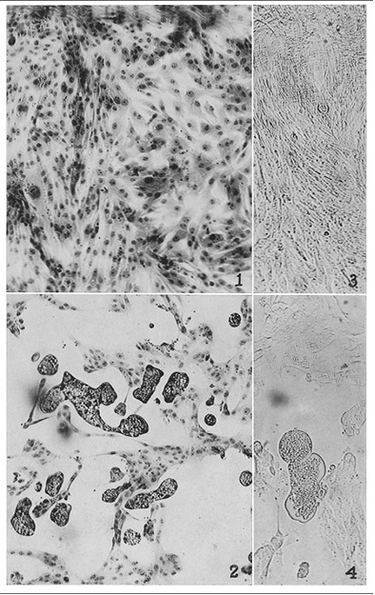
Genetic diversity of Parainfluenza Virus 1, 2 and 3 identified in samples collected at the University Hospital of the University of São Paulo, during the years 1995-2005.
Importance
Second leading cause of bronchiolitis and pneumonia in infants during the first year of life
High rate of hospitalization and morbidity in infants less than 1 year

Slide 6
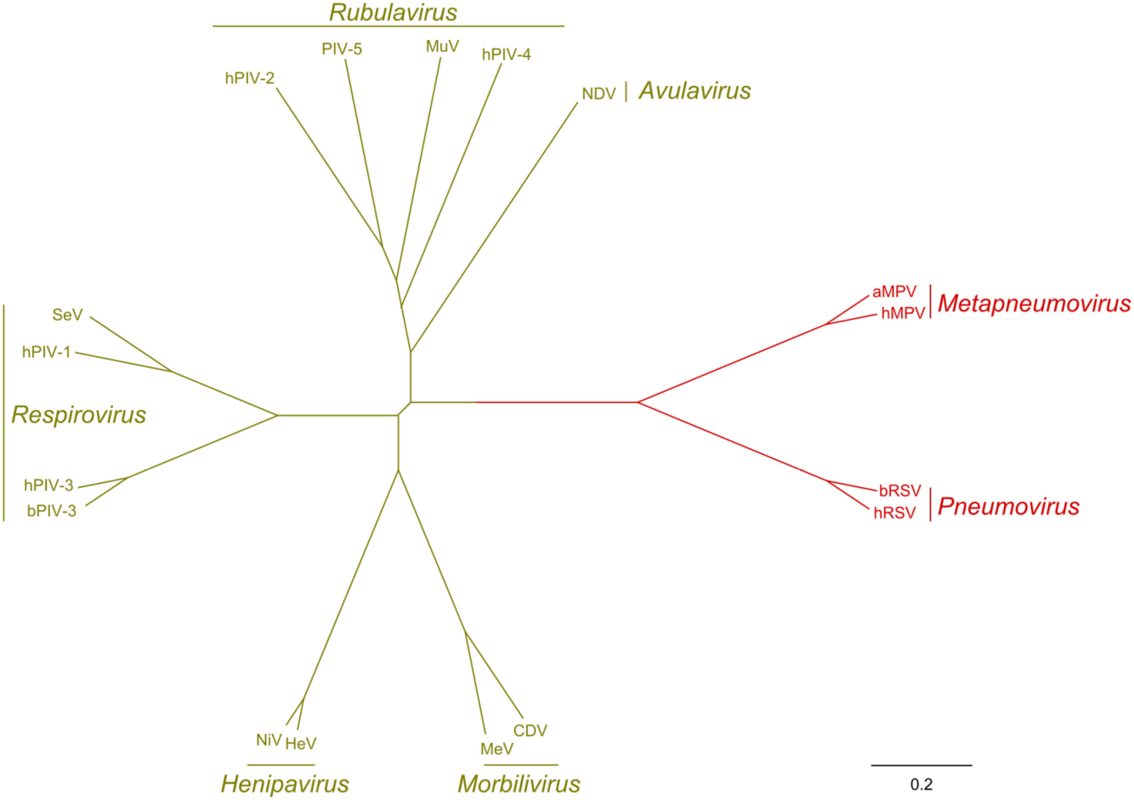
Overview
First report 1956 by Chanock at al.
Actually belongs to genus Repirovirus (hPiV-1 and hPiV-3) and Rubulavirus (hPiV-2 and hPiv-4)

Slide 7
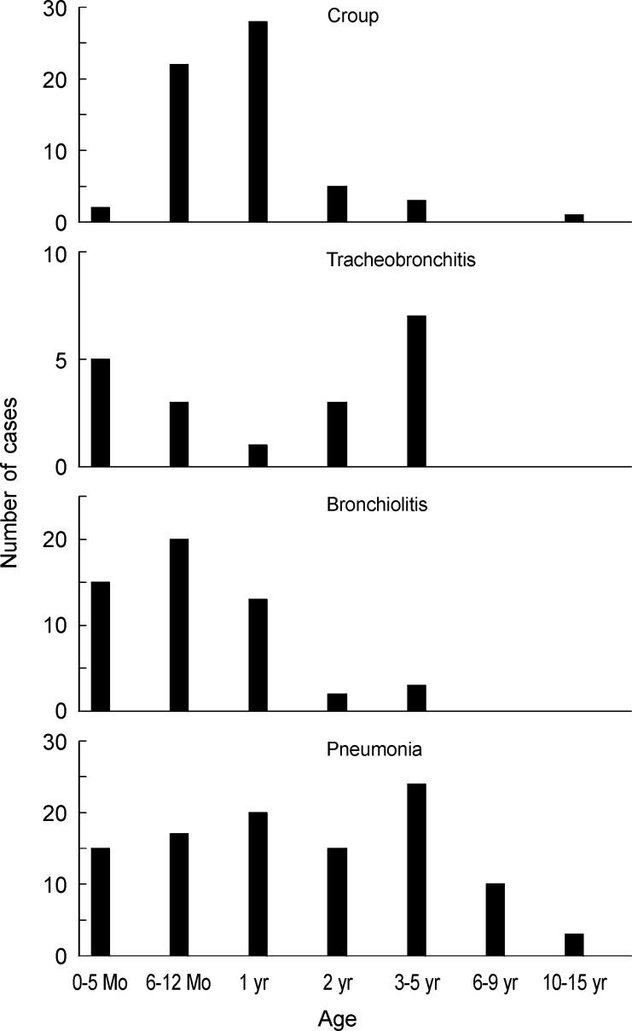
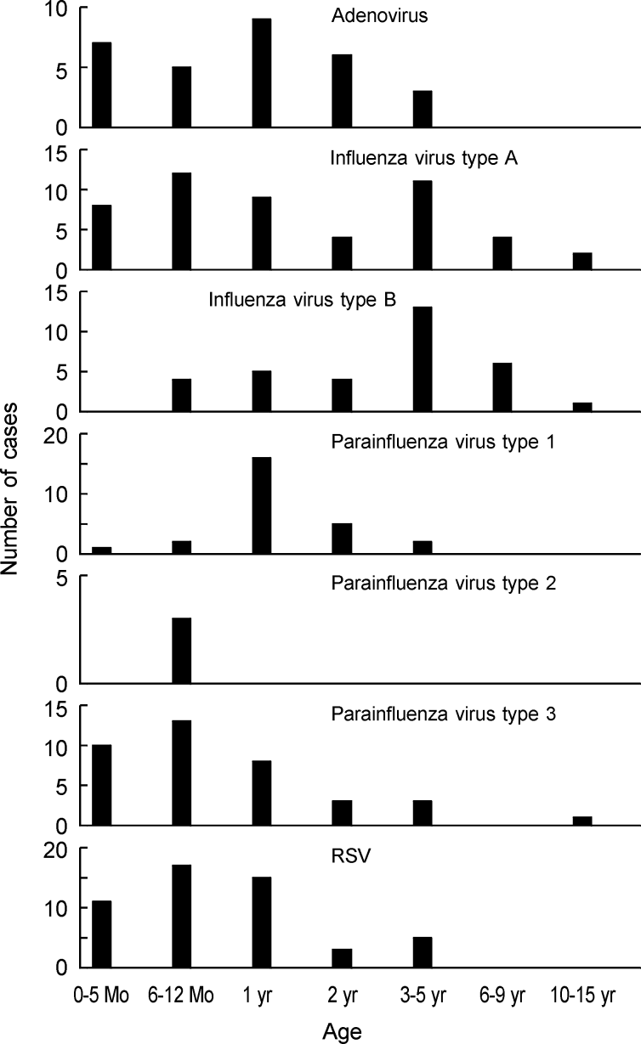
Distribution by age of four acute viral syndromes of the lower respiratory tract
Association of viral agents with age of patients with acute infections of the lower respiratory tract
Ahn et al., 1999 – J. Korean Me Sci 14: 405-411.

Slide 8
We analyzed 2152 samples of collection of the Institute of Biomedical Sciences, USP, obtained between the years 1995 to 2005 from children attending the nursery or children's ICU of the University Hospital of USP.
This work was approved by the Ethics Committee on Research with Human Beings of ICB-USP (Opinion 808 / CEP).

Slide 9
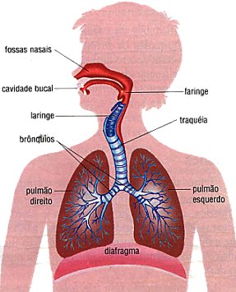
Transmission
Person to person and contaminated objects
Stability of the viral particle in fomites: 4h - 10h
Incubation period of 2 to 8 days

Slide 10
Diagnostic
Throat swabs or nasopharyngeal and nasal aspirates + washed
Isolation in cell culture (LLC-MK2, Vero, HeLa cells, and Hep-2)
RT-PCR
real time pcr
Antigen detection by IFA

Slide 11
Prevention and treatment
There are currently no fully effective antiviral, and its only applied support treatment
Antivirals tested:
Ribavirin: only displays in vitro activity against HPIVs
Zanamivir: only interfere in the binding of HN to the receiver, acting in the late functions of HN

Slide 12
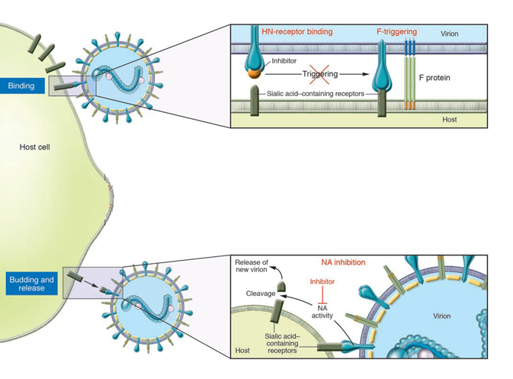
Promising drugs BCX2798 e BCX2855 (Moscona, 2005)

Slide 13
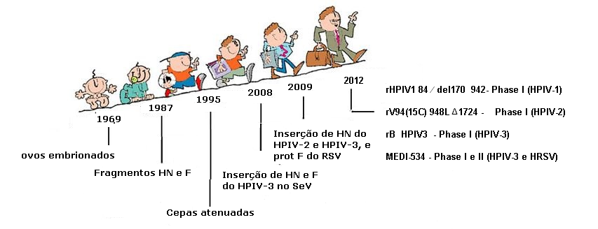
Vaccine Development

Slide 14
Conclusions
The percentage of positivity for HPIVs in children with acute respiratory syndrome, in HU-USP in São Paulo was 6%, the HPIV-3 most frequently detected.
The percentage of positivity for HPIVs in children with acute respiratory syndrome, in HU-USP in São Paulo was 6%, the HPIV-3 most frequently detected.
For 10 years there has been a movement of a genotype HPIV-1 indicates low variability HN protein stability changes over time and the temporal pattern of movement of the lines.

Slide 15
The Brazilian sample of HPIV-2 showed 31 changes to the 485 nucleotide fragment assessed against the prototype strain isolated in 1955 of which 74.1% were non-silent mutations.
The Brazilian sample of HPIV-2 showed 31 changes in the 485 nucleotide fragment analyzed when compared with the prototype strain isolated in 1955. 74.1% of which were non-silent mutations.
The epidemiology of HPIV-3 was characterized by the co-circulation of different strains in the same year, as well as the circulation of the same strain in different years and that the persistence of the same strain over the years can occur.

Slide 16
Some changes in the HPIV-3 and HPIV-2 occurred in regions that are conserved between viruses belonging to the family Paramyxoviridae - NRKSCS region (positions 254 of HPIV-3 and 262 of the HPIV-2 region) , with the main highlight of replacing the conserved lysine, where important role of antigenic and HN protein changes are reported.
Two important changes in predictive of sites of N-glicosilation, an addition and a loss were verified.

Slide 17
Journal of Infectious Diseases and Therapy
Bacteriology & Parasitology
Clinical Microbiology: Open Access
Virology & Antiviral Research
Virology & Mycology

Slide 18
Journal of Infectious Diseases and Therapy
2nd International Congress on Bacteriology and Infectious Diseases
3rd International Conference on Clinical Microbiology & Microbial Genomics

Slide 19
OMICS Group Open Access Membership
OMICS publishing Group Open Access Membership enables academic and research institutions, funders and corporations to actively encourage open access in scholarly communication and the dissemination of research published by their authors.
For more details and benefits, click on the link below:
http://omicsonline.org/membership.php

Slide 20
OMICS Journals are welcoming Submissions
OMICS Group welcomes submissions that are original and technically so as to serve both the developing world and developed countries in the best possible way.
OMICS Journals are poised in excellence by publishing high quality research. OMICS Group follows an Editorial Manager® System peer review process and boasts of a strong and active editorial board.
Editors and reviewers are experts in their field and provide anonymous, unbiased and detailed reviews of all submissions.
The journal gives the options of multiple language translations for all the articles and all archived articles are available in HTML, XML, PDF and audio formats. Also, all the published articles are archived in repositories and indexing services like DOAJ, CAS, Google Scholar, Scientific Commons, Index Copernicus, EBSCO, HINARI and GALE.
For more details please visit our website: http://omicsonline.org/Submitmanuscript.php

