Slide 1
OMICS international
OMICS International through its Open Access Initiative is committed to make genuine and reliable contributions to the scientific community. OMICS International hosts over 700 leading-edge peer reviewed Open Access Journals and organizes over 1000 International Conferences annually all over the world. OMICS International journals have over 10 million readers and the fame and success of the same can be attributed to the strong editorial board which contains over 50000 eminent personalities that ensure a rapid, quality and quick review process. OMICS International signed an agreement with more than 1000 International Societies to make healthcare information Open Access.
Contact us at: contact.omics@omicsonline.org

Slide 2
OMICS Journals are welcoming Submissions
OMICS International welcomes submissions that are original and technically so as to serve both the developing world and developed countries in the best possible way.
OMICS Journals are poised in excellence by publishing high quality research. OMICS International follows an Editorial Manager® System peer review process and boasts of a strong and active editorial board.
Editors and reviewers are experts in their field and provide anonymous, unbiased and detailed reviews of all submissions.
The journal gives the options of multiple language translations for all the articles and all archived articles are available in HTML, XML, PDF and audio formats. Also, all the published articles are archived in repositories and indexing services like DOAJ, CAS, Google Scholar, Scientific Commons, Index Copernicus, EBSCO, HINARI and GALE.
For more details please visit our website: http://omicsonline.org/Submitmanuscript.php

Slide 3
Editorial Board
Andrew Hunt
Associate Professor
Department of Earth and Environmental Sciences
University of Texas at Arlington
USA
Tel: 817-272-0437

Slide 4
Biography
Dr. Andrew Hunt completed his BSc and PhD degrees at Liverpool University, England. He then spent four years in post-doctoral research in the Environmental Geochemistry Research Group in the Royal School of Mines at Imperial College, London. For the Next 15 years Dr. Hunt was on the faculty of the Pathology Department of Upstate Medical University, Syracuse, NY. Initially appointed as a Research Assistant Professor, he was later appointed Research Associate Professor and Associate Director of the Division of Environmental and Occupational Pathology.
> > >

Slide 5
Since 2008, Dr. Hunt has been on the faculty of the Department of Earth and Environmental Sciences at the University of Texas at Arlington (in the Dallas-Fort Worth metroplex). Dr. Hunt works primarily in the field of Exposure Science. He has research interests in: inhalation toxicology, pediatric exposures to aeroallergens, exposures to heavy metals and airborne particulate matter. His work has been funded by several US Federal Agencies.

Slide 6
Dr. Andrew Hunt research interests include inhalation toxicology, pediatric exposures to aeroallergens, exposures to heavy metals and airborne particulate matter. His work has been funded by several US Federal Agencies.

Slide 7
Publications
Detrimental effects of secondhand smoke exposure on infants with cystic fibrosis
Benjamin T. Kopp, Lisa Sarzynski, Sabrina Khalfoun, Don Hayes,Rohan Thompson, Lisa Nicholson, Frederick Long, Robert Castile, Judith Groner
Comprehensive evaluation of lung allograft function in infants after lung and heart-lung transplantation.
Don Hayes, Aymen Naguib, Stephen Kirkby, Mark Galantowicz,Patrick I McConnell, Peter B Baker, Benjamin T Kopp, Eric A Lloyd, Todd L Astor

Slide 8
Survival of patients with cystic fibrosis on ECMO: analysis of the Extracorporeal Life Support Organization Registry.
Don Hayes, Benjamin T Kopp, Thomas J Preston, Stephen Kirkby,Joseph D Tobias, Thomas J Papadimos, Bryan A Whitson
IFN-γ Stimulates Autophagy-Mediated Clearance of Burkholderia cenocepacia in Human Cystic Fibrosis Macrophages.
Kaivon Assani, Mia F Tazi, Amal O Amer, Benjamin T Kopp

Slide 9
Comprehensive evaluation of lung allograft function in infants after lung transplantation
Don Hayes, Aymen Naguib, Stephen Kirkby, Mark Galantowicz,Peter B. Baker, Benjamin T. Kopp, Eric A. Lloyd, Todd L. Astor
Respiratory syncytial virus: current and emerging treatment options.
Tiffany L Turner, Benjamin T Kopp, Grace Paul, Lindsay C Landgrave, Don Hayes, Rohan Thompson

Slide 10
Surveillance transbronchial biopsies in infant lung and heart-lung transplant recipients.
Don Hayes, Peter B Baker, Benjamin T Kopp, Stephen Kirkby,Mark Galantowicz, Patrick I McConnell, Todd L Astor
Right heart catheterization measuring central hemodynamics in cystic fibrosis during exercise.
Don Hayes, Curt J Daniels, Heidi M Mansour, Benjamin T Kopp,Andrew R Yates, Karen S McCoy, Alpa V Patel, Stephen Kirkby

Slide 11
Elevated high-sensitivity C-reactive protein in preterm infants with pulmonary colonization with Ureaplasma.
John T Meadows, Benjamin T Kopp, Lori A Shook, Hubert O Ballard, Don Hayes
Light exposure and depression in hospitalized adult patients with cystic fibrosis.
Benjamin T Kopp, Don Hayes, Mia Ratkiewicz, Nancy Baron,Mark Splaingard
Diabetic myonecrosis in a cystic fibrosis patient.
Benjamin T Kopp, Stephen Kirkby, Don Hayes, Kevin M Flanigan

Slide 12
Pulmonology
Pulmonology is a medical specialty that deals with diseases involving the respiratory tract. Pulmonology is synonymous with pneumology, respirology and respiratory medicine.
Pulmonology is known as chest medicine and respiratory medicine in some countries and areas. Pulmonology is considered a branch of internal medicine, and is related to intensive care medicine.
Pulmonology often involves managing patients who need life support and mechanical ventilation. Pulmonologists are specially trained in diseases and conditions of the chest, particularly pneumonia, asthma, tuberculosis, emphysema, and complicated chest infections.

Slide 13
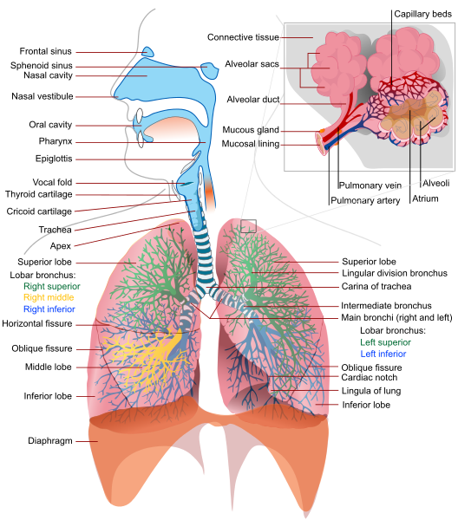

Slide 14
Diagnosis
The pulmonologist begins the diagnostic process with a general review focusing on:
hereditary diseases affecting the lungs (cystic fibrosis, alpha 1-antitrypsin deficiency)
exposure to toxins (tobacco smoke, asbestos, exhaust fumes, coal mining fumes)
exposure to infectious agents (certain types of birds, malt processing)
an autoimmune diathesis that might predispose to certain conditions (pulmonary fibrosis, pulmonary hypertension)

Slide 15
Journal of Air & Water Borne Diseases
Related Journals
Journal of Bacteriology & Parasitology
Journal of Medical Microbiology & Diagnosis
Journal of Microbial & Biochemical Technology
Journal of Plant Pathology & Microbiology
Journal of Vaccines & Vaccination

Slide 16
Journal of Bioterrorism & Biodefense Related Conferences
Allergy Conference
4th Bacteriology and Infectious Diseases Conference
2nd Infectious Diseases Congress

Slide 17
OMICS International Open Access Membership
OMICS International Open Access Membership enables academic and research institutions, funders and corporations to actively encourage open access in scholarly communication and the dissemination of research published by their authors.
For more details and benefits, click on the link below:
http://omicsonline.org/membership.php

