Slide 1
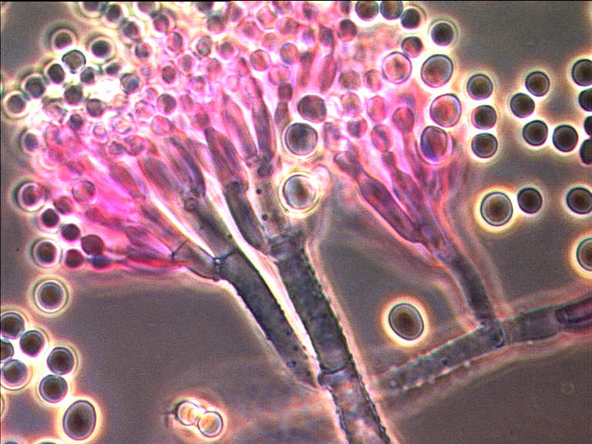
Fermentation – An Old Profession
Koji from rice by Aspergillus oryzae = 5,000 years
Cheese by Penicillium roqueforti = 4,000 years
Soy sauce in Asia = 3,000 years
Bread in Egypt = 3,000 years
(Hoelker et al., 2004)

Slide 2
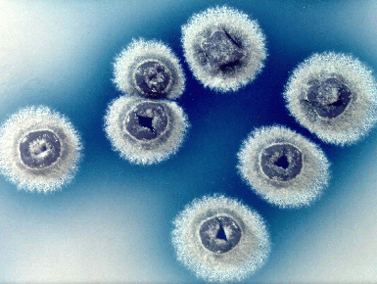
Microbes: Masters of the Biosphere
Life on earth is not possible without microbes
They are the progenitors of all life on earth
Characteristics:
Rapid generation times
Genetic flexibility
Unequaled experimental scale
Manageable study systems
Estimate: 5x10³¹ microbial cells exist = 50 quadrillion metric tons
Carry out more photosynthesis than green plants
Over 90% of the cells in our bodies are microbial
Sterile animals are less healthy then those colonized by microbes

Slide 3
PRIMARY METABOLITES
Integral part of normal growth processes
Building blocks for macromolecules
Amino Acids
Nucleotides
Precursors of coenzymes
Vitamins
Precursors of lipids
Fatty Acids
Glycerol
Precursors of polysaccharides
Sugars
Catabolic products
Organic acids
Ethanol
Acetone
Butanol

Slide 4
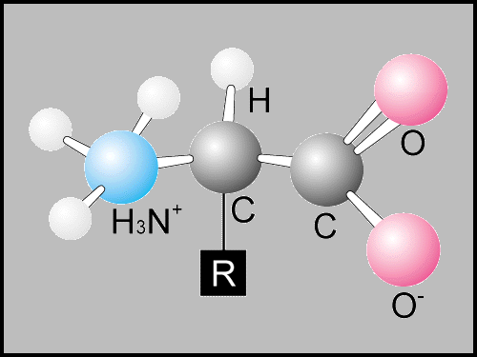
TITERS OF AMINO ACID PROCESSES
L-lysine HCl L-glutamate | 170 g/L 130
L-alanine L-valine | 114 105
L-threonine L-proline | 100 100
L-arginine L-serine | 96 65
L-tryptophan L-tyrosine | 60 55
L-phenylalanine L-glutamine | 51 49
L-histidine L-hydroxyproline | 42 41
L-isoleucine L-leucine | 40 34

Slide 5
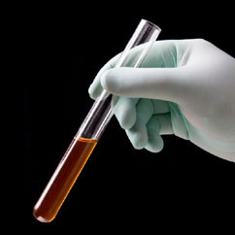
Organic Acids
Pyruvic: 80 g/L at 2 g/Lh by recombinant Escherichia coli – fed-batch
Gluconic: 240 g/L with 99.4% yield by Penicillium variable; 50,000-60,000 tons, mainly by Aspergillus niger
Fumaric: 107 g/L by Rhizopus arrhizus
D-Lactic: 120 g/L by recombinant Corynebacterium glutamicum
L(+) Lactic: 136g/L by Rhizopus oryzae
Succinic: 146 g/L in 46h by recombinant C. glutamicum
Malic: 113 g/L by Aspergillus flavus
(Crognale et al., 2008; Engel et al., 2008, Okino et al., 2008; Zelle et al., 2008;Skory, 2004; Ge et al., 2004; Ding and Tan, 2006; Zhu et al., 2008)

Slide 6
SECONDARY METABOLITES
ANTIBIOTICS
ANTIBACTERIAL
ANTIFUNGAL
NON-ANTIBIOTIC
INSECTICIDES
ANTITUMOR AGENTS
HERBICIDES
ANTI-PARASITIC AGENTS
PLANT-GROWTH REGULATORS
PHARMACOLOGICAL AGENTS
ENZYME INHIBITORS
IMMUNOSUPPRESSANTS

Slide 7
NATURAL PRODUCTS
1 million total
- 500,000-600,000 by plants
- 50,000 by microbes
200,000-250,000 biologically active
- 22,500 biologically active from microbes
* 10,100 (45%) by actinomycetes
* 8,600 (38%) by fungi
* 3,800 (17%) by unicellular bacteria
Berdy, 2005

Slide 8
ANTI-INFECTIVE MARKET IN 2000
Cephalosporins = $9.9 billion.
Penicillins = $8.2 billion.
Other β-lactams = $1.5 billion.
Antivirals excluding vaccines = $10.2 billion.
Quinolones = $6.4 billion.
Antifungals and antiparasitics = $4.2 billion.
Aminoglycosides = $1.8 billion.
Tetracyclines = $1.4 billion.
Other antibacterials = $6.1 billion.
Total = $55 billion.
(M.S. Barber, 2001)

Slide 9
BENEFITS OF SECONDARY METABOLITES
Average life expectancy in the USA increased from 47 years in 1900 to 74 years (males) and 80 years (females) in 2000.
Reduced pain and suffering.
Revolutionized medicine by facilitating organ transplantation.
(Verdine, 1996; Lederberg, 2000)

Slide 10
ANTI-CANCER AGENTS SINCE 1940
>60%: Natural products, derivatives, or mimics
Approved products
Actinomycin D
Anthracyclines (daunorubicin, doxorubicin, epirubicin, pirirubicin, valrubicin
Glycopeptolides (bleomycin)
Mitosanes (mitomycin C)
Anthracenones (mithramycin, streptozotocin, pentostatin)
Endiynes (calcheamycin)
Taxol
(Newman and Cragg, 2005)

Slide 11
METASTATIC TESTICULAR CANCER
Uncommon (1% of male malignancies in USA; 80,000 in USA in 2000).
Most common carcinoma in men aged 15-35.
Cure rates:
5% in 1974
90% in 2001
Combination chemotherapy:
Bleomycin + etopside + cisplatin.
(L.H. Einhorn, 2002)

Slide 12
Rapamycin
Discovered as antifungal agent.
Produced by Streptomyces hygroscopicus.
Unusual nitrogen-containing triene macrolide (polyketide) with very large 31-membered lactone ring.
Has antitumor activity.
Immunosuppressive potency somewhat greater than FK-506 and 150X cyclosporin A.
Toxicity less than cyclosporin A.
Precursors: acetate, propionate, methionine, pipecolate, shikimate.

Slide 13
STATINS
Produced by Aspergillus, Monascus, Penicillium, Doratomyces, Eupenicillium, Gymnoascus, Hypomyces, Paecilomyces, Phoma, Trichoderma, and Pleurotis.
Uses
Reduce risk of cardiovascular disease
Prevent stroke
Reduce development of peripheral vascular disease
Antithrombotic
Anti-inflammatory
Lovastatin production by A. terreus = 7-8 g/L.
Compactin production by P. citrinum = 5 g/L.
Pravastatin can be made directly by certain strains of Aspergillus and Monascus.
(Manzoni et al., 1998, 1999; Manzoni & Rollini, 2002)

Slide 14
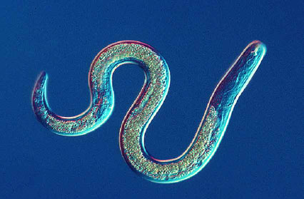
Avermectin – An Antiparasitic Agent
Produced as a complex by S. avermitilis
Antihelmintic agent and insecticide
Disaccharide macrolides which do not inhibit protein synthesis but interfere with neurotransmission in invertebrates
At least 10x more active than any synthetic
Active against nematode and arthropod parasites in sheep, cattle, dogs, horses and swine

Slide 15
OMICS International
www.omicsonline.org
OMICS International (and its subsidiaries), is an Open Access publisher and international conference Organizer, which owns and operates peer-reviewed Clinical, Medical, Life Sciences, and Engineering & Technology journals and hosts scholarly conferences per year in the fields of clinical, medical, pharmaceutical, life sciences, business, engineering, and technology. Our journals have more than 3 million readers and our conferences bring together internationally renowned speakers and scientists to create exciting and memorable events, filled with lively interactive sessions and world-class exhibitions and poster presentations. Join us! OMICS International is always open to constructive feedback. We pride ourselves on our commitment to serving the Open Access community and are always hard at work to become better at what we do. We invite your concerns, questions, even complaints. Contact us at contact.omics@omicsonline.org. We will get back to you in 24-48 hours. You may also call 1-800-216-6499 (USA Toll Free) or at +1-650-268-9744 and we will return your call in the same timeframe.
Contact us at: contact.omics@omicsonline.org

Slide 16
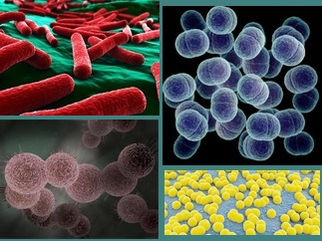
Journal of Microbial & Biochemical Technology: Open Access
Related Journals
Journal of Chemical Engineering & Process Technology
Journal of Biotechnology & Biomaterials
Journal of Bioremediation & Biodegradation
Journal of Bacteriology & Parasitology
Journal of Medical Microbiology & Diagnosis

Slide 17
Journal of Microbial & Biochemical Technology: Open Access
Related Conferences
3rd International Conference on Clinical Microbiology & Microbial Genomics

Slide 18
OMICS Group Open Access Membership
OMICS publishing Group Open Access Membership enables academic and research institutions, funders and corporations to actively encourage open access in scholarly communication and the dissemination of research published by their authors.
For more details and benefits, click on the link below:
http://omicsonline.org/membership.php

