Slide 1

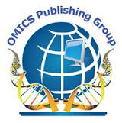
OMICS Group
OMICS Group International through its Open Access Initiative is committed to make genuine and reliable contributions to the scientific community. OMICS Group hosts over 400 leading-edge peer reviewed Open Access Journals and organizes over 300 International Conferences annually all over the world. OMICS Publishing Group journals have over 3 million readers and the fame and success of the same can be attributed to the strong editorial board which contains over 30000 eminent personalities that ensure a rapid, quality and quick review process. OMICS Group signed an agreement with more than 1000 International Societies to make healthcare information Open Access.
Contact us at: contact.omics@omicsonline.org

Slide 2

OMICS Journals are welcoming Submissions
OMICS Group welcomes submissions that are original and technically so as to serve both the developing world and developed countries in the best possible way.
OMICS Journals are poised in excellence by publishing high quality research. OMICS Group follows an Editorial Manager® System peer review process and boasts of a strong and active editorial board.
Editors and reviewers are experts in their field and provide anonymous, unbiased and detailed reviews of all submissions.
The journal gives the options of multiple language translations for all the articles and all archived articles are available in HTML, XML, PDF and audio formats. Also, all the published articles are archived in repositories and indexing services like DOAJ, CAS, Google Scholar, Scientific Commons, Index Copernicus, EBSCO, HINARI and GALE.
For more details please visit our website: http://esciencecentral.org/journals/alternative-integrative-medicine.php

Slide 3

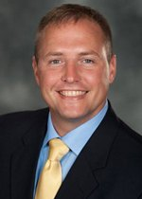
Arthur Jason De Luigi
Georgetown University School of Medicine , USA
Editor-in-chief
of
Journal of Alternative & Integrative Medicine

Slide 4
Bio-Sketch
Arthur Jason De Luigi, DO, is the Director of Sports Medicine at MedStar National Rehabilitation Hospital, and Program Director of the MedStar National Rehabiliation Hospital/Georgetown University Hospital Sports Medicine Fellowship. Dr. De Luigi is board certified in Physical Medicine and Rehabilitation (PM&R), Sports Medicine, Pain Medicine, and Musculoskeletal Ultrasound.
Dr. De Luigi specializes in Sports Medicine, Interventional Pain Management, Musculoskeletal Ultrasound, Concussions, and Fluoroscopic Guided Interventional Spine and Pain procedures.
Since joining MedStar NRH Dr. De Luigi established the ACGME accredited Sports Medicine fellowship and the MedStar NRH Interventional Spine Center, and also serves as the Editor-In-Chief for Alternative & Integrative Medicine. Prior to his arrival at MedStar NRH, Dr. De Luigi served as the Program Director of the PM&R Residency at Walter Reed Army Medical Center/National Capital Consortium. During his years of military service, Dr. De Luigi twice served in military deployments in Operation Iraqi Freedom (OIF) as a Battalion Surgeon.

Slide 5
Research Interests
Physical Medicine and Rehabilitation
Pain Medicine
Physiatry
Sports Medicine
Musculoskeletal Medicine
Ultrasonography (Diagnostic and Guided Injections)
Fluoroscopic Guided Injections
Interventional Spine
Interventional Pain Procedures
Pain Management

Slide 6
Fellowship & Certifications
Sports Medicine and Pain Medicine, University of Utah, Salt Lake City, UT, 2008
ABPMR (Sports Medicine), 2006 (2008)
American Board of Pain Medicine, 2011
American Board of Physical Medicine and Rehabilitation
American Registry of Diagnostic Medical Sonography (ARDMS), Registered in Musculoskeletal Sonography

Slide 7
Publications
Emerging Concepts in the Treatment of Myofascial Pain: A Review of Medications, Modalities, and Needle-based Interventions.” Annaswamy T, De Luigi AJ, Keole N, O’Neill B, Berbrayer D. Clinical Review: Current Concepts. PM&R. Oct 2011. 3(10):940-961.
“Physical Exam in Radiculopathy.” De Luigi AJ, Fitzpatrick KF. Phys Med Rehabil Clin N Am. 2011 Feb; 22(1):7-40. Epub 2010 Dec 14.
”Analgesic benefit of niacin for shrapnel wound pain in war veteran,” Military Medicine, Kamerath JH, De Luigi AJ. Mil Med. 2010 Nov; 175(11):876-7.
“Rucksack Induced Plexopathy Mimicking a Lateral Antebrachial Cutaneous Neuropathy,” American Journal of Physical Medicine & Rehabilitation. De Luigi AJ, Pasquina P, Dahl E. 2008 Sep; 87(9):773-5.
“The Wheelchair Athlete.” De Luigi AJ, Fitzpatrick KF, Pasquina PF. ACSM’s Sports Medicine: A Comprehensive Review. Chapter 111: 749-751.
“Evaluation of Highly Adjustable Throwing Chair for People with Disabilities.” Grindle GG, De Luigi AJ, LaFerrier JZ, Cooper RA. Assistive Technology: The Official Journal of RESNA. 2012: 24 (4): 240-245.
“Complementary and Alternative Medicine in Osteoarthritis.” De Luigi AJ. PM&R. 2012;(4):S122-S133.
“Lower Back/Gluteal Pain.” McCallin JP, De Luigi AJ. AAPM&R Case of the Month, MSK Case #26, April 2012, http://me.e-aapmr.org/CaseStudies.aspx. Electronic Publication.
“Iliotibial Band Syndrome.” De Luigi AJ, Krabak BJ. http://www.racingtheplanet.com/store/ITB. Electronic Publication

Slide 8
Introduction
Physical Medicine and Rehabilitation
Physical medicine and rehabilitation (PM&R), also referred to as physiatry, is a medical specialty concerned with diagnosis, evaluation, and management of persons of all ages with physical and/or cognitive impairment and disability. This specialty involves diagnosis and treatment of patients with painful or functionally limiting conditions, the management of comorbidities and co-impairments, diagnostic and therapeutic injection procedures, electrodiagnostic medicine, and emphasis on prevention of complications of disability from secondary conditions.

Slide 9
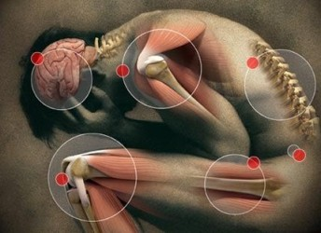

Slide 10
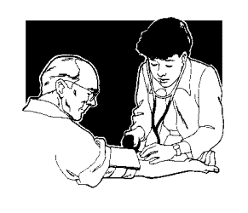
Physical Medicine and Rehabilitation Practice

Slide 11
Scope & Future
It is with a feeling of great pride that we physicians who have devoted our interest to the combined specialty of physical medicine and rehabilitation gather here for the first meetings of the new section of the American Medical Association which deals with this field. Physical medicine has been defined as the employment of the physical and other effective diagnostic and therapeutic properties of light, heat, cold, water, electricity, massage, manipulation, exercise and mechanical devices for diagnosis, for research and for physical and occupational therapy and physical rehabilitation. Rehabilitation has been defined as the employment of physical medicine, technics of psychosocial adjustment and vocational retraining for the purpose of aiding the patient to achieve the maximal function and adjustment and of preparing him physically, mentally, socially and vocationally for the fullest possible life compatible with his abilities and disabilities.

Slide 12
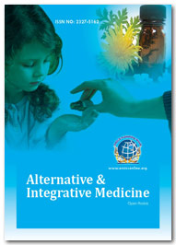
Related Journals
Journal of Community Medicine & Health Education
Internal Medicine: Open Access
General Medicine: Open Access
Journal of Vascular Medicine & Surgery

Slide 13
Related Conferences
2nd International Conference on
Predictive, Preventive and Personalized Medicine & Molecular Diagnostics

Slide 14
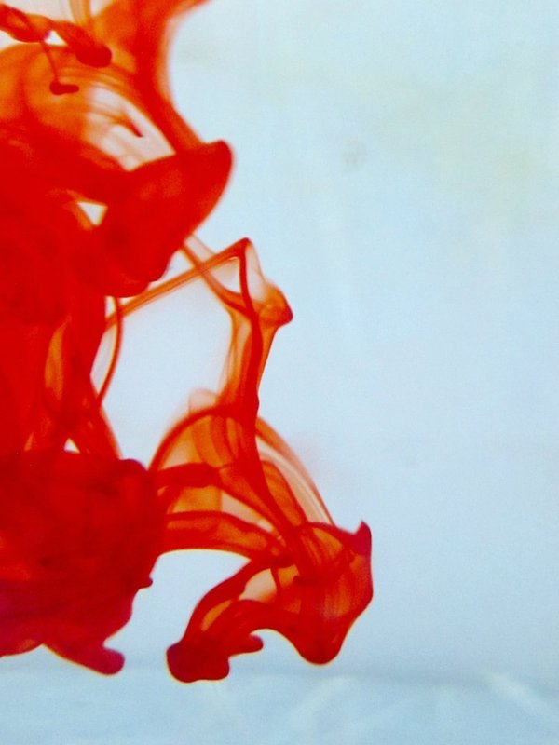

OMICS Group Open Access Membership
OMICS publishing Group Open Access Membership enables academic and research institutions, funders and corporations to actively encourage open access in scholarly communication and the dissemination of research published by their authors.
For more details and benefits, click on the link below:
http://omicsonline.org/membership.php

