Slide 1
OMICS Journals are welcoming Submissions
OMICS International welcomes submissions that are original and technically so as to serve both the developing world and developed countries in the best possible way.
OMICS Journals are poised in excellence by publishing high quality research. OMICS International follows an Editorial Manager® System peer review process and boasts of a strong and active editorial board.
Editors and reviewers are experts in their field and provide anonymous, unbiased and detailed reviews of all submissions.
The journal gives the options of multiple language translations for all the articles and all archived articles are available in HTML, XML, PDF and audio formats. Also, all the published articles are archived in repositories and indexing services like DOAJ, CAS, Google Scholar, Scientific Commons, Index Copernicus, EBSCO, HINARI and GALE.
For more details please visit our website: http://omicsonline.org/Submitmanuscript.php

Slide 2
ASAD U Khan
Professor and Coordinator
Int Biotechnology Unit AMU Aligarh 202002 India

Slide 3
Biography
Dr. Asad U Khan has received his PhD from Aligarh M University in collaboration with ICGEB, New Delhi during the period of 1998. Currently, he is working as Associate Professor in Aligarh M University. He has successfully completed his Administrative responsibilities as Editorial members of Scientific Domain of Global Science Book, Gene, Molecular & Cell Therapy, Medical & Pharma Board, Gene Genomes & Genomics, Biochemistry Processes Biotechnology & Molecular Biology. He /she is serving as an editorial member of several reputed journals like PlOS ONE, Bioinformation (Biomedical Information), Genomics proteomics and Bioinformatics (Elsevere), Asian Pacific Journal of Tropical Medicine (Elsevier), Journal of Mol. Genetic Medicine (Oxford), Journal of Industrial Research and Toxicology. He has authored over 135 research articles, 3 books. He is a member of (1) Life member of International Society of Genomics and Evolutionary Microbiology, (2) Life member of AMI (3) Member of New York Academy of Science. He has honoured as BOYSCAST Fellow of DST, Government of India to work as Visiting Scientist in one of the lab in University of Napoli, Italy in 2004. He is recipient of INSA Fellowship of 2005 for Indian lab. He is recipient of Young Scientist Award and Alembic Award of Association of Microbiologist of India in Medical Microbiology in 2006 and 2009 respectively. In year 2010 Dr. Khan has been given “Most Active Teachers Award of AMU” and DBT-CREST award of Department of Biotechnology and National Bioscience Award for Career Development” of Government of India, Department of Biotechnology for the year 2012

Slide 4
Characterization of some important resistant mutants of Class A β-lactamases

Slide 5
Beta-lactamases confer resistance to a broad range of antibiotics and inhibitors by accumulating mutations.
The number of betalactamase and their variants are steadily increasing.
However, the information about these betalactamase classes and their variants was scattered.
Categorizing all these classes and associated variants along with their relevant information on one platform could be helpful to the researcher working on multidrug resistant bacteria.
Thus, the BLAD (Betalactamase database) has been developed to provide comprehensive information on betalactamases.

Slide 6
DATABASE CONTENT
This database includes
Information about the sequences (nucleotide and protein)
Resistance: It includes information about the resistance type.
PDBS: This dataset includes information about the three dimensional structure of enzymes and their variants along with the description of physiochemical properties of bounds ligand.
Genome: Iincludes the information of the plasmids. These information included as type, variant, organism, resistance type, mutant, protein and nucleotide sequences with NCBI links and literature reference with the PubMed links. Cross-reference to the UniProt protein sequence database is also provided.
The current version of BLAD holds ~4000 gene sequences which includes all classes betalactamase. Moreover, ~200 crystal structures for all types of betalactamase were also included. All the data were collected from literatures, NCBI, protein data bank (Sussman et al., 1998) and other authentic resources

Slide 7
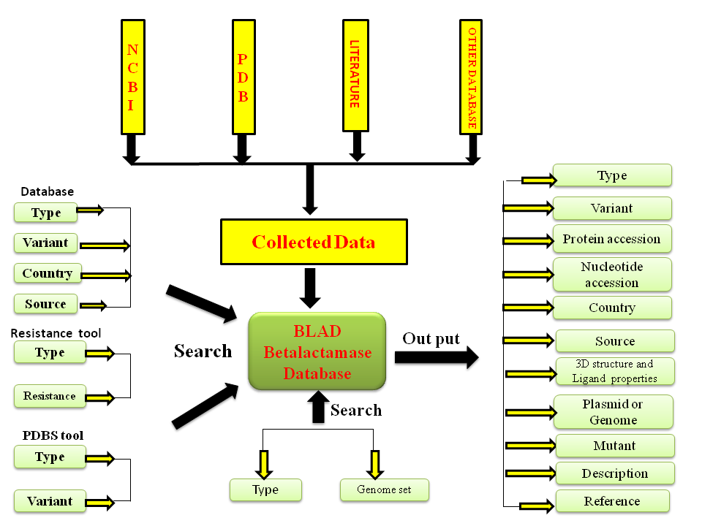
A schematic representation of architecture of BLAD database.

Slide 9
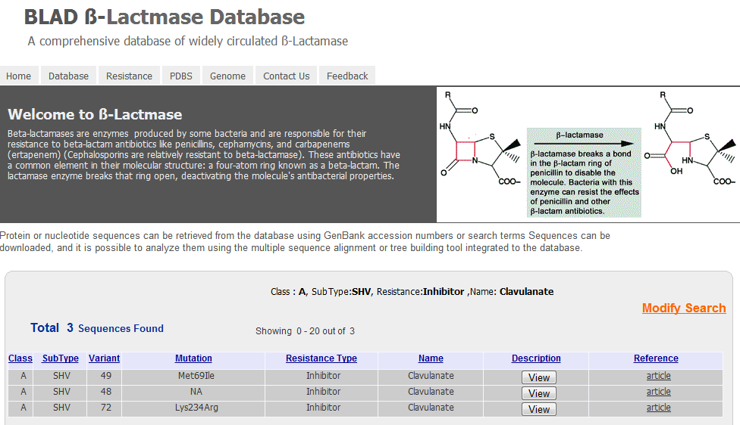

Slide 11
FUTURE PROSPECTS
This is the is the first time one have developed such a comprehensive database, especially for all the widely circulated β-lactamases which catalog, categorize, the resistance pattern about all the four different classes of β-lactamases identified by experimental studies.
These informations were scattered and we have tried to bring them on a common platform.
This database also provides information about the available three dimensional structures along with the physio-chemical properties of ligand bound within each structure.
BLAD is equipped with highly flexible search features which includes a user-friendly browse interface and hypertext link-outs to nucleotide and protein sequence databases.
We believe that this database will provide a very useful platform for future experimental and computational analyses of β-lactamases.

Slide 12
Homology Modelling Process
Template recognition
Alignment
Determining structurally conserved regions
Backbone generation
Building loops or variable regions
Conformational search for side chains
Refinement of structure
Validating structures

Slide 13
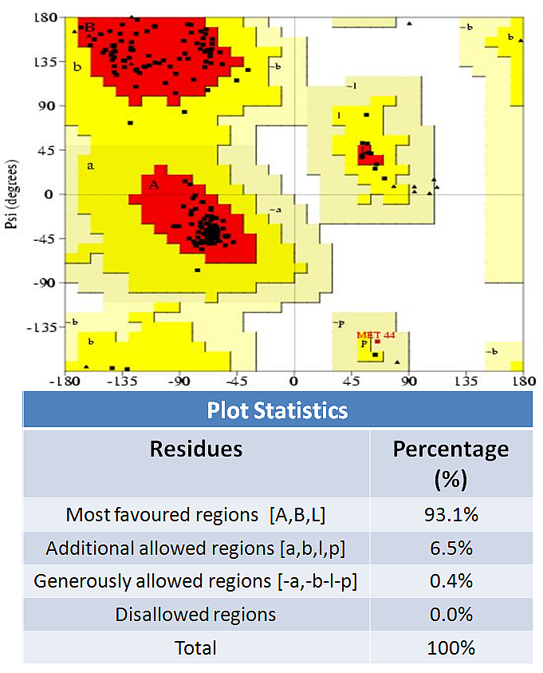
NH2
COOH
Modelled structure of SHV-72 along with its Ramachandran plot and sequence alignment with its wild type.
Notes:
13

Slide 14
VALIDATION OF THE DOCKING PROTOCOL
Docking methods are typically validated by ‘redocking’ experiments,where a known crystal complex is separated and then redocked, ensuring that the docking algorithm can reproduce the observed binding mode.
The structure of TEM-1 β-lactamase in complex with a designed boronic acid inhibitor (1R)-2- phenylacetamido-2-(3-carboxyphenyl ) ethyl boronic acid (pdb id: 1ERO) was selected.
Protein and ligands were separated, hydrogen atoms were added and minimized using the CHarMm force field.
Finally the ligand was docked back into the active site of TEM-1 using GOLD.

Slide 15
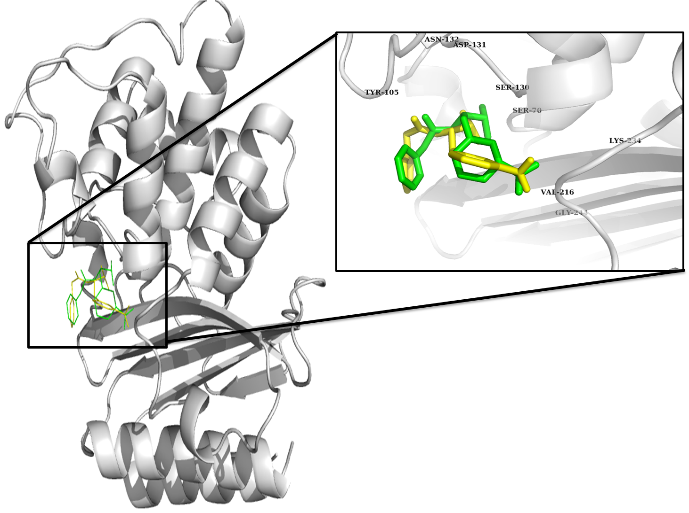
Binding orientation of the original (green) and redocked (yellow) conformation of the ligand.

Slide 16
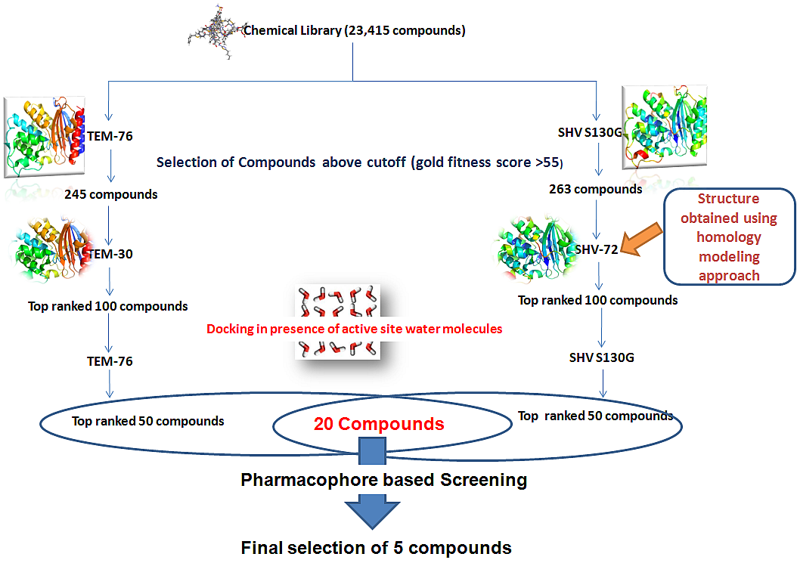

Slide 17
Mutants Selected: SHV S130G, SHV-72, TEM-30 and TEM-76
Library Design
4.5 millions compounds from zinc database were scanned on the properties of the known β-lactamase inhibitors (Xlogp, MW, Rotatable bonds, HBD, HBA) to screen out the compounds . A total of 23,415 compounds were screened out for further analysis of their efficacies against the resistant mutants.
Docking-based virtual screening
GOLD (Genetic Optimization for Ligand Docking)
AUTODOCK
X-SCORE

Slide 18
Compounds | Pubchem id | Fit Value
LN-1255 | 25147490 | 2.94547
Tazobactam | 123630 | 1.99978
Penam-1 | 21941339 | 1.99911
Penam-2 | 21941375 | 1.96089
Clavulanic acid | 5280980 | 1.55216
Sulbactam | 130313 | 1
The fit values of the external test set of known β-lactamase inhibitors

Slide 19
Compounds | Fit value
ZINC00959167 | 3.96904
ZINC01234548 | 3.93984
ZINC01301026 | 3.93677
ZINC14671560 | 3.93437
ZINC02775438 | 3.82992
ZINC03830398 | 3.67902
ZINC06143162 | 3.65642
ZINC01738195 | 3.63313
ZINC00627649 | 3.28382
ZINC09212678 | 2.99403
The fit values of the test set of compounds on Hypo-1.

Slide 20
Compounds | Gold Fitness Score
 | SHV S130G | SHV-72 | TEM-76 | TEM-30
ZINC00959167 | 62.56 | 63.23 | 60.89 | 61.44
ZINC14671560 | 60.20 | 60.03 | 60.25 | 62.02
ZINC02775438 | 61.95 | 61.25 | 64.05 | 63.46
ZINC01301026 | 60.28 | 63.16 | 61.16 | 67.99
ZINC01234548 | 63.15 | 62.79 | 60.93 | 64.24
Goldfitness score of the selected inhibitors against all the selected mutants

Slide 21
Compounds | ∆G(Kcal/mol) (autodock) | X-score | ∆G(Kcal/mol) (autodock) | X-score
 | SHV S130G |  | SHV-72
ZINC00959167 | -8.14 | -8.23 | -6.93 |  | -7.20
ZINC14671560 | -7.59 | -7.14 | -7.02 |  | -6.98
ZINC02775438 | -7.54 | -7.85 | -7.38 |  | -7.94
ZINC01301026 | -7.67 | -7.93 | -8.54 |  | -8.44
ZINC01234548 | -8.53 | -8.24 | -6.95 |  | -7.36
Binding affinity obtained by autodock and x-score of the selected inhibitors against SHV S130G and SHV-72.

Slide 22
Compounds | ∆G(Kcal/mol) (autodock) |  | X-score | ∆G(Kcal/mol) (autodock) | X-score
 | TEM-76 |  |  | TEM-30
ZINC00959167 | -6.84 | -6.96 |  | -7.56 |  | -7.20
ZINC14671560 | -6.98 | -7.44 |  | -7.73 |  | -7.18
ZINC02775438 | -7.86 | -7.94 |  | -7.46 |  | -6.94
ZINC01301026 | -7.24 | -6.98 |  | -8.42 |  | -8.23
ZINC01234548 | -6.48 | -7.02 |  | -7.94 |  | -6.97
Binding affinity obtained by autodock and x-score of the selected inhibitors against TEM-76 and TEM-30.

Slide 23
Compounds | Residues involved
 | Hydrogen bond | Hydrophobic interactions
ZINC00959167 | K73, K234, T235 | S70, Y105, G130, T167, N170, E171, G238, E240
ZINC14671560 | N132 | Y105, T167, E168, N170, E171, V216, A237, G238, E240, R244, M272
ZINC02775438 | N132, N170 | S70, Y105, G130, T167, E168, E171, V216, T235
ZINC01301026 | N132 | S70, T167, E168, N170, E171, V216, T235, G236, A237, G238, E240, R244, M272
ZINC01234548 | N132, K234, T235 | S70, G130, N132, T167, N170, T235, A237, G238
Detail description of the amino acid residues involved in interaction of the selected inhibitors against SHV S130G

Slide 24
Compounds | Residues involved
 | Hydrogen bond | Hydrophobic interactions
ZINC00959167 | N170, A237 | S70, Y105, G130, N170, V216, P219, A237, G238, M272
ZINC14671560 | No Hydrogen bond | S70, Y105, G130, N132, P167, N170, V216, P219, G238, R244, M272
ZINC02775438 | K73, G238 | S70, Y105, G130, N132, E166, N170, V216, A237, G238, R244
ZINC01301026 | Y105 | S70, Y105, S106, P107, G130, V216, K234, A237
ZINC01234548 | S70, N132, N170, A237 | S70, E104, G130, P167, N170, V216, G236, R244, M272
Detail description of the amino acid residues involved in interaction of the selected inhibitors against TEM-76

Slide 25
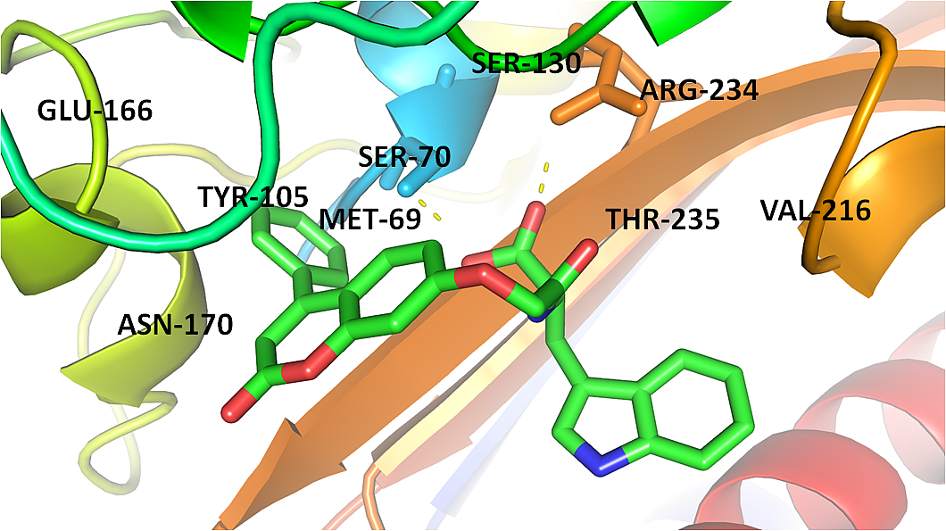
The binding mode of compound ZINC00959167 within the active site of SHV-72

Slide 26
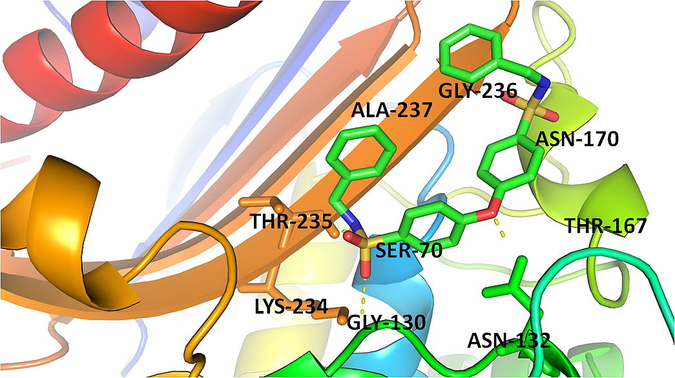
The binding mode of compound ZINC01234548 within the active site of SHV-S130G

Slide 27
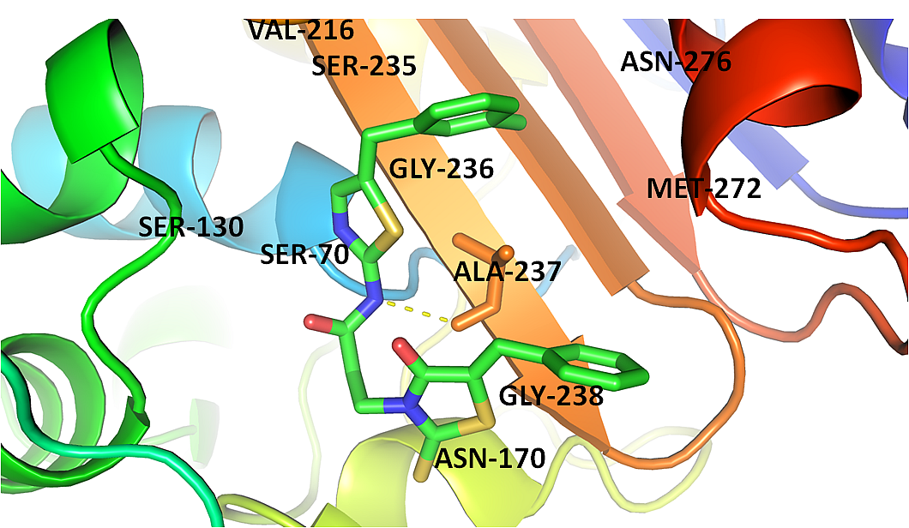
The binding mode of compound ZINC01301026 within the active site of TEM-30

Slide 28
Journal of Proteomics & Bioinformatics Related Journals
Transcriptomics: Open Access
Journal of Pharmacogenomics & Pharmacoproteomics
Journal of Data Mining in Genomics & Proteomics

Slide 29
For more details on Conferences Related
Journal of Proteomics & Bioinformatics please visit:
http://www.conferenceseries.com/biochemistry-meetings

Slide 30
Open Access Membership with OMICS International enables academicians, research institutions, funders and corporations to actively encourage open access in scholarly communication and the dissemination of research published by their authors.
For more details and benefits, click on the link below:
http://omicsonline.org/membership.php

