Slide 1
Biography
Ashfaq M graduated from Department of Plant Breeding and Genetics, University of Agriculture Faisalabad, Pakistan in 2011. He visited McGill University Canada in plant science department as a visiting scientist from 17-01-2010 to 10-08-2010. He also joined the USDA, Arkansas, USA as a visiting scientist from 11-08-2010 to 23-11-2010. Currently he is working as Assistant Professor in the Institute of Agricultural Sciences, University of the Punjab, Lahore, Pakistan from 5-10-2011 to date. He has participated many International conferences in different countries. His main focus is on rice breeding and genetics and has been recognized in this field.

Slide 2
Research Interest
Rice Breeding, Rice Genetics, Rice Biotechnology, Abiotic stress tolerance in Rice, Biotic stress tolerance in Rice and breeding for micronutrients improvement in rice

Slide 3
Muhammad Ashfaq
Assistant Professor
Plant Breeding & Genetics
Specialization: Rice Breeding
Institute of Agricultural Sciences,
University of the Punjab, Lahore, Pakistan.

Slide 4
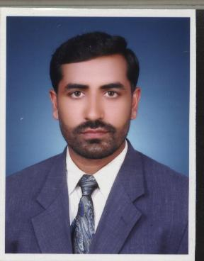

Slide 5
OMICS International
OMICS international Membership enables academic and research institutions, funders and corporations to actively encourage open access in scholarly communication and the dissemination of research published by their authors.
For more details and benefits, click on the link below:
http://omicsonline.org/membership.php

