Slide 1

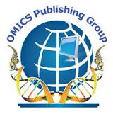
OMICS Group
OMICS Group International through its Open Access Initiative is committed to make genuine and reliable contributions to the scientific community. OMICS Group hosts over 400 leading-edge peer reviewed Open Access Journals and organizes over 300 International Conferences annually all over the world. OMICS Publishing Group journals have over 3 million readers and the fame and success of the same can be attributed to the strong editorial board which contains over 30000 eminent personalities that ensure a rapid, quality and quick review process. OMICS Group signed an agreement with more than 1000 International Societies to make healthcare information Open Access.
Contact us at: contact.omics@omicsonline.org

Slide 2

OMICS Journals are welcoming Submissions
OMICS Group welcomes submissions that are original and technically so as to serve both the developing world and developed countries in the best possible way.
OMICS Journals are poised in excellence by publishing high quality research. OMICS Group follows an Editorial Manager® System peer review process and boasts of a strong and active editorial board.
Editors and reviewers are experts in their field and provide anonymous, unbiased and detailed reviews of all submissions.
The journal gives the options of multiple language translations for all the articles and all archived articles are available in HTML, XML, PDF and audio formats. Also, all the published articles are archived in repositories and indexing services like DOAJ, CAS, Google Scholar, Scientific Commons, Index Copernicus, EBSCO, HINARI and GALE.
For more details please visit our website: http://omicsonline.org/Submitmanuscript.php

Slide 3
Ayman M. Noreddin
Editor-in-Chief of Journal of Pharmaceutical Care & Health Systems

Slide 4
Research Interests
Pharmacoklinetic/Pharmacodynamic modeling of anti-infective and anti-cancer therapy
Clinical simulation and Monte Carlo analysis
Bacterial resistance in biofilm studies
Cancer epigenetic studies
Minority health care studies

Slide 5
Recent Publications
Ahmed GF, Elkhatib WF, and Noreddin AM. Inhibition of adhesion and invasion of
Pseudomonas aeruginosa PAO1 to A549 lung epithelial cells by some natural extracts. Journal of
Infection and Public Health. (In press)
Zhanel GG, Yachison C, Nichol K, Adam H, Noreddin AM, Hoban DJ, Karlowsky JA
Assessment of the activity of ceftaroline against clinical isolates of penicillin-intermediate
and penicillin-resistant Streptococcus pneumoniae with elevated MICs of ceftaroline using
an in vitro pharmacodynamic model. J Antimicrob Chemother.67(7):1706-11, 2012
Noreddin AM, Elkhatib WF, Cunnion KG and Ghanel GG. Cumulative clinical experience
from over a decade of use of levofloxacin in community acquired pneumonia; critical
appraisal and role in therapy", Drug, Healthcare and Patient Safety.3:59–68,2011.
Salem A., Noreddin E., Zhanel G, Noreddin A. Comparative pharmacodynamics of
ceftobiprole, daptomycin, linezolid, telavancin, tigecycline, and vancomycin in the treatment
of methicillin resistant staphylococcus aureus: a monte carlo simulation Analysis. J Vaccines
Vaccin. 2:5,2011
Zhanel GG, Rossnagel E, Nichol K, Cox L, Karlowsky JA, Zelenitsky S, Noreddin AM,
Hoban DJ. Ceftaroline pharmacodynamic activity versus community-associated and
healthcare-associated methicillin-resistant Staphylococcus aureus, heteroresistant
vancomycin-intermediate S. aureus, vancomycin-intermediate S. aureus and vancomycinresistant
S. aureus using an in vitro model.J Antimicrob Chemother.66(6):1301-5,2011.

Slide 6
Pharmacokinetics
Pharmacokinetics, sometimes described as what the body does to a drug, refers to the movement of drug into, through, and out of the body.—the time course of its absorption

Slide 7
PHARMACOKINETICS
“What the body does to the drug”

Slide 8
Pharmacokinetics (PK)
The study of the disposition of a drug
The disposition of a drug includes the processes of ADME
    Absorption
    Distribution
    Metabolism
    Excretion
    Toxicity
Elimination

Slide 9
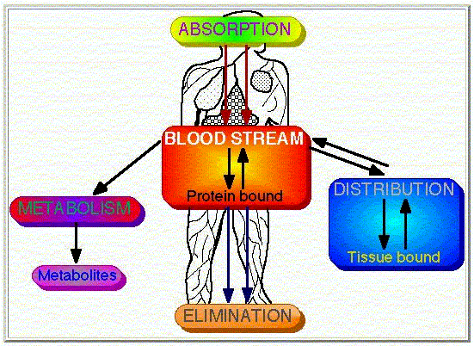
ADMET

Slide 10
DRUG R&D
Drug discovery and development
10-15 years to develop a new medicine
Likelihood of success: 10%
Cost $800 million – 1 billion dollars (US)

Slide 11
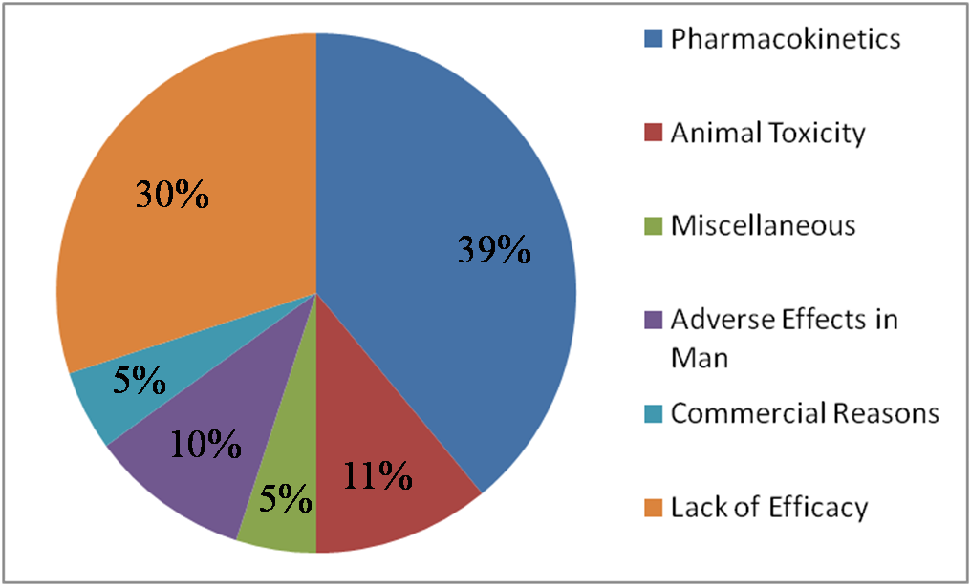
Why drugs fail

Slide 12
Importance of PK studies
Patients may suffer:
  Toxic drugs may accumulate
  Useful drugs may have no benefit because doses are too small to establish therapy
  A drug can be rapidly metabolized.

Slide 13
Routes Of Administration
Routes Of Drug Administration
Parenteral
Topical
Enteral
Injection
Nasal
Pulmonary
Rectal
Oral

Slide 14


OMICS Group Open Access Membership
OMICS publishing Group Open Access Membership enables academic and research institutions, funders and corporations to actively encourage open access in scholarly communication and the dissemination of research published by their authors.
For more details and benefits, click on the link below:
http://omicsonline.org/membership.php

Slide 15
Approved By
E-signature: Ayman Noreddin

