Slide 1
OMICS Group
OMICS Group International through its Open Access Initiative is committed to make genuine and reliable contributions to the scientific community. OMICS Group hosts over 400 leading-edge peer reviewed Open Access Journals and organizes over 300 International Conferences annually all over the world. OMICS Publishing Group journals have over 3 million readers and the fame and success of the same can be attributed to the strong editorial board which contains over 30000 eminent personalities that ensure a rapid, quality and quick review process. OMICS Group signed an agreement with more than 1000 International Societies to make healthcare information Open Access.
Contact us at: contact.omics@omicsonline.org

Slide 2
OMICS Journals are welcoming Submissions
OMICS Group welcomes submissions that are original and technically so as to serve both the developing world and developed countries in the best possible way.
OMICS Journals are poised in excellence by publishing high quality research. OMICS Group follows an Editorial Manager® System peer review process and boasts of a strong and active editorial board.
Editors and reviewers are experts in their field and provide anonymous, unbiased and detailed reviews of all submissions.
The journal gives the options of multiple language translations for all the articles and all archived articles are available in HTML, XML, PDF and audio formats. Also, all the published articles are archived in repositories and indexing services like DOAJ, CAS, Google Scholar, Scientific Commons, Index Copernicus, EBSCO, HINARI and GALE.
For more details please visit our website:
http://esciencecentral.org/journals/alternative-integrative-medicine.php

Slide 3
GENOMIC PROGRAMS FOR
NEURONAL APOPTOSIS
Dr. Barbara Maino
National Research Council - Institute of Neurological Sciences , Italy
Notes:
NEURONAL APOPTOSIS

Slide 4
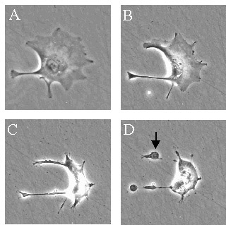
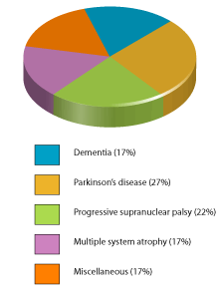
NEURONAL APOPTOSIS
The programmed cell death or apoptosis, characterized by specific biochemical and morphological events, is a crucial phenomenon to determine the fate of neurons, both in physiological and in pathological conditions.
Elucidating the molecular mechanisms underlying neuronal apoptosis hence may contribute to our understanding of basic developmental biology and human neuropathology.
Cytoplasm shrinks due to cleavage of nucleari lamins and actin (A)
Chromatin is broken down as nucleus condenses (often “horse-shoe” shaped) (B)
Cells shrink making an easy meal for phagocytes that are responsible for clearing the apoptotic cells (C)
Cells undergo plasma membrane changes – move phosphatidylserine from inner to outer leaflet of the membrane; this attracts macrophages. At the end, membrane blebs appear (D).
Small vesicles called apoptotic bodies are also sometimes observed (D, arrow).
Queen Square Brain Bank for Neurological Disorders
(QSBB) 2013
Dementia (17%)
Parkinson’s disease (27%)
Fig.1 Apoptosis by microscopy
Progressive supernuclear palsy (22%)
Multiple system atrophy (17%)
Dr. Barbara Maino
National Research Council - Institute of Neurological Sciences , Italy
Miscellaneous (17%)

Slide 5
EXPRESSING THE STORY OF LIFE FROM THE GENETIC CODE
The analysis of the TRASCRIPTOME, defined as the complete set of trascripts and their relative levels of expression, is going to be a very important issue for the clinical implications
MICROARRAY TECHNOLOGY propelled functional genomics into the spotlight, because it allowed functional analysis of genome-wide differential RNA expression between different samples, states and cell types
Genomics
Trascriptomics
Proteomics
Dr. Barbara Maino
National Research Council - Institute of Neurological Sciences , Italy

Slide 6
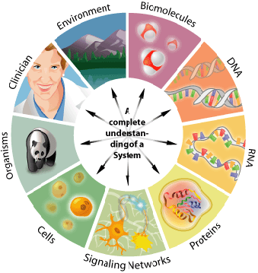
A NEW APPROACH TO DECODING LIFE
SYSTEM BIOLOGY
The GOAL is…
To decode biological meaning of gene expression changes
To organize gene expression changes into molecular processes of a cell
To promote the knowledge about the molecular mechanisms underlying neuronal apoptosis
Dr. Barbara Maino
National Research Council - Institute of Neurological Sciences , Italy

Slide 7
…NEW WAYS OF THINKING
SYSTEM BIOLOGY FOR
DRUG DISCOVERY
Leads to identify…
POTENTIAL DRUG TARGET
where intervention could make a difference in progression of neurodegenerative disease
Dr. Barbara Maino
National Research Council - Institute of Neurological Sciences , Italy

Slide 8
CORE OF RESEARCH INTEREST
What makes CGNs decide to commit suicide?
What rescues apoptotic CGNs ?
Withdrawal of serum and lowering of extracellular potassium from 25 to 5mM
On the basis of a previous study
CGNs treatment by a maximal effective dose (100 nM) of Gastric inhibitory polypeptide (Gip)
WHAT ARE THE
MOLECULAR PATHWAYS UNDERLYING CGNsESCUE
AFTER GIP TREATMENT ?
Dr. Barbara Maino
National Research Council - Institute of Neurological Sciences , Italy
Notes:
On the basis of previuos study

Slide 9
“Transcriptional analysis of apoptotic cerebellar granule neurons following rescue by gastric inhibitory polypeptide.”
Maino B, Ciotti MT, Calissano P, Cavallaro S
In our study
we conducted whole-genome expression profiling to obtain a comprehensive view of the previously unknown transcriptional program underlying the rescue effect of Gip in CGN.
By using DNA microarray technology, we identified 65 genes, we named survival related genes, whose expression is significantly de-regulated following Gip treatment (Fig.2).
We rendered a portrait of the molecular framework involved in CGN survival program (Fig. 3)
Dr. Barbara Maino
National Research Council - Institute of Neurological Sciences , Italy
Notes:
The molecular framework involved in CGN survival program

Slide 10
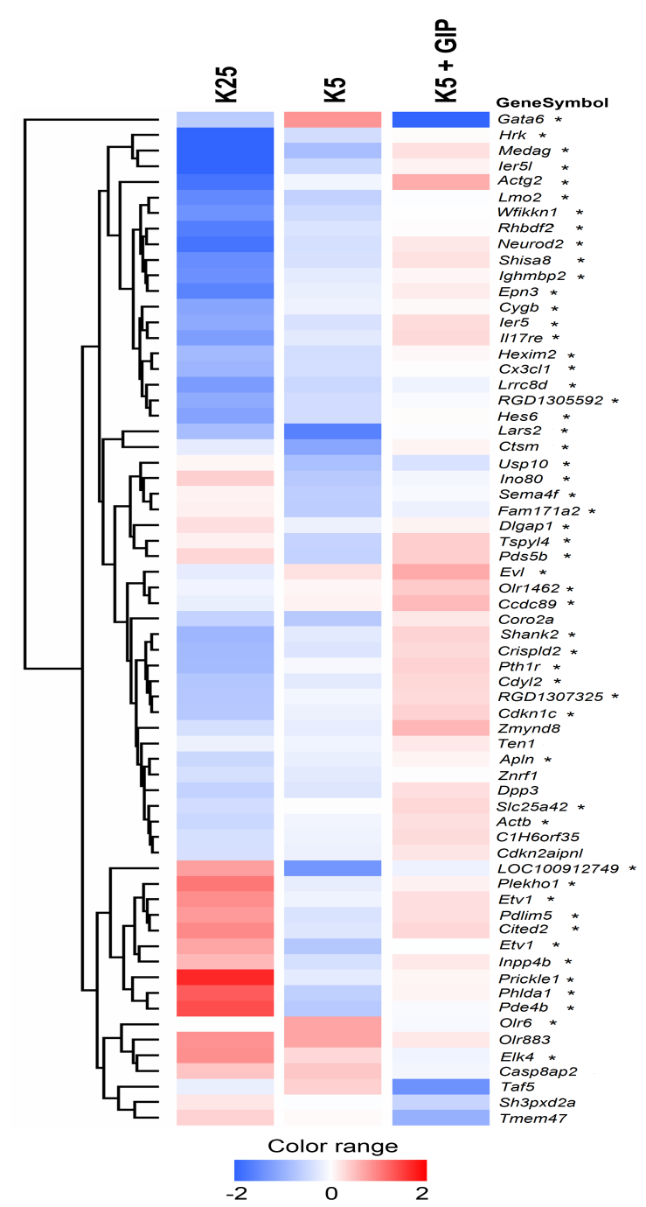
HIERARCHICAL CLUSTERING
of genes differently expressed in CGNs treated with Gip during the pre-commitment of apoptosis
Data are presented in a matrix format: each row is equivalent to a single gene and each column is equivalent to one of the three different experimental conditions (K25, K5, K5 + Gip).
The color of the corresponding cell in the matrix indicates the averaged normalized intensity from replicates. Red, blue and white respectively represent transcript levels below, equal or above the median abundance across all conditions.
Color intensity reflects the magnitude of the deviation from the median (see scale below).
Dr. Barbara Maino
National Research Council - Institute of Neurological Sciences , Italy
Notes:
Fig.2

Slide 11
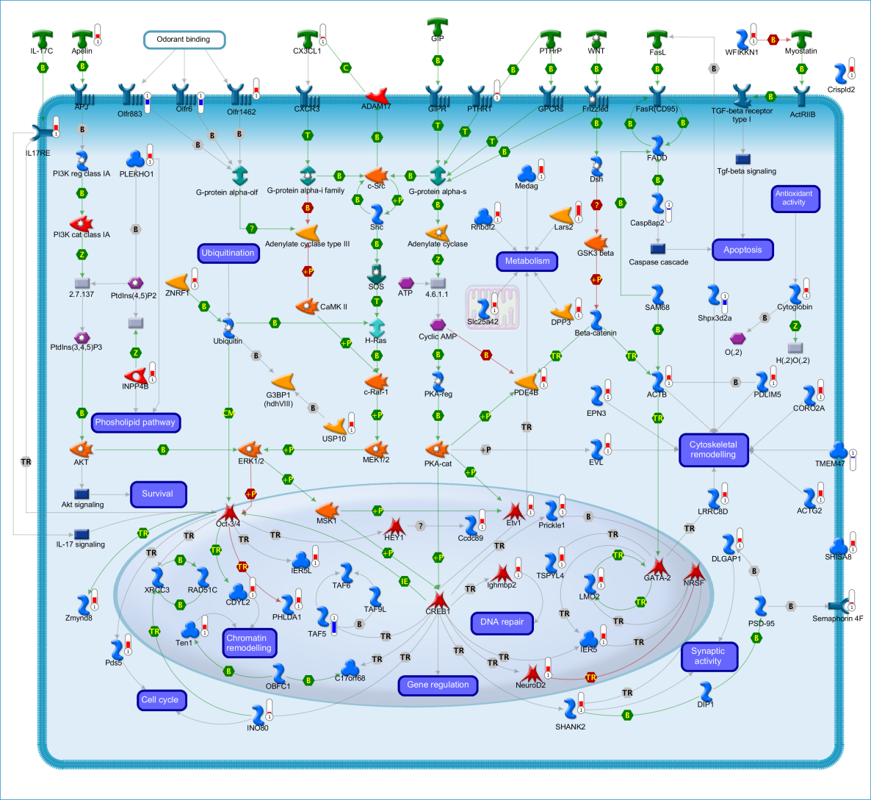
GIP-RESCUE PATHWAY IN CGNs
The survival effects of Gip are initiated by a G-protein-coupled receptor and activate a variety of intracellular second messengers. These signaling pathways converge into the nucleus and regulate a transcriptional program governing neuronal cell life.
Ligand
Receptor
Enzyme
Trascription
factor
Dr. Barbara Maino
National Research Council - Institute of Neurological Sciences , Italy
Notes:
Fig. 3

Slide 12
CONCLUSION
Our results reveal:
The existence of a previously unknown transcriptional program associated to neuronal survival.
Our results form:
The basis for further functional analyses and pharmacological exploitation to identify neuroprotective drugs.
Dr. Barbara Maino
National Research Council - Institute of Neurological Sciences , Italy

Slide 13
THE FUTURE ?
Pharmacological exploitation of potential targets will help to determine their cause-relationship and
identify new clues for neuroprotective drugs.
Further studies will be interesting for understanding complex biological systems as well as DRUG DISCOVERY and NEURODISEASE DIAGNOSIS.
Dr. Barbara Maino
National Research Council - Institute of Neurological Sciences , Italy

Slide 14
Journal of Community Medicine & Health Education
Internal Medicine: Open Access
General Medicine: Open Access
Journal of Vascular Medicine & Surgery

Slide 15
Related Conferences
2nd International Conference on
Predictive, Preventive and Personalized Medicine & Molecular Diagnostics

Slide 16
OMICS Group Open Access Membership
OMICS publishing Group Open Access Membership enables academic and research institutions, funders and corporations to actively encourage open access in scholarly communication and the dissemination of research published by their authors.
For more details and benefits, click on the link below:
http://omicsonline.org/membership.php

