Slide 1


OMICS Group
OMICS Group International through its Open Access Initiative is committed to make genuine and reliable contributions to the scientific community. OMICS Group hosts over 400 leading-edge peer reviewed Open Access Journals and organizes over 300 International Conferences annually all over the world. OMICS Publishing Group journals have over 3 million readers and the fame and success of the same can be attributed to the strong editorial board which contains over 30000 eminent personalities that ensure a rapid, quality and quick review process. OMICS Group signed an agreement with more than 1000 International Societies to make healthcare information Open Access.
Contact us at: contact.omics@omicsonline.org

Slide 2

OMICS Journals are welcoming Submissions
OMICS Group welcomes submissions that are original and technically so as to serve both the developing world and developed countries in the best possible way.
OMICS Journals are poised in excellence by publishing high quality research. OMICS Group follows an Editorial Manager® System peer review process and boasts of a strong and active editorial board.
Editors and reviewers are experts in their field and provide anonymous, unbiased and detailed reviews of all submissions.
The journal gives the options of multiple language translations for all the articles and all archived articles are available in HTML, XML, PDF and audio formats. Also, all the published articles are archived in repositories and indexing services like DOAJ, CAS, Google Scholar, Scientific Commons, Index Copernicus, EBSCO, HINARI and GALE.
For more details please visit our website: http://omicsonline.org/Submitmanuscript.php

Slide 3

Carlos Bregni
Professor
Department of Pharmacy
School of Pharmacy and Biochemistry
University of Buenos Aires
Argentina

Slide 4
Factors Involved in the biochemical etiology of human seminal plasma hyperviscosity
Percutaneous drug delivery systems for improving antifungal therapy effectiveness.
Pharmaceutical optimization of lipid-based dosage forms for the improvement of taste-masking, chemical stability and solubilizing capacity of phenobarbital.
Development, characterization and in vitro evaluation of tamoxifen microemulsions
Solubility of amphotericin B in water-lecithin-dispersions and lecithin-based submicron emulsions.
Formulation strategies, characterization and in vitro evaluation of lecithin-based nanoparticles for siRNA delivery.
Polyphenols and antimicrobial activity in extracts of Lippia alba (Mill.).
An antibody recognizing the apical domain of human transferrin receptor 1 efficiently neutralizes all New World hemorrhagic fever arenaviruses.
Recently published articles

Slide 5
Principles of Drug Delivery

Slide 6
Drug Delivery
Definition
  The appropriate administration of drugs through various routes in the body for the purpose of improving health
  It is highly interdisciplinary
  It is not a young field
  It has recently evolved to take into consideration
    Drug physico-chemical properties
    Body effects and interactions
    Improvement of drug effect
    Patient comfort and well being
Controlled
Drug Delivery

Slide 7
Drug Delivery
Conventional
Controlled
Enteral
Sustained
Extended
Parenteral
Site-specific
Other
Pulsatile

Slide 8
Oral Administration
Advantages
  Patient: Convenience, not invasive, higher compliance
  Manufacture: well established processes, available infrastructure
Disadvantages
  Unconscious patients cannot take dose
  Low solubility
  Low permeability
  Degradation by GI enzymes or flora
  First pass metabolism
  Food interactions
  Irregular absorption

Slide 9
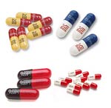

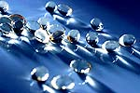
Oral Administration
Traditional oral delivery systems
  Tablets
  Capsules
  Soft gelatin capsules
  Suspensions
  Elixirs

Slide 10

Buccal/Sublingual
Advantages
  By-pass First pass metabolism
  Rapid absorption
  Low enzymatic activity
Disadvantages
  Discomfort during dissolution
  Probability of swallowing- lost of effect
  Small doses
Traditional delivery system/devices
  Tablets
  Chewing gum

Slide 11
Rectal
Advantages
  By-pass first pass metabolism
  Useful for children
Disadvantages
  Absorption depends on disease state
  Degradation by bacterial flora
  Uncomfortable
Traditional delivery system/devices
  Suppository
  Enema

Slide 12

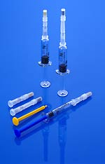
Intravenous (IV)
Advantages
  Drug 100% bioavailable
  Rapid response
  Total control of blood concentration
  Maximize incorporation of degradable drugs
  By-pass FPM
Disadvantages
  Invasive
  Trained personnel
  Possible toxicity due to incorrect dosing
  sterility
Traditional delivery system/devices
  Injection-bolus
  IV bag - infusion

Slide 13
Subcutaneous
Advantages
  Patient self-administration
  Slow, complete absorption
  By-pass FPM
Disadvantages
  Invasive
  Irritation, inflammation
  Maximum dose volume - 2mL

Slide 14
Intramuscular
Advantages
  Patient can administer the drug himself
  Larger volume than subcutaneous
  By-pass first pass metabolism
Disadvantages
  Invasive – patient disconfort
  Irritation, inflamation
  May require some training

Slide 15
Inhalers
Advantages
  By-pass FPM
  Gases are rapidly absorbed
Disadvantages
  Solids and liquids can be absorbed if size is below 0.5um

Slide 16


Transdermal
Advantages
  Local effect
  Ease of administration
Disadvantages
  Low absorption for some drugs
  May cause allergic reactions
Requirements
  Low dosage <10 mg/mL
  MW< 1,000

Slide 17
Factors Influencing the Selection of the Delivery Route
Drug physico-chemical properties
  Drug molecular size (molecular weight)
  Half-life
  Chemical stability
  Loss of biological activity in aqueous solution
    Proteins
      Denaturation, degradation

Slide 18
Factors Influencing the Selection of the Delivery Route
  Solubility in aqueous solution (hydrophobicity/hydrophilicity)
    pH
    pKa - ionization
    Temperature
    Concentration
    Crystalinity
    Particle size
    State of hydration

Slide 19
Factors Influencing the Selection of the Delivery Route
Drug biological interactions
  Sensitive to FPM
  Low membrane permeabiltiy
    Efflux pumps (MRP, MDR) – cancer drugs
    Hydrophilicity
    High-density charge
  Enzymatic degradation
  Bacterial degradation
  Half-life
  Side effects
    Irritation

Slide 20
Factors Influencing the Selection of the Delivery Route
Desired pharmacological effect
  Local
    topical, vaginal
  Systemic
    oral, buccal, IV, SC, IM, rectal, nasal
  Immediate response
    IV, SC, IM, nasal
  Dose size
  Drug molecular size

Slide 21
Pharmacokinetics and Pharmacodynamics
Pharmacokinetics
Pharmacodynamics
Design
of dosage regimen
Where?
How much?
How often?
How long?
Plasma
Concentration
Effects
Plasma refers to the clear supernatant fluid that results from blood after the cellular components have been removed

Slide 22
Plasma Concentration
Toxicity
Plasma concentration
(mg/mL)
Therapeutic window
No therapeutic effect
Time (min)

Slide 23
Unsuccessful
therapy
Plasma concentration
(mg/mL)
Successful
therapy
Time (min)

Slide 24
Oral
Administration
Gastrointestinal
Tract
Intravenous
Injection
Circulatory
System
Excretion
Intramuscular
Injection
Tissues
Metabolic
Sites
Subcutaneous
Injection

Slide 25
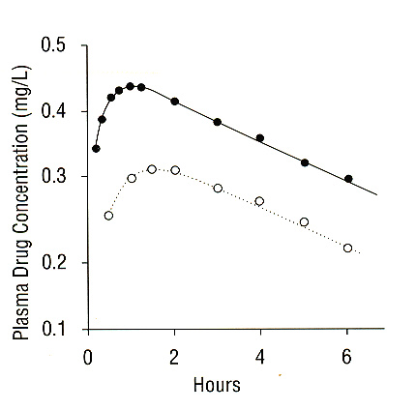
Absorption of drugs could vary within different administration routes
500 mg dose given
  intramuscularly
  orally
**to the same subject on
separate occasions
Biological barriers greatly affect the extent of drug absorption

Slide 26

Journal of Nanomedicine & Biotherapeutic Discovery
Journal of Nanomedicine & Biotherapeutic Discovery
Journal of Nanomedicine & Nanotechnology

Slide 27

Journal of Nanomedicine & Biotherapeutic Discovery
International Conference on Nanotek & Expo
International Conference on Signal Processing

Slide 28


OMICS Group Open Access Membership
OMICS publishing Group Open Access Membership enables academic and research institutions, funders and corporations to actively encourage open access in scholarly communication and the dissemination of research published by their authors.
For more details and benefits, click on the link below:
http://omicsonline.org/membership.php

