Slide 1
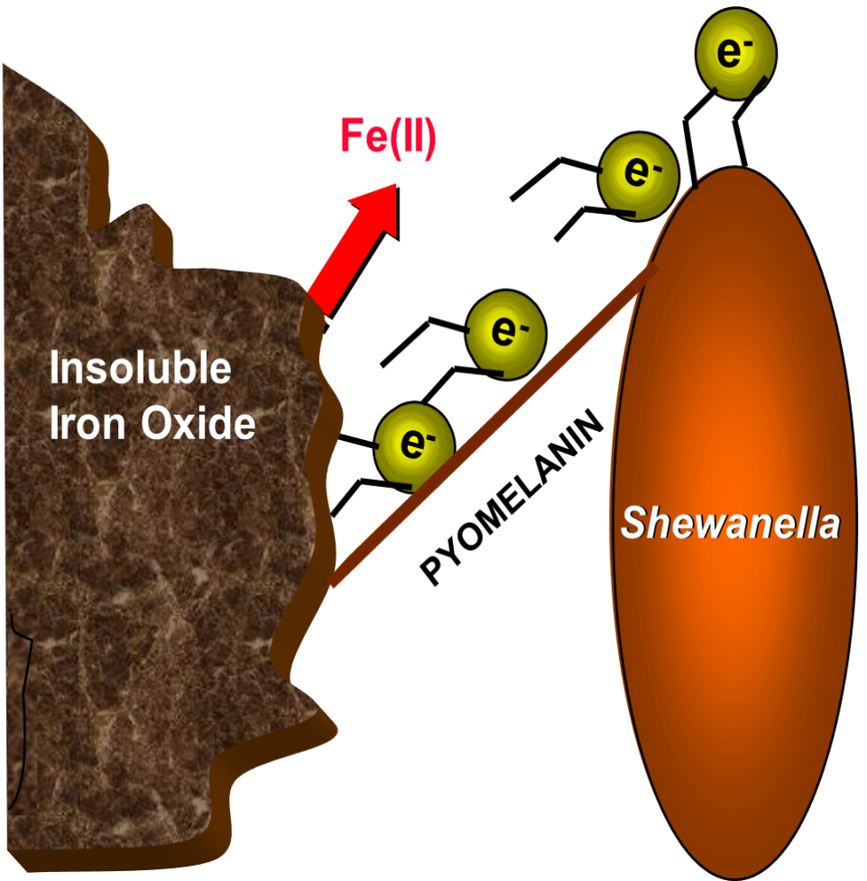
Adventures in Microbial Electron Transfer and Technology Development
Charles E. Turick, Ph.D.
Environmental Biotechnology
Savannah River National Laboratory

Slide 2
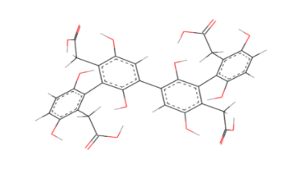
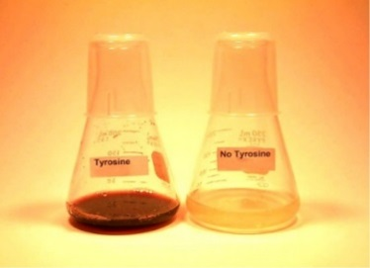
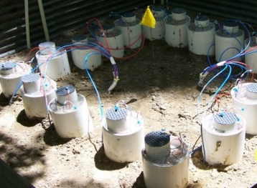
Progress to Technology Development
Fundamental Science
Applied Science
Technology
Development
Electromicrobiology
New scientific information moves from fundamental science to potential applications and then ultimately to technology development.
This process is not linear, but is very iterative. Often as we learn more about a specific application, we are better able to direct new fundamental studies.
Molecular &
Genetic
Mechanisms
Physiology
Microbial Ecology
Technology Development
The following slides highlight research directed at understanding how bacteria change the chemistry of toxic metals. This is useful for biotechnology development for detoxifying contaminated environments. This work is also leading to new applications from microorganisms that transfer electric current as well as bio-inspired radiation resistant materials.

Slide 3
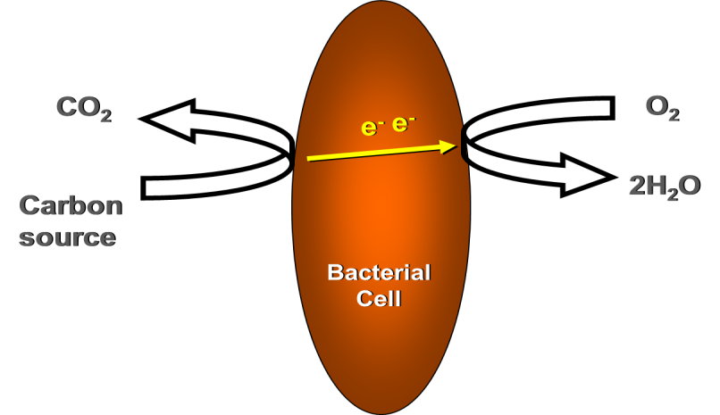
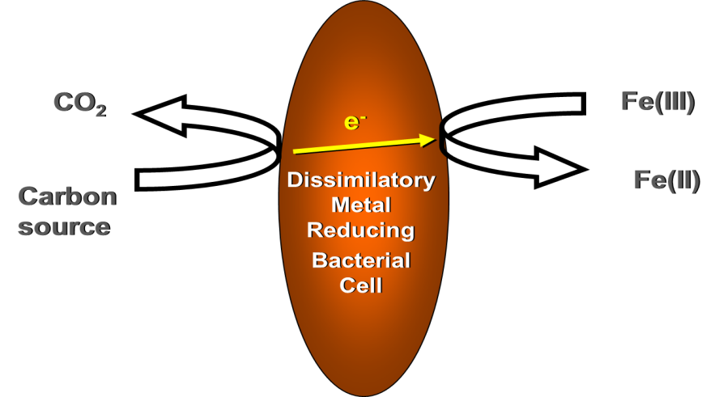
Aerobic and Anaerobic Respiration
Aerobic conditions
Under aerobic conditions many bacteria can use oxygen as a terminal electron acceptor to couple growth to energy conservation.
Anaerobic conditions
In the absence of oxygen, respiration is still possible with many bacteria. A common anaerobic terminal electron acceptor is Fe(III). Fe(III) oxides and dissimilatory metal reducing bacteria (DRMB) are common and can play important roles in environmental cleanup and biotechnology.

Slide 4
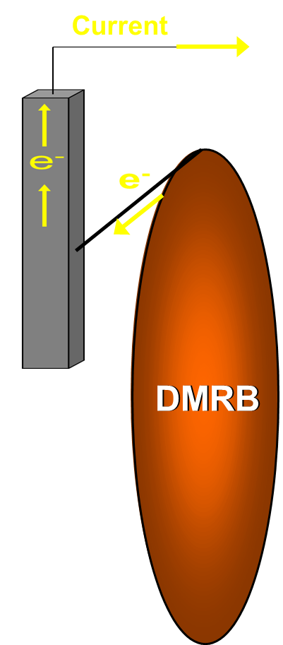
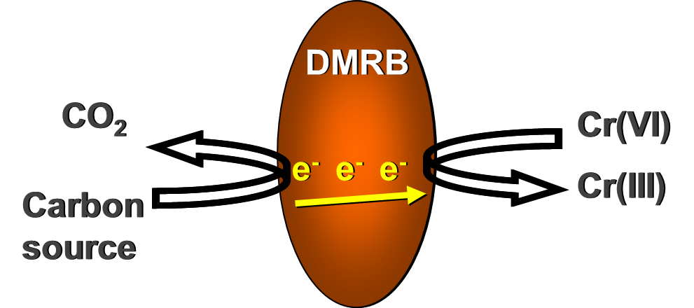
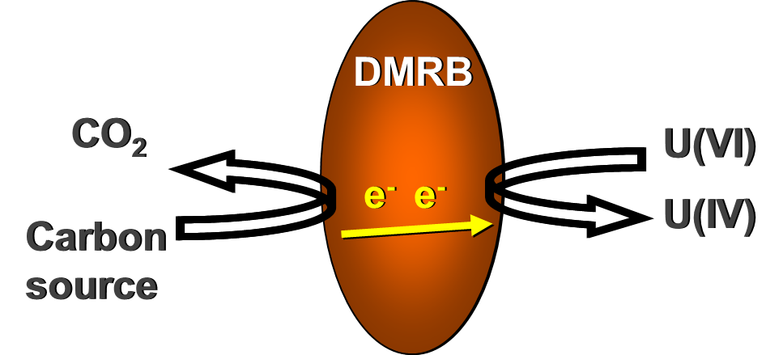
Applications of DMRB in Biotechnology
DMRB can be used to detoxify environmental contaminants like hexavalent chromium and uranium. The ability of DMRB to transfer electrons to solid terminal electron acceptors (like electrodes) also creates opportunities to study microbes with electrochemistry known as electromicrobiology.

Slide 5

Challenge: Understand How Bacteria can be Used
In a Biotechnology for Cr(VI) Reduction for Detoxification
Industrial Wastewater
Microbial reduction
of Cr(VI) to Cr(III)
Groundwater
Contaminated Soil
The goal was to develop a biotechnical approach employing bacteria
to chemically reduce toxic, soluble Cr(VI) to the much less toxic and less soluble Cr(III). Industrial collaborators had simple operational requirements; turn it on, plug it in and walk away. This meant that the bioprocess could not be complex, like the use of pure cultures. Instead the technology had to rely on microbial ecology and incorporate robust and adaptive cultures.

Slide 6
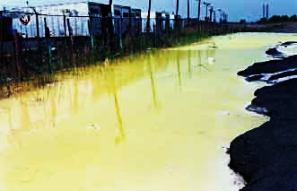


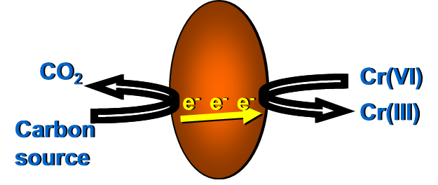
Establishing the Ubiquity of Cr(VI) Reducing Bacteria
a
b
c
Isolating Cr(VI) reducing cultures from contaminated environments (a) was the first step to show that some environmental bacteria can adapt to use Cr(VI) as a terminal electron acceptor (b). Demonstrating that Cr(VI) reducing bacteria can be selected from pristine environments (c) showed that Cr(VI) resistance and reduction is common and bacteria from any environment can be used in a robust Cr(VI) reducing bioreactor (d).
d
Appl.Microbiol. Biotechnol. 44:683-688
J. Environ. Eng. 124:449-455
Biotechnol. Lett. 19:691-694
Appl. Biochem. Biotechnol. 63-65:855-864

Slide 7
Challenge met: Exploiting the ubiquity of Cr(VI) reducing
bacteria provided a foundation for technology development
Industrial
Wastewater
Ubiquity
of
Cr(VI) reducers
In the environment
Microbial reduction
of Cr(VI) to Cr(III)
Groundwater
Contaminated Soil
or Sediments
The discovery that Cr(VI) reducing bacteria are common in the environment allowed us to develop a bioprocessing strategy where we allowed a Cr(VI) environment to select for Cr(VI) reducers. Non Cr(VI) reducers were out competed. So, pure cultures are not needed and the microbial community is self regulating.

Slide 8
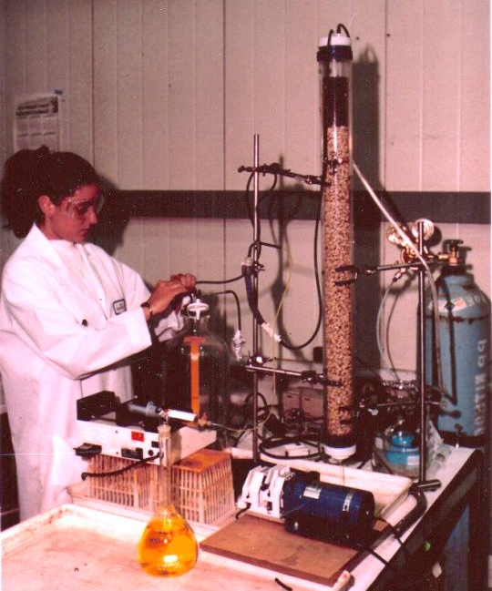
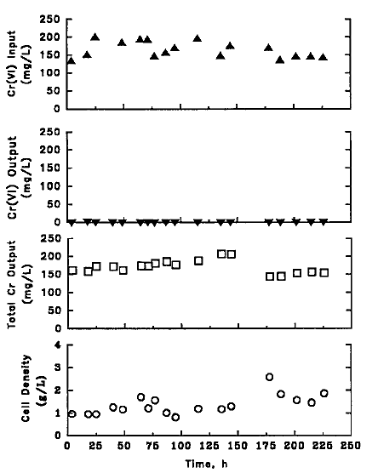
Microbial Ecology Studies and Bioreactor Proof-of-Principal
a
b
c
Incorporating a mixed culture of Cr(VI) reducing bacterial biofilm into a bioreactor (a) demonstrated that a robust mixed culture could be isolated from the environment. The mixed culture biofilm grew well across a wide range of Cr(VI) concentrations (b) and reduced about 200 mg/l of Cr(VI) with a 48 hr. retention time (c).
J. Ind. Microbiol. Biotechnol.
18:247-250

Slide 9
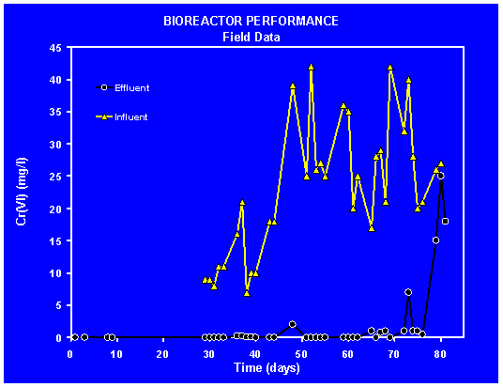
Microbial Ecology Studies and Bioreactor Field Study
Our technology was incorporated into a 30,000 liter industrial bioreactor to remove Cr(VI) from waste leachate at a chromium steel factory in Sweden. Indigenous Cr(VI) reducing bacteria dominated the bioprocess that was fed acetate waste from a neighboring industry. The resulting Cr(III) precipitated inside the bioreactor as a hydroxide.
Vatten 53:245-251

Slide 10
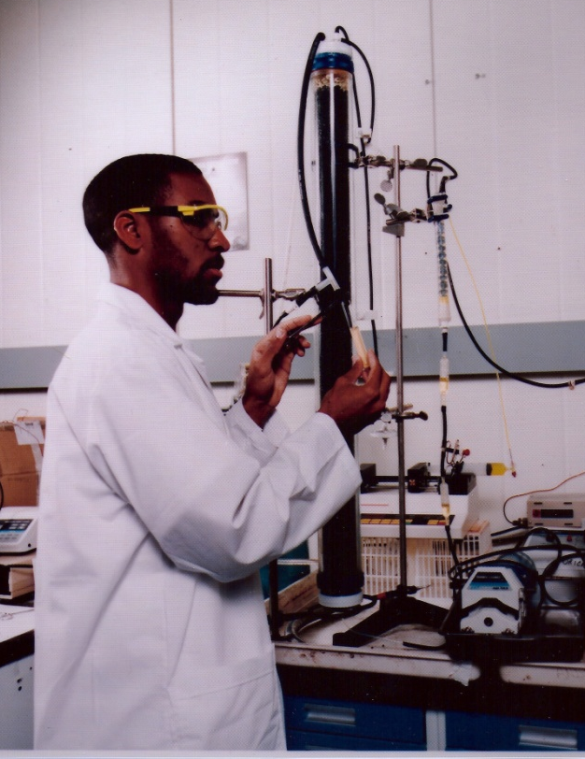
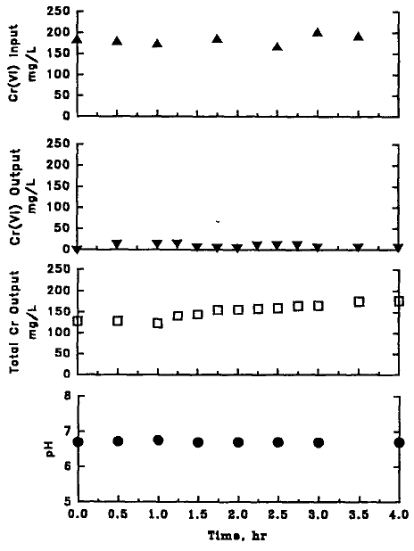
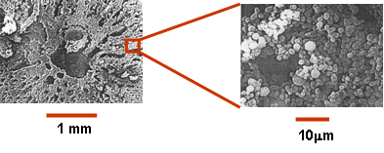
High Throughput Bioreactor Study
a
c
A high throughput bioreactor (a) was developed in order to treat industrial effluents with low concentrations of Cr(VI). Immobilized cell technology was used to increase cell density in the bioreactor and maintain low cell density in the effluent (b). This resulted in an increase in volumetric productivity (c) and low BOD in the bioreactor effluent.
b
Appl. Biochem. Biotechnol. 63-65:871-877

Slide 11
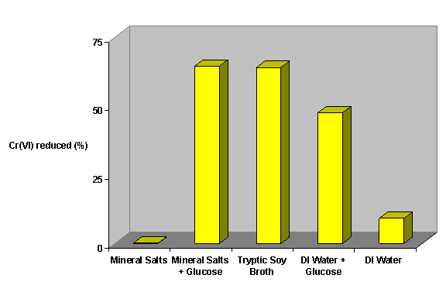
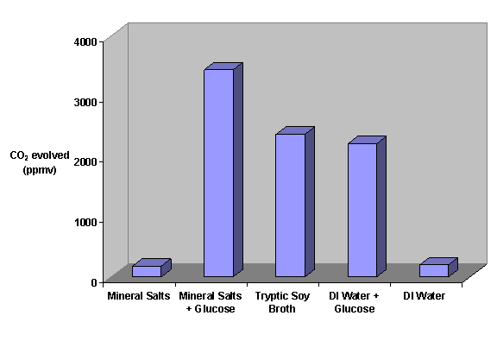
In-Situ Soil Bioremediation Demonstration
a
Mineral Salts
Mineral Salts + Glucose
Tryptic Soy Broth
DI Water + Glucose
DI Water
b
c
Carbon and energy sources added to Cr(VI) contaminated soil (a) allowed indigenous bacteria to detoxify the soil (b) in relation to bacterial growth (c). Some of the nutrient supplements to the soil caused Cr(VI) to desorb from soil particles. This showed that Cr(VI) in solution is more bioavailable and was reduced faster by bacteria compared to Cr(VI) sorbed to soil minerals (solid phase Cr(VI)).
Bioremediation. J. 2:1-6

Slide 12
Next Challenge: Increase the rate of electron transfer to
solid phase metal and actinide contaminants
Industrial
Wastewater
Ubiquity
of
Cr(VI) reducers
In the environment
Microbial reduction
of Cr(VI) to Cr(III)
Groundwater
Contaminated Soil
or Sediments
Mechanisms of solid
phase electron transfer
Bacterial electron transfer to metal contaminants like Cr(VI) is impeded when the metals are sorbed to soil particles because the contaminants are part of the solid phase. This limits but does not negate their bioavailability. In order to increase bacterial electron transfer rates to solid oxidized metals and actinides we first had to drop back to more fundamental studies to understand the mechanisms of solid phase electron transfer.

Slide 13
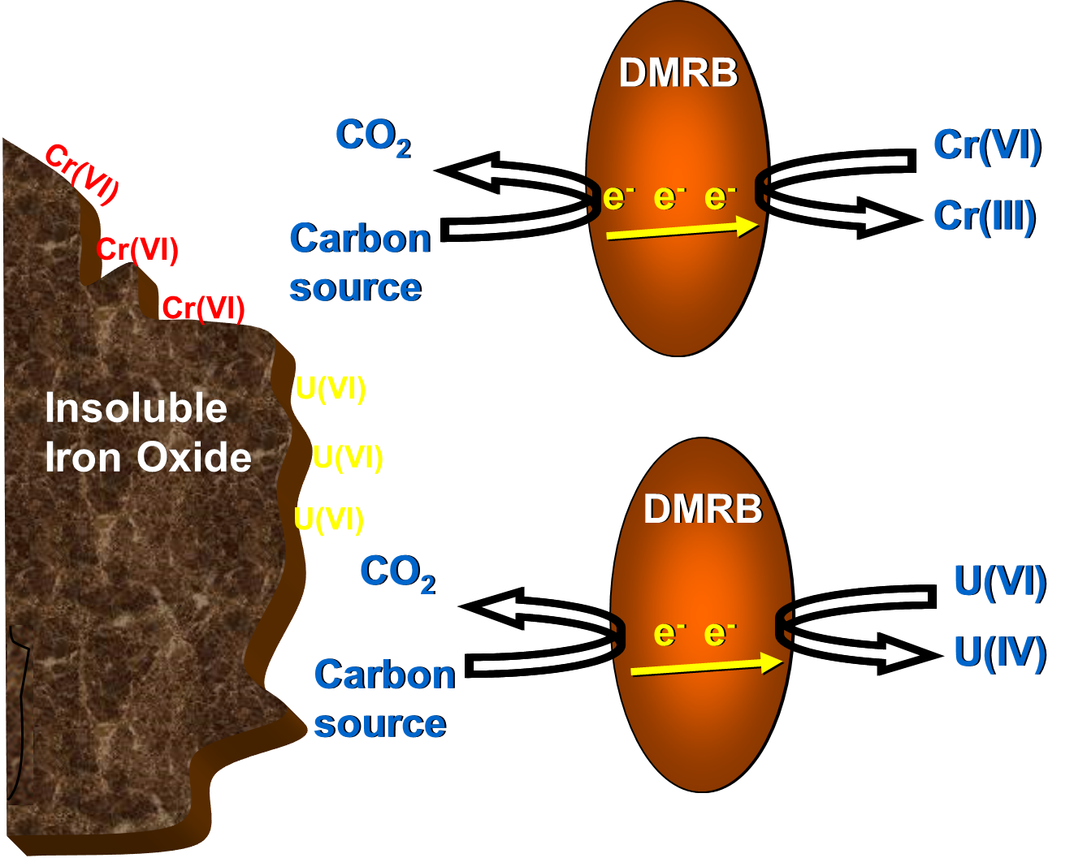
Soluble vs Solid Phase Metals
DMRB can use many metal oxides as terminal electron acceptors to respire when oxygen is absent. This is especially easy when the metals are in solution.
Transferring electrons from the bacterial cell outside to solid phase terminal electron acceptors requires some mechanism to send the electrons from the cell.
Understanding and exploiting mechanisms for extracellular electron transfer will increase the efficiency of bioremediation of heavy metals and radionuclides.
Cr(VI)
Cr(III)
U(VI)
U(IV)

Slide 14
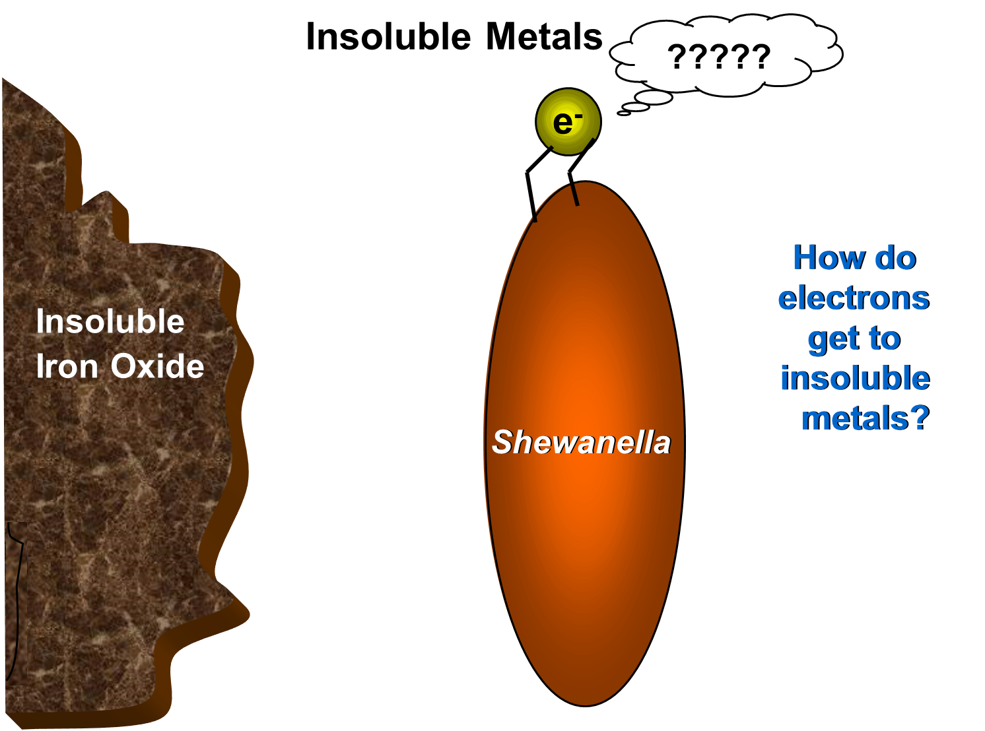
We tried to see the problem from the point of view of an electron.
The model DMRB we work with are in the genus Shewanella.

Slide 15

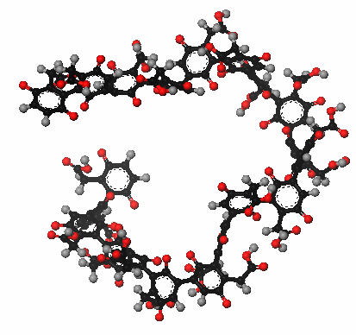
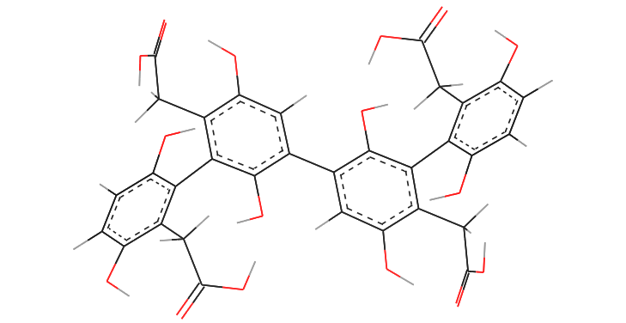
Growth and Pigment Production
4
1.0E+09
3
Cells
Pigment
2
1.0E+08
Pigment (OD 400 nm)
Cell density (Cells/ml)
1
0
0
20
40
60
80
100
120
140
160
1.0E+07
Time (hr)
Many species of Shewanella produce the extracellular polymer pyomelanin from tyrosine degradation. The polymer is rich in the redox cycling structure – quinones.
This offered promise as an electron shuttle to bridge the gap between bacteria and solid phase metal oxides.
Applied Env. Microbiol. 68: 2436-2444
http://www.intechopen.com/books/show/title/biopolymers

Slide 16
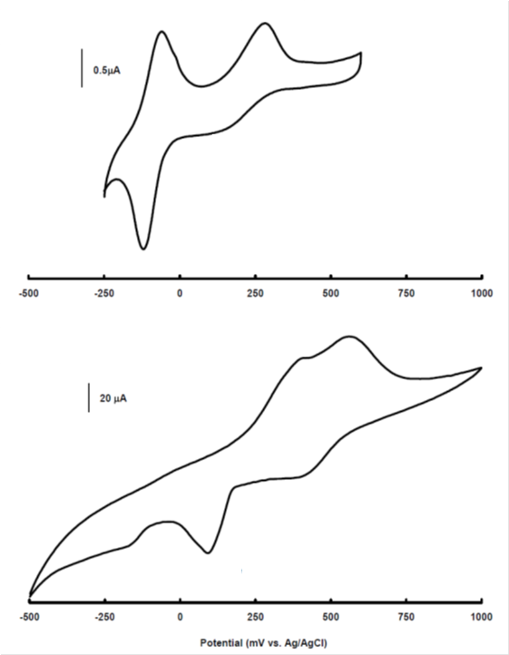

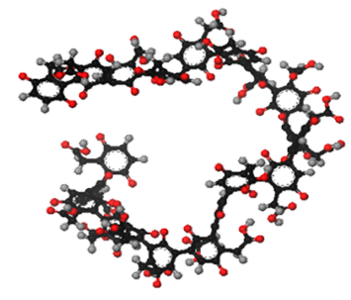
Electrochemistry of Pyomelanin
Antraquinone
2-6 disulfonate
Antraquinone
2-6 disulfonate
Pyomelanin
Pyomelanin
When evaluated with an electrochemical technique called cyclic voltammetry, pyomelanin demonstrated redox activity similar to another quinone containing molecule. With this technique the electrical potential (mV) is scanned from least to most oxidizing (left to right) and then least to most reducing (right to left). The two oxidation peaks (up) and 2 reduction peaks (down) are typical of quinones.
http://www.intechopen.com/books/show/title/biopolymers

Slide 17

Pyomelanin Enhances Extracellular Electron Transfer
Pyomelanin produced by several strains and species of Shewanella enhance extracellular electron transfer to metal oxides.
FEMS Microbiol. Lett. 220:99-104
Can J. Microbiol. 54:334-339

Slide 18
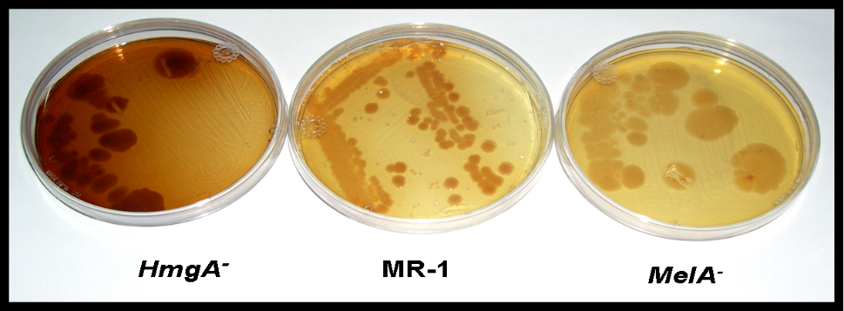
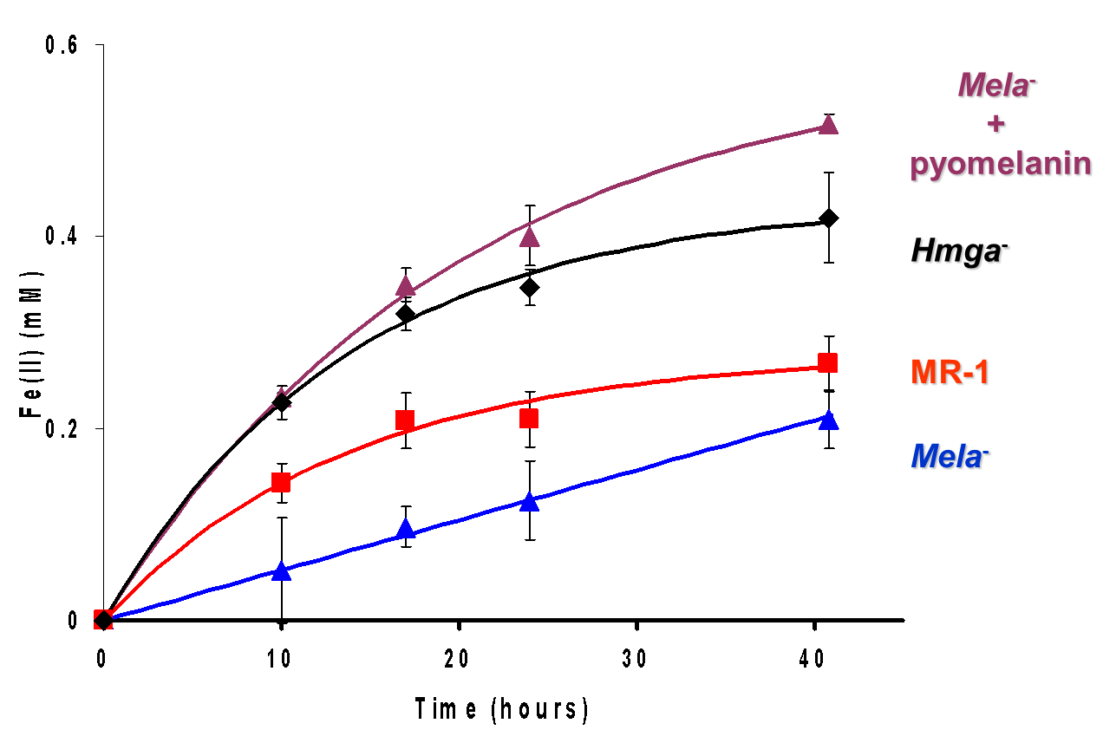
Pyomelanin as an Electron Shuttle
a
S. oneidensis MR-1 along with mutants of that strain that included a pyomelanin over producer and a pyomelanin minus mutant (a) were used to show that pyomelanin plays an important role in enhancing extracellular electron transfer to solid phase metal oxides (in this case Fe(III) oxides) (b). The addition of soluble pyomelanin to the melanin minus mutant also increased its rate and degree of metal reduction.
b
Fe(II) (mM)
FEMS Microbiol. Ecol. 68:223-235
Appl. Environ. Microbiol. 68:2436–2444
Time (hr)

Slide 19
Next Challenge: Increase the rate of electron transfer to
solid phase metal and actinide contaminants
Industrial
Wastewater
Ubiquity
of
Cr(VI) reducers
In the environment
Microbial reduction
of Cr(VI) to Cr(III)
Groundwater
Contaminated Soil
or Sediments
Mechanisms of solid
phase electron transfer
Production of quinone polymers
The production of electroactive polymers by some bacteria bridge the gap for electron transfer to metal oxides. At least in the lab.
Next try: enhance electron transfer in the environment.

Slide 20
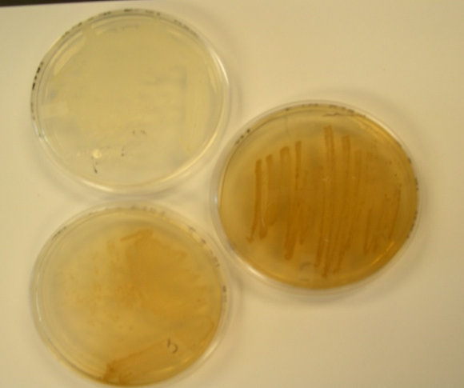
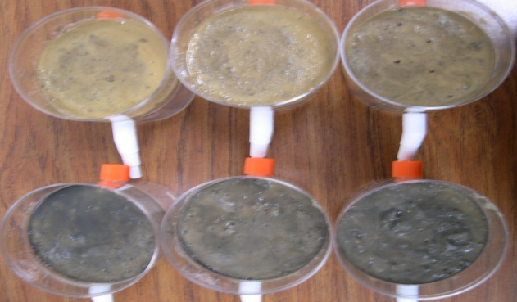
Pigment Producing Microbes in Soil
Soil Assay
a
b
Control
Tyrosine
We were able to stimulate production of a dark pigment in soil after addition of tyrosine (a). Bacteria capable of pyomelanin production (b) were the most common pigment producers in the soils we were studying.
Most common pigment producer
tentatively identified as
Bacillus mycoides
Pigment produced was
characterized as pyomelanin
MPN results
1.1x10⁶ cells/g wet wt of soil

Slide 21
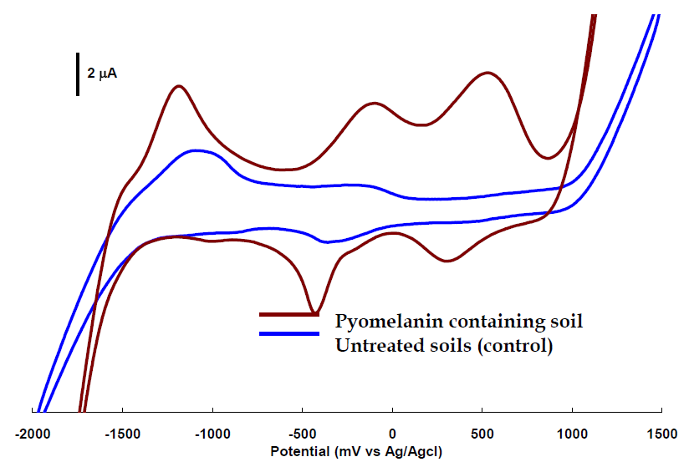
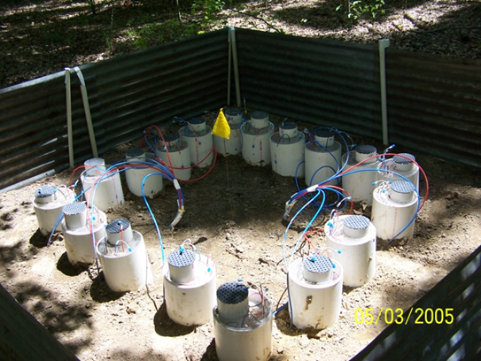
Pigment Producing Microbes in Soil
a
b
Field Lysimeters
Soil with the pyomelanin pigment was much more electroactive compared to the untreated soil. Electrochemical studies showed 2 oxidation peaks (upward) and 2 reduction peaks (downward) between -1 and 1 volt (a). This behaves as we expect quinone containing polymers and shows that we were able to change the electrochemistry of the soil. The increase in electron transfer suggests that with pyomelanin, soluble and mobile U(VI) contaminants could be reduced and immobilized in the soil. So we set up an experiment in U(VI) contaminated soils to try to immobilize U in place (b).
J. Environ. Radioact. 99:890-899
http://www.intechopen.com/books/show/title/biopolymers

Slide 22
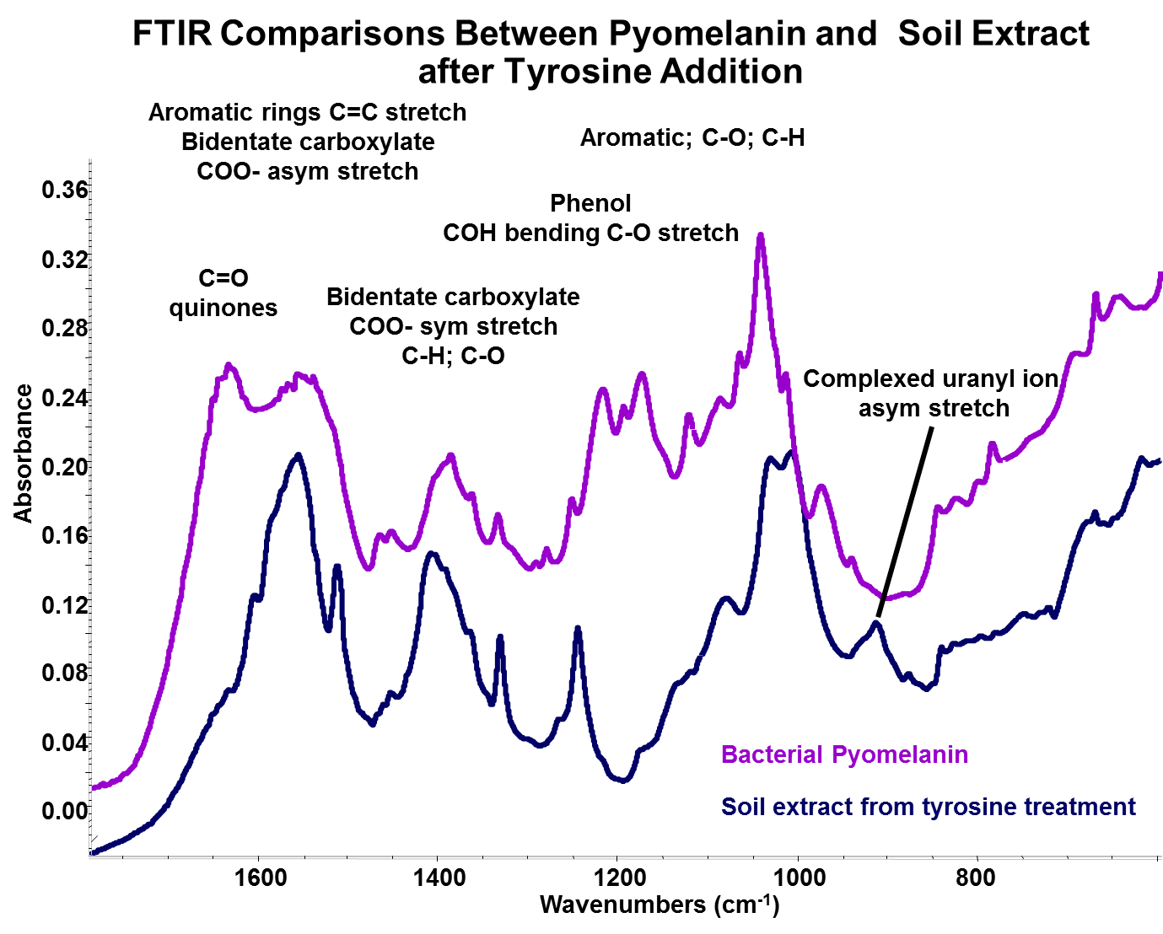
Melanin Effects on U Immobilization
a
b
16
Control
Tyrosine
12
1 month
13 months
g/l)
μ
8
U (
4
0
10 cm
30 cm
50 cm
10 cm
30 cm
50 cm
Depth
The soil pigment was compared to bacterial pyomelanin and showed many similarities (a). Differences were likely do to OH and COOH groups binding uranium and also attaching to soil particles. Because of that, the pigment was able to reduce U(VI) and also “tether” it to soil particles resulting in immobilized uranium (b). Just one small application of tyrosine resulted in pyomelanin production and uranium immobilization that lasted over one year.
J. Environ. Radioact. 99:890-899

Slide 23
Challenge met: Increased the rate of electron transfer to
solid phase metal and actinide contaminants.
Industrial
Wastewater
Ubiquity
of
Cr(VI) reducers
In the environment
Microbial reduction
of Cr(VI) to Cr(III)
Groundwater
Contaminated Soil
or Sediments
Mechanisms of solid
phase electron transfer
Pyomelanin, an electron shuttle for solid phase metal reduction
Ubiquity of
environmental
pyomelanin production
Pyomelanin assisted
uranium
immobilization
By controlling microbial production of electron shuttles in the soil we were able to significantly enhance electron transfer to contaminants in the environment, leading to contaminant immobilization.

Slide 24
New Challenge: How do dark-pigment-producing fungi that are exposed to chronic, high levels of gamma radiation (i.e. Chernobyl reactor facility) actually grow better in the presence of radiation?
Growth of Wangiella dermatitidis with/without
γ irradiation (~500x background)
PLoS ONE. 5:e457

Slide 25
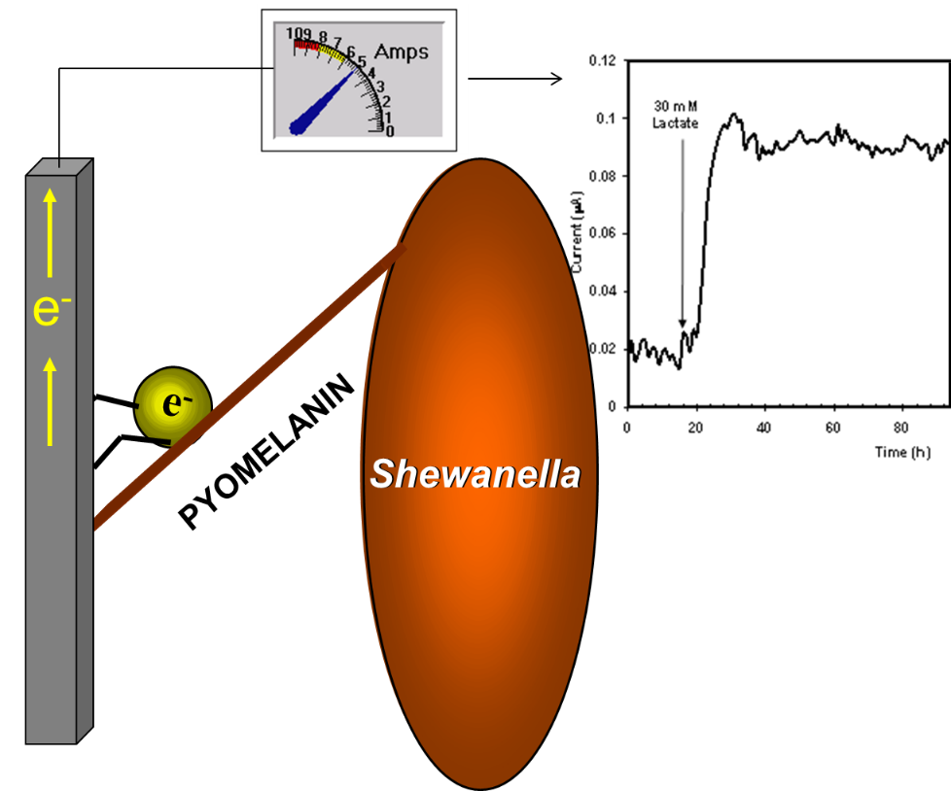
Clue: Shewanella can use the pyomelanin they make as a
terminal electron acceptor when O₂ is absent.
a
b
Incubation with pyomelanin
and without
The bacteria could transfer electrons to oxidized pyomelanin and grow (a).
When we included an electrode, pyomelanin acted as an electron conduit so the electron flow could be monitored with electrochemical techniques (b). This led to an idea about how some microbes might grow better with ionizing radiation and how we could study them.

Slide 26
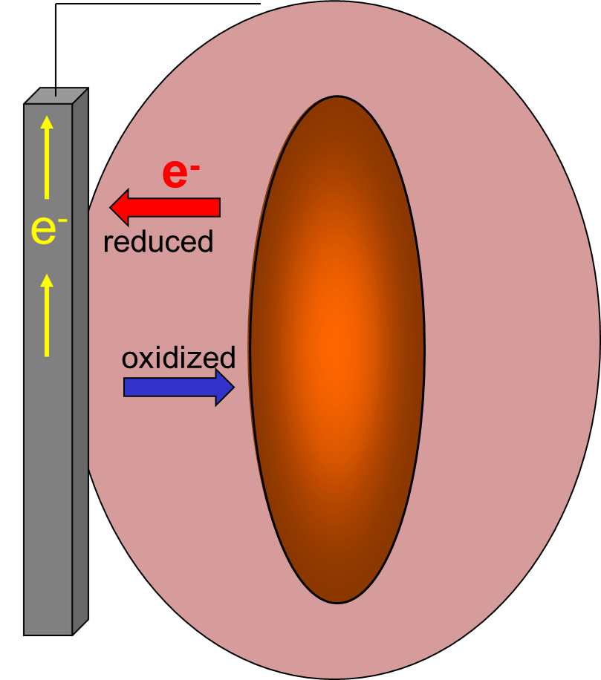
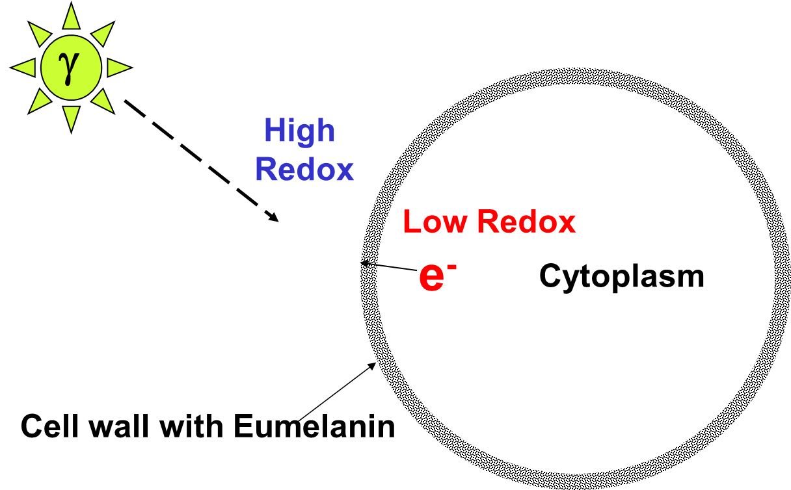
Electron Transfer with Extracellular Melanin
Yeast Cell
Pyomelanin
Shewanella
The fungi that grow well in radiation fields all produce the pigment eumelanin,
a similar pigment to pyomelanin. A constantly oxidized electrode takes electrons from reduced pyomelanin, restoring the pyomelanin back to the oxidized state. Could gamma radiation constantly oxidize fungal melanin and act as a “bottomless pit” for electrons?

Slide 27
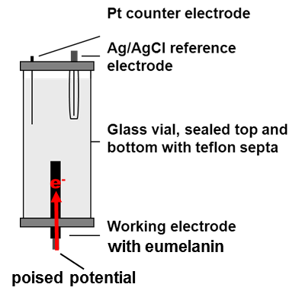
Gamma Exposure (4x10⁵ rad/hr) to Various Concentrations of Eumelanin
In order to test the hypothesis that radiation turns eumelanin into a “bottomless pit” for electrons we set up the following experiment. With eumelanin isolated from the surface of fungal cells we constructed an electrode and placed it next to a radiation source. With the electrodes connected to a potentiostat, a potential was applied to the eumelanin electrode. Next we turned on the radiation. If gamma radiation oxidized the eumelanin an electric current would flow.
Bioelectrochem. 82:69-73

Slide 28
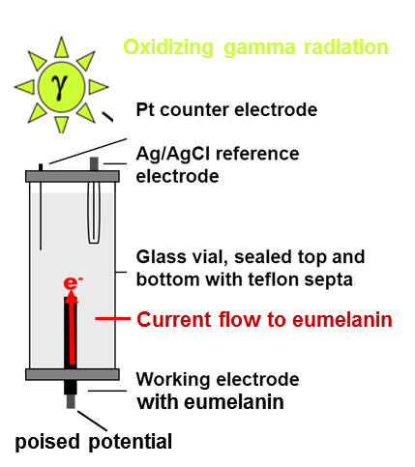
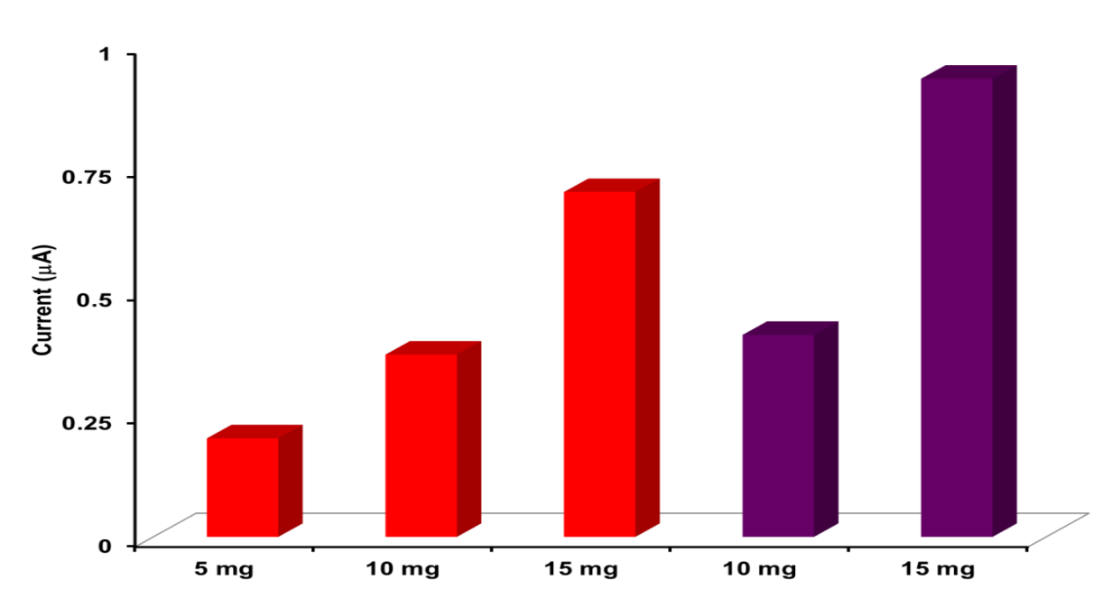
Gamma Exposure (4x10⁵ rad/hr) to Various Concentrations of Eumelanin
Eumelanin Concentration
60 min. exposure
90 min. exposure
Irradiated eumelanin was able to allow electrons to flow through it. The more eumelanin in the electrodes and the longer the exposure time, the more current was produced.
Bioelectrochem. 82:69-73

Slide 29
Electron transfer to gamma irradiated eumelanin
How do microorganisms
thrive in radioactive
environments
Irradiated eumelanin
Is a bottomless pit
for electrons
Why doesn’t the eumelanin
get bleached by
all the radiation?
A plausible answer to one question raised another interesting question.
The tremendous oxidizing power of the radiation we used was enough
to oxidize the eumelanin. The chronic levels of radiation encountered by
the microbes in the Chernobyl nuclear facility should also oxidize them.
Why aren’t they all bleach blondes?

Slide 30
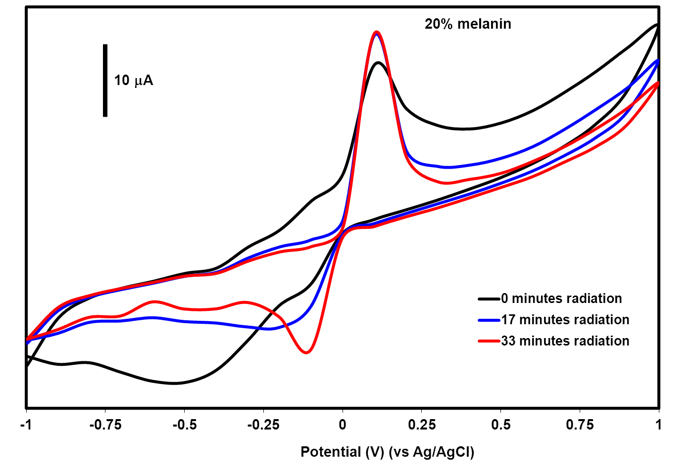
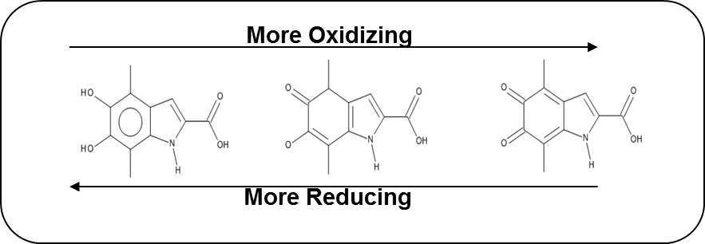
A Mechanism of Radiation Protection
Cyclic voltammetry of the
eumelanin electrodes showed
that the polymer is oxidized by
radiation (upward pointing peaks). The addition of electrons restore the chemical structure of eumelanin to a reduced state (downward pointing peaks).
This could be a radiation protection mechanism that also allows some microbes to gain energy at the same time.
Bioelectrochem. 82:69-73

Slide 31
Challenge met: Electron transfer to gamma irradiated eumelanin
How do microorganisms
thrive in radioactive
environments
Irradiated eumelanin
Is a bottomless pit
for electrons
Why doesn’t the eumelanin
get bleached by
all the radiation?
Continuous electron transfer restores oxidized eumelanin.
As a bottom-less pit for electrons, fungal eumelanin is also chemically restored as a radiation protecting molecule.

Slide 32
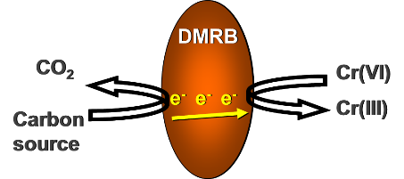


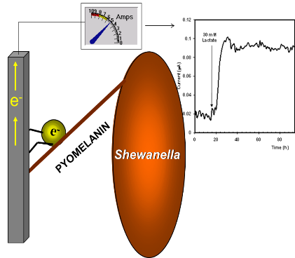

Conclusions
Our fundamental studies are moving to applied science and
technology developments as summed up below.
Industrial
biotechnology
Fundamental studies in
microbial electron transfer
are leading to:
Bio-inspired
materials
Enhanced solid-phase
electron transfer
In-situ
bioremediation
Electromicrobiology

Slide 33
















Acknowledgements
Funding
Agencies
Collaborating Institutions

